Slide 1
The Children’s Place
Mitch Johnson & Chelsi Nahrgang

Slide 2
Basic Information
Largest children’s specialty apparel retailer in America
Designs, contracts to manufacture, sells and licenses to sell fashionable, high-quality merchandise at value prices
Proprietary brands: “The Children’s Place”, "Place“, "Baby Place"
1,039 stores in the United States, Canada and Puerto Rico
Online store at www.childrensplace.com
150 international points of distribution open and operated by its 6 franchise partners in 17 countries.
Notes:
Condense into BP

Slide 3
Basic Information
Ticker Symbol: PLCE
Industry: Apparel Stores
Current Stock Price: $113
Target Stock Price 12 months: $120
Market Cap: $1.9 Billion
Investment Recommendation: Buy
Notes:
GROUP items

Slide 4
Basic Information
Liquidity
Current Ratio: 1.86
Quick Ratio: 0.99
Float 17.25 million
Major Stock Owners: | Percent of shares | Total Investment
The Vanguard Group, Inc. | 13.31% | $269,403,701.95
BlackRock, Inc. | 12.60% | $255,602,298.65
Royce & Associates, LP | 6.08% | $122,948,026.30
Dimensional Fund Advisors LP | 5.43% | $109,824,794.05
Notes:
New chart, keep %. Shares times price $112.15

Slide 5
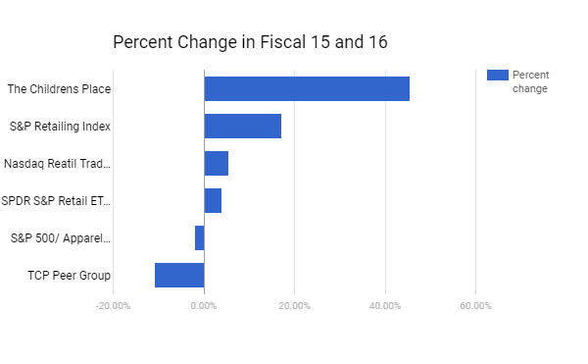
Investment Summary
Stock Price increased 45.6% during fiscal 2016
94th percentile of peer group
Notes:
Show trend (5)

Slide 6
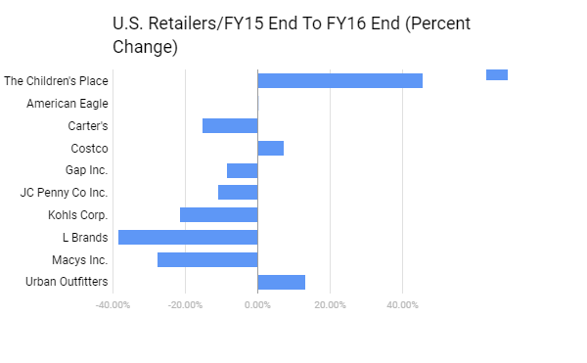
Competitive Environment

Slide 7
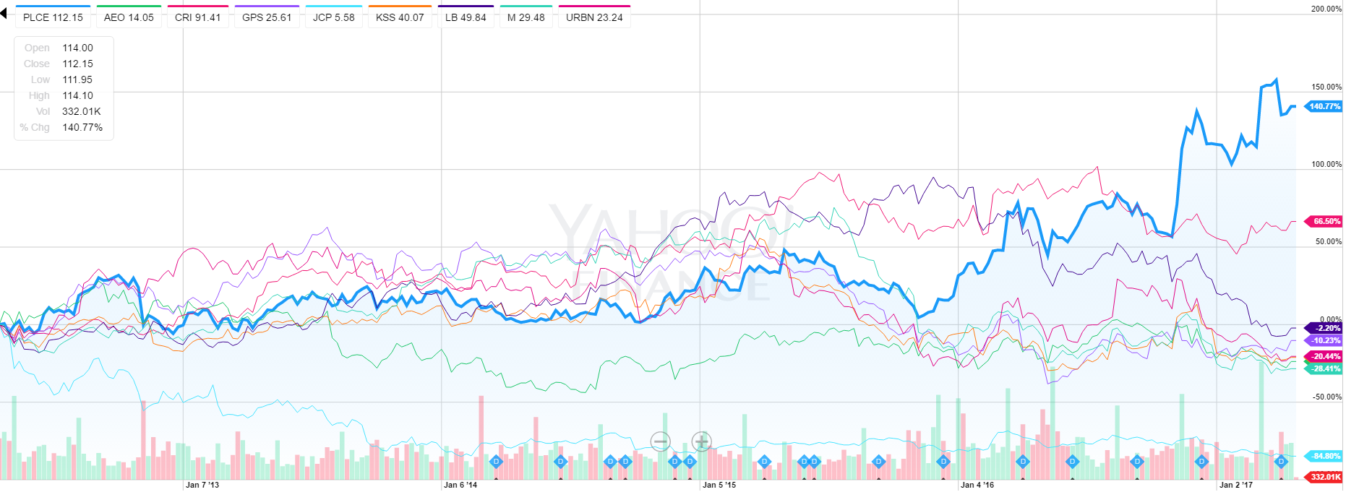
Competitive Environment

Slide 8
Return of Capital
$15 million in dividends in fiscal 2016
Expected annual dividend increase of 100% from $0.80 to $1.60 in 2017
Returned 83% of cash from operations in 2016
Repurchased over $150 million shares in 2016
Over $750 million in share repurchases since 2009
Notes:
Do not use one BP, out ROC in title

Slide 9
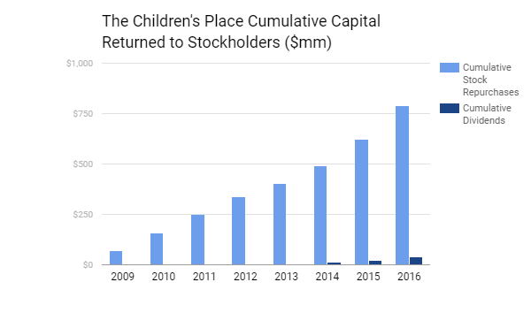
Return of Capital
Notes:
Why are repurchases part of strategy

Slide 10
Return Measures
Notes:
Take out or re-do

Slide 11
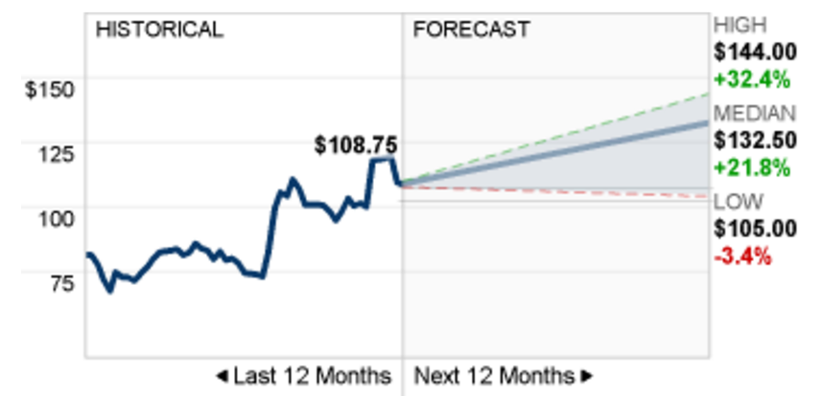
Consensus Earnings Forecast
Analyst Recommendations:
6 have a Buy Rating
5 have a Hold Rating
Ratings steady since March
Notes:
Title, blow up graph and talk about the written info

Slide 12
Sales Strategy
Branding
Significant sales (ex: 60% off sitewide)
Coupons
Rewards points

Slide 13
Valuation (Peer Comparison)
Company EPS Dividend MarketCap
PLCE $5.44 $1.60 (1.43%) 1.9 Bil
JCP ($0.04) - 1.8 Bil
KSS $3.13 $2.20 (5.56%) 6.7 Bil

Slide 14
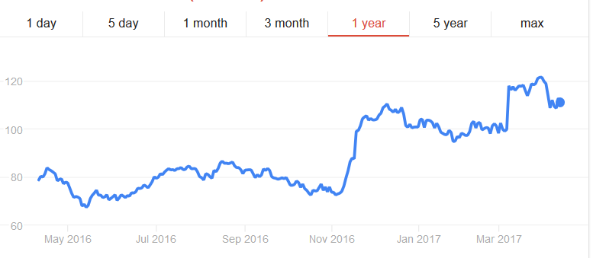
Share Valuation
Exceeded earnings expectations in November
PLCE is buying back shares

Slide 15
Financial Analysis (in thousands except dividends)
Dividends 2017-2018: $1.60 (100% increase)
2016-2017: $0.80 (30% increase)
2015-2016: $0.60 (13% increase)
2014-2015: $0.53
Net Sales 2016-2017: $1,785,316
2015-2016: $1,725,777
2014-2015: $1,761,324
Net Income 2016-2017: $102,336
2015-2016: $ 57,884
2014-2015: $ 56,888

Slide 16
Final Recommendation
Buy rating for the following reasons:
Fertility is expected to rise from 1.89 children per woman to 1.92 in 2045-2050 in the U.S.
Strong Dividend Growth
Strong Analyst Recommendations

