Slide 1
MAY 3RD, 2019
INVESTING IN
ASGN INCORPORATED
Prepared by Eli Casey, McKenzie Meyers, Coco Wiencek, Caleb Wagner and Hunter Drake

Slide 2
COMPANY OVERVIEW
CEO Peter Damirist
"TOMORROW'S WORKFORCE"
EST. 1985 & went public in 1992
Provider of information technology and professional services in the digital, creative, healthcare technology, and government sectors
Emphasis on Information Technology Staffing
Highly skilled employees improve productivity and utilization in corporations throughout North America and Europe

Slide 3
THE
INDUSTRY
INFORMATION SERVICES AND STAFFING
Provides services for healthcare, engineering, life sciences, and digital technology
Technological problem solving
Customer Care
ASGN | 2019

Slide 4
Company Strengths & Weaknesses
STRENGTHS
WEAKNESSES
Large number of outlets in almost every state
Skilled labor force
ASGN invested extensively in the training of its employees
Strong relationship with its dealers
Smaller research and development budget than their competitors
The time it takes for products to be purchased and sold are higher than the industry average

Slide 5
Company Opportunities & Threats
OPPORTUNITIES
THREATS
Ever growing demand for new technology
Local collaboration in international markets
Increased government regulations
Possibilities for expansion are endless
High demand for good employees, larger companies have the upper hand
There is a skill gap between employees and the positions in demand
Changing demographics
US and China Trade War

Slide 6
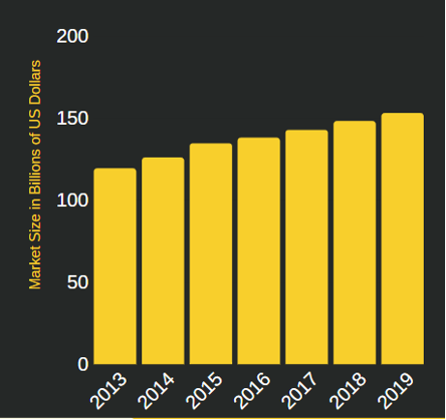
GROWTH POTENTIAL
DEMAND FOR TECHNOLOGY
Technology use is increasing drastically and with that comes higher demand for IT assistance, along with price increases. Estimated US staffing industry will grow its revenues by 4% in 2019
RECENT AQUISITION
Recently added the new subsidiary ECS, which signed 2 huge contracts with the US Mint Enterprise and the FBI. Now compete in the Federal IT and professional services sector.
PAST GROWTH
Due to ASGN's size and service offering they have grown faster than anyone else in the staffing industry for 16 consecutive quarters.

Slide 7
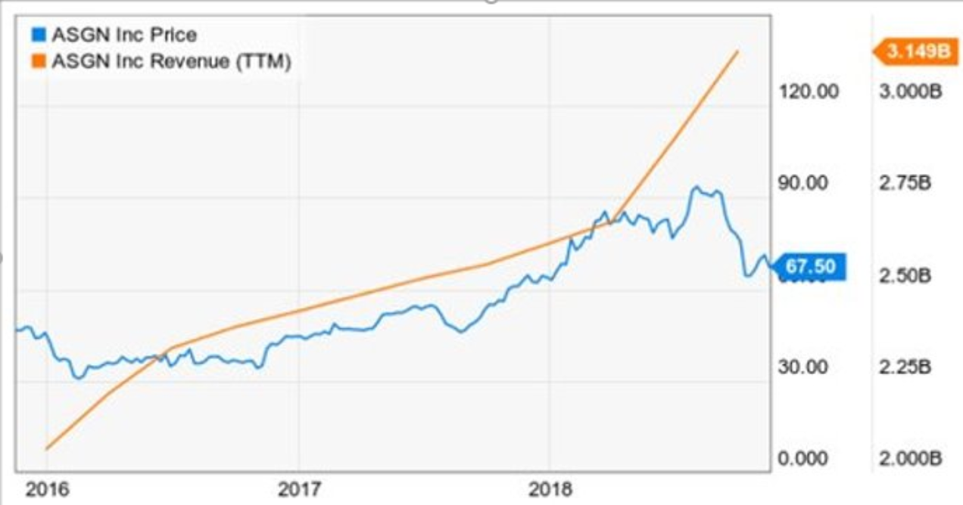
GROWTH ANALYSIS
ASGN | 2019

Slide 8
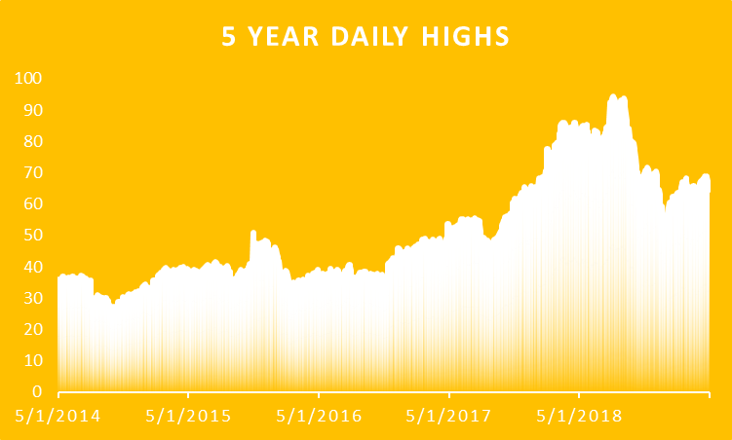
GROWTH ANALYSIS
ASGN | 2019

Slide 9
FREE CASH FLOW FROM EQUITY
ANALYSIS
Free cash flow was $57.3 million, 6.2 % of revenue
Allowed them to fund the acquisition of ECS
ASGN | 2019

Slide 10
KEY RATIOS
ASGN INC.
INDUSTRY
ROA - 6.38%
ROE - 13.34%
Asset Turnover - 1.38
Working Capital - 2.38
ROA - 5.38%
ROE - 17.91%
Asset Turnover - 0.66
Working Capital - 1.54

Slide 11
PRO FORMA FINANCIALS
2018
A LOOK INTO THE FUTURE
2019
2020
Operating Margin -
7.65%
11.74%
13.37%
Profit Margin -
4.64%
8.73%
10.37%
Return on Net Equity -
13.34%
23.07%
36.46%
Return on Invested Capital -
21.24%
32.82%
37.55%

Slide 12
IN CONCLUSION
Current Market Price: $63.24
Target Market Price: $72.00
-Industry is seeing huge growth & ASGN is a leader of that growth
-Company has continuously growth since being established and plans to continue acquiring
-Stock price has not caught up with the companies huge revenue growth.
We believe that the Winona State Student Managed Fund should invest ASGN Incorporated stock.

Slide 13
THANK YOU!
COCO WIENCEK, ELI CASEY, HUNTER DRAKE, MCKENZIE MEYERS, CALEB WAGNER

