Slide 1
FIN 377: Investments
Topic 5: Asset Pricing Models
Larry Schrenk, Instructor

Slide 2
Overview
7.1 The Capital Asset Pricing Model
7.2 Empirical Tests of the CAPM
7.3 The Market Portfolio: Theory versus Practice
7.4 Arbitrage Pricing Theory
7.5 Multifactor Models and Risk Estimation
Appendix: Multiple Regression in Excel

Slide 3
Learning Objectives
How does the capital asset pricing model (CAPM) extend the results of capital market theory?
What special role does beta play in the CAPM, and how do investors calculate a security’s characteristic line in practice?
What is the security market line (SML), and what are the similarities and differences between the SML and the capital market line (CML)?
How can the SML be used to evaluate whether securities are properly priced?
What do the various empirical tests of the CAPM allow us to conclude, and does the selection of a proxy for the market portfolio matter?
What is the arbitrage pricing theory (APT), and how is it similar to and different from the CAPM?
How can the APT be used in the security valuation process?
How do you test the APT by examining anomalies found with the CAPM?
What are multifactor models, and how are they related to the APT?
What are the two primary approaches used in defining common risk factors?
What are the main macroeconomic variables used in practice as risk factors?
What are the main security characteristic–oriented variables used in practice as risk factors?
How are multifactor models used to estimate the expected risk premium of a security or portfolio?

Slide 4
Readings
Reilley, et al., Investment Analysis and Portfolio Management, Chap. 7

Slide 5
7.1 The Capital Asset Pricing Model

Slide 6
7.1 The Capital Asset Pricing Model
CAPM evaluates risk-return trade-off for both diversified portfolios and individual securities
Redefines risk from total volatility to just market risk
Beta calculates level of market risk

Slide 7
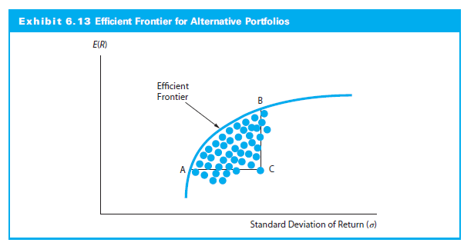
7.1 The Capital Market Line (CML)
CML
RFR

Slide 8
7.1.1 A Conceptual Development of the CAPM
Risk-free asset makes capital market line (CML) the relevant frontier
CML doesn’t measure expected return on individual assets
For individual asset (or any portfolio), the relevant risk measure is the asset’s covariance with the market portfolio
σ_{i} ρ_{iM}, where ρ_{iM} is the correlation coefficient between the asset and the market

Slide 9
7.1.1 A Conceptual Development of the CAPM
Inserting σ_{i} ρ_{iM} into the CML:
If β_{i}=(σ_{i} ρ_{iM}) / σ_{M} is the asset beta, CAPM equation:

Slide 10
CAPM Equation
CAPM equation:

Slide 11
CAPM Equation (Reformulation)

Slide 12
7.1.2 The Security Market Line (SML)
Graphical form of the CAPM
Risk and return trade-off is straight line from risk-free rate
Considers only market risk
NOTE:
For CML: Risk is standard deviation (σ)
For SML: Risk is beta (β)

Slide 13
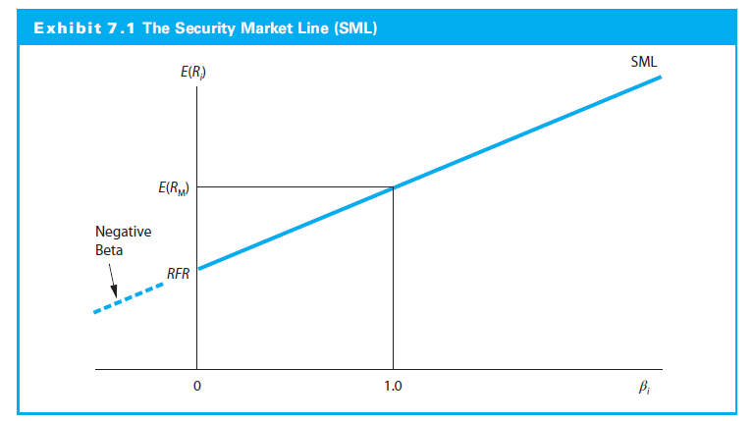
7.1.2 The Security Market Line

Slide 14
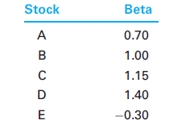
7.1.2 The Security Market Line
Expected Rate of Return for a Risky Asset
Example:

Slide 15
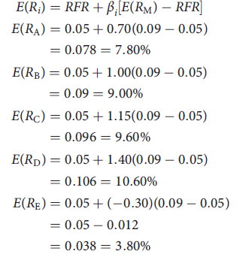
7.1.2 The Security Market Line
Risk-free rate is 5% and the market return is 9%
This implies a market risk premium of 4%

Slide 16
7.1.2 The Security Market Line
Identifying Undervalued and Overvalued Assets
In equilibrium, all assets and portfolios on the SML
Security above SML is underpriced
Security below SML is overpriced
Superior investor must identify underprice or overpriced securities

Slide 17
7.1.2 The Security Market Line

Slide 18
7.1.2 The Security Market Line

Slide 19
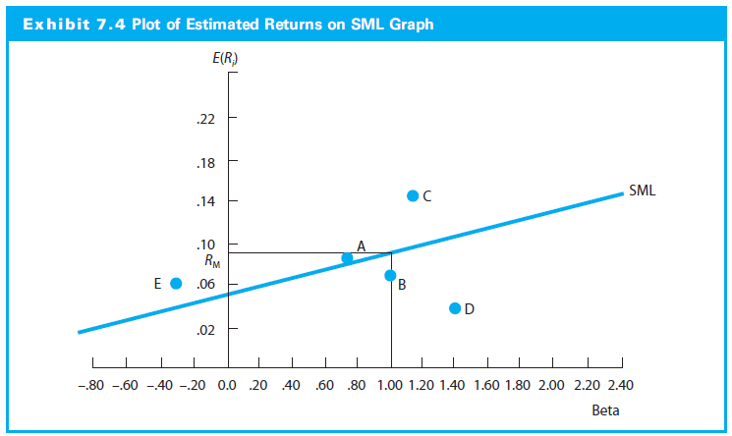
7.1.2 The Security Market Line

Slide 20
7.1.2 The Security Market Line
Calculating Systematic Risk
Beta for Security i:
Betas can also estimated as slope coefficient between the returns to security (R_{it}) and returns (R_{Mt}) to the market (characteristic line):
R_{it} = a_{i} + β_{i}(R_{Mt}) + ε_{it}

Slide 21
7.1.2 The Security Market Line
The Impact of the Time Interval
The number of observations and time interval causing beta to vary
There is no “correct” interval for analysis
Morningstar monthly returns over five years
Reuters Analytics daily returns over two years
Bloomberg uses weekly returns over two years

Slide 22
7.1.2 The Security Market Line
The Effect of the Market Proxy
S&P 500 often used as proxy :
Large proportion of the market value of U.S. stocks
It is a value weighted index
Theoretically, the market portfolio should include all U.S. and non-U.S. stocks and bonds, real estate, coins, stamps, art, antiques, and any other marketable risky asset from around the world

Slide 23
7.1.2 The Security Market Line
Computing a Characteristic Line
Characteristic line for Microsoft Corp (MSFT) using monthly return data from January 2016 to December 2016
Betas for MSFT are calculated using:
The S&P 500 (SPX)
The MSCI World Equity (MXWO) index

Slide 24
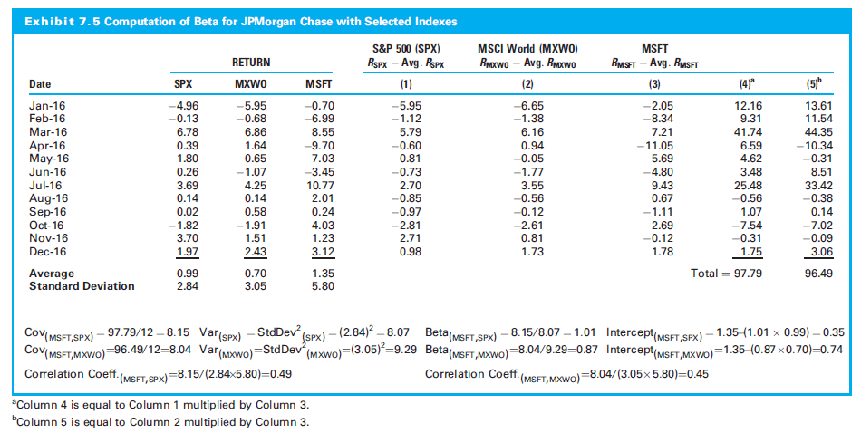
7.1.2 The Security Market Line

Slide 25
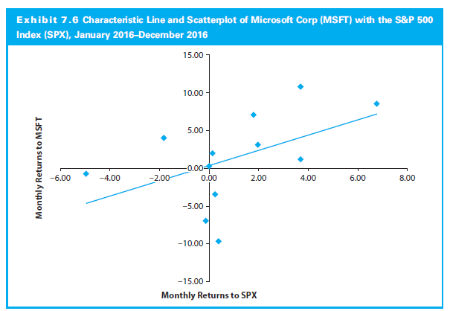
7.1.2 The Security Market Line

Slide 26
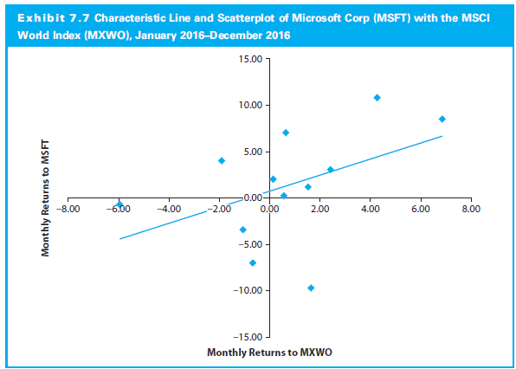
7.1.2 The Security Market Line

Slide 27
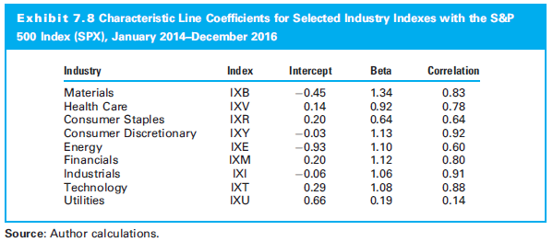
7.1.2 The Security Market Line
Industry Characteristic Lines
The characteristic line used to estimate beta value can be computed for sector indexes

Slide 28
7.2 Empirical Tests of the CAPM

Slide 29
7.2 Empirical Tests of the CAPM
Two major questions:
How stable is beta?
Is there a positive linear relationship between beta and the return on risky assets?

Slide 30
7.2.1 Stability of Beta
Numerous studies concluded beta not stable for individual stocks but stable for portfolios
Larger the portfolio and the longer the period, the more stable the beta
Betas regress toward the mean
High and low beta portfolios tended to converge over time toward 1.00

Slide 31
7.2.2 Relationship Between Systematic Risk and Return
Ultimate CAPM question: It is useful in explaining the return on risky assets
Is there a positive linear relationship between the market risk and the return on risky assets?
Jensen shows:
Most SMLs had a positive slope
The slopes change between periods
The intercepts are not zero
The intercepts change between periods

Slide 32
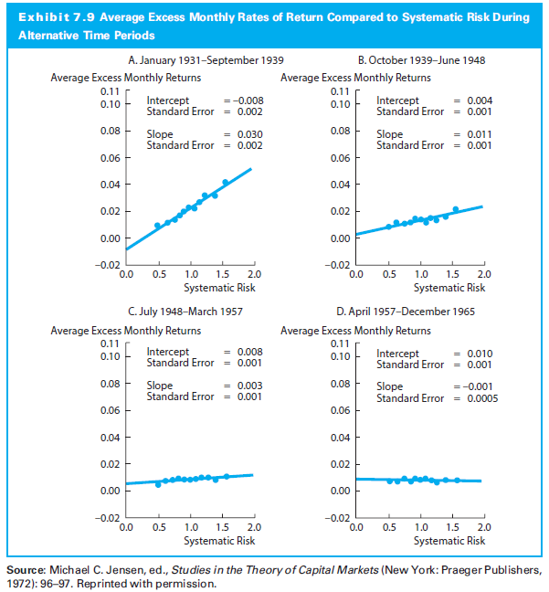
7.2.2 Relationship Between Systematic Risk and Return

Slide 33
7.2.2 Relationship Between Systematic Risk and Return
Effect of a Zero-Beta Portfolio
The characteristic line using a zero-beta portfolio should have a higher intercept and a lower slope coefficient
Studies find conflicting results

Slide 34
7.2.2 Relationship Between Systematic Risk and Return
Effect of Size, P/E, and Leverage
Size and P/E are additional risk factors along with beta
Investors require higher returns from small firms and stocks with low P/E ratios
Financial leverage (beyond beta and size) also helps explain the cross section of average returns

Slide 35
7.2.2 Relationship Between Systematic Risk and Return
Effect of Book-to-Market Value
Fama and French (1992): Size and book-to-market equity capture the cross-sectional variation in average stock returns associated with size, E/P, book-to-market equity, and leverage
Fama and French Three-Factor Model (later)

Slide 36
7.2.3 Additional Issues
Effect of Transaction Costs
With transactions costs, the SML will be a band of securities, rather than a straight line
Effect of Taxes
Differential tax rates could cause major differences in the CML and SML among investors

Slide 37
7.2.4 Summary of Empirical Results for the CAPM
Early evidence supported the CAPM
Evidence that the intercepts higher than RFR
Consistent with a zero-beta model or
Higher borrowing rates
Beyond beta, size, P/E ratio, financial leverage, and book-to-market value ratio have explanatory power

Slide 38
7.2.4 Summary of Empirical Results for the CAPM (cont’d)
Further studies:
Kothari, Shanken, and Sloan (1995): Substantial compensation for beta risk suggesting Fama and French results time-period specific
Jagannathan and Wang (1996): Conditional CAPM allowing changes in betas and in market risk premium performed well in explaining the cross section of returns
Reilly and Wright (2004): Examined the performance of 31 different asset classes with betas computed using a broad market portfolio proxy; the risk-return relationship was significant and as expected by theory

Slide 39
7.3 The Market Portfolio: Theory versus Practice

Slide 40
7.3 The Market Portfolio: Theory versus Practice
True market portfolio should
Include all the risky assets in the world
In proportion to their market value
U.S. Index as a market proxy
Most studies use an U.S. index
U.S. stocks constitutes less than 15% of the global risky asset portfolio

Slide 41
7.3 The Market Portfolio: Theory versus Practice
The beta intercept of the SML will differ if
There is an error in selecting the risk-free asset
There is an error in selecting the market portfolio
Incorrect SML may lead to incorrect evaluation of a portfolio performance

Slide 42
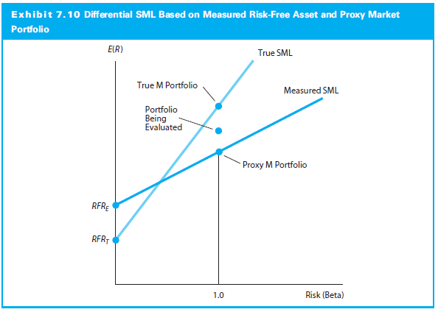
7.3 The Market Portfolio: Theory versus Practice

Slide 43
7.3 The Market Portfolio: Theory versus Practice

Slide 44
7.4 Arbitrage Pricing Theory

Slide 45
7.4 Arbitrage Pricing Theory
CAPM is criticized:
Many unrealistic assumptions
Difficulties in selecting a proxy for the market portfolio
Pricing theory with fewer assumptions: Arbitrage Pricing Theory (APT)

Slide 46
7.4 Arbitrage Pricing Theory
Three major assumptions:
Capital markets perfectly competitive
Investors prefer more to less wealth with certainty
Stochastic process generating asset returns can be expressed as a linear function of a set of K factors or indexes
In contrast to CAPM, APT does not assume:
Normally distributed security returns
Quadratic utility function
A mean-variance efficient market portfolio
Notes:
15

Slide 47
7.4 Arbitrage Pricing Theory
Return-generating stochastic process can be represented as a K factor model of the form:
Notes:
15

Slide 48
7.4 Arbitrage Pricing Theory
Return on a zero-investment, zero-systematic-risk portfolio is zero when the unique effects are fully diversified
Expected return on any asset i can be expressed as:
Notes:
15

Slide 49
7.4 Arbitrage Pricing Theory
Notes:
15

Slide 50
7.4.1 Using the APT
Two-stock and two-factor model example:
Two common factors:
One related to unexpected changes in the level of inflation and
Another related to unanticipated changes in the real level of GDP
Risk factor definitions and sensitivities:
Notes:
15

Slide 51
7.4.1 Using the APT
Assume also that there are two assets (x and y) that have the following sensitivities to these common risk factors:
Notes:
15

Slide 52
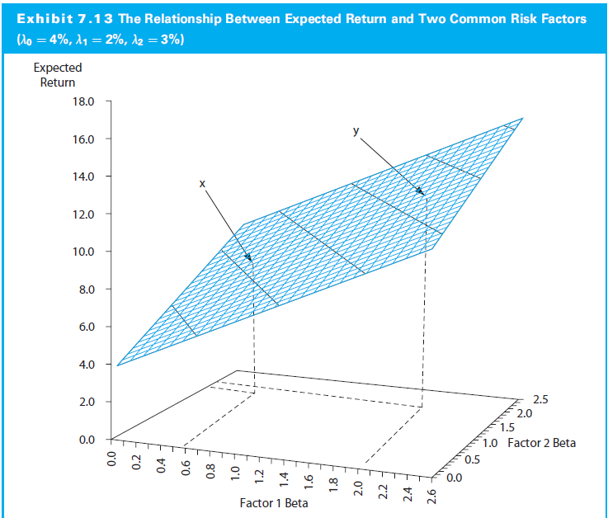
7.4.1 Using the APT
Notes:
15

Slide 53
7.4.2 Security Valuation with the APT: An Example
Three stocks (A, B, and C) and two common systematic risk factors (1 and 2) have the following relationship (assume zero-beta return [λ₀] equals zero):
If λ₁ = 4% and λ₂ = 5%, then the returns can be expressed as:
Notes:
15

Slide 54
7.4.2 Security Valuation with the APT: An Example
If all three stocks are priced at $35 and do not pay a dividend, the expected prices are:
Notes:
15

Slide 55
7.4.2 Security Valuation with the APT: An Example
If everyone believes the future prices of A, B, and C but do not revise their forecasts, then the current prices for the three stocks will be adjusted by arbitrage trading to:
Notes:
15

Slide 56
7.4.3 Empirical Tests of the APT
Roll-Ross Study (1980)
Two-step procedure:
Estimate the expected returns and the factor coefficients
Use estimates to test the basic cross-sectional pricing
Evidence generally supported the APT but tests not conclusive

Slide 57
7.4.3 Empirical Tests of the APT
Extensions of the Roll-Ross Tests
Cho, Elton, and Gruber (1984): Examined the number of factors in the return-generating process
Dhrymes, Friend, and Gultekin (1984): Found the number of factors varies with the size of the portfolio
Roll and Ross (1984): Number of factors is secondary issue compared to how well the model can explain the expected return

Slide 58
7.4.3 Empirical Tests of the APT
Connor and Korajczyk (1993): Number of factors allowing unsystematic components of risk to be correlated across assets
Harding (2008): Connection between systematic and unsystematic risk factors

Slide 59
7.4.3 Empirical Tests of the APT
APT and Stock Market Anomalies
APT Tests of the Small-Firm Effect
Reinganum: Results inconsistent with APT
Chen: Supported APT model over CAPM
APT Tests of the January Effect
Gultekin and Gultekin: APT not better than CAPM
Burmeister and McElroy: Effect not captured by model but still rejected CAPM in favor of APT

Slide 60
7.4.3 Empirical Tests of the APT
Is the APT Even Testable?
Shanken (1982)
Factors need not be observable, so equivalent sets may conform to different factor structures
Empirical formulation of the APT may yield different implications regarding the expected returns for a given set of securities
Theory cannot explain differential returns because it cannot identify the relevant factor structure that explains differential returns
A number of subsequent papers, such as Brown and Weinstein (1983), Geweke and Zhou (1996), and Zhang (2009), have proposed new methodologies for testing the APT

Slide 61
7.5 Multifactor Models and Risk Estimation

Slide 62
7.5 Multifactor Models and Risk Estimation
In multifactor model, investor chooses the exact number and identity of risk factors (while the APT model does not specify either of them)
where:
F_{it}= Period t return to the jth designated risk factor
R_{it} = Security i’s return that can be measured as either a nominal or excess return to Security i

Slide 63
7.5.1 Multifactor Models in Practice
Wide variety of empirical factors in practice
Alternative models identify different economic influences
Two approaches:
Macroeconomic risk factors
Microeconomic risk factors

Slide 64
7.5.1 Multifactor Models in Practice
Macroeconomic-Based Risk Factor Models
Chen, Roll, and Ross (1986):
where:

Slide 65
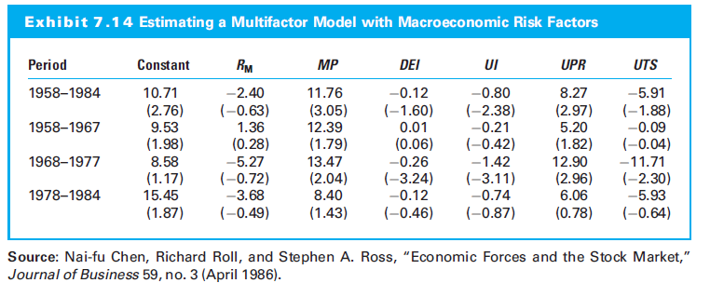
7.5.1 Multifactor Models in Practice

Slide 66
7.5.1 Multifactor Models in Practice
Burmeister, Roll, and Ross (1994) have a model based on the macroeconomic factors:
Confidence risk
Time horizon risk
Inflation risk
Business cycle risk
Market timing risk

Slide 67
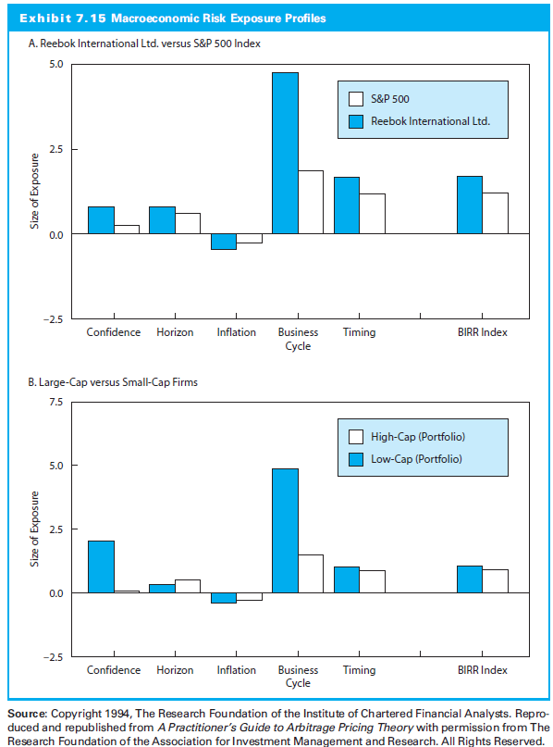
7.5.1 Multifactor Models in Practice

Slide 68
7.5.1 Multifactor Models in Practice
Fama and French Three-Factor Model
(1993), multifactor microeconomic model
SMB (i.e. small minus big) = return to a portfolio of small cap stocks less the return to a portfolio of large cap stocks
HML (i.e. high minus low) = return to a portfolio of stocks with high ratios of book-to-market values less the return to a portfolio of low book-to-market value stocks

Slide 69
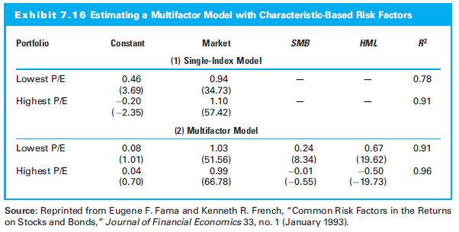
7.5.1 Multifactor Models in Practice

Slide 70
7.5.1 Multifactor Models in Practice
Carhart (1997): Four-factor model, Fama-French three-factor model plus momentum
Tendency for firms with positive returns to produce positive future returns
where
MOM_{t} = the momentum factor

Slide 71
7.5.1 Multifactor Models in Practice
Fama and French Five-Factor Model (2015): Three-factor model plus two additional terms to account for company quality
Corporate profitability risk exposure and
Corporate investment risk exposure

Slide 72
7.5.1 Multifactor Models in Practice
Extensions of Characteristic-Based Risk Factor Models
Use of index portfolios (e.g. S&P 500, Wilshire 5000) as common risk factors
Elton, Gruber, and Blake (1996):
S&P 500
Bloomberg Barclays Capital aggregate bond index
Prudential Bache index of the difference between large- and small-cap stocks
Prudential Bache index of the difference between value and growth stocks

Slide 73
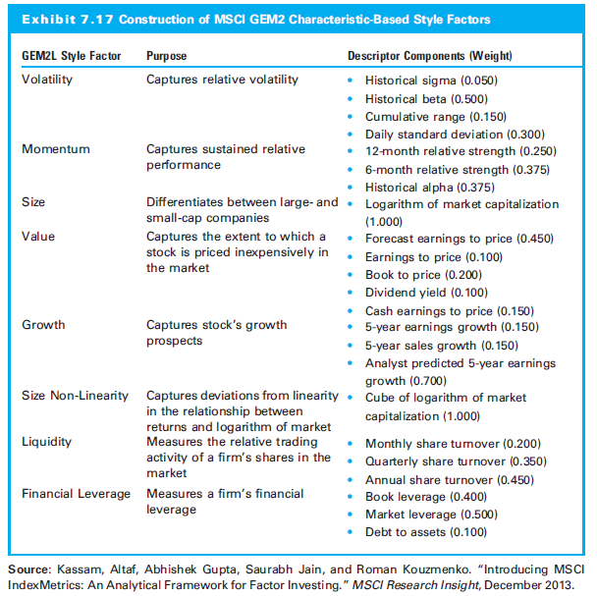
7.5.1 Multifactor Models in Practice

Slide 74
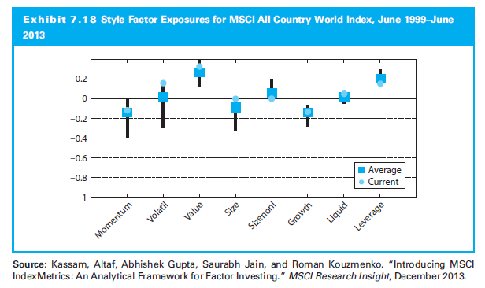
7.5.1 Multifactor Models in Practice

Slide 75
7.5.2 Estimating Risk in a Multifactor Setting: Examples
Estimating Expected Returns for Individual Stocks
Identify set of K common risk factors (or proxies)
Estimate risk premia (F_{j}) for the factors
Estimate sensitivities (b_{ij}) of stock to each factors
Calculated expected return

Slide 76
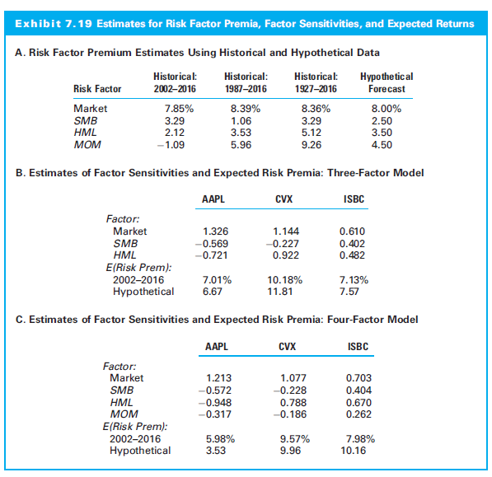
7.5.2 Estimating Risk in a Multifactor Setting: Examples

Slide 77
7.5.2 Estimating Risk in a Multifactor Setting: Examples
Comparing Mutual Fund Risk Exposures
Consider returns produced by two popular mutual funds:
Fidelity’s Contrafund (FCNTX) and
T. Rowe Price’s Mid-Cap Value Fund (TRMCX)

Slide 78
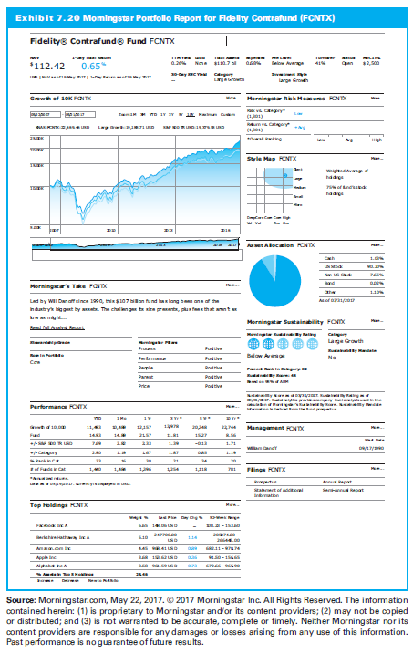
7.5.2 Estimating Risk in a Multifactor Setting: Examples

Slide 79
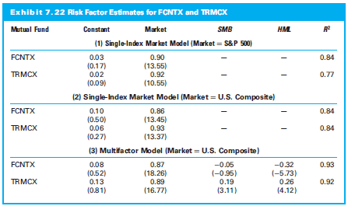
7.5.2 Estimating Risk in a Multifactor Setting: Examples

Slide 80
Appendix: Multiple Regression in Excel
NOTE: Required for MindTap Assignment

Slide 81
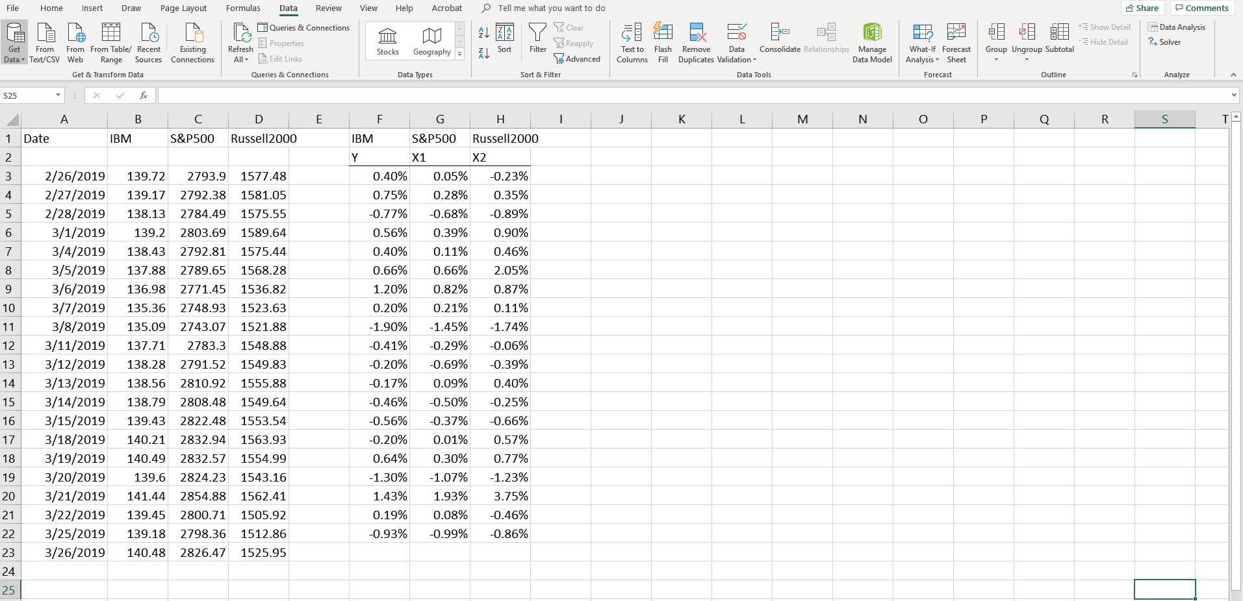
Data Analysis ToolPak Installed?

Slide 82
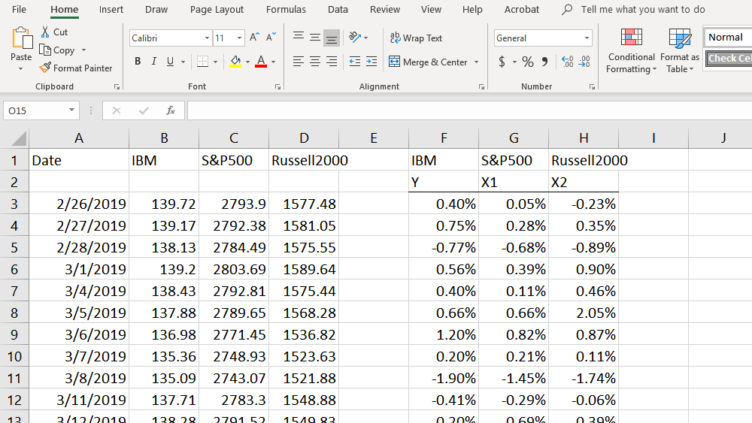
Installing Data Analysis ToolPak

Slide 83
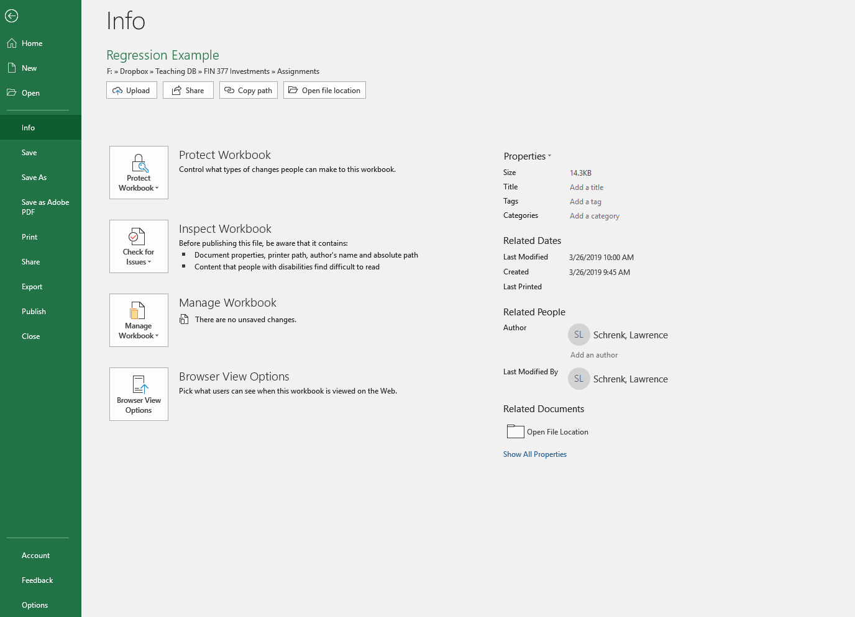
Installing Data Analysis ToolPak

Slide 84
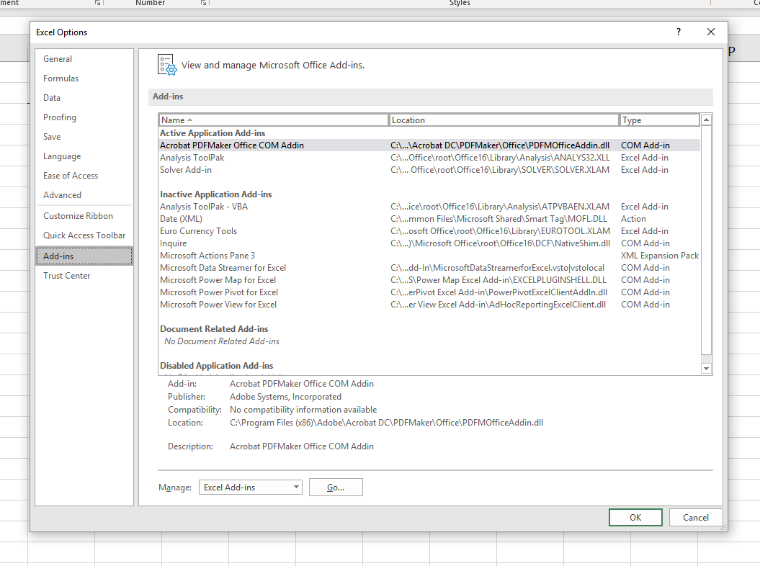
Installing Data Analysis ToolPak

Slide 85
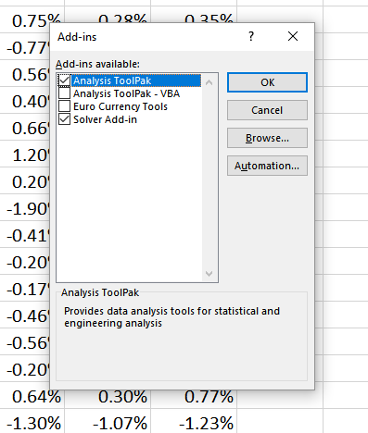
Installing Data Analysis ToolPak

Slide 86
Multiple Regression in Excel

Slide 87
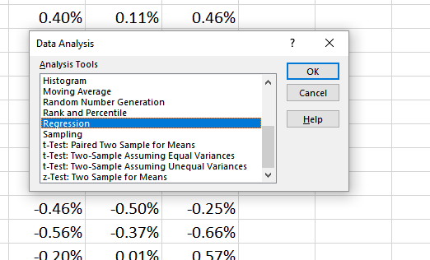
Multiple Regression in Excel

Slide 88
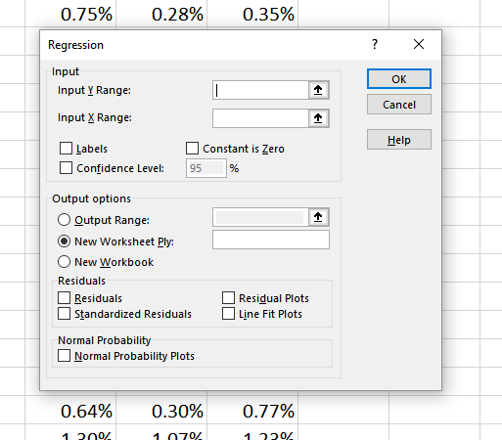
Multiple Regression in Excel

Slide 89
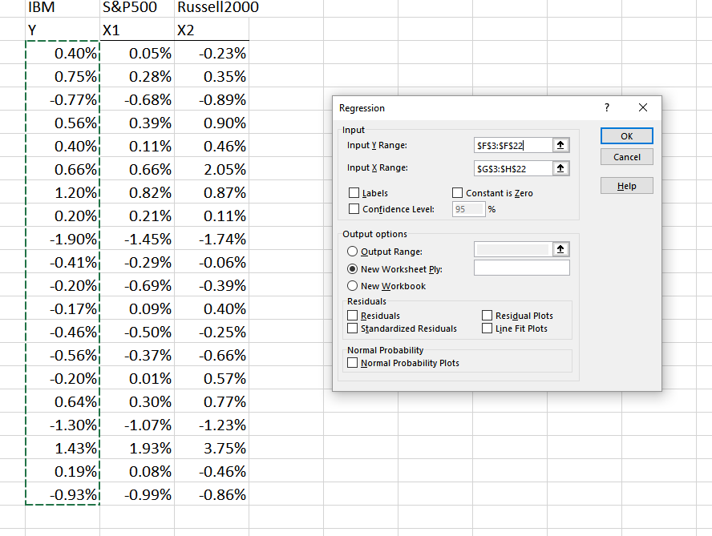
Multiple Regression in Excel

Slide 90
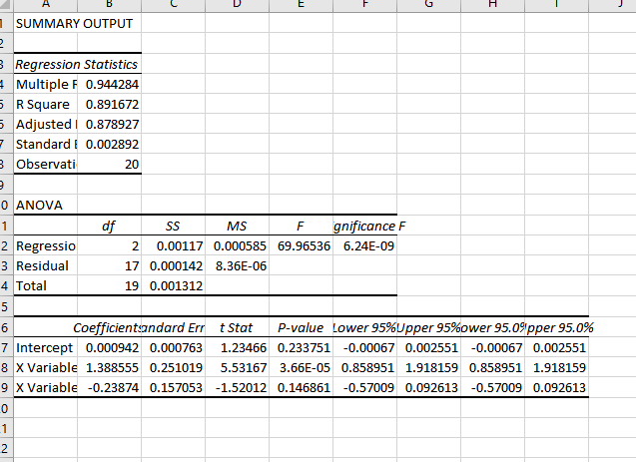
Multiple Regression in Excel

