Slide 1
FIN 377: Investments
Topic 3: Asset Allocation and Security Decision
Larry Schrenk, Instructor

Slide 2
Overview
2.1 Individual Investor Life Cycle
2.2 The Portfolio Management Process
2.3 The Need for a Policy Statement
2.4 Input to the Policy Statement
2.5 Constructing the Policy Statement
2.6 The Importance of Asset Allocation
2.7 The Case for Global Investments
2.8 Historical Risk-Returns on Alternative Investments

Slide 3
Learning Objectives
What is involved in the asset allocation process?
What are the four steps in the portfolio management process?
What is the role of asset allocation in investment planning?
Why is a policy statement important to the planning process?
What objectives and constraints should be detailed in a policy statement?
How and why do investment goals change over a person’s lifetime?
Why should investors have a global perspective regarding their investments?
What has happened to the relative size of U.S. and foreign stock and bond markets?
What are the differences in the rates of return on U.S. and foreign securities markets?
How can changes in currency exchange rates affect the returns that U.S. investors experience on foreign securities?
What are the additional advantages to diversifying in international markets beyond domestic diversification?
What alternative securities are available? What are their cash flow and risk properties?
What are the historical return and risk characteristics of the major investment instruments?
What is the relationship among the returns for foreign and domestic investment instruments?
What is the implication of these relationships for portfolio diversification

Slide 4
Readings
Reilley, et al., Investment Analysis and Portfolio Management, Chap. 2

Slide 5
2.1 Individual Investor Life Cycle

Slide 6
2.1 Individual Investor Life Cycle
Financial plans and investment needs differ for each individual and change over the life cycle
Financial plan should be related to age, financial status, future plans, risk aversion characteristics, and needs

Slide 7
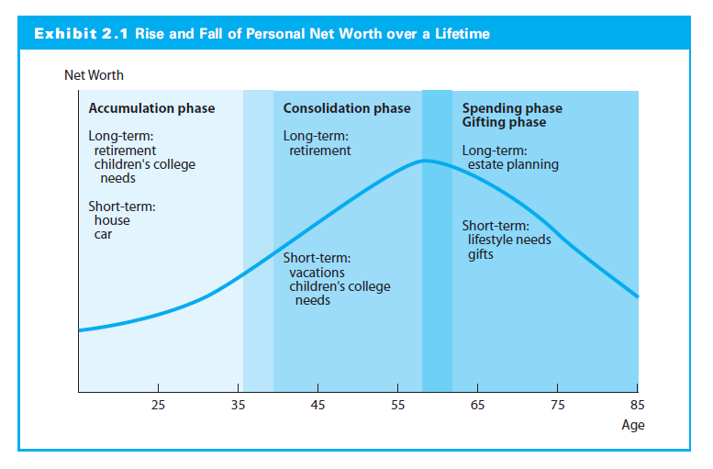
2.1.2 Investment Strategies over an Investor’s Lifetime

Slide 8
2.1.2 Investment Strategies over an Investor’s Lifetime
Accumulation phase
Early to middle years of working career
Long investment horizon
Relatively high-risk investments
Consolidation phase
Past midpoint of careers
Earnings greater than expenses
Horizon is still long (20 to 30 years)
Moderately high-risk investments
Capital preservation

Slide 9
2.1.2 Investment Strategies over an Investor’s Lifetime
Spending phase
After retirement
Social Security income and investment income
Less risky, but growth for inflation protection
Gifting phase
May be concurrent with the spending phase
Excess assets to relatives or charity
Estate planning to minimize taxes

Slide 10
2.1.3 Life Cycle Investment Goals
Short-term, high-priority goals
Vacation or a car
Medium-term, high-priority goals
Down-payment for a house
Long-term, high-priority goals
Retirement

Slide 11
2.2 The Portfolio Management Process

Slide 12
2.2 The Portfolio Management Process
Policy statement
Risks, investment goals, and constraints
Reviewed and updated periodically
Understand financial and economic conditions and forecast future trends
Needs and financial market expectations determine the investment strategy

Slide 13
2.2 The Portfolio Management Process
Construct the portfolio
Allocate funds to minimize risks and meet investment goals
Continual monitoring
Evaluate portfolio performance
Monitor changing needs and market conditions
Revise policy statement as needed
Modify investment strategy accordingly

Slide 14
2.3 The Need for a Policy Statement

Slide 15
2.3 The Need for a Policy Statement
Reasons for a policy statement:
Realistic investment goals based on financial markets and the risks of investing
Standard by which to judge the performance of the portfolio manager

Slide 16
2.3.1 Understanding Realistic Investor Goals
Investors articulate their realistic needs and goals and become familiar with financial markets and investing risks
Without this, investors cannot communicate needs to portfolio manager who needs this input to construct a portfolio that will satisfy clients’ needs

Slide 17
2.4 Input to the Policy Statement

Slide 18
2.4.1 Investment Objectives
Risk tolerance:
Individual psychological makeup
Other factors, current insurance coverage, cash reserves, family situation, and age
Influenced by current net worth and income expectations
Return objectives
Absolute or a relative percentage return or
General goals, capital preservation, current income, capital appreciation, or total return

Slide 19
2.4.1 Investment Objectives
Capital preservation
Minimize their risk of loss, usually in real terms
Maintain purchasing power of investment
Return needs to be no less than the rate of inflation
Capital appreciation
Portfolio growth in real terms to meet some future need
Growth mainly occurs through capital gains
Current income
Income rather than capital gains
Retirees to generate spendable funds
Total return strategy
Portfolio growth in real terms to meet some future need
Capital gains and reinvesting current income

Slide 20
2.4.1 Investment Objectives
Investment Objective: 25-Year-Old
Typically, total return or capital appreciation
Investment Objective: 65-Year-Old
Typically, current income and capital preservation, or
Current income and total return (to outpace inflation)

Slide 21
2.4.2 Investment Constraints
Liquidity Needs
An asset is liquid if convertible to cash at close to fair market value
Examples include Money Market Funds
Time Horizon
Long investment horizons → less liquidity and greater portfolio risk
Shorter time horizons → more liquid and less risky investments

Slide 22
2.4.2 Investment Constraints
Tax Concerns
Planning complicated by taxes especially if international investments
Income from interest, dividends, or rents taxable at marginal tax rate
A Note Regarding Taxes
The impact of taxes on investment strategy very significant
Consult a tax accountant

Slide 23
2.4.2 Investment Constraints
Legal and Regulatory Factors
Investment process and the financial markets highly regulated
Regulations can constrain investments available to someone in a fiduciary role
A fiduciary, or trustee, supervises an investment portfolio of a third party
All investors must respect certain laws, such as insider trading prohibitions

Slide 24
2.4.2 Investment Constraints
Unique Needs and Preferences
Unique concerns of each investor
Implications differ for each person
Individual must determine and communicate these specific needs and preferences in policy statement

Slide 25
2.5 Constructing the Policy Statement

Slide 26
2.6 The Importance of Asset Allocation
Capital Allocation
How much in risk-free vs. risky assets?
Asset Allocation
What asset classes should be included?
What weights for asset class?
Security Selection
What specific securities or funds should be in each asset class?
NOTE: Different than textbook

Slide 27
2.6 The Importance of Asset Allocation

Slide 28
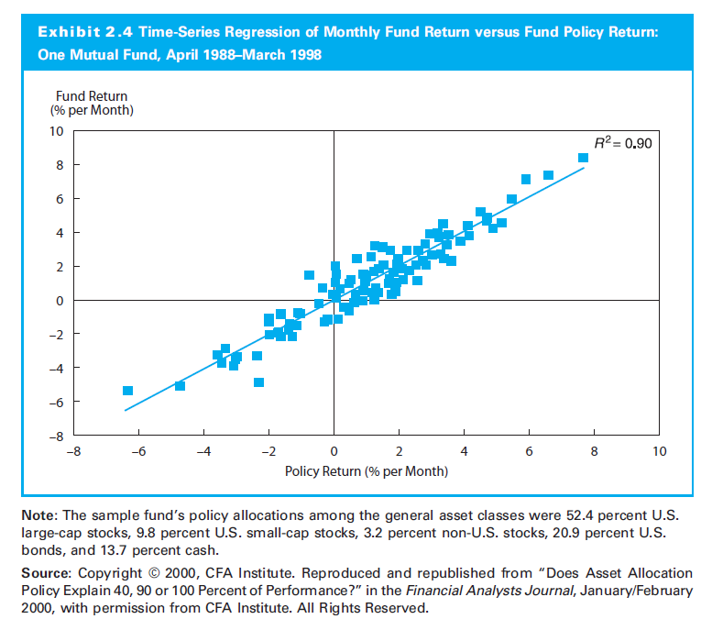
2.6 The Importance of Asset Allocation

Slide 29
2.6.1 Investment Returns after Taxes and Inflation
1997 investment in S&P 500 would have averaged a 7.68% annually through 2016
Taxes lower average annual return to 5.98%
Inflation lowers average annual (real) return to 2.87%

Slide 30
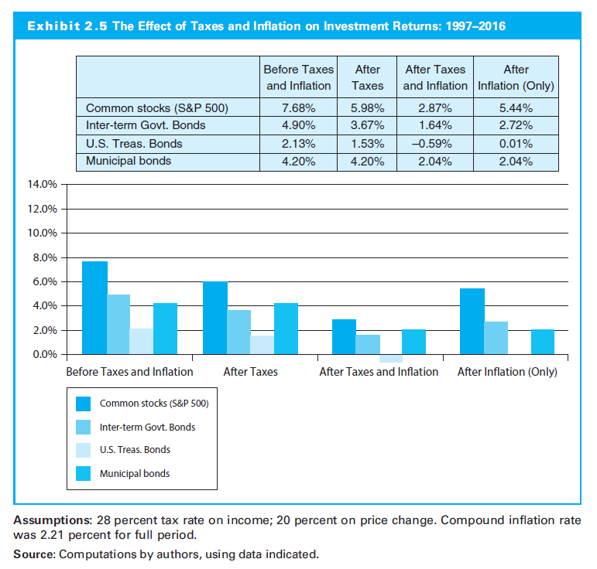
2.6.1 Investment Returns after Taxes and Inflation

Slide 31
2.6.2 Returns and Risks of Different Asset Classes
If the investor has a long time horizon the risk of equities is small and that of T-bills is large because of their differences in long-term expected returns

Slide 32
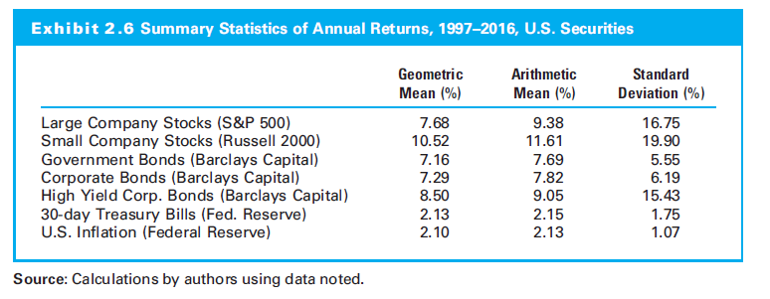
2.6.1 Investment Returns after Taxes and Inflation

Slide 33
2.6.3 Asset Allocation Summary
Asset allocation decision dominates portfolio’s returns over time
Capital appreciation, income, or even capital preservation requires sizable allocation to the equity
Risk depends on the investor’s goals and time horizon

Slide 34
2.7 The Case for Global Investments

Slide 35
2.7 The Case for Global Investments
Ignoring foreign markets reduces investment choices to <50% of available investment opportunities.
Return on non-U.S. securities often exceeds U.S.-only securities
Substantial diversification with foreign securities having low correlation with U.S. securities

Slide 36
2.7.1 Relative Size of U.S. Financial Markets
U.S. securities smaller proportion of the total world capital market
Faster economic growth of many other countries
Growing importance of these foreign securities in world capital market

Slide 37
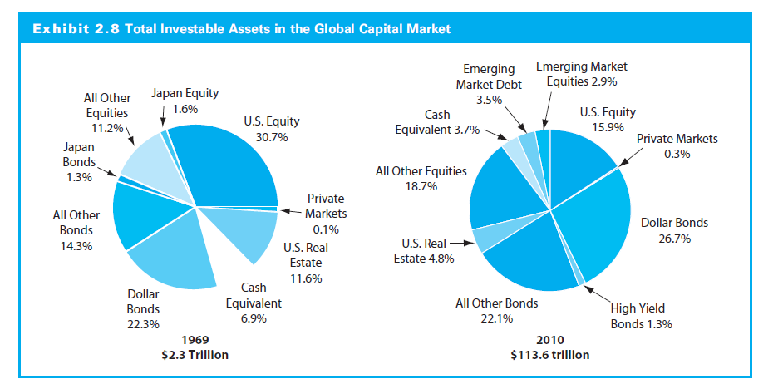
2.7.1 Relative Size of U.S. Financial Markets

Slide 38
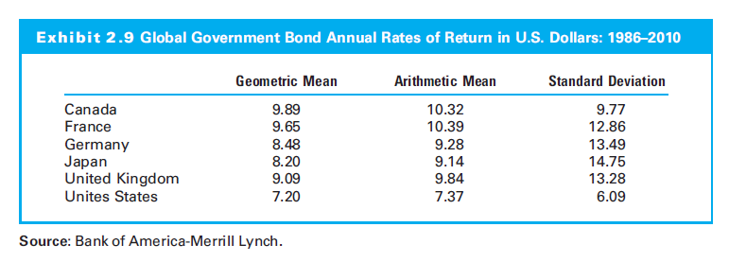
2.7.2 Rates of Return on U.S. and Foreign Securities

Slide 39
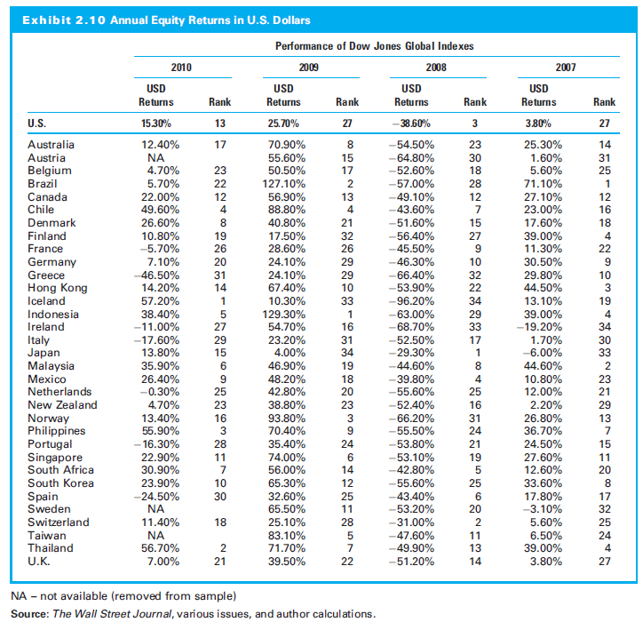
2.7.2 Rates of Return on U.S. and Foreign Securities

Slide 40
2.7.3 Risk of Diversified Country Investments
Diversified portfolio provides more stable rate of return (lower standard deviation)
To diversify a portfolio choose investments with low positive correlation, zero correlation, or, ideally, negative correlation with the portfolio

Slide 41
2.7.3 Risk of Diversified Country Investments
Global Bond Portfolio Risk
Correlation of bond returns between the United States and other countries differ
These correlations change over time due to international trade, economic growth, fiscal policy, and monetary policy
A change in these change how economies are related and change the correlations between bonds

Slide 42
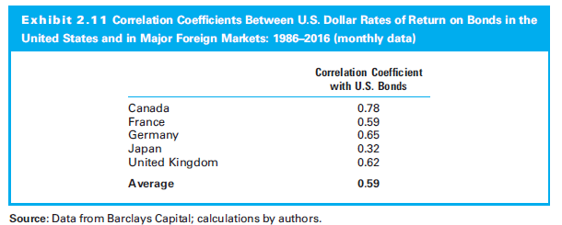
2.7.3 Risk of Diversified Country Investments

Slide 43
2.7.3 Risk of Diversified Country Investments
Global Equity Portfolio Risk
Small, positive correlations between U.S. and foreign stocks
Diversify stock portfolios by including foreign stocks
Standard deviation declines as you increase the number of randomly selected securities in a portfolio

Slide 44
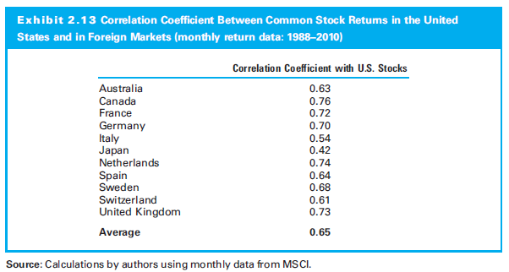
2.7.3 Risk of Diversified Country Investments

Slide 45
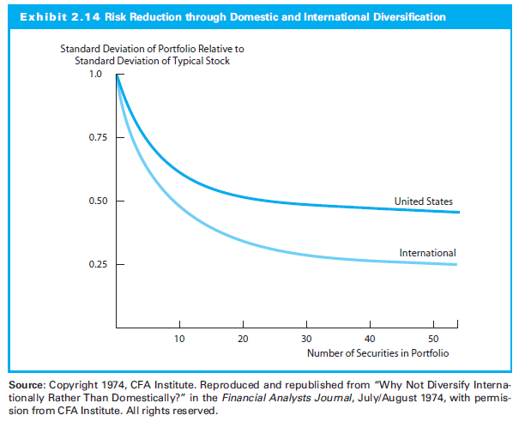
2.7.3 Risk of Diversified Country Investments

Slide 46
2.8 Historical Risk-Returns on Alternative Investments

Slide 47
2.8.1 World Portfolio Performance
Asset Return and Total Risk
Riskier assets with higher standard deviations experience higher returns
For example, the U.S. stock indexes had relatively high returns (10-17%) and large standard deviations (15-23%)

Slide 48
2.8.1 World Portfolio Performance
Return and Systematic Risk
Systematic risk is the volatility of an asset relative to a market portfolio
Systematic risk measure (beta) does better job of explaining than the total risk measure (standard deviation)
Systematic risk measure (beta) that used the Brinson Global Security Market Index (GSMI) as a market proxy was better than the beta that used the S&P 500 Index

Slide 49
2.8.1 World Portfolio Performance
Correlations between Asset Returns
U.S. equities have reasonably high correlation with most developed countries but low correlation with emerging market stocks and Pacific Basin stocks (including Japan)
U.S. equities show almost zero correlation with world government bonds and with the commodities index
Most assets have negative correlations with inflation → poor inflation hedges

Slide 50
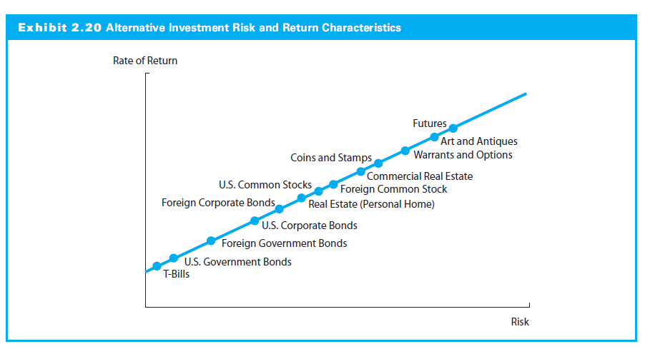
2.8 Historical Risk-Returns on Alternative Investments

