Slide 1
FIN 377: Investments
Project Guidelines and Example
Larry Schrenk, Instructor

Slide 2
Course Project: Overview
Groups Randomly Assigned
Excel Spreadsheet
See Example Below
Follow the Excel Guidelines
Submit in D2L
No E-mail Attachments
Only One File per Group

Slide 3
Course Project: Firm
‘S&P 500’ (see Wikipedia for List)
Alternates Must be Approved
Firm Criteria:
Solvent and Simple
No Financial Firms
Issues Long-Term Bonds
Paid Dividends for the Last Five Years

Slide 4
Worksheet 1: Info
Firm Name
Ticker Symbol
Group Members
Please list in alphabetical order
Brief Explanation of Why You Chose this Firm

Slide 5
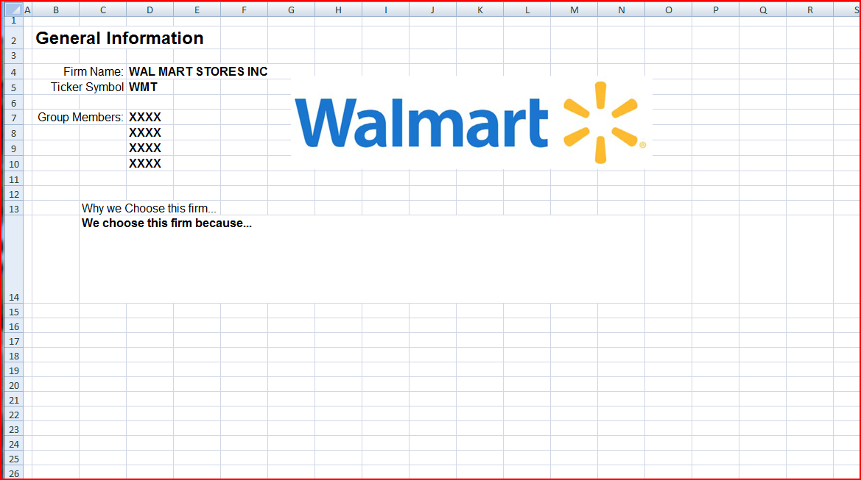
Worksheet 1: Example

Slide 6
Worksheet 2: FinStat
Financial Statements
Download your Firm's Most Recent 10Q from EDGAR
Extract/Copy
Current, Quarterly Income Statement and
Current Balance Sheet
Put these on Worksheet 2

Slide 7
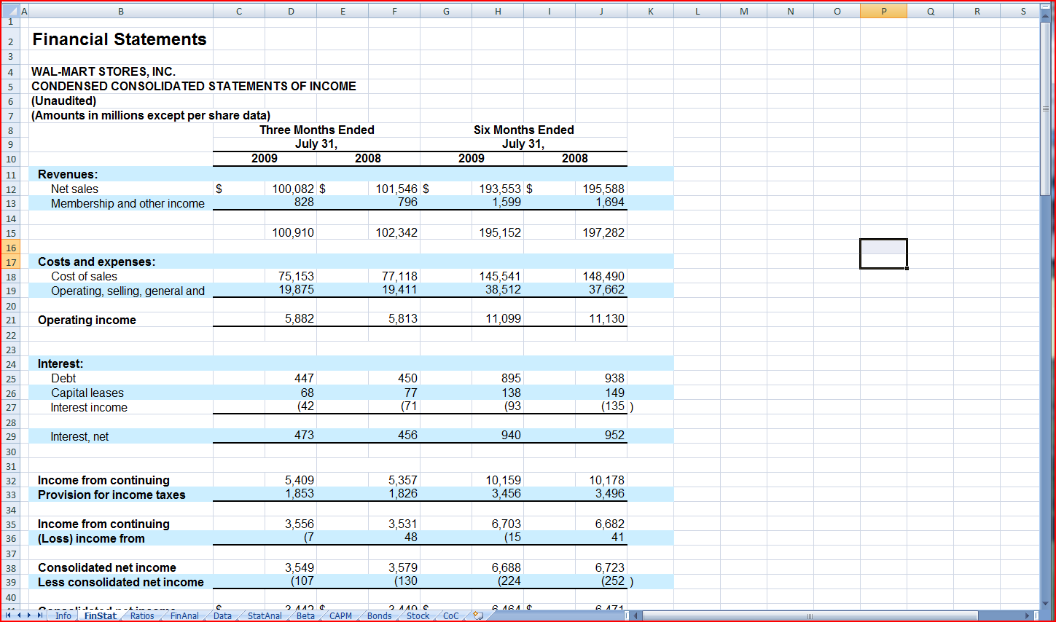
Worksheet 2: Example

Slide 8
Worksheet 3: Ratios
Calculate Ratios
Traditional Ratios
Use the example for the list
Remember to annualize
Custom Ratio
Calculate Ratios for Your Firm and Three Peer Firms
Use Capital IQ for Data
Capital IQ Introduced in Class

Slide 9
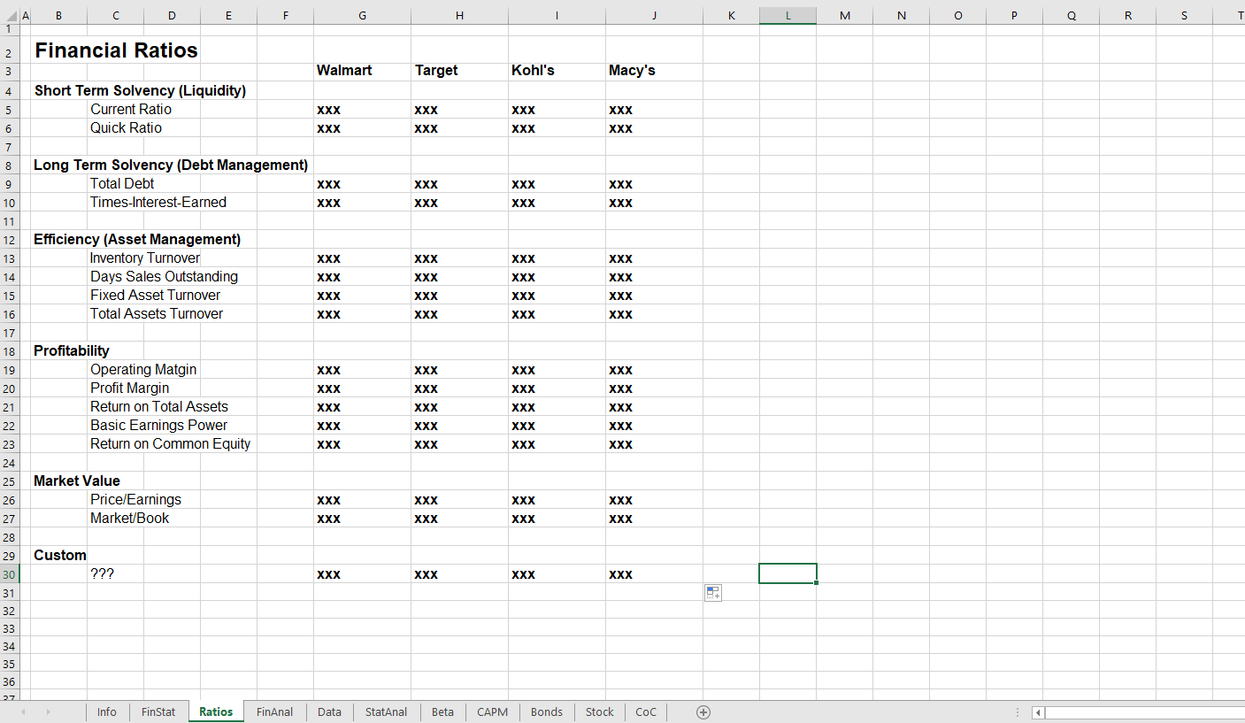
Worksheet 3: Example

Slide 10
Worksheet 4: FinAnal
Financial Analysis
Perspective: Equity Investor
Analysis
Financial Statements
Three Traditional Ratios (Only)
One Custom Ratio
Use CapIQ for Peer Comparisons
One Page Written Analysis
Recommendation: Do the report in Word and paste into Excel.

Slide 11
Worksheet 4: Example

Slide 12
Worksheet 5: Data
Market Data on Four Assets
Download from the FRED2 database (http://research.stlouisfed.org/fred2/):
Monthly data on the 1-Year Treasury Constant Maturity Rate (GS1) for the last five years.
Download from Yahoo Finance (http://finance.yahoo.com/):
Monthly levels of the S&P 500 Index for the last five years,
Monthly stock prices for your firm for the last five years, and
Monthly stock prices for IBM for the last five years.
Calculate the EAR.
NOTE: Use ‘Adj. Close’ Prices

Slide 13
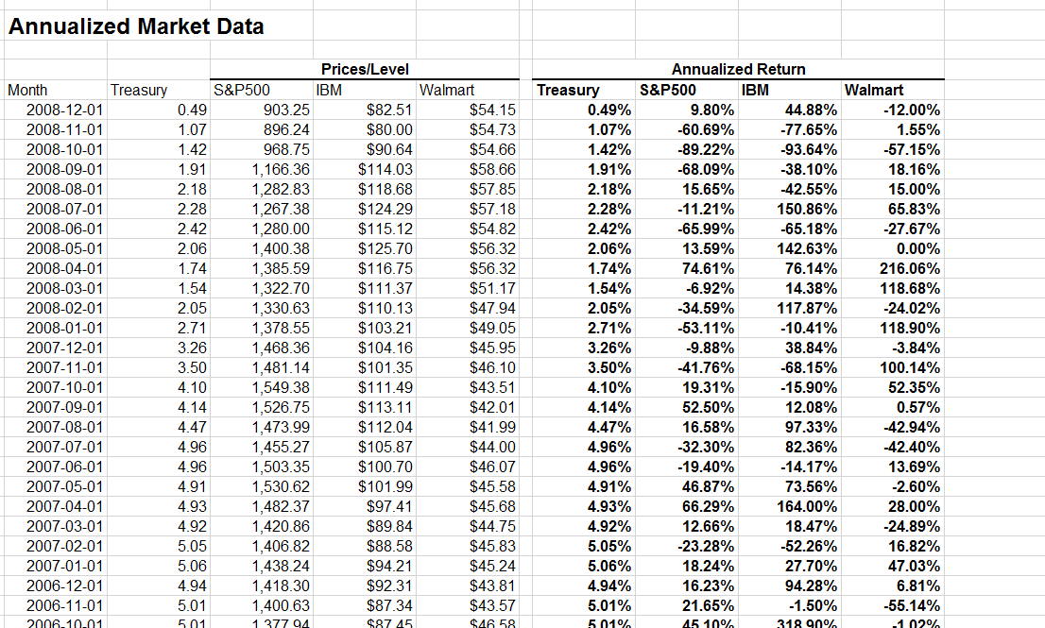
Worksheet 5: Data

Slide 14
Data Notes I
Put data in the columns on Worksheet 5.
Convert any non-return or non-annual data to the equivalent annual return (EAR).
Since you are downloading 60 months of data, you will have 59 returns.
Some data is listed from latest to earliest and other data in the reverse order. For each data set the most recent data should be at the top of each column.
Make sure that the dates match for data from different sources.

Slide 15
Data Notes II
Every downloaded data value should be in only one cell in the spreadsheet.
Do not copy the primary data to other worksheets.
To use data from one worksheet in a calculation another, make a reference to it using the ‘!’ operator.
For example, if I wanted to put the value in C4 on the Data worksheet in a cell on another worksheet, I would put ‘=Data!C4’ in that cell.
If I wanted to calculate the average value of the C4 to C10 cells from the Data worksheet on another worksheet, I would put ‘=AVERAGE(Data!C4:C10)’ in that cell.

Slide 16
Worksheet 6: StatAnal
Statistical Analysis
Calculate for each asset:
Mean of Annualized Returns
Standard Deviation of Annualized Returns
Skewness of Annualized Returns
Kurtosis of Annualized Returns
Construct the covariance matrix
Construct the correlation matrix
Graph for each asset:
Histogram of returns
Use ‘Histogram’ in the Data Analysis Add-In

Slide 17
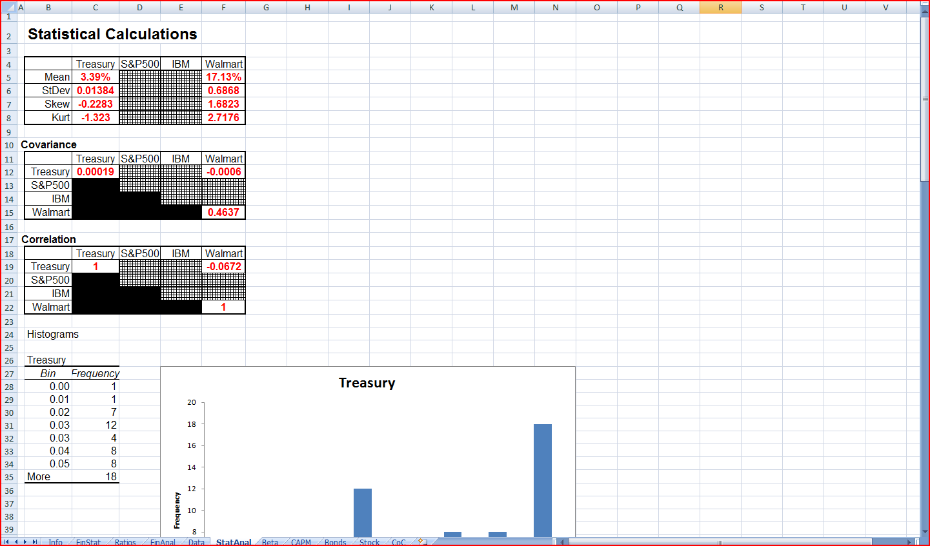
Worksheet 6: Example

Slide 18
Worksheet 7: Beta
Data already downloaded
Find the beta for the stock of your firm:
Linear regression:
Y (Dependent) Variable: Firm Equity Return
X (Independent) Variable: S&P 500 Return
NOTE: Slides for Topic 12 have Excel instructions for linear regression.

Slide 19
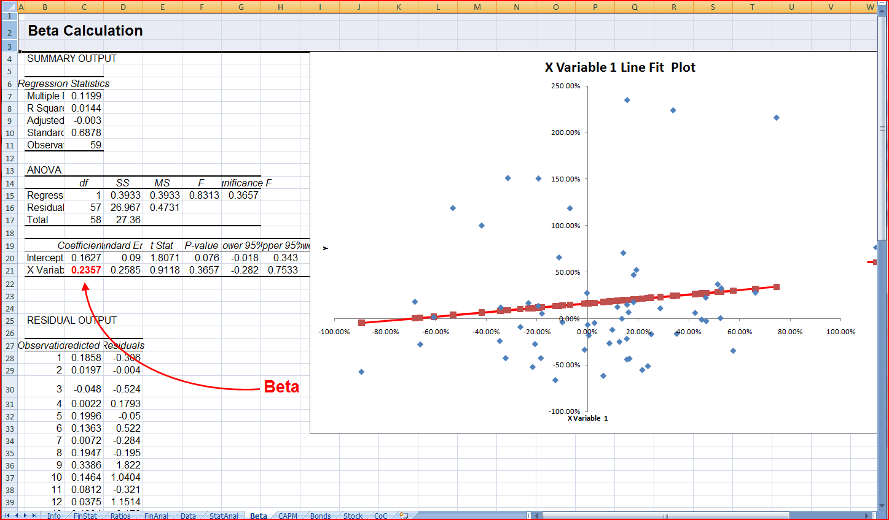
Worksheet 7: Example

Slide 20
Worksheet 8: CAPM
Use your Data and beta to find the expected return

Slide 21
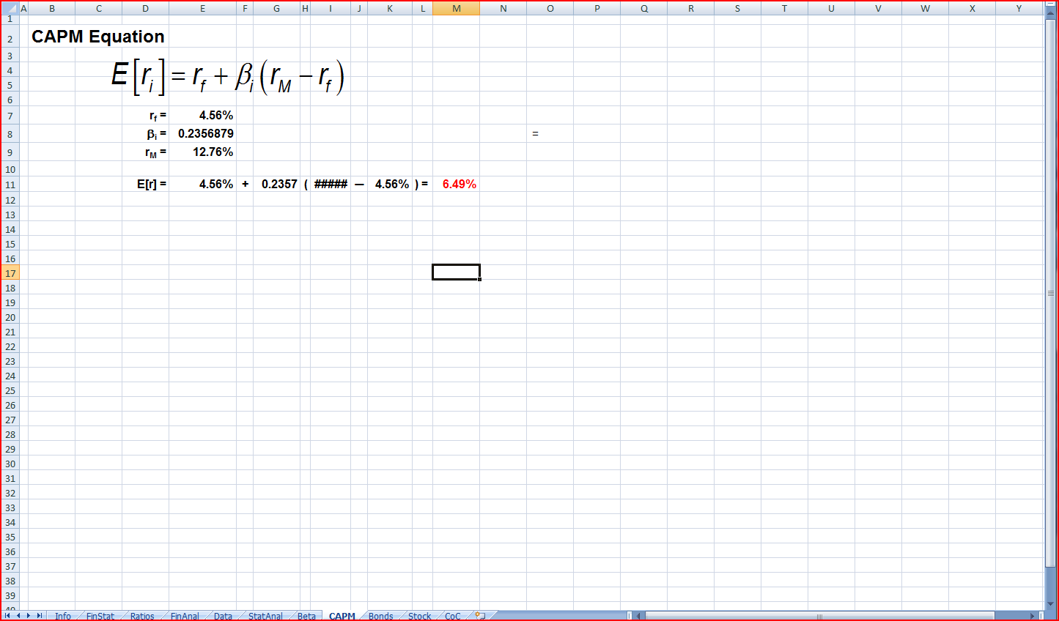
Worksheet 8: Example

Slide 22
Worksheet 9: Fama-French
TBA

Slide 23
Worksheet 10: Multifactor Model
TBA

Slide 24
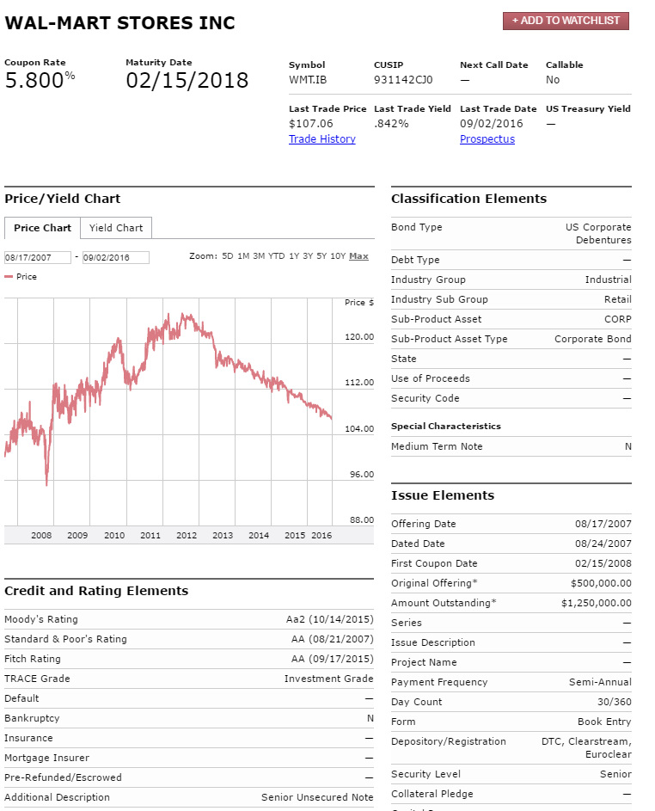
Worksheet 11: Bonds
Find a bond issued by your firm.
http://finra-markets.morningstar.com/BondCenter/Default.jsp
Search for a (preferably) non-callable bond
Click on the bond symbol
Use ‘Bond Profile’
Information.

Slide 25
Worksheet 11: Bonds
Calculate the yield to maturity and compare your calculation with FINRA’s.
How would the price of the bond change if the interest rate
Increased by 50 basis points?
Decreased by 50 basis points?

Slide 26
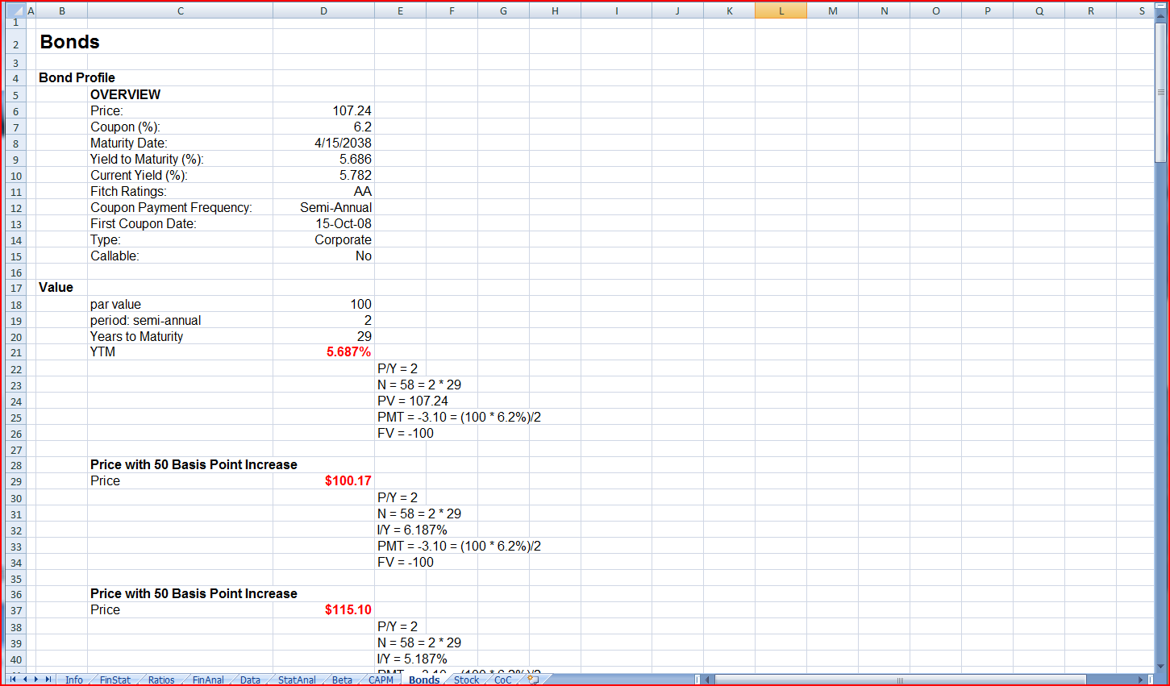
Worksheet 11: Example

Slide 27
Worksheet 12: Stock
Price the stock with DDM
Dividend History
http://finance.yahoo.com/
Enter Ticker Code in
Click on ‘Historical Prices’
Search selecting ‘Dividends Only’

Slide 28
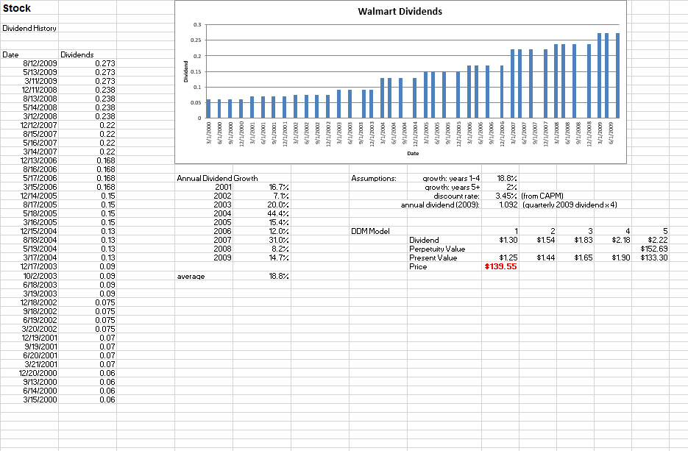
Worksheet 12: Example

Slide 29
Worksheet 13: Final Evaluation
About One Page
Evaluate the firm using the analysis from all the data and analysis you have done in the report.
This could take several forms, such as:
A recommendation of buy, hold, or sell with a justification
A report to the CEO of the firm and its financial stability

