Slide 1
FIN 377: Investments
Week 15: An Introduction to Derivative Markets and Securities II
Larry Schrenk, Instructor

Slide 2
Overview
Review and Questions
Current Events
Practice Problems
Excel Skills: Pivot Tables

Slide 3
1. Review and Questions

Slide 4
Key Ideas (Slides 8.36-73)
Forward and Option Contracts
Put-Call-Spot Parity
Adjusted for Dividends
Option Strategies
Protective Put

Slide 5
14.3.1 Put-Call-Spot Parity
Net investment (S₀ + P_{0,T} – C_{0,T})
CF at expiration (no matter the stock price) X
The result is a risk-free investment
Because the risk-free rate equals the T-bill rate:
(Long Stock) + (Long Put) + (Short Call) = (Long T-bill)

Slide 6
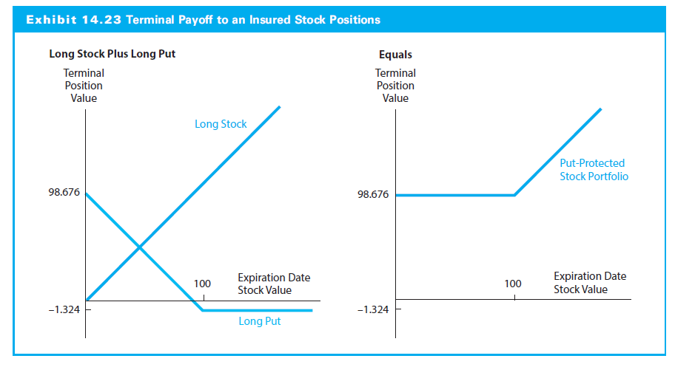
14.4.2 Protecting Portfolio Value with Put Options

Slide 7
2. Current Events

Slide 8
3. Practice Problems

Slide 9
Practice Problem 1
A stock is currently selling for $100.00. A 3 month put option at $110.00 is currently valued at $20.00 and the risk-free rate is 5%. What is the price of the corresponding call?

Slide 10
Practice Problem 2
A stock is currently selling for $100.00 and it will pay a $4.00 dividend in 3 months. A 3 month put option at $110.00 is currently valued at $20.00 and the risk-free rate is 5%. What is the price of the corresponding call?

Slide 11
4. Excel Skills

Slide 12
Pivot Tables
Pivot Tables

