Slide 1
FIN 377: Investments
Week 14: An Introduction to Derivative Markets and Securities I
Larry Schrenk, Instructor

Slide 2
Overview
Review and Questions
Current Events: Intangibles
Practice Problems
Excel Skills: Macros

Slide 3
1. Review and Questions

Slide 4
Key Ideas (Slides 8.1-46)
Introduction to Derivative Markets
Futures/Forward Contracts
Option Contracts
Ananlysis of Derivatives
Payoff and Profit Diagrams

Slide 5
14.1 Overview of Derivative Markets
Two basic kinds of derivatives available:
Forward and futures contracts
Option contracts
Only one forward contract is needed for any particular maturity and underlying asset
Two types of options
Calls
Puts
For each of these derivatives, an investor can enter into a transaction as:
The long position (the buyer)
The short position (the seller)

Slide 6
14.1.1 The Language and Structure of Forward and Futures Markets
Forward contract gives holder obligation to execute a transaction
At a predetermined date (maturity date)
At a predetermined price (contract price)
Two parties (counterparties)
The eventual buyer (or long position)
The eventual seller (or short position)

Slide 7
14.1.3 The Language and Structure of Option Markets
Option contract gives right, but not the obligation to buy or to sell underlying at a predetermined future date and a predetermined price
Option to buy is a call option
Option to sell is a put option
Buyer has the long position in the contract
Seller (writer) has the short position in the contract
Buyer and seller are counterparties in the transaction

Slide 8
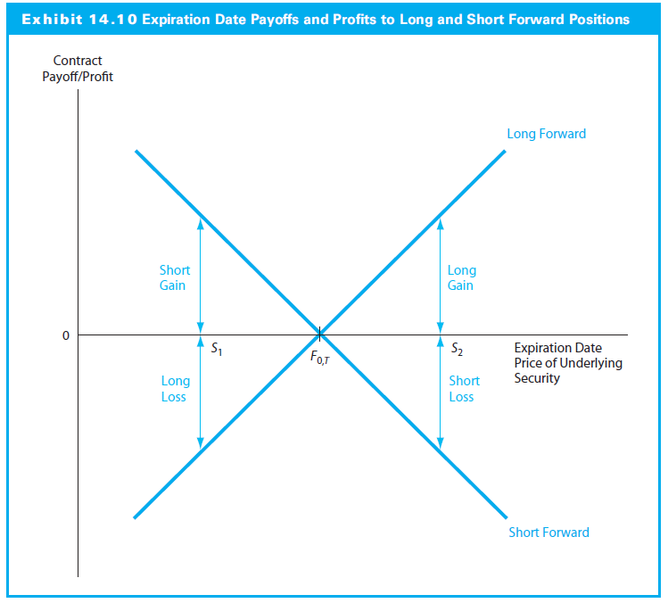
14.2.2 Basic Payoff and Profit Diagrams for Forward Contracts

Slide 9
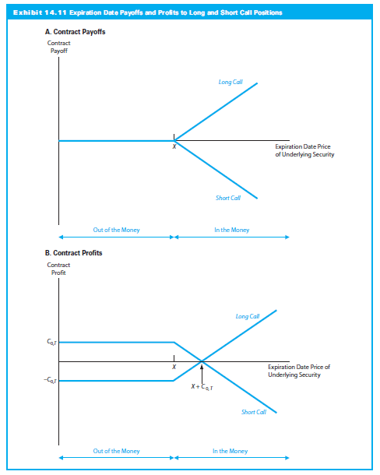
14.2.3 Basic Payoff and Profit Diagrams for Call and Put Options

Slide 10
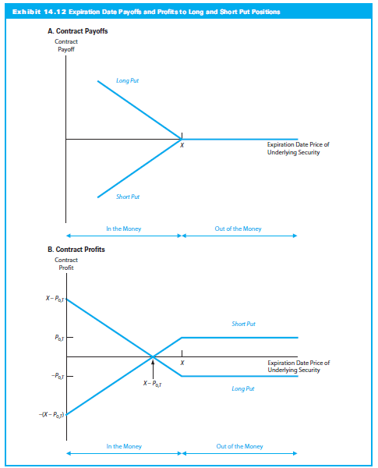
14.2.3 Basic Payoff and Profit Diagrams for Call and Put Options

Slide 11
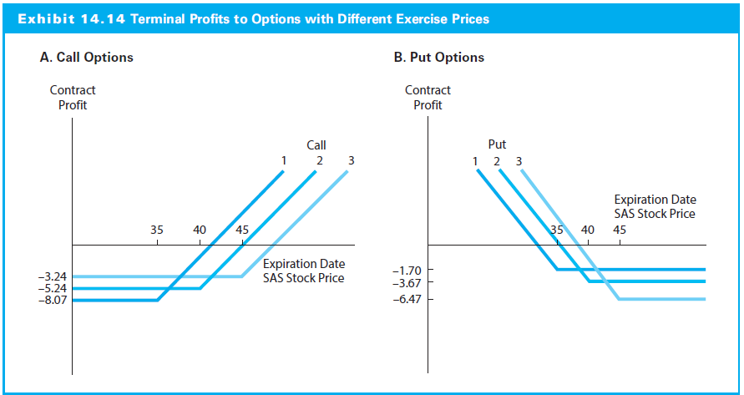
14.2.4 Option Profit Diagrams: An Example

Slide 12
14.3.1 Put-Call-Spot Parity
Net investment (S₀ + P_{0,T} – C_{0,T})
CF at expiration (no matter the stock price) X
The result is a risk-free investment
Because the risk-free rate equals the T-bill rate:
(Long Stock) + (Long Put) + (Short Call) = (Long T-bill)

Slide 13
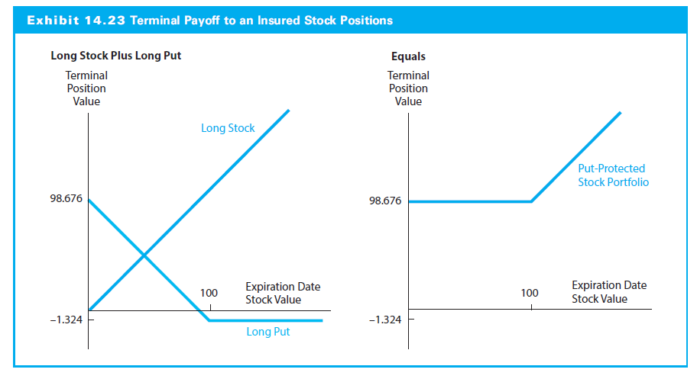
14.4.2 Protecting Portfolio Value with Put Options

Slide 14
2. Current Events: Intangibles

Slide 15
Question
Here’s a profile of a company. Do you want to buy the stock?
This company will be profitable for each of the next 15 years. Both sales and net income will grow at close to a 40 percent compound annual rate. The company will also initiate a dividend in the third year, which will grow at nearly a 50 percent compound annual rate through the end of the period.
Here’s another profile. Do you want to buy the stock?
This company will have negative free cash flow for each of the next 15 years. The level of debt will grow at a 34 percent compound annual rate over this time. Its cash balance will start at 2.5 percent of sales and will dwindle to 2.0 percent by the end of the period.

Slide 16
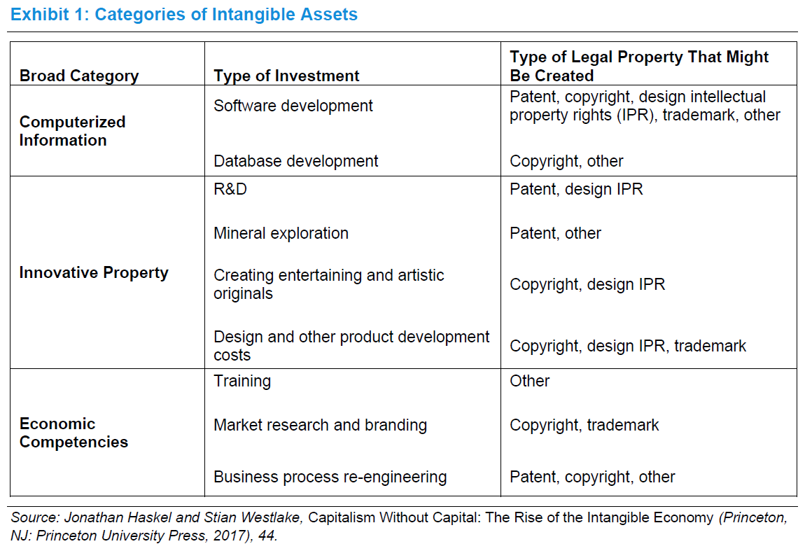
Types of Intangibles

Slide 17
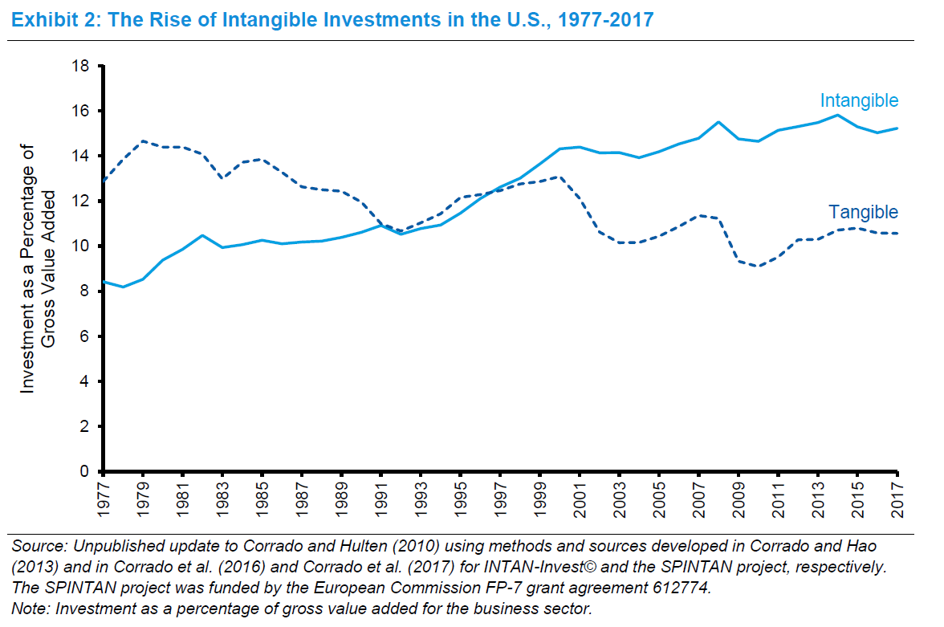
Changing Value of Intangibles

Slide 18
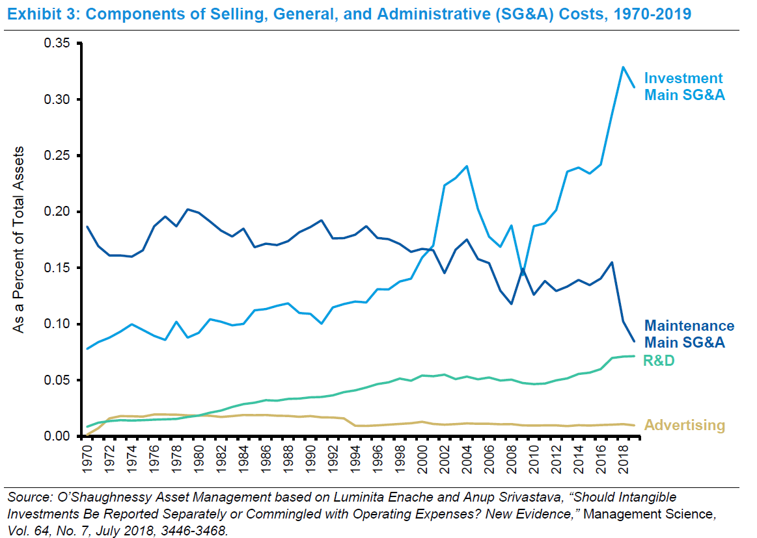
SG&A

Slide 19
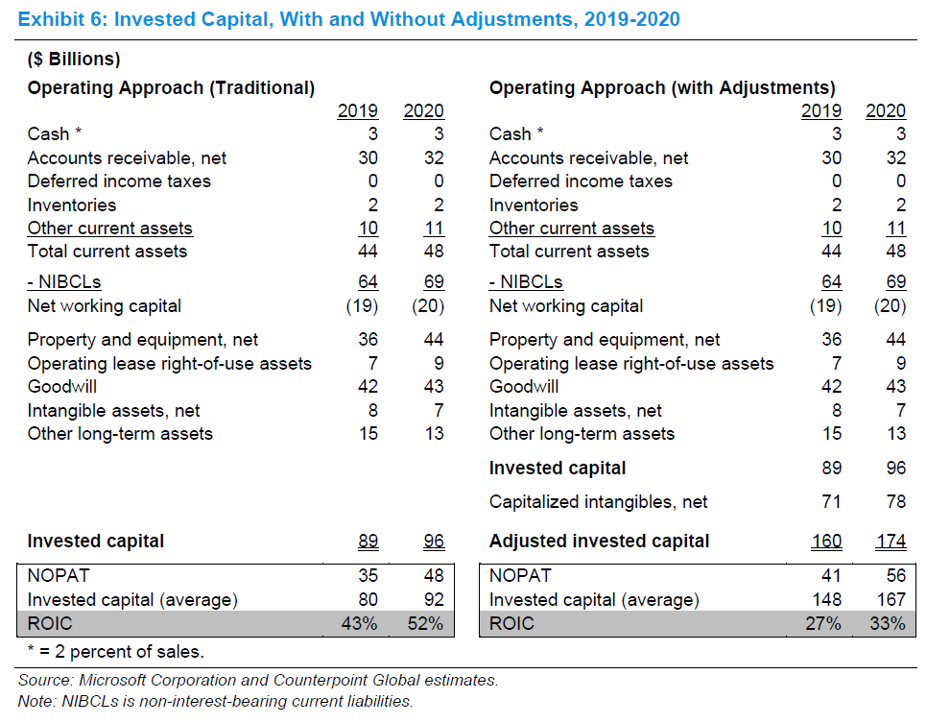
New Analysis

Slide 20
Bibliography
Michael J. Mauboussin and Dan Callahan. “One Job: Expectations and the Role of Intangible Investments.” Blog: CONSILIENT OBSERVER, September 15, 2020.
Jonathan Haskel and Stian Westlake. Capitalism without Capital: The Rise of the Intangible Economy. Princeton University Press, 2017.

Slide 21
3. Practice Problems

Slide 22
Practice Problem 1
Graph the payoff of buying a call option and selling a put at X.
Call
Put
Payoff
Option/Portfolio Payoff/Profit
Stock Price
X

Slide 23
Practice Problem 2
Find the algebraic payoff of buying a call option and selling a put at X.
Below X Above X
Buy Call
Sell Put
Total

Slide 24
Practice Problem 3
Graph the payoff and profit of buying a call option and buying a put at X.
Call
Put
Payoff
Profit
Option/Portfolio Payoff/Profit
Stock Price
X
Note: This is a straddle.

Slide 25
Practice Problem 4
Find the algebraic payoff of buying a call option and buying a put at X.
Below X Above X
Buy Call
Buy Put
Total

Slide 26
Practice Problem 5
Graph the payoff buying a stock and buying a put at X.
Stock
Put
Payoff
Option/Portfolio Payoff/Profit
Stock Price
X
Note: This is a Protective Put.

Slide 27
Practice Problem 6
Find the algebraic payoff buying a stock and buying a put at X.
Below X Above X
Buy Stock
Buy Put
Total

Slide 28
Practice Problem 7
Graph the payoff buying a stock, buying a put at X, and selling a call at X.
Stock
Put
Call
Payoff
Option/Portfolio Payoff/Profit
Stock Price
X
Note: This is the Put-Call Parity.

Slide 29
Practice Problem 8
Find the algebraic payoff buying a stock, buying a put at X, and selling a call at X.
Below X Above X
Buy Stock
Buy Put
Sell Call
Total

Slide 30
4. Excel Skills

Slide 31
Macros
Macros

