Slide 1
FIN 377: Investments
Week 12: Equity Valuation I
Larry Schrenk, Instructor

Slide 2
Overview
Review and Questions
Current Events: Financialization of the Economy
Practice Problems
Excel Skills: Histograms

Slide 3
1. Review and Questions

Slide 4
Key Ideas (Slides 7.1-65)
Equity Analysis
Discounted Cash Flow (DCF)
Discounted Dividend Model (DDM)
No Growth
Constant Growth
Mixed Model

Slide 5
8.1.1 Fairly Valued, Overvalued, and Undervalued
Two approaches to valuation:
Absolute valuation
Discounted cash flow (DCF) valuation
Relative valuation

Slide 6
8.1.2 Top-Down Approach versus Bottom-Up Approach
Two approaches:
Top-down, three-step approach
Bottom-up, stock valuation, stock picking approach
Difference: Importance of economic and industry influence on individual firms and stocks
Both can be implemented by fundamentalists or technicians

Slide 7
8.3 Discounted Cash Flow
Present value of cash flow, such as dividends, operating cash flow, or free cash flow:

Slide 8
8.2 An Introduction to DCF and Relative Valuation
Discounted cash flow analysis can be done in several different ways:
Free cash flow to the firm (FCFF) valuation or weighted average cost of capital (WACC) analysis
Free cash flow to equity (FCFE) model
Dividend discount model (DDM)

Slide 9
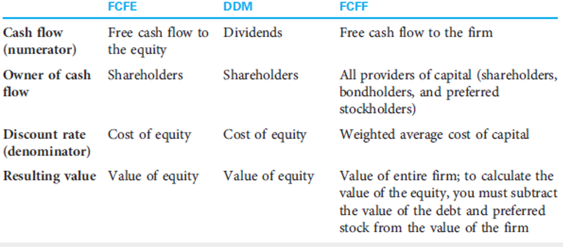
8.2.1 The Foundations of Discounted Cash Flow Valuation

Slide 10
DDM Issues
Motivation
Dividends are cash flows from common stock.
Price is the present value of cash flows.
Thus, price of a common share should be the present value of its dividends
Some Problems
Dividends (especially far future ones) are not easily estimated.
Dividends can be manipulated.
Dividends may not represent available cash flow.

Slide 11
DDM Patterns
Constant/No Growth Model
Dividends remain constant
Constant Growth Model
Dividends grow at a constant rate
Mixed/Multistage Model
Dividends grow at different rates.

Slide 12
8.2.3 The No-Growth Model
Cash flows not growing
Special case of constant growth
Constant Perpetuity

Slide 13
8.2.2 The Constant Growth Model
The constant growth model
Gordon growth model
Treats cash flow as a growing perpetuity
Assumes k > g

Slide 14
Calculations
Value of the short term dividends is PV of the individual dividends.
2) Value of the long term dividends is a delayed growing perpetuity.
NOTE: It is a delayed growing perpetuity because the long term dividends do not begin until after the short term dividends end.
3) Stock price = PV_{short term} + PV_{long term}

Slide 15
Present Value of Growth Opportunities
Firm Value = Assets-in-Place + PVGO
The value of the firm equals the value of the assets already in place, the no-growth value of the firm...
Plus the NPV of its future investments, the present value of growth opportunities (PVGO).

Slide 16
2. Current Events: Financialization of the Economy

Slide 17
Distinction
Activity-centered view of economic change (Production)
versus
Accumulation-centered view of economic change (Profit)

Slide 18
Three Themes
Emergence of a new regime of accumulation
Ascendency of shareholder value orientation
Financialization of everyday life

Slide 19
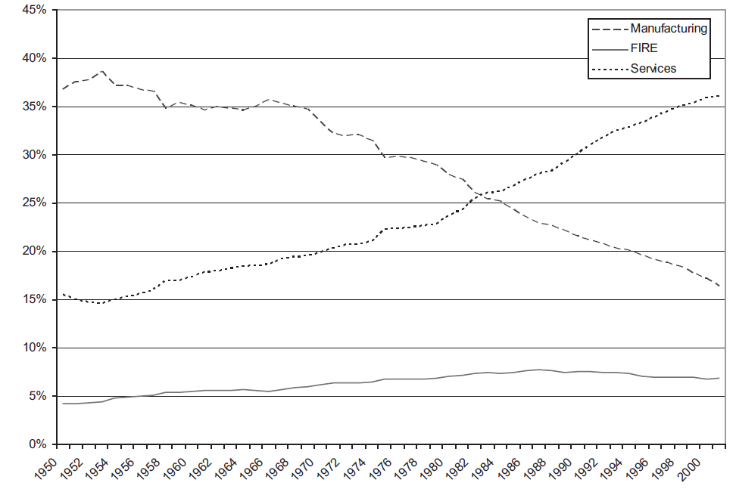
Relative industry shares of employment in US economy, 1950-2001
Krippner “The Financialization of the American Economy.”

Slide 20
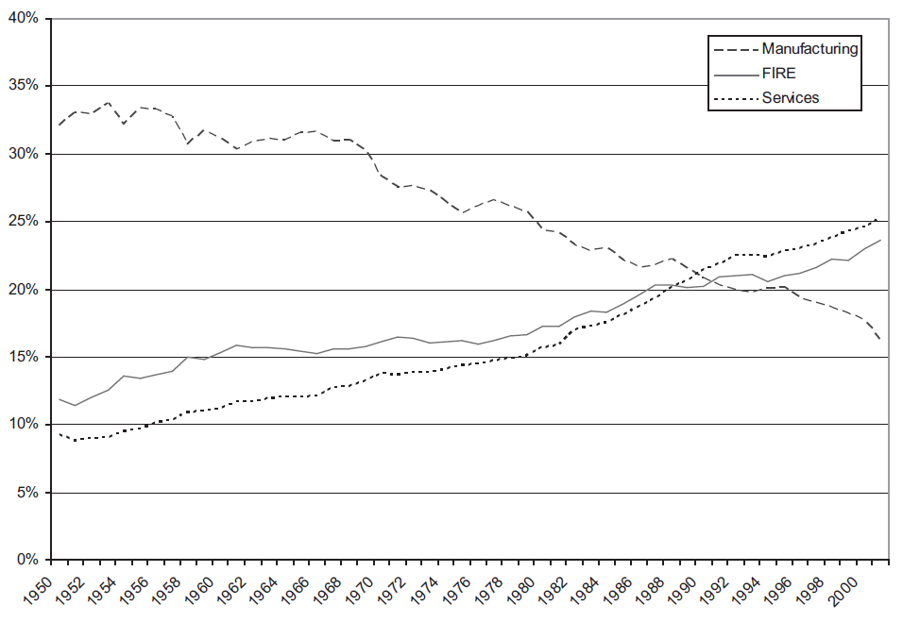
Relative industry shares of current-dollar GDP in US economy, 1950-2001
Krippner “The Financialization of the American Economy.”

Slide 21
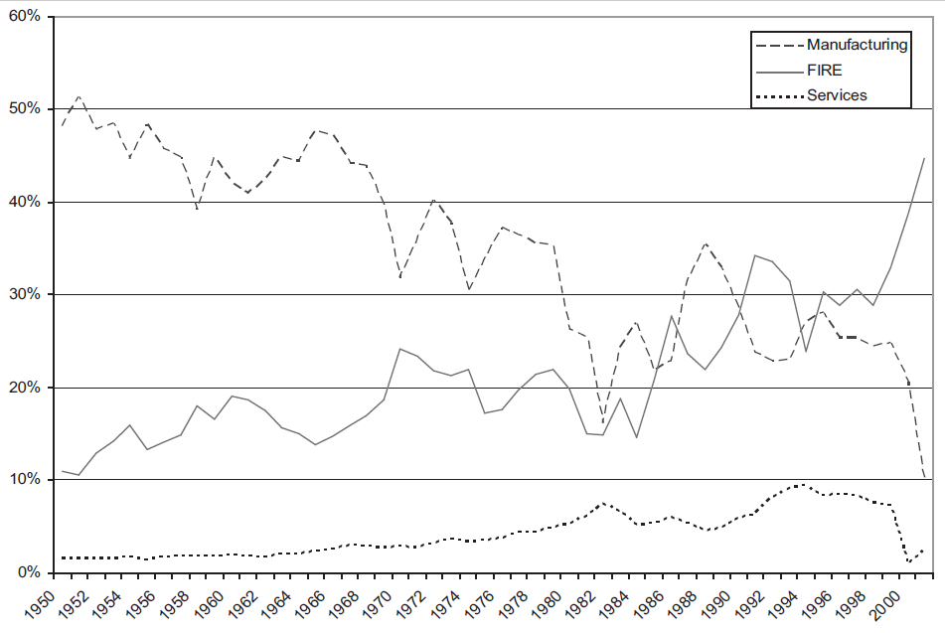
Relative industry shares of corporate profits in US economy, 1950-2001
Krippner “The Financialization of the American Economy.”

Slide 22
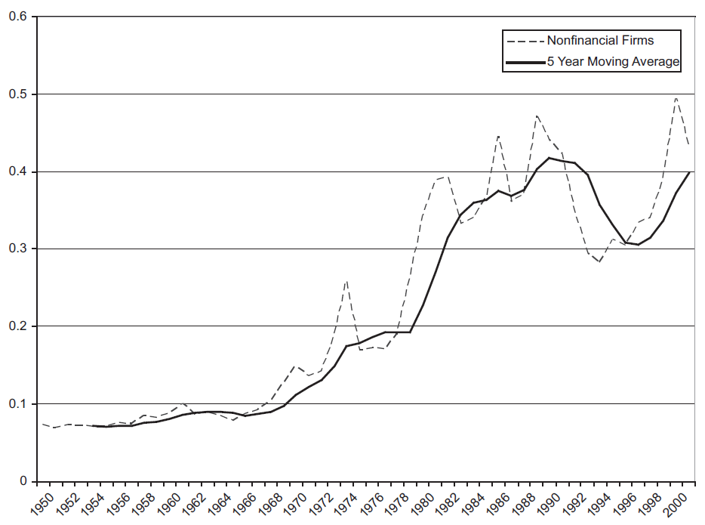
Ratio of portfolio income to cash flow for US non-financial corporations, 1950-2001
Krippner “The Financialization of the American Economy.”

Slide 23
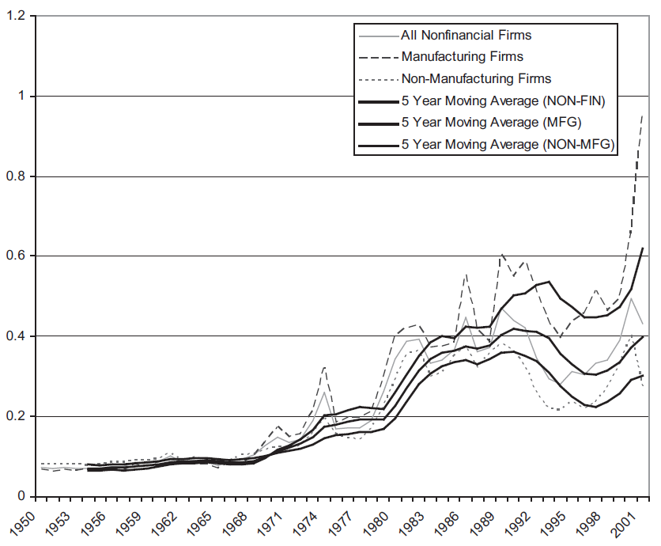
Ratio of portfolio income to cash flow for US manufacturing and non-manufacturing industries, 1950-2001
Krippner “The Financialization of the American Economy.”

Slide 24
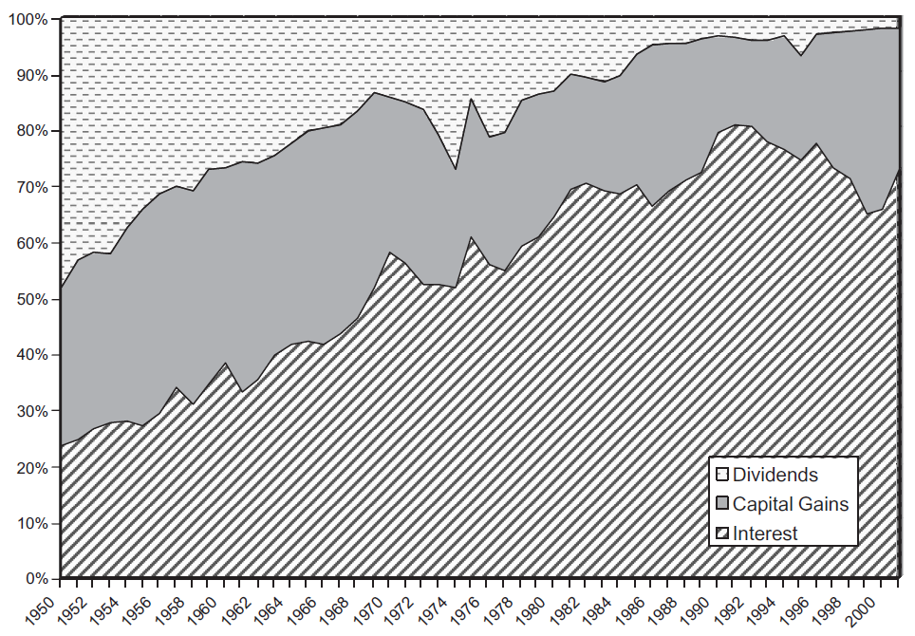
Share of total portfolio income accounted for by individual components for US non-financial corporations, 1950-2001
Krippner “The Financialization of the American Economy.”

Slide 25
Bibliography
Krippner, Greta R. “The Financialization of the American Economy.” Socio-Economic Review 3 (2005): 173‐208.
Davis, Gerald F. and Suntae Kim. “Financialization of the Economy.” Annual Review of Sociology 41 (2015): 203-221.
Foster, J. B. “The Financialization of Capitalism.” Monthly Review: An Independent Socialist Magazine 58 (2007): 1-14.
Krippner Greta R. Capitalizing on Crisis: The Political Origins of the Rise of Finance. Harvard, 2012
Tomaskovic-Devey, Donald and Ken-Hou Lin. “Income Dynamics, Economic Rents, and the Financialization of the U.S. Economy.” American Sociological Review 76.4 (2011): 538-559.
van der Zwan, Natascha. “Making Sense of Financialization.” Socio-Economic Review 12.1 (2014): 99-129.

Slide 26
3. Practice Problems

Slide 27
Practice Problem 1
What is the value of a stock that is expected to pay a constant dividend of $6.00/year, if the discount rate is 7%?

Slide 28
Practice Problem 2
What is the value of a stock that is expected to pay a dividend of $6.00 next year increasing at 3% forever, if the discount rate is 7%?

Slide 29
Practice Problem 3
What is the value of a stock that has just paid a dividend of $6.00 which is decreasing at 2% forever, if the discount rate is 7%?

Slide 30
Practice Problem 4
What level of dividend growth should we expect for a firm that has a dividend payout rate of 30% and a return on equity of 7%?

Slide 31
Practice Problem 5
A firm has a ROE of 19%. earnings are $4.00 of which $3.00 will be paid out in dividends. If the capitalization rate is 8%. What is the value of a share, assets in-place and PVGO?
1. Find the dividend growth rate:

Slide 32
Practice Problem 5 (cont’d)
A firm has a ROE of 19%. Earnings are $4.00 of which $3.00 will be paid out in dividends. If the capitalization rate is 8%. What is the value of a share, assets in-place and PVGO?
2. Find the price:

Slide 33
Practice Problem 5 (cont’d)
A firm has a ROE of 19%. Earnings are $4.00 of which $3.00 will be paid out in dividends. If the capitalization rate is 8%. What is the value of a share, assets-in-place and PVGO?
3. Find the value of assets-in-place:

Slide 34
Practice Problem 5 (cont’d)
A firm has a ROE of 19%. Earnings are $4.00 of which $3.00 will be paid out in dividends. If the capitalization rate is 8%. What is the value of a share, assets in-place and PVGO?
4. Find the value of PVGO:

Slide 35
4. Excel Skills

Slide 36
Histograms
Histograms

