Slide 1
FIN 377: Investments
Week 6: Introduction to Portfolio Management
Larry Schrenk, Instructor

Slide 2
Overview
Review and Questions
Current Events: The Power of Compounding
Practice Problems
Excel Skills: Project Criteria

Slide 3
1. Review and Questions

Slide 4
Key Ideas (Slides 4.1-89)
Some Background Assumptions
Markowitz Portfolio Theory
The Efficient Frontier
Capital Market Theory

Slide 5
2. Current Events The Power of Compounding

Slide 6
Who's the Better Investor?
John starts by investing $5,000 per year at age 20 but gets bored after just 10 years and doesn’t make any more contributions.
Sarah waits until she’s 30 but diligently invests $5,000 every year for the next 40 years.

Slide 7
Who's the Better Investor?
John’s total contribution:
$5,000 x 10 = $50,000
Sarah’s total contribution:
$5,000 x 40 = $200,000

Slide 8
Who's the Better Investor?
John contributes for only 10 years.
Sarah contributes for 40 years.

Slide 9
Who's the Better Investor???
John or Sarah

Slide 10
Who's the Better Investor?
At age 70 and with a 10% return,
Sarah has ???
But John has ???

Slide 11
Who's the Better Investor?

Slide 12
Other Rates of Return?
The higher the return, the better John does. As long as the average return is greater than about 7%, John will be the better investor.
Return | John | Sarah | Difference
7.00% | $1,034,469.09 | $998,175.56 | $36,293.53
9.00% | $2,386,005.56 | $1,689,412.23 | $696,593.33
11.00% | $5,434,725.43 | $2,909,130.33 | $2,525,595.10
13.00% | $12,229,014.37 | $5,068,521.22 | $7,160,493.15
15.00% | $18,262,481.24 | $6,710,125.49 | $11,552,355.74

Slide 13
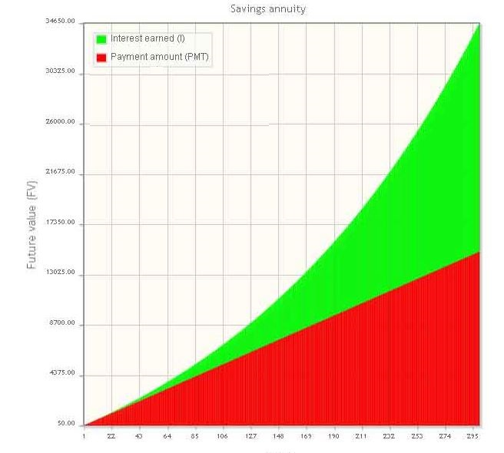
The Reasoning
Compounding causes your investment to increase geometrically,
So even a little more time can mean a lot more money.

Slide 14
3. Practice Problems

Slide 15
Practice Problem 1
Which of the following assets dominates another?
Portfolio | r | σ
A | 10% | 15%
B | 12% | 18%
C | 13% | 16%

Slide 16
Practice Problem 2
What is the expected return?
State | Probability | Return
A | 40% | 10%
B | 30% | 20%
C | 30% | 25%

Slide 17
Practice Problem 3
What is the expected return?
1 | 2 | 3
12% | 20% | 10%

Slide 18
Practice Problem 4
What is the variance and standard deviation?
1 | 2 | 3
12% | 20% | 10%

Slide 19
Practice Problem 5
Your portfolio contains the following assets.
What are the corresponding weights?
What are the weights of the risk free and risky assets?
What are the weights of debt and equity in the risky portfolio?
What are the weights of debt and equity in the total portfolio?
Asset | Investment
Risk Free Asset | $12,000
Debt | $22,000
Equity | $35,000

Slide 20
Practice Problem 6
Your portfolio contains one risk free and one risky asset. Find the expected return (as weighted average), variance, standard deviation, and expected return (using the CML equation).
Expected Return =
Standard Deviation =
Variance =
Expected Return =
Asset | r | σ | weight
Risk Free | 3% | 0% | 20%
Risky (m) | 7% | 10% | 80%

Slide 21
Practice Problem 7
Your portfolio contains two risky assets. Find the expected return, variance, and standard deviation.
Expected Return =
Variance =
Standard Deviation =
Asset | r | σ | weight | ρ
A | 8% | 11% | 40% | 0.7
B | 12% | 15% | 60%

Slide 22
Practice Problem 8
What is the standard deviation of the portfolio if there is no diversification (ρ = 1)?
Asset | r | σ | weight
A | 10% | 18% | 30%
B | 15% | 20% | 70%

Slide 23
Practice Problem 10
Suppose you have a riskless security at 2% and a market portfolio with a return of 12% and a standard deviation of 15%. How should you go about investing your money so that your investment will have a risk level of 10%?
Return on risky portfolio:
Investment in the risk-free security:

Slide 24
4. Excel Skills

