Slide 1
FIN 377: Investments
Week 3: The Investment Setting III
Larry Schrenk, Instructor

Slide 2
Overview
Review and Questions
Current Events
Practice Problems
Excel Skills: Basic Math

Slide 3
1. Review and Questions

Slide 4
Key Ideas (Slides 1.71-127)
Decomposition of Return
Inflation; Real vs. Noninal Values
Risk Premium
Analysis of Risk
Market vs. Non-Market
Security Market Line (SML)
Financial Ethics

Slide 5
Real versus Nominal
Nominal Values
‘Money of the Day’
Not Adjusted for Inflation
The Dollar Value You Actually Pay
Real Values
Adjusted for Inflation
‘Current’ Dollars/Today’s Dollars
Constant Consumption Value

Slide 6
1.3.4 Risk Premium and Portfolio Theory
From portfolio theory, relevant risk measure for an asset is its co-movement with the market portfolio
Systematic risk relates the variance of the investment to the variance of the market
Unsystematic risk is due to the asset’s unique features

Slide 7
1.3.4 Risk Premium and Portfolio Theory
Risk premium for an individual asset is a function of the asset’s systematic risk
The measure of an asset’s systematic risk is its beta (β).

Slide 8
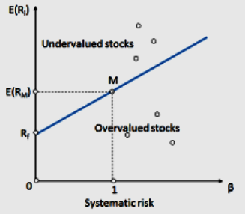
Security Market Line (SML)

Slide 9
1.4 Changes in the SML
Individual investments can change position
Due to changes in perceived risk
Slope of the SML can change
Due to a change in the risk attitudes of investors
SML can have parallel shift
Due to a change in the RRFR or the expected rate of inflation

Slide 10
Challenges to Ethical Conduct
Ethical infrastructure
Situational influences shape our thinking, decision making, and behavior
Behavioral finance/ethics

Slide 11
The Code of Ethics
■ Act with integrity…
■ Place the integrity of the investment profession and the interests of clients above their own personal interests.
■ Use reasonable care and exercise independent professional judgment…
■ Practice and encourage others to practice in a professional and ethical manner…
■ Promote the integrity and viability of the global capital markets…
■ Maintain and improve their professional competence…

Slide 12
2. Current Events An Especially Interesting Index

Slide 13
The CBOE VIX Index
Chicago Board Options Exchange (CBOE)
Real-time market index of 30-day forward-looking volatility.
Derived from the S&P 500 index options
"Fear Gauge" or "Fear Index.“
Investopedia

Slide 14
Digression: What Does ‘Implied’ Mean?
Value of unobserved variable implied by a model and a market price
Assumptions/Inputs:
Model Equation
Market Value
Output:
Value of an Unobserved Variable

Slide 15
Example: Implied
A perpetuity that pays $10 annually currently sells for $100.
Model: Price = CF/r
Market Price: $100
Rearrange equation:
r = CF/Price = 100/10 = 10%
‘Implied’ discount rate is 10%

Slide 16
‘Implied’ Volatility
Black-Scholes Equation
Price Volatility

Slide 17
The CBOE VIX Index
Real-time market index of
Implied volatility
Derived from 30-day calls and puts
On the S&P 500 index
That is, the 30-day implied volatility of the S&P 500 index

Slide 18
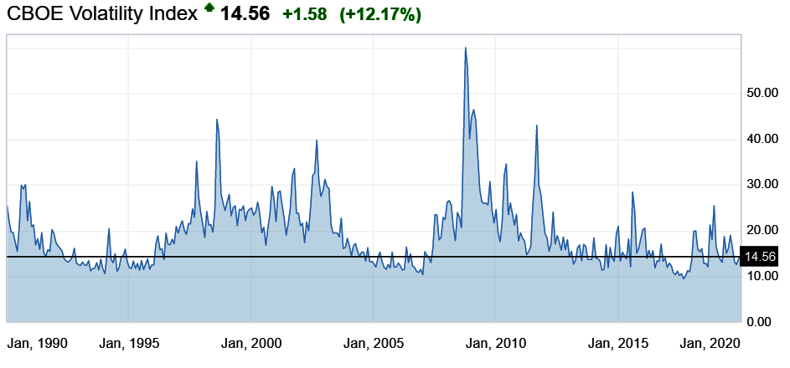
VIX 1990-Jan. 2020

Slide 19
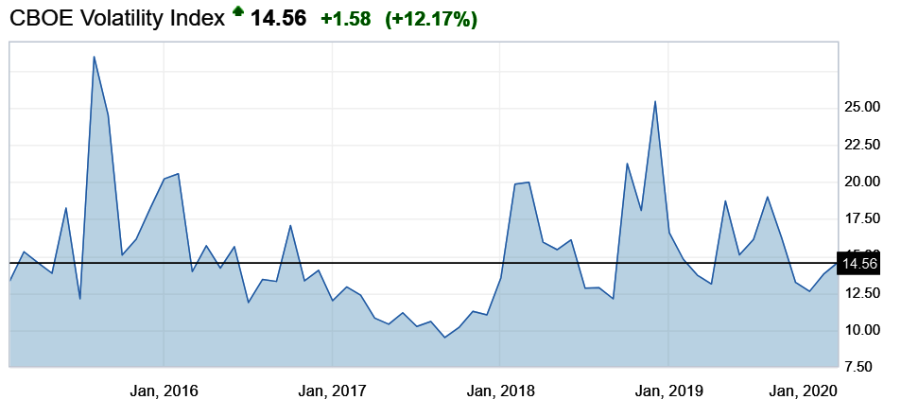
VIX 2015-Jan. 2020

Slide 20
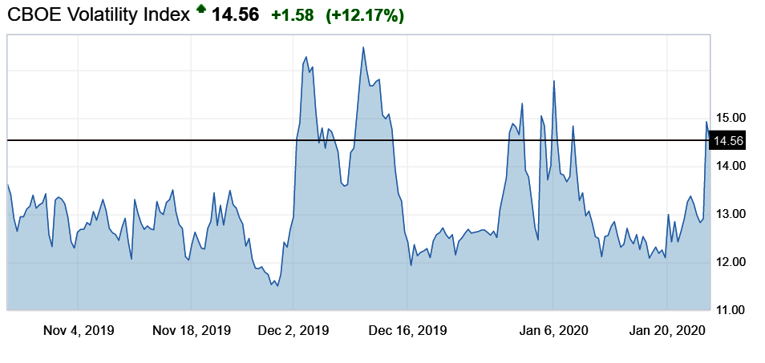
VIX Nov. 2019-Jan. 2020

Slide 21
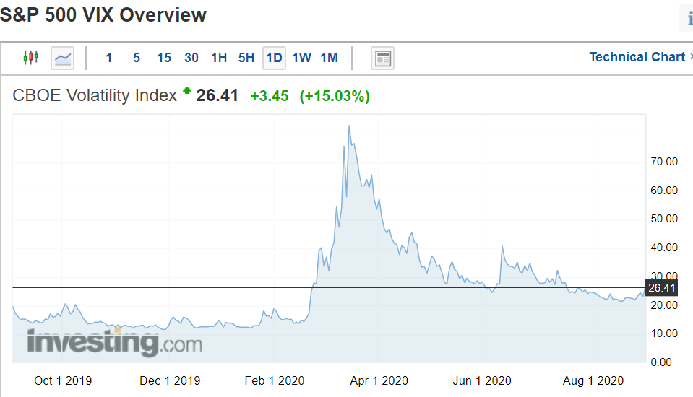
VIX Oct. 2019-Aug. 2020

Slide 22
Current VIX
CBOE Volatility Index (VIX)

Slide 23
Other Volatility Indices
CBOE S&P 100 Volatility Index (VXO)
CBOE /CBOT 10-year U.S. Treasury Note Volatility Index (TYVIX)
CBOE /CME FX Yen Volatility Index (JYVIX)

Slide 24
Volatility Strategy Indices
Cboe VIX Premium Strategy Index (VPD)
Tracks the performance of a strategy that systematically sells 1-month VIX futures
Cboe Capped VIX Premium Strategy Index (VPN)
Tracks the performance of a strategy that systematically sells 1-month VIX futures, capped by the purchase of a VIX call option.

Slide 25
The CBOE VVIX Index
The VIX of the VIX
Expected volatility of the 30-day forward price of the VIX
Index of the volatility of the volatility of the S&P 500

Slide 26
Beyond Volatility
CBOE SKEW Index
CBOE S&P 500 Implied Correlation Index

Slide 27
3. Practice Problems

Slide 28
Important Note
These practice problems are not exhaustive−that is, there may be types of problems on the exam beyond those shown here.

Slide 29
Practice Problem 1
Which stock would you choose from each pair?
 | R | σ
A | 9% | 12%
B | 10% | 10%
 | R | σ
E | 14% | 15%
F | 12% | 17%
 | R | σ
C | 11% | 12%
D | 13% | 15%
 | R | σ
G | 11% | 20%
H | 14% | 25%

Slide 30
Practice Problem 2
Which stocks are dominated?
B
D
A
Return
E
C
F
σ

Slide 31
Practice Problem 3
What is the real rate of return, if the nominal rate is 8% and inflation is 3%?

Slide 32
Practice Problem 4
What is the real value of $150 in ten years if inflation is 3%?

Slide 33
Practice Problem 5
What is the rate of inflation if a real value is $150 in five years and a nominal value $180?

Slide 34
Practice Problem 6
Discount the annual, real cash flows (r_{n} = 10%; i = 3%): 17.00 25.00 13.00

Slide 35
4. Excel Skills

Slide 36
Basic Math
SUM
SQRT
POWER
EXP
LN
ABS
SIGN
‘-A’
COUNT, COUNTA

