Slide 1
FIN 360: Corporate Finance
Topic 8: Risk and Return II
Larry Schrenk, Instructor

Slide 2
Topics
Diversification
Mathematics of Diversification
Standard Deviation and Variance as Risk Measures
Measurement of Market Risk
The Capital Asset Pricing Model (CAPM)
Project: CAPM

Slide 3
1. Diversification

Slide 4
Diversification: An Example
We bounce a rubber ball and record the height of each bounce.
  The average bounce height is very volatile
As we add more balls…
  Average bounce height less volatile.
  Greater heights ‘cancels’ smaller heights

Slide 5
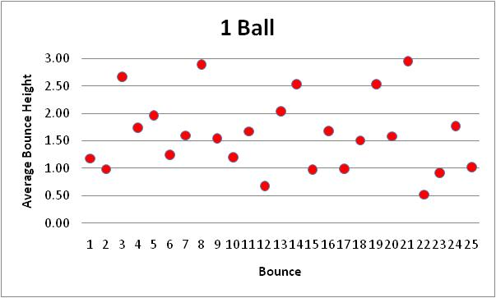
Average Bounce

Slide 6
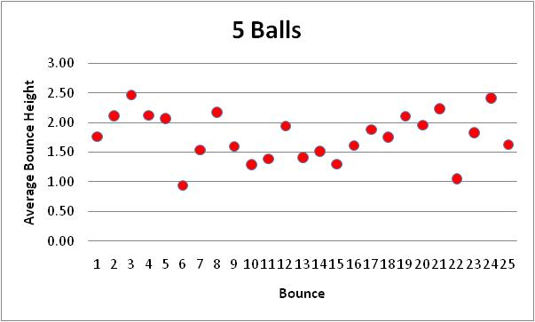
Average Bounce

Slide 7
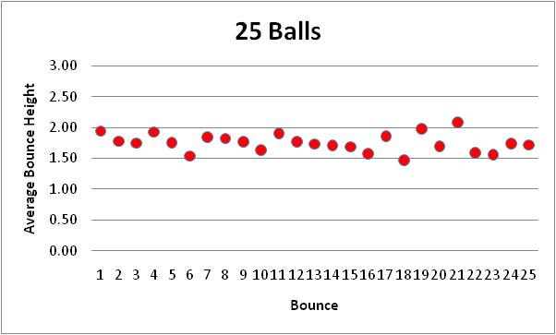
Average Bounce

Slide 8
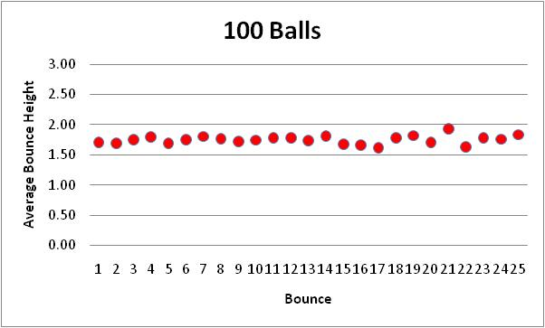
Average Bounce

Slide 9
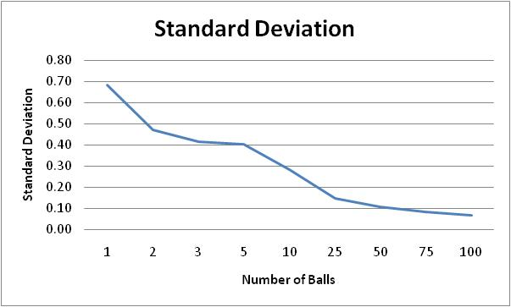
Bouncing Ball Standard Deviation

Slide 10
Diversification: An Analogy
‘Cancellation’ effect = diversification
Hold one stock and record daily return
  The return is very volatile.
As we add more stock…
  Average return less volatile
  Larger returns ‘cancels’ smaller returns

Slide 11
Diversification: The Dis-Analogy
Stocks are not identical to balls.
Drop more balls, volatility will
  Eventually go to zero.
Add more stocks, volatility will
  Decrease, but
  Level out at a point well above zero.

Slide 12
Stock Diversification
Key Idea: No matter how many stocks in my portfolio, the volatility will not get to zero!

Slide 13
What Different about Stocks?
As I start adding stocks
The non-market risks of some stocks cancel the non-market risks of other stocks.
The volatility begins to go down.

Slide 14
What Different about Stocks?
At some point, all non-market risks cancel each other.
But there is still market risk!
But volatility can never reach zero.
Diversification cannot reduce market risk.

Slide 15
Diversification and Market Risk
Market risk
  Impact on all firms in the market
  No cancellation effect
Example:
  Government doubles the corporate tax
  All firms worse off
  Holding many different stocks would not help.
Diversification can eliminate my portfolio’s exposure to non-markets risks, but not the exposure to market risk.

Slide 16
What Happens in Stock Diversification?▪
Non-Market Risk
Volatility of Portfolio
Market Risk
Number of Stocks

Slide 17
T-P-S
If an investor buys enough stocks, he or she can, through diversification, eliminate all of the market risk inherent in owning stocks, but as a general rule it will not be possible to eliminate all diversifiable risk.
True
False

Slide 18
Diversification Example
Five Companies
  Ford (F)
  Walt Disney (DIS)
  IBM
  Marriott International (MAR)
  Wal-Mart (WMT)

Slide 19
Diversification Example (cont’d)
Five Equally Weighted Portfolios
Portfolio Equal Value in…
F Ford
F,D Ford, Disney
F,D,I, Ford, Disney, IBM
F,D,I,M Ford, Disney, IBM, Marriott
F,D,I,M,W Ford, Disney, IBM, Marriott, Wal-Mart
Minimum Variance Portfolio (MVP)

Slide 20
Individual Returns

Slide 21
F Portfolio

Slide 22
F,D Portfolio

Slide 23
F,D,I Portfolio

Slide 24
F,D,I,M Portfolio

Slide 25
F,D,I,M,W Portfolio

Slide 26
F,D,I,M,W versus F Portfolio

Slide 27
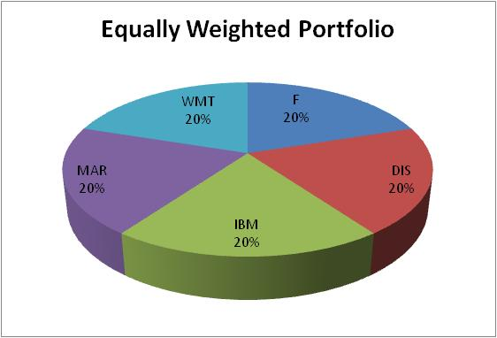
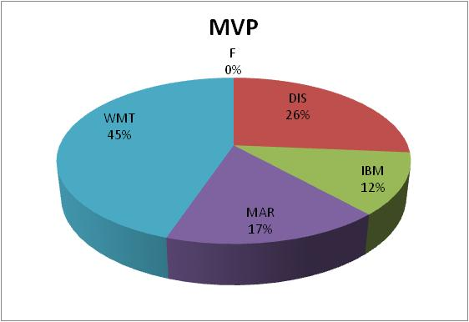
Equally Weighted versus MVP

Slide 28
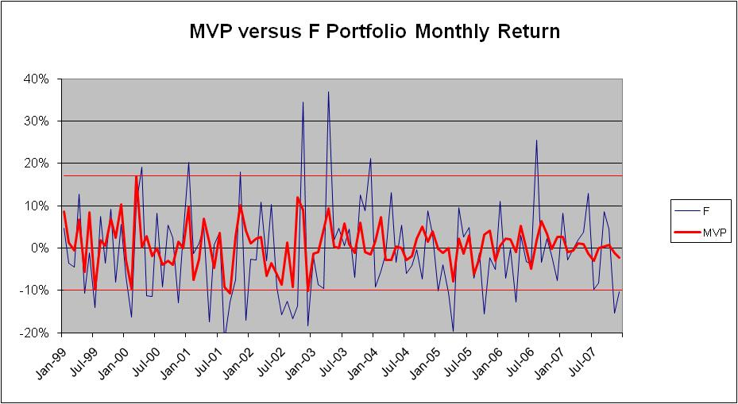
MVP versus F Portfolio

Slide 29
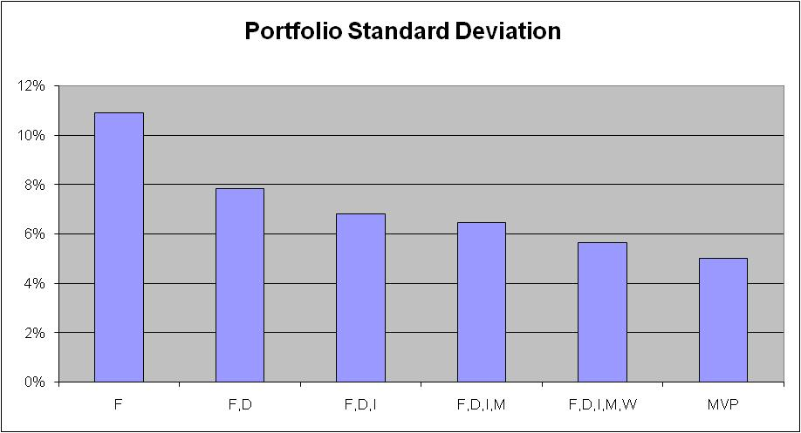
Decreasing Risk

Slide 30
A Well-Diversified Portfolio
‘Well-diversified’ portfolio
  Non-market risks eliminated by diversification
Assumption: All investors hold well-diversified portfolios.
  Index funds
    S&P 500
    Russell 2000
    Wilshire 5000

Slide 31
Implications
If investors hold well-diversified portfolios…
  Ignore non-market risk
  No compensation for non-market risk
  Only concern is market risk
Risk Identification.
  If you hold a well diversified portfolio, then your only exposure is to market risk.
  Risk Analysis, Step 1 Revised

Slide 32
Risk Analysis: Summary
Risk Exposure: Market Risk
  Not Return Volatility/Total Risk
Risk Measure: Standard Deviation???
Risk Price: ???

Slide 33
2. Mathematics of Diversification

Slide 34
Mathematics of Diversification
Current Diversification Strategy
  Randomly add more stocks to portfolio.
Better Method?
  What would make a stock better at lowering the volatility of our portfolio?
Answer: Low Correlation

Slide 35
Efficient Diversification
Optimal Diversification Strategy
  Max diversification with min stocks
  Add the stock least correlated with portfolio.
The lower the correlation, the more effective the diversification.

Slide 36
Two Asset Portfolio: Return
Return of a Two Asset Portfolio:
Returns are weighted averages.

Slide 37
Two Asset Portfolio: Risk
Variance of a Two Asset Portfolio:
Variance increases and decreases with correlation.
  Notes:
  Remember -1 < ρ < 1
  Be careful not to confuse σ² and σ.

Slide 38
Two Asset Portfolio: Example
Asset | Return | σ | Weight | ρ
A | 7% | 19% | 80% | 0.8
B | 11% | 22% | 20%
NOTE: σ_{p} < σ_{A} and σ_{p} < σ_{B}

Slide 39
Two Asset Portfolio: Example▪
r
A
ρ = 1
ρ = 0.2
ρ = −0.1
ρ = −1
B
σ

Slide 40
3. Standard Deviation and Variance as Risk Measures

Slide 41
Failure of Standard Deviation
Risk exposure: Only market risk.
Problem: standard deviation and variance do not measure market risk.
  They measure total risk, i.e., the effects of market risk and non-market risks.

Slide 42
Example
If I hold a stock with a standard deviation of 20%, would I get more diversification by adding a stock with a standard deviation of 10% or 30%?
If I added two stocks each with a standard deviation of 25%, the standard deviation of the portfolio could be anywhere from 25% to 0%–depending on the correlation.
  If ρ = 1, σ = 25%
  If ρ = -1, σ = 0% (with the optimal weights)

Slide 43
Standard Deviation and Stock Risk
Standard deviation tells nothing about…
  Stock’s diversification effect on a portfolio; or
  Whether including that stock will increase or decrease the exposure to market risk.
Thus, standard deviation (and variance)
  Not a correct measure of market risk, and
  Cannot be used as our measure of risk in the analysis of stocks.

Slide 44
Risk Analysis: Recap
Risk Exposure: Market Risk
  Not Return Volatility/Total Risk
Risk Measure: ???
  Not Standard Deviation/Variance
Risk Price: ???

Slide 45
4. Measurement of Market Risk

Slide 46
Beta: Measure of Market Risk
Standard deviation failed
  We need a new measure.
Beta (β)
Beta measures
  Sensitivity of changes in the return of an asset to changes in the market.

Slide 47
Risk Analysis: Recap
Risk Exposure: Market Risk
  Not Return Volatility/Total Risk
Risk Measure: Beta (β)
  Not Standard Deviation/Variance
Risk Price: ???

Slide 48
Question
Measuring of Market Risk
If the market were to go up by 10%, how much would a particular stock approximately change?

Slide 49
Beta
Measures average change in return to changes in the market
Sensitivity of stock return to market return
‘Multiplier’
Correct approach to step two: Measure risk.

Slide 50
Possible Betas
β >1
Market (β =1)
β < 1

Slide 51
β = 1
Return moves with the market
Same sensitivity to market risk as the market as a whole
Average sensitivity to market risk
Implication
  Stock return = market return
  Stock return = average return on market

Slide 52
β > 1
Return moves more than the market
Greater sensitivity to market risk than the market as a whole
High sensitivity to market risk
Implication
  Stock return > market return
  Stock return > average return on market

Slide 53
β < 1
Return moves less than the market
Less sensitivity to market risk than the market as a whole.
Low sensitivity to market risk
Implication
  Stock return < market return
  Stock return < average return on market

Slide 54
Two Known Betas
The market portfolio has beta of 1
  β_{M} = 1
  The market moves with itself
Risk free assets have a beta of 0
  β_{rf} = 0
  Risk free ⇒ return is pre-determined
  Pre-determined ⇒ not sensitive to changes in the market

Slide 55
Beta Examples
IBM 0.76
Wal-Mart 0.20
Disney 1.15
Harley-Davidson 2.33
Xcel Energy 0.13
Dell 1.35
Microsoft 0.98

Slide 56
Beta from Linear Regression
Independent variable: Market return
Dependent variable: Stock return
Slope: Beta

Slide 57
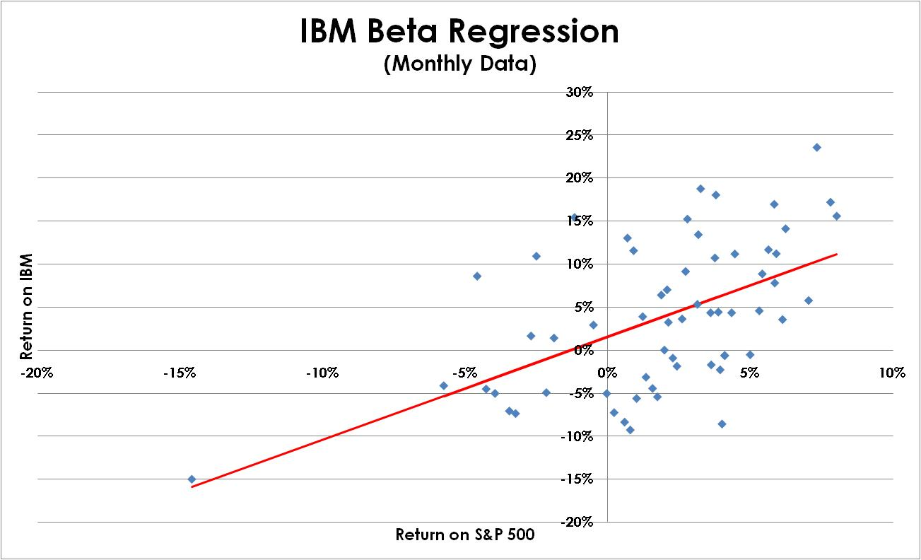
Linear Regression: Example
Slope = β

Slide 58
Linear Regression: Example
Intercept 0.02
Coefficient (Beta) 1.20
R² 0.30
Standard Error 0.07

Slide 59
Beta Formula
There is also a formula for beta:

Slide 60
5. The Capital Asset Pricing Model (CAPM)

Slide 61
The Capital Asset Pricing Model
Risk Analysis: Steps 1 & 2 Complete
  Identify Risk: Market Risk
  Measure Risk: Beta
Step 3: Price Risk
  What return should an investor expect from a stock with a beta of 0.9?

Slide 62
Security Market Line
  Security Market Line (SML)
  Graphing the relationship between beta and return
Begin with the two points we know:
 | Return | Beta
Market | r_{M} | 1
Risk Free Asset | r_{f} | 0

Slide 63
Building the SML▪
We know two points.
Return
Where would we find portfolios that contain combinations of the risk free asset and the market?
Return
r_{M}
Market
r_{f}
Risk Free Asset
0
1
Beta

Slide 64
Using the SML▪
What would happen if there were a stock above the line?
SML
Return
Return
Market equilibrium forces all stocks to be on the line, which is called the Security Market Line (SML).
r_{M}
What would happen if there were a stock below the line?
r_{f}
0
1
Beta

Slide 65
The CAPM Equation
CAPM equation
  Formula for the SML
  Firm Data
    Beta
  Market Data
    The risk free rate
    The return on the market

Slide 66
CAPM Data
Beta
  Linear regression
  Firm stock return on market return (S&P 500)
Risk free rate
  Treasury security
  Maturity = CAPM time horizon
Return on the market
  Average return on a market portfolio (S&P 500)

Slide 67
The CAPM Equation: Examples
Use the following, to find the expected return:
    r_{f} = 4.5%
    r_{M} = 12.3%
  Find the expected return on the following three stocks:
    • β_{A} = 1.02
    • β_{B} = 0.89
    • β_{C} = 1.34

Slide 68
The CAPM Equation: Examples

Slide 69
Risk Analysis: Recap
Risk Exposure: Market Risk
  Not Return Volatility/Total Risk
Risk Measure: Beta (β)
  Not Standard Deviation/Variance
Risk Price: CAPM
  Done!

Slide 70
6. Project: CAPM

Slide 71
Project
Data already downloaded
Find the beta for the stock of your firm
  Linear regression: Firm versus S&P 500
Calculate the CAPM expected return

Slide 72
Excel: Linear Regression
Linear regression
  Best fit line
  beta (β) of a firm’s equity
Example
  Beta of MMM
  Independent variable (x-axis)
    S&P 500 as proxy for the market
  Dependent variable (y axis)
    Return on MMM

Slide 73
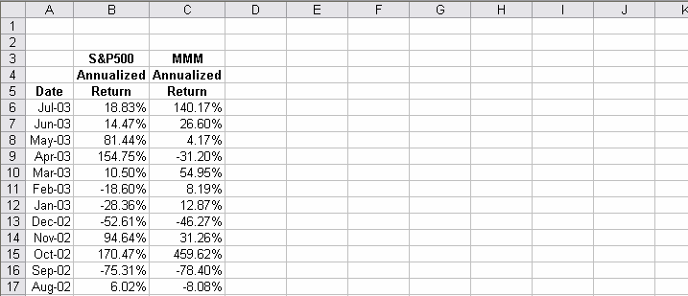
Excel: Linear Regression
1) Returns of the assets arranged in columns:

Slide 74
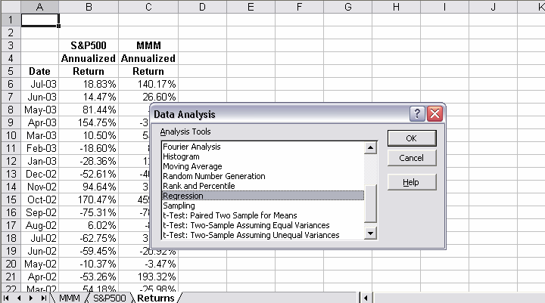
Excel: Linear Regression
2) Click on Data Analysis under the ‘Tools’ drop-down menu to open the Data Analysis window. Select ‘Regression’…

Slide 75
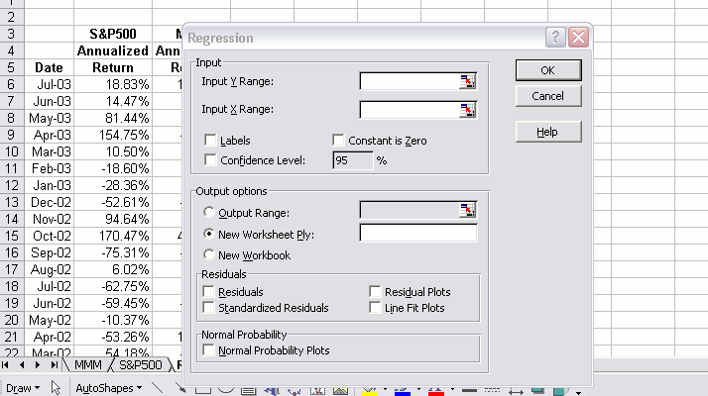
Excel: Linear Regression
3) Regression box opens

Slide 76
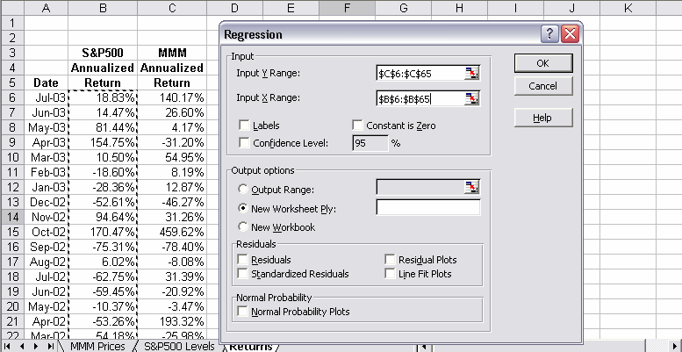
Excel: Linear Regression
4) Enter the cells for the y variable (MMM) and the x variable (S&P 500). Click on ‘Line Fit Plots’ box and ‘OK’.

Slide 77
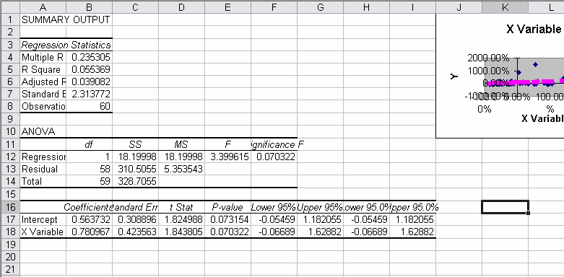
Excel: Linear Regression
5) A new worksheet will appear with the results and a graph.

Slide 78
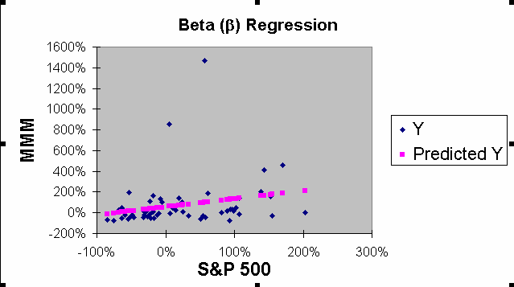
Excel: Linear Regression
6) Blue squares are data points and the pink the points on the best-fit line.

Slide 79
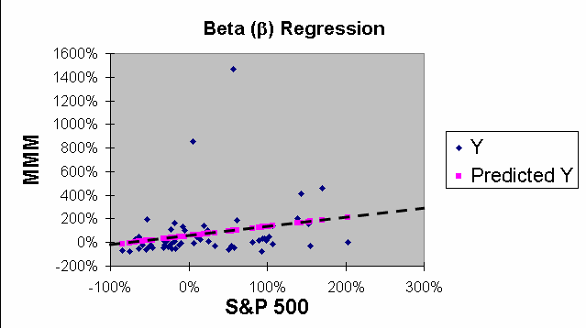
Excel: Linear Regression
7) Same graph with a dashed line drawn though the points.

Slide 80
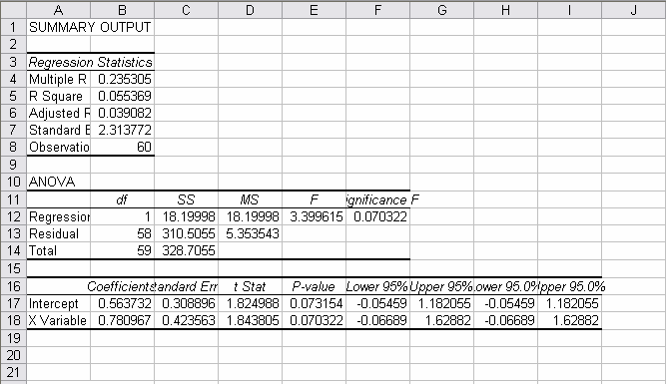
Excel Features: Linear Regression
8) Summary statistics: beta is the coefficient of the x variable.

