Slide 1
Video 16 (Topic 3.6): The Efficient Market Hypothesis (EMH)
FIN 614: Financial Management
Larry Schrenk, Instructor

Slide 2
Topics
What is an Efficient Market?
Levels of Efficiency
Weak Form
Semi-Strong Form
String Form
The Critique of the EMH

Slide 3
Efficient Market Hypothesis (EMH)
Asset prices (stock prices) reflect all available information
Markets adjust immediately to new information
Prices incorporate expectations about future
‘Informational’ Efficiency

Slide 4
Implications
Stock Market Efficiency
→ Stock prices already reflect all relevant, available information
→ Using the historical data to predict future prices will not work
→ Stock prices are close to a ‘random walk’
→ No trading strategy consistently beat the market

Slide 5
Three Forms of Market Efficiency
Weak Form
Past Prices
Random Walk
Semi-Strong Form
All Publicly Available Information
Strong Form
All Information Relevant to a Stock

Slide 6
Graph of the Three Forms ▪
Strong Form
All Information
Semi-Strong Form
Public Information
Weak Form
All Prices

Slide 7
Weak Form Efficiency
Prices fully reflect all security-market information
Historical prices, odd-lot trading.....
Rates of returns are independent over time
Past stock price patterns cannot be used to make extraordinary profits
Technical Analysis Contrary

Slide 8
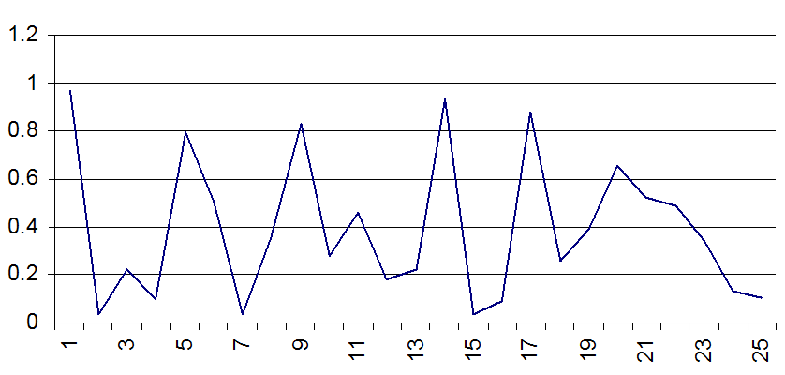
What is the Pattern?▪
Actually, these are randomly generated numbers!
They are a random walk!

Slide 9
Semi-Strong Market Efficiency
Prices fully reflect all public information
Earnings/dividends information, dividend yield....
Analyst's Reports
Corporate Publications
News Items
Fundamental Analysis Contrary

Slide 10
Strong Market Efficiency
Prices fully reflect all private and public information
Insider Information

Slide 11
Throwing Darts?
Could investors can throw darts to select stocks?
Almost True
But an investor must still decide the risk of a portfolio

Slide 12
Evidence for Efficient Markets
Investment analysts and mutual funds don't beat the market
Anticipated announcements don't affect stock price
Stock prices and exchange rates close to random walk
Technical analysis does not outperform market

Slide 13
Evidence against Efficient Markets (Anomalies)
Small-Firm Effect
January Effect
P/E Effect
Stock Price Over-Reaction
Excess Volatility
Bubbles
Behavioral Finance

Slide 14
Video 16 (Topic 3.6): The Efficient Market Hypothesis (EMH)
FIN 614: Financial Management
Larry Schrenk, Instructor

