Slide 1

FIN 365 Business Finance
Topic 8: Interest Rates
Larry Schrenk, Instructor

Slide 2
Today’s Outline
Inflation
Term Structure/Yield Curve
Theories of Term Structure
‘Implied’ Future Rates

Slide 3
Inflation

Slide 4
Inflation Basics
Rise in the general level of prices
Unit of currency buys less
Erosion in purchasing power
Measure–Annualized percentage change in a general price index (CPI)

Slide 5
Pro’s and Con’s
Benefits
  Borrowers
Costs
  Lenders
  Instability and planning uncertainty
  Discourage investment and saving
  Shortages and hoarding
Distinguish
  Expected versus Unexpected

Slide 6
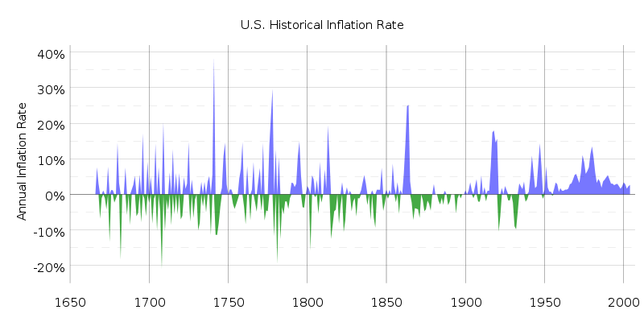
Inflation History

Slide 7
Inflation Example
You want to be a millionaire by age 50.
You save $546.23/month at 9%, so that you have $1,000,000 at the end of 30 years. ▪
You are technically a millionaire since you do have $1,000,000 in your investment account.
But, in today’s dollars, that million is only worth $301,795.87 if the inflation rate is 4%.
  ‘In Today’s Dollars’–$1,000,000 in 30 years will allow you to buy the same goods that $301,795.87 buys today.▪

Slide 8
Simple Example
A can of soda costs $1.00 today and $1.05 next year. What is the inflation rate?
At this rate of inflation, what will a can of soda cost in 5 years?

Slide 9
Simple Example with Calculator
At 5% inflation, what will a $1.00 can of soda cost in 5 years?
  Input 5, Press N (This is annual so N = 5)
  Input 5, Press I/Y
  Input 1, press +/-, press PV
  Press CPT, FV to get $1.28
Do you recognize this pattern? ▪
The following three questions are identical:
  At 5% inflation, what will a $1.00 can of soda cost in 5 years? $1.28
  At 5% growth, how tall will a 1 foot tree be in 5 years? 1.28 feet
  At a 5% interest rate, what will be the future value of $1.00 5 years? $1.28 ▪

Slide 10
Real versus Nominal Values

Slide 11
Real versus Nominal
Nominal Values
  ‘Money of the Day’
  Not Adjusted for Inflation
  The Dollar Value You Actually Pay
Real Values
  Adjusted for Inflation
  ‘Current’ Dollars/Today’s Dollars
  Constant Consumption Value

Slide 12
Real versus Nominal Values
Case 1:
  Twice as much money to spend
  Price double
  Nominal Change
Case 2:
  Twice as much money to spend
  Prices are unchanged
  Real Change
Case 3:
  Twice as much money to spend
  Prices increase, but less than double
  Mix of Nominal and Real Changes

Slide 13
Real versus Nominal CFs
Nominal Values
  On labels or in contracts
  Amount that we actually pay
Real Values
  Take out the effects of inflation

Slide 14
Real versus Nominal CFs
If inflation is 5% per year and the nominal cash flow in year two is $150.00, then the corresponding real cash flow is:
P/Y = 1; N = 2; I/Y = 5; PV = $136.05; PMT = 0; FV = -150

Slide 15
Real versus Nominal Rates
Real (r_{r}) and nominal (r_{n}) interest rates:
Note: There is an approximation formula, r_{n} = r_{r} + i , that should never be used.

Slide 16
Real versus Nominal Values
Discount the annual, nominal cash flows (r_{r} = 6%; i = 4%): 150.00 220.00 -120.00
  1) Convert the rate and discount, or

Slide 17
Real versus Nominal Values
  2) Discount the converted the cash flow.
  You are mathematically certain to get the same answer for both procedures!
  Simple Rule–Be Consistent. Discount
    Real Amounts with Real Rate
    Nominal Amounts with Nominal Rate

Slide 18
Calculator Mixed Stream CFs
‘Cash Flow Worksheet’
  TI BA II Plus
  CF, NPV (IRR Later)
  Construct cash flows, then operations.
  Frequencies
Buttons
  CF = Start Cash Flow Worksheet
  ⇓/⇑ = View Cash Flows and Frequencies

Slide 19
Calculator Example
What is the present value of the following annual cash flows: 200, -300, 1,200 (r = 18%)?
    Press CF, Input 0, Press Enter
    Press ⇓, Input 200, Press Enter
    Press ⇓, ⇓ (Default Frequency is 1)
    Press ⇓, Input 300, Press +/-, Press Enter
    Press ⇓, ⇓
    Press ⇓, Input 1200, Press Enter
    Press NPV, “I = “
    Input 18, Press Enter
    Press ⇓, CPT to get 684.39, i.e., $684.39

Slide 20
Other Calculators
  HP 10IIb is similar to TI BA II Plus
  TI-83/84
  Cash flow functions in menu items 7 and 8
  To find NPV: APPS, FINANCE, scroll down to 7: npv( and then press ENTER
      Rate = 18%
      CF0 = 0
      CO1 = 200, CO2 = -300, CO3 = 1200
      FO1 = 1, FO2 = 1, FO3 = 1
  npv( 18, 0, {200,-300,1200}, {1,1,1} and then press ENTER
  The screen should display NPV = 684.39.

Slide 21
The Term Structure of Interest Rates

Slide 22
Term Structure of Interest Rates
‘Term Structure of Interest Rates’
Graph
  Annual returns on bonds (Not HPR)
  Maturities
‘Yield Curve’.

Slide 23
Term Structure of Interest Rates
‘Yield Curve’
Variables
  Annual Returns on Bonds (Not HPR)
  Maturities (Not Time)

Slide 24
Term Structure of Interest Rates
Yield Curve Shape Theories:
  Pure Expectations Hypothesis
  Premiums: Liquidity, Maturity, Default
Yield Curve Shape
  Upward ⇒ normal yield curve.
  Downward ⇒ ‘inverted’ yield curve.

Slide 25
Pure Expectations Hypothesis
Yield curve function of expected inflation
Increase expected ⇒ LT > ST
Maturity risk premium for Treasuries is zero.
LT rates average of ST rates

Slide 26
‘Implied’ Future Interest Rates
Maturity | 1 | 2 | 3 | 4
Rate | 5.4 | 5.6 | 6.1 | 5.8
5.4%
5.6%
6.1%
5.8%

Slide 27
‘Implied’ Future Interest Rates
5.4%
5.6%
???
f_{n} = future interest rate
1.054(1+ f₂) = (1.056)²
f₂ = (1.056)² /1.054 – 1 = 5.8%
Future rate = Expected spot rate
No Arbitrage Pricing
Market forecast of future interest rates

Slide 28
‘Implied’ Future Interest Rates
General Formula

Slide 29
‘Implied’ Future Interest Rates
Maturity | 1 | 2 | 3 | 4
Rate | 5.4 | 5.6 | 6.1 | 5.8
f_{n} | 5.4 | 5.8 | 7.1 | 4.9

Slide 30
Premiums
Liquidity
Maturity
Default

