Slide 1

FIN 365 Business Finance
Topic 11: Risk and Return II
Larry Schrenk, Instructor

Slide 2
Topics
Diversification
Standard Deviation and Variance as Risk Measures

Slide 3
Diversification

Slide 4
Diversification: An Example
We bounce a rubber ball and record the height of each bounce.
  The average bounce height is very volatile
As we add more balls…
  Average bounce height less volatile.
  Greater heights ‘cancels’ smaller heights

Slide 5
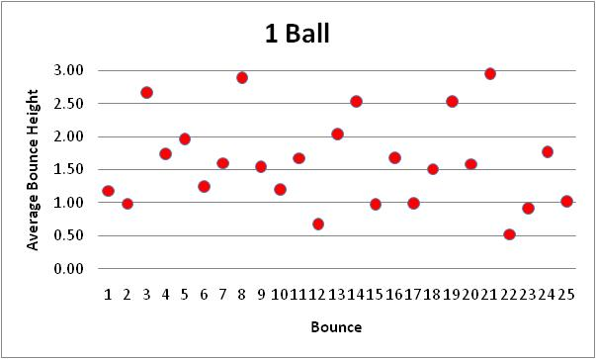
Average Bounce

Slide 6
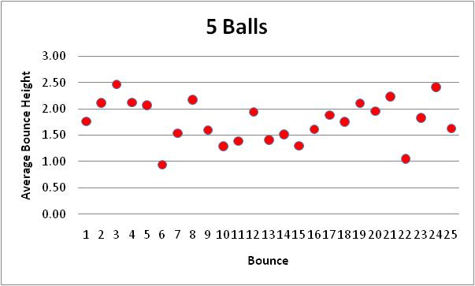
Average Bounce

Slide 7
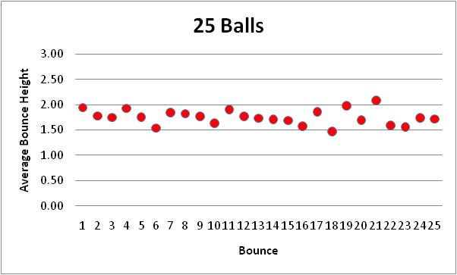
Average Bounce

Slide 8
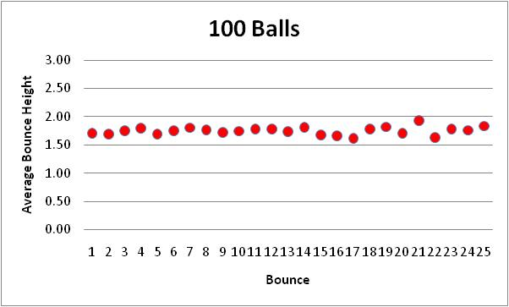
Average Bounce

Slide 9
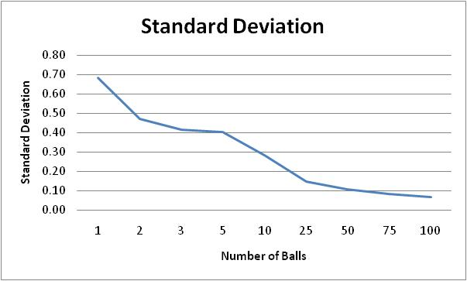
Bouncing Ball Standard Deviation

Slide 10
Diversification: An Analogy
‘Cancellation’ effect = diversification
Hold one stock and record daily return
  The return is very volatile.
As we add more stock…
  Average return less volatile
  Larger returns ‘cancels’ smaller returns

Slide 11
Diversification: The Dis-Analogy
Stocks are not identical to balls.
Drop more balls, volatility will
  Eventually go to zero.
Add more stocks, volatility will
  Decrease, but
  Level out at a point well above zero.
Key Idea: No matter how many stocks in my portfolio, the volatility will not get to zero.

Slide 12
What Different about Stocks?
As I start adding stocks
  The volatility begins to go down.
  The non-market risks of some stocks cancel the non-market risks of other stocks.
But volatility can never reach zero.
  At some point, all non-market risks cancel each other.
  But there is still market risk!
  Diversification cannot reduce market risk.

Slide 13
Diversification and Market Risk
Market risk
  Impact on all firms in the market
  No cancellation effect
  Example:
    Government doubles the corporate tax
    All firms worse off
    Holding many different stocks would not help.
Diversification can eliminate my portfolio’s exposure to non-markets risks, but not the exposure to market risk.

Slide 14
What Happens in Stock Diversification?▪
Non-Market Risk
Volatility of Portfolio
Market Risk
Number of Stocks

Slide 15
Diversification Example
Five Companies
  Ford (F)
  Walt Disney (DIS)
  IBM
  Marriott International (MAR)
  Wal-Mart (WMT)

Slide 16
Diversification Example (cont’d)
Five Equally Weighted Portfolios
Portfolio Equal Value in…
F Ford
F,D Ford, Disney
F,D,I, Ford, Disney, IBM
F,D,I,M Ford, Disney, IBM, Marriott
F,D,I,M,W Ford, Disney, IBM, Marriott, Wal-Mart
Minimum Variance Portfolio (MVP)

Slide 17
Individual Returns

Slide 18
F Portfolio

Slide 19
F,D Portfolio

Slide 20
F,D,I Portfolio

Slide 21
F,D,I,M Portfolio

Slide 22
F,D,I,M,W Portfolio

Slide 23
F,D,I,M,W versus F Portfolio

Slide 24
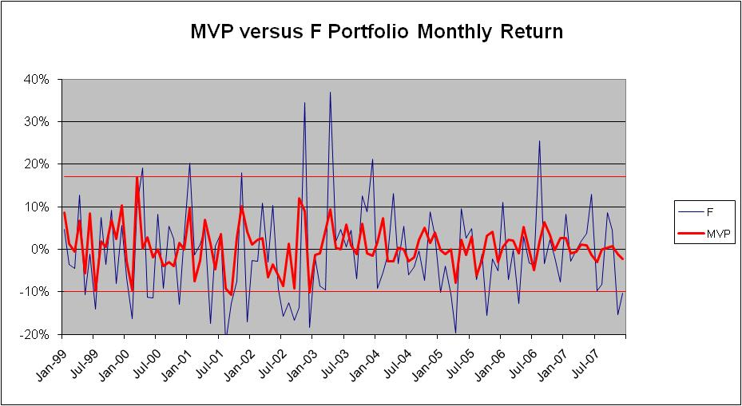
MVP versus F Portfolio

Slide 25
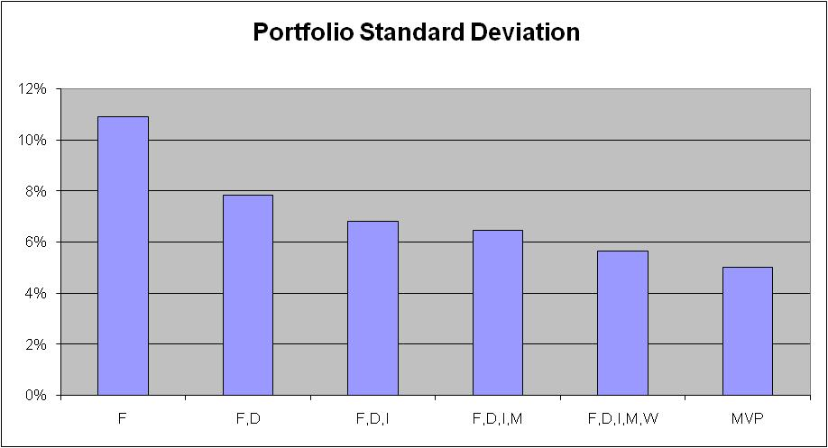
Decreasing Risk

Slide 26
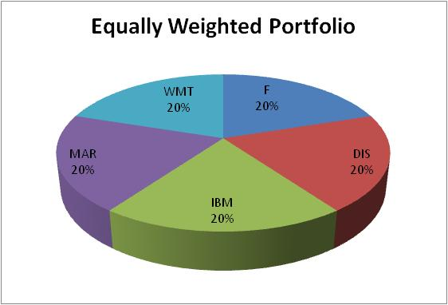
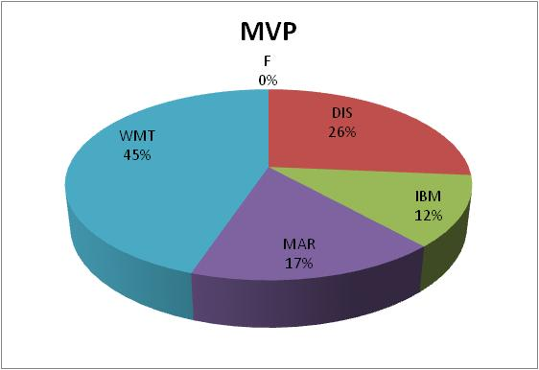
Equally Weighted versus MVP

Slide 27
A Well-Diversified Portfolio
‘Well-diversified’ portfolio
  Non-market risks eliminated by diversification
Assumption: All investors hold well-diversified portfolios.
  Index funds
    S&P 500
    Russell 2000
    Wilshire 5000

Slide 28
Implications
If investors hold well-diversified portfolios…
  Ignore non-market risk
  No compensation for non-market risk
  Only concern is market risk
Risk Identification.
  If you hold a well diversified portfolio, then your only exposure is to market risk.
  Risk Analysis, Step 1 Revised

Slide 29
Risk Analysis: Summary
Risk Exposure: Market Risk
  Not Return Volatility/Total Risk
Risk Measure: Standard Deviation???
Risk Price: ???

Slide 30
Mathematics of Diversification
Current Diversification Strategy
  Randomly add more stocks to portfolio.
Better Method?
  What would make a stock better at lowering the volatility of our portfolio?
Answer: Low Correlation

Slide 31
Efficient Diversification
Optimal Diversification Strategy
  Max diversification with min stocks
  Add the stock least correlated with portfolio.
The lower the correlation, the more effective the diversification.

Slide 32
Two Asset Portfolio: Return
Return of a Two Asset Portfolio:
Returns are weighted averages.

Slide 33
Two Asset Portfolio: Risk
Variance of a Two Asset Portfolio:
Variance increases and decreases with correlation.
  Notes:
  Remember -1 < ρ < 1
  Be careful not to confuse σ² and σ.

Slide 34
Two Asset Portfolio: Example
Asset | Return | σ | Weight | ρ
A | 7% | 19% | 80% | 0.8
B | 11% | 22% | 20%
NOTE: σ_{p} < σ_{A} and σ_{p} < σ_{B}

Slide 35
The Two Asset Portfolio
Standard deviation increases with correlation.
  w_{A} = 50%, σ_{A} = 20%; w_{B} = 50%, σ_{B} = 20%

Slide 36
Standard Deviation and Variance as Risk Measures

Slide 37
Failure of Standard Deviation
Risk exposure: Only market risk.
Problem: standard deviation and variance do not measure market risk.
  They measure total risk, i.e., the effects of market risk and non-market risks.

Slide 38
Example
If I hold a stock with a standard deviation of 20%, would I get more diversification by adding a stock with a standard deviation of 10% or 30%?
If I added two stocks each with a standard deviation of 25%, the standard deviation of the portfolio could be anywhere from 25% to 0%–depending on the correlation.
  If ρ = 1, σ = 25%
  If ρ = -1, σ = 0% (with the optimal weights)

Slide 39
Standard Deviation and Stock Risk
Standard deviation tells nothing about…
  Stock’s diversification effect on a portfolio; or
  Whether including that stock will increase or decrease the exposure to market risk.
Thus, standard deviation (and variance)
  Not a correct measure of market risk, and
  Cannot be used as our measure of risk in the analysis of stocks.

Slide 40
Risk Analysis: Recap
Risk Exposure: Market Risk
  Not Return Volatility/Total Risk
Risk Measure: ???
  Not Standard Deviation/Variance
Risk Price: ???

