Slide 1
Video 44 (Topic 8.5): Real Options I
FIN 614: Financial Management
Larry Schrenk, Instructor

Slide 2
Topics
Flaws in Discounted Cash Flow (DCF)
What are Real Options?
Types of Real Options

Slide 3
Discounted Cash Flow Flaws
Cannot properly capture flexibility to adapt and revise later decisions in response to unexpected market developments.
Assume an expected scenario of cash flows and presume passive commitment to a certain static operating strategy.

Slide 4
Discounted Cash Flow Flaws
Flexibility: Ability to defer, abandon, expand, or contract an investment.
Contingency: When future investments are contingent on the success of today’s investment.
Managers may make investments today–even those deemed to be NPV negative–to access future investment opportunities.

Slide 5
What is an Option?
An option gives the holder the right, but not the obligation to buy (call option) or sell (put option) a designated asset at a predetermined price (exercise price) on or before a fixed expiration date
Options have value because their terms allow the holder to profit from price moves in one direction without bearing (or, limiting) risk in the other direction.

Slide 6
What are Real Options?
Extension of financial options theory to options on real (non financial) assets
Contingent decisions
Give the opportunity to make a decision after you see how events unfold
Aligned with financial market valuations
If possible use financial market input and concepts

Slide 7
What are Real Options?
Financial option valuation techniques applied to capital budgeting decisions
Value flexibility
When managers can influence the size and risk of a project’s cash flows by taking different actions during the project’s life in response to changing market conditions
Project Value = Discounted Cash Flow (DCF) + Real Options

Slide 8
Real Options Graph
Contingent investment strategy
(EXPAND)
Project
Value
A
Fixed investment strategy
(DCF PLAN)
B
CURRENT
PROJECT
VALUE
Contingent investment strategy
(CLOSE)
PROJECT
START
TODAY
PROJECT
END
Time

Slide 9
Types of Real Options
Delay Options
Pharmaceuticals
Growth Options
R&D
Land
Oil Exploration
Software
Staged Investments; Expansion Options
Follow-On or Sequential Investments (M&A Program, Brands)
Contraction Options
Abandonment of Project or Division
Contract Scale or Temporarily Shut Down
Switching Options
Input or Output Mix Flexibility
Global Production Flexibility
Energy

Slide 10
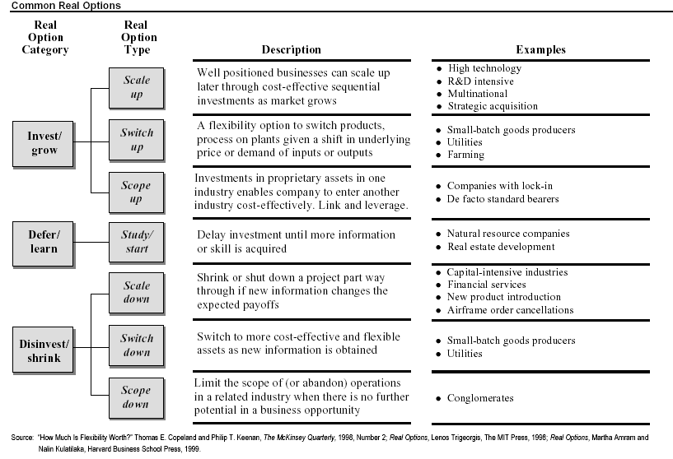
Types of Real Options

Slide 11
Video 44 (Topic 8.5): Real Options I
FIN 614: Financial Management
Larry Schrenk, Instructor

