Slide 1
FIN 470: Financial Analysis in Excel
Topic 8.2: Bond Valuation, Excel
Larry Schrenk, Instructor
The slides for this course are adapted from: Timothy R. Mayes, Financial Analysis with Microsoft Excel, 9th Edition. © 2021 Cengage. All Rights Reserved.

Slide 2
Overview
PV, PRICE, YIELD
DISC, YIELDDISC
DURATION, MDURATION
Date and Time Functions

Slide 3
1. PV, PRICE, YIELD

Slide 4
Two Excel Function Families
PV Family
PV(Rate, NPer, Pmt, Fv, Type)
PV
FV
RATE
NPER
PMT
PRICE Family
PRICE(Sett, Mat, Rate, Yld, Red, Freq, Basis)
PRICE
YIELD
DISC
YIELDDISC
DURATION
MDURATION

Slide 5
PV
PV Function
PV(Rate, NPer, Pmt, Fv, Type)
Value of a bond on a coupon payment date.
Inputs as before.
Price a 3 year semi-annual bond with a face value of $1,000 and a coupon rate of 8% if the discount rate is 10%.
PV(0.10/2, 2*3, (0.08*1000)/2, -1000) = 543.19

Slide 6
Excel PRICE Function
PRICE function returns clean price of a bond on any date
Settlement = Date on which ownership officially changes hands
Maturity = Maturity date of the bond
Rate = Annual coupon rate
Yld = Annual yield to maturity (required return)
Redemption = Maturity value as % of face value (typically 100)
Frequency = Frequency of coupon payments (usually 2)
Basis = Method by which days counted (day count basis)
Result is the clean price as % of face value of bond
94.5 would be 94.50% of the face value, typically $945
PRICE(Settlement, Maturity, Rate, Yld, Redemption, Frequency, Basis)

Slide 7
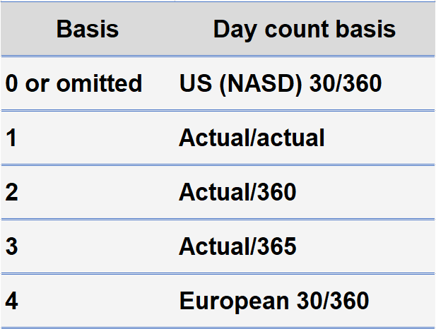
How Many Days in a Year?

Slide 8
PRICE
PRICE Function
PRICE(Settlement, Maturity, Rate, Yld, Redemption, Frequency, Basis)
Calculates clean price of a bond between coupon payment dates.
Dirty price = clean price + accrued interest
What is the price on 2/15/2008 of a semi-annual bond with a face/redemption value of $100 maturing on 11/15/2017? The annual coupon rate is 5.75% and the annual yield is 6.50%. (Use default day count basis, US (NASD) 30/360.)
PRICE(DATE(2008,2,15), DATE(2017,11,15), 0.0575, 0.065,100, 2) = 94.63

Slide 9
‘Rate’ Ambiguity in Bonds
In different functions, ‘Rate’ has different meanings in the context of bonds:
PV, FV, NPER, PMT (when used with bonds)
‘Rate’ = discount rate (‘for bonds the ‘yield’)
Pmt = Coupon payment, i.e., coupon rate x face value
PRICE, YIELD, DISC, YIELDDISC, DURATION, MDURATION(when used with bonds)
‘Rate’ = annual coupon rate (‘for bonds the ‘yield’)
Yld = Yield of the bond, i.e., discount rate

Slide 10
Yield
Yield Function
YIELD(Settlement, Maturity, Rate, Pr, Redemption, Frequency, Basis)
What is the yield on 2/15/2008 of a semi-annual bond with a face/redemption value of $100 maturing on 11/15/2017, if the market price is 94.63 and the annual yield is 6.50%. (Use default day count basis, US (NASD) 30/360.)
YIELD(DATE(2008,2,15), DATE(2017,11,15), 0.0575, 94.63,100, 2) = 0.065

Slide 11
2. DISC, YIELDDISC

Slide 12
DISC
DISC Function
DISC(Settlement, Maturity, Rate, Redemption, Basis)
Returns Bank Discount Rate (BDR).
What is the BDR on 2/15/2008 of a discount bond with a face/redemption value of $100 maturing on 11/15/2017, if the market price is 97.97? (Use day count basis, actual/actual, so basis = 1.)
DISC(DATE(2008,2,15), DATE(2017,11,15), 97.97,100, 1) = 0.0021

Slide 13
YIELDDISC
YIELDDISC Function
YIELDDISC(Settlement, Maturity, Pr, Redemption, Basis)
Returns Bond Equivalent Yield (BEY).
What is the BEY on 2/16/2008 of a discount bond with a face/redemption value of $100 maturing on 3/1/2008, if the market price is 99.975? (Use day count basis, Actual/360, so basis = 2.)
YIELDDISC(DATE(2008,2,16), DATE(2008,3,1), 99.975,100, 2) = 0.0064

Slide 14
3. DURATION, MDURATION

Slide 15
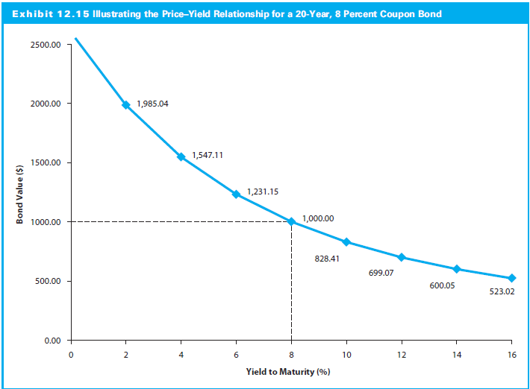
Bond Duration and Convexity
Convexity
Duration

Slide 16
DURATION
DURATION Function
DURATION(Settlement, Maturity, Coupon, Yld, Frequency, Basis)
Returns Macaulay Duration
On 2/15/2008, what is the (Macaulay) duration of a semi-annual bond with a face/redemption value of $100 maturing on 11/15/2017? The annual coupon rate is 5.75% and the annual yield is 6.50%. (Use default day count basis, US (NASD) 30/360.)
DURATION(DATE(2008,2,15), DATE(2017,11,15), 0.0575, 0.065, 2) = 7.42
NOTE: Same variables as PRICE

Slide 17
MDURATION
MDURATION Function
MDURATION(Settlement, Maturity, Coupon, Yld, Frequency, Basis)
Returns Modified Duration
On 2/15/2008, what is the modified duration of a semi-annual bond with a face/redemption value of $100 maturing on 11/15/2017? The annual coupon rate is 5.75% and the annual yield is 6.50%. (Use default day count basis, US (NASD) 30/360.)
MDURATION(DATE(2008,2,15), DATE(2017,11,15), 0.0575, 0.065, 2) = 7.18
NOTE: Same variables as PRICE

Slide 18
4. Date and Time Functions

Slide 19
Conventions: Dates
Creation of the World (in Excel)
January 1, 1900
DATE(1900,1,1) = 1
Dates as (integer) serial numbers
DATE(year,month,day)
DATE(1924,8,26) = 9005
9005 days since creation
DATE(2022,10,24) = 44858
44858 days since creation
DATE(1844,8,26) = 673747 ???
Long, long explanation
NOTE: Cell formatting important.

Slide 20
Conventions: Times
Times as (percentage) serial numbers; Percentage of day
TIME(hour, minute, second)
6:00 PM
TIME(18,0,0) = 0.75
6:00 PM is 75% into the day
6:07 PM
TIME(18,7,0) = 0.754861
6:07:30 PM
TIME(18,7,30) = 0.755521
7:00 PM June 16, 1957
DATE(1957,6,16) + TIME(19,0,0) = 20987.791667

Slide 21
Date Functions I
DATE(year,month,day) Returns serial number of a particular date
DATE(2022,10,24) = 44858
DATEVALUE(date_text) Converts date text to serial number
DATEVALUE("8/22/2011") = 407778
" " versus “ ” (curved or smart quotation marks)
DATEVALUE(“8/22/2011”) = Problem with Formula
DATEDIF(start_date,end_date,unit) Calculates days, months, or years between two dates
Unit: Y, M, D, etc.
DATEDIF("1/1/2010", "7/14/2022","Y") = 12

Slide 22
Date Functions II
TODAY() Returns serial number of today's date
TODAY() = 44858 (on 10/24/2022)
EDATE(start_date, months) Returns serial number of date a number of months before or after the start date
EDATE("1/1/2010",17) = 6/1/2011
WEEKDAY(serial_number,[return_type]) Converts serial number today of the week
WEEKDAY(44858) = 2 (Monday)
YEARFRAC(start_date, end_date, [basis]) Returns fraction of year between two dates
YEARFRAC("1/1/2010", "8/20/2010") = 0.6361

Slide 23
Time Functions
TIME(hour, minute, second) Returns serial number of a particular time
TIME(13, 14, 22) = 0.5516
TIMEVALUE(time_text) Converts time text to a serial number
TIMEVALUE("13:14:22") = 0.5516
HOUR(serial_number) Converts a serial number to an hour
HOUR(0.5516) = 13
NOW() Returns serial number of current date and time
NOW() = 44858.9226 (10/24/2022 22:08)

Slide 24
Times and Dates Codes
11:21:30 AM Wednesday, October 5, 2022
Typical Time/Date Codes
hh:mm:ss 11:21:30
dd/mm/yyyy 08/05/2022
Extended Time/Date Codes (Day Example)
d Date with Single Digit 5
dd Date with Double Digit 05
ddd Date Short Name Wed
dddd Date Short Name Wednesday

Slide 25
Formatting: TEXT Function
REMEMBER: “Number” Menu for manual formatting
TEXT(value, format_text) on 10:42:16 PM Monday, October 24, 2022
TEXT(NOW(),"MM/DD/YY") = 10/24/22
TEXT(NOW(),"MM/DD/YYYY") = 10/24/2022
TEXT(NOW(),"MM/DDD/YY") = 10/Mon/22
TEXT(NOW(),"DDDD") = Monday
TEXT(NOW(),"hh:mm:ss") = 22:42:16
TEXT(NOW(),"H:MM AM/PM") = 10:42 PM
TEXT(NOW()," MM/DD/YY H:MM AM/PM") = 10/24/22 10:42 PM
TEXT(1234.567,"$#,##0.00") = $1,234.57
TEXT(1234567898,"(###) ###-####") = (123) 456-7898

