Slide 1
FIN 470: Financial Analysis in Excel
Topic 8.1: Bond Valuation, Theory
Larry Schrenk, Instructor
The slides for this course are adapted from: Timothy R. Mayes, Financial Analysis with Microsoft Excel, 9th Edition. © 2021 Cengage. All Rights Reserved.

Slide 2
Overview
Bond Basics
Bond Pricing and Yields
Bond Sensitivities

Slide 3
1. Bond Basics

Slide 4
Fundamentals of Valuation
Intrinsic value of an asset is the present value of the expected future cash flows:
Three inputs:
Amount of expected future cash flows
Timing of expected future cash flows
Required rate of return
The value of the asset can be compared to its market price to determine whether the asset is over- or underpriced

Slide 5
Bond Cash Flows
Interest/Couon Payments
Annual Coupon = Coupon Rate x Face Value
Period Coupon: Divide by number of period in year
Fixed cash flow
Finaite cash flow
Annuity
Principal Repayment
Face Value repaid at terminus
Embedded Options
Adjust for call, conversion, etc. provisions

Slide 6
Discount Rate
Required rate of return
=r_{r} + E(i) + Risk Premium
Treasury yield proxies r_{r} + E(i)
Risk Premium:
Default Risk Premium: Higher yields higher with greater chance of default
Maturity Risk Premium: Typically, higher yields at longer maturities (inflation expectations)
Liquidity Risk Premium: Higher yields higher at longer maturities due to possible liquidity issues

Slide 7
Bond Terminology I
Discount Bond – Bond that is issued for less than its par value
Accrued Interest – Interest that has been incurred, but not yet been paid out
Dirty Price – Price of a bond including accrued interest
Actual value
What you would pay
Clean Price – Price of bond not including accrued interest
Quoted price
How bond dealers quote the price
Callable Bond – Bond the issuer may redeem prior to stated maturity
Make-Whole Call – Call in which investor receives a single payment for NPV of all future cash flows

Slide 8
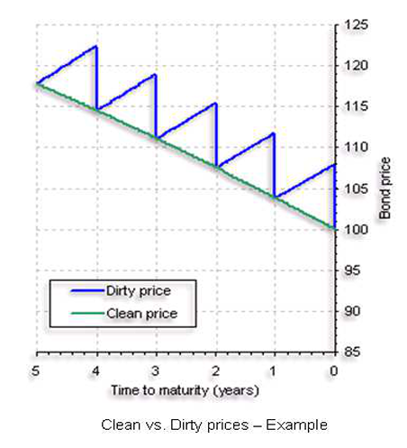
Clean vs. Dirty Price

Slide 9
Bond Terminology II
(Macauley) Duration – How many years to be repaid bond’s price by the its total cash flows
Modified Duration – Price change in a bond given a 1% change in interest rates
Convexity – Measure of the curvature in the relationship between bond prices and yields

Slide 10
2. Bond Pricing

Slide 11
Bond Value on a Payment Date
Like stock, the value of a bond is the present value of its cash flows
Constant interest payments (Pmt, annuity), typically, every six months
Face value (FV, lump sum) at maturity
Value of a bond on a coupon payment date:
Excel’s PV function
PV(Rate, NPer, Pmt, Fv, Type)

Slide 12
Dirty, Clean, Accrued Interest
Accrued interest – Interest that has been incurred, but not yet been paid out
Accrued interest does not compound between coupon dates; instead, interest accrues equally on each day.
Dirty prices include accrued interest.
Dirty price = previous price + capital gains + accrued Interest
Clean prices do not include accrued interest.
Clean price = previous price + capital gains + accrued interest
When a coupon has just been paid, dirty price = clean price

Slide 13
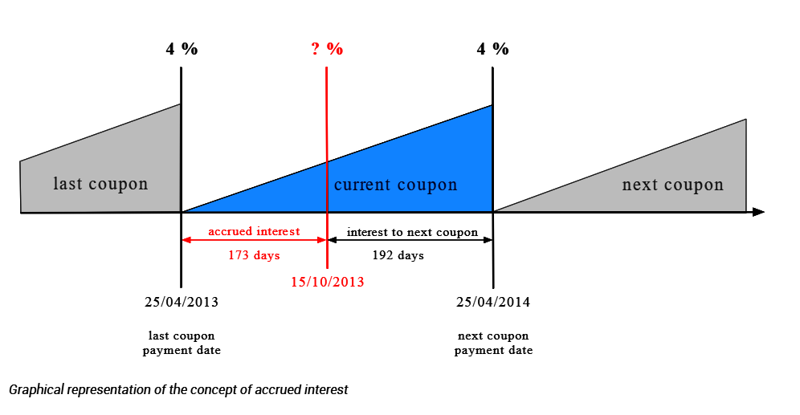
Accrued Interest

Slide 14
Bond Value between Coupon Dates
Three steps:
Value bond as of previous payment date using PV function, V_{B,0}.
Find FV as of the current date to get dirty price (includes accrued interest) where α is the fraction of the period that has elapsed:
Subtract accrued interest to get the clean price.
Clean price using Excel’s PRICE function:
PRICE(Settlement, Maturity, Rate, Yld, Redemption, Frequency, Basis)

Slide 15
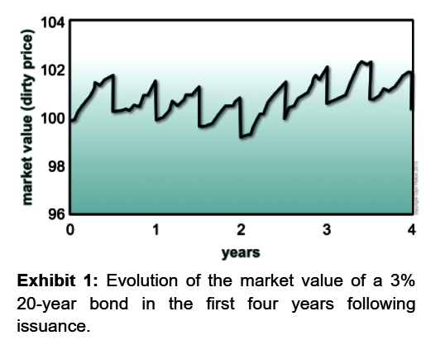
Bond Value between Coupon Dates

Slide 16
Excel PRICE Function
PRICE function returns clean price of a bond on any date
Settlement = Date on which ownership officially changes hands
Maturity = Maturity date of the bond
Rate = Annual coupon rate
Yld = Annual yield to maturity (required return)
Redemption = Maturity value as % of face value (typically 100)
Frequency = Frequency of coupon payments (usually 2)
Basis = Method by which days counted (day count basis)
Result is the clean price as % of face value of bond
94.5 would be 94.50% of the face value, typically $945.
PRICE(Settlement, Maturity, Rate, Yld, Redemption, Frequency, Basis)

Slide 17
Bond Return Measures
Current Yield – Annual coupon payment divided by price
Ignores capital gains/losses
Yield to Maturity – Compound average annual rate of return if held to maturity
Includes capital gains/losses
Calculated with the YIELD function (Works like PRICE function)
Yield to Call – Compound average annual rate of return if called prior to maturity
For traditional call, calculated using YIELD function
For make-whole call, calculated using YIELD function, where make-whole price (NPV of all future cash flows) used for Redemption value

Slide 18
Discounted Debt Securities I
Money market securities are short-term, high-quality, debt securities sold on a discounted basis
No coupon; instead, sold for less than face and face at maturity
Discount rate is interest rate used to determine the present value of future cash flows
Returns quoted on bank discount basis using Bank Discount Rate (BDR):
Use DISC function for BDR:
DISC(Settlement, Maturity, Pr, Redemption, Basis)

Slide 19
Discounted Debt Securities II
For comparison to interest bearing securities, calculate the bond equivalent yield (BEY):
Use YIELDDISC function for BEY:
YIELDDISC(Settlement, Maturity, Pr, Redemption, Basis)

Slide 20
3. Bond Sensitivities

Slide 21
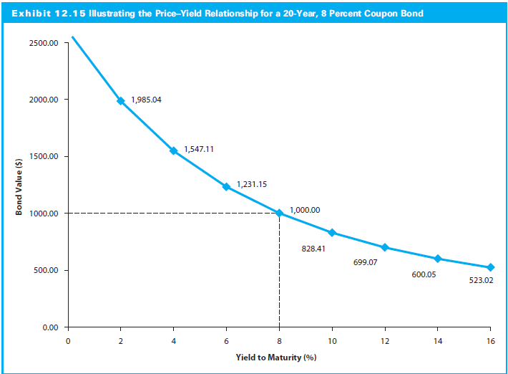
Bond Duration and Convexity
Convexity
Duration

Slide 22
Bond Price Sensitivities
Bond prices change as any inputs change:
Prices vary inversely with yields
Higher YTM, smaller % change in price (duration) for change in yield
Greater maturity, greater % change in price (duration) for change in yield
Smaller coupon, greater % change in price (duration) for change in yield
Price sensitivity (duration) to yield increases with maturity, but at decreasing rate
Price changes are greater (in absolute value) when rates fall than when rates rise

Slide 23
Duration and Modified Duration
Duration combines effects of maturity, coupon rate, and yield to measure the (overall) interest rate sensitivity of a bond
Longer duration, greater interest rate risk
Calculate Macaulay Duration with DURATION function:
Modified Duration is better measure of change in price when yields change
For small changes in yield, approximate % change in price using:
DURATION(Settlement, Maturity, Coupon, Yld, Frequency, Basis)
MDURATION(Settlement, Maturity, Coupon, Yld, Frequency, Basis)

Slide 24
Convexity Approximation
Convexity measures curvature of price/yield relationship
Price changes greater (in absolute value) when rates fall than rise
No built-in convexity function to calculate, but close approximation using the PRICE function for P:
Where
P_{yld} = price at yield to maturity
P_{yld + h} and P_{yld − h} = prices if yield changed by a small amount, h
With convexity, better approximation of the price change:

Slide 25
Convexity Formula

