Slide 1
FIN 470: Financial Analysis in Excel
Topic 6.1: Time Value of Money, Theory
Larry Schrenk, Instructor
The slides for this course are adapted from: Timothy R. Mayes, Financial Analysis with Microsoft Excel, 9th Edition. © 2021 Cengage. All Rights Reserved.

Slide 2
Overview
Time Value Basics
Future Value, Present Value
Periods, Rate, Payment
Annuities, Perpetuities, Mixed CFs
Other Issues

Slide 3
1. Time Value Basics

Slide 4
Time Value of Money
Because the value of money (normally) increases into the future, money has a “time value”
$100 is worth more today than next year
Many financial problems involve comparing cash flows in different periods (and converting from one period to another)
For comparison, cash flows cab be “moved” to the same time period
Compounding is moving cash flows to a later time period (typically the cash flows get larger)
Discounting is moving cash flows to an earlier time period (typically the cash flows get smaller)

Slide 5
Patterns of Cash Flows
Common cash flow patterns:
Lump Sums – Single cash flow at some point in time
Annuities – Regular, constant, finite cash flows
Graduated/Growing Annuities – Regular, finite cash flows growing at constant rate
Deferred Annuities – Annuities where first cash flow occurs after the first period
Perpetuities – Regular, constant, infinite cash flows
Graduated/Growing Perpetuities – Regular, infinite cash flows growing at constant rate
Uneven Cash Flows – A series of cash flows whose amounts differ in each period

Slide 6
Cash Flow Sign (+/-) Convention
Cash flow sign convention:
Cash inflows (money you receive) are positive numbers
Cash outflows (money you pay) are negative numbers
If not followed RATE, NPER, and PMT will return an error or (worse) a wrong answer
Example: A firm issues a bond:
Capital Raised Cash Inflow Positive
Interest Payment Cash Outflow Negative
Principal Repayment Cash Outflow Negative

Slide 7
Calculator vs Excel Functions
Comparison of calculator vs Excel financial functions:
Calculator Variable | Excel Function
N | NPer(Rate, Pmt, Pv, Fv, Type)
I/Yr | Rate(NPer, Pmt, Pv, Fv, Type, Guess)
PV | Pv(Rate, NPer, Pmt, Fv, Type)
PMT | Pmt(Rate, NPer, Pv, Fv, Type)
FV | Fv(Rate, NPer, Pmt, PV, Type)

Slide 8
2. Future Value, Present Value

Slide 9
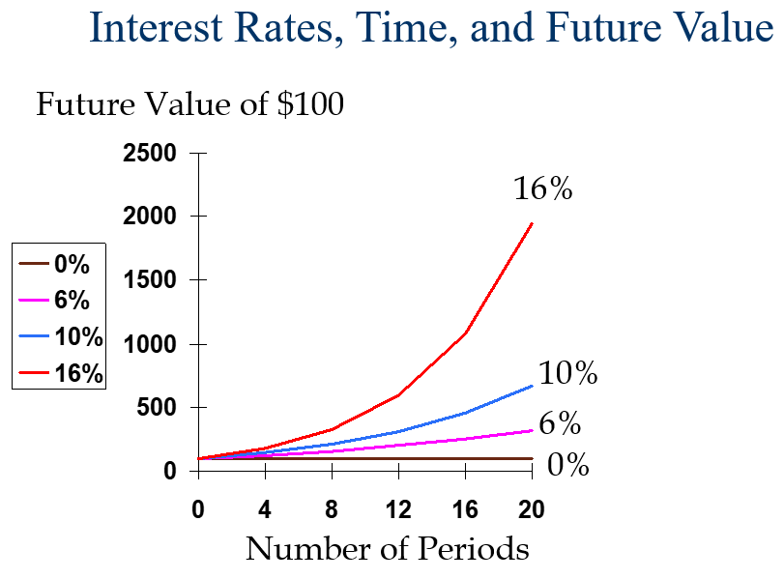
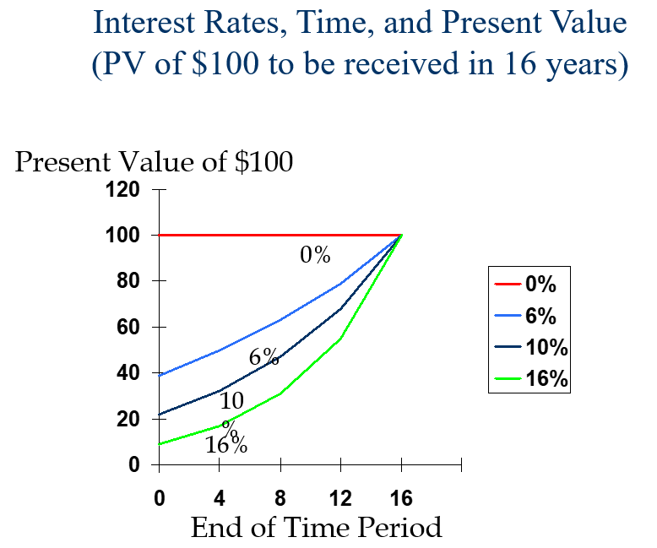
FV, PV Graphs

Slide 10
Single Dollar Problem Types
Future Value (FV)
What is it Worth Later?
Present Value (PV)
What is it Worth Now?
Time (N)
How Long will it Take?
Interest Rate (r)
What is the Interest Rate?

Slide 11
Future Value of Lump Sum
Future value of a cash flow (or series of cash flows) is value the cash flow will have at some future time given a particular interest rate
The future value of a lump sum can be calculated as:
Where:
PV = present value
i = interest rate per period
N = total number of periods
FV function in Excel:
Where:
Rate = interest rate per period
NPer is the number of periods
Pmt = cash flow per period (0 for lump sum)
Pv = present value
Type indicates cash flows timing (0 for lump sum)
FV(Rate, NPer, Pmt, Pv, Type)

Slide 12
Present Value of Lump Sum
Present value of a cash flow (or series of cash flows) is value of the cash flow today given a particular interest rate
The present value of a lump sum is given by:
PV function in Excel
PV(Rate, NPer, Pmt, Fv, Type)
Pmt and Type should both be set to 0 for a lump sum

Slide 13
Question
If you double the time you invest, the final value will:
Less than double
Double
More than double
Cannot tell

Slide 14
3. Periods, Rate, Payment

Slide 15
Period (NPER) Problems
Present Value: How many periods (Nper) will it take to repay a loan?
Future Value: How many periods (Nper) will it take to save a certain amount?

Slide 16
Number of Periods of Lump Sum
Given present value, future value, and interest rate, we can solve for the number of periods (N) for present value to grow into future value
many periods
many periods
Where:
Ln(·) = natural logarithm
NPER function in Excel
NPER(Rate, Pmt, Pv, Fv, Type)
Pmt and Type should both be set to 0 for a lump sum

Slide 17
Interest Rate (RATE) Problems
Present Value: What it the interest rate (Rate) on a loan?
Future Value: What interest rate (Rate) do you need to achieve an investment goal?

Slide 18
Interest Rate of Lump Sum
Given present value, future value, and number of periods, we can solve for the interest rate (i) for present value to grow into future value
RATE function
RATE(NPer, Pmt, Pv, Fv, Type, Guess)
Guess argument is not usually required, and Pmt and Type should both be set to 0 for a lump sum

Slide 19
Payment (PMT) Problems
Present Value: What it the payment (Pmt) on a loan?
Future Value: How much per period (Pmt) do you need to save to achieve an investment goal?

Slide 20
4. Annuities, Perpetuities, Mixed CFs

Slide 21
Annuities
Annuities are nominally equal cash flows, equally timed
Find the present value or future value of an annuity, or solve for the interest rate, number of periods, or payment amount
The value (present or future) of an annuity is the sum of the values of each payment
The Principal of Value Additivity
PV, FV, NPER, and RATE work for annuities just like for lump sums
Except you must provide the Pmt argument
Solve for the payment amount by using the PMT function
PMT(Rate, NPer, Pv, Fv, Type)

Slide 22
Annuities: PV and FV Versions
PV
Loan/Borrowing
Value now
FV
Savings/investments

Slide 23
Uses of Annuity: PV
Present Value of an Annuity
‘Borrowing’ Problems (Loans)
How much can I borrow (PV)?
How much are my payments (PMT)?
What interest rate am I getting (I/Y)?
How long will it take (N)?
‘Value Now’ Problems
How much is it worth now(PV)?
How much are my cash flows(PMT)?
What is the interest rate (I/Y)?
How long does it go on(N)?

Slide 24
Uses of Annuity: FV
Future Value of an Annuity
‘Savings’ Problems (Retirement Fund)
How much will I have (FV)?
How much are my payments (PMT)?
What interest rate am I getting (I/Y)?
How long will it take (N)?

Slide 25
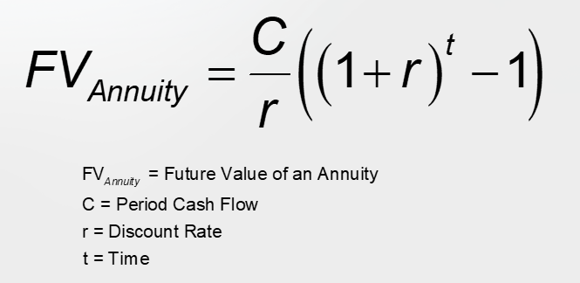
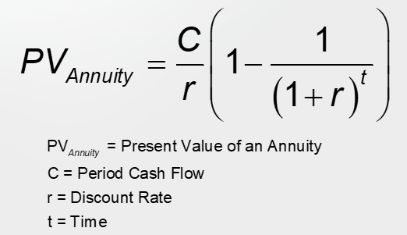
Annuity Formulae
FV of Annuity
PV of Annuity

Slide 26
Deferred Annuities
Deferred annuity begins payments after period 1
Calculate the future value using the FV function as usual
To calculate the present value, discount the cash flows twice:
First, find the PV of the annuity at the beginning of the cash flows
Then find the PV (now) of the previously calculated present value
Use PV function nested inside second PV function:
PV(Rate, NPer, 0, PV(Rate, NPer, Pmt, Fv, Type), Type)
0 1 2 3 4 5
0 0 CF CF CF

Slide 27
Annuities Due
Cash Flow Begins Now
Not Next Period
Method
Set Type = 1

Slide 28
Annuities Due
An annuity due is an annuity that begins this period, not next.
Five Year Annuity of $100 per Year
Five Year Due Annuity of $100 per Year
0
1
2
3
4
5
6
0
50
50
50
50
50
0
0
1
2
3
4
5
6
50
50
50
50
50
0
0

Slide 29
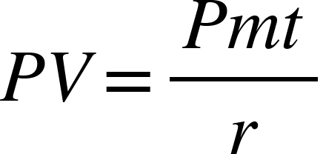
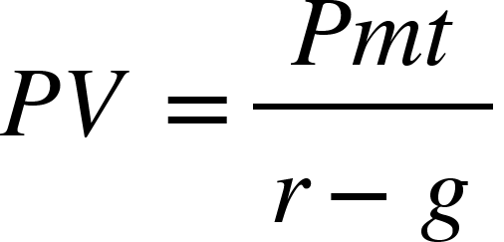
(Growing) Perpetuities
Perpetuities are regular, constant, infinite cash flows
Graduated/Growing perpetuities are regular, infinite cash flows growing at constant rate
Since perpetuities are infinite, they cannot have a future value.
No built-in functions, but formulae are easy:
Perpetuity
Growing Perpetuity

Slide 30
Mixed/Uneven Cash Flows
Uneven/mixed cash flows have different cash flows in each period
Use NPV to find the present value of regular, uneven cash flows
IMPORTANT: NPV does not calculate financial Net Present Value
NPV(Rate, Value1, Value2, …)
To find future value of an uneven cash flow, nest NPV inside FV :
FV(Rate, NPer, Pmt, NPV(Rate, Value1, Value2, …), Type)
Solve for internal rate of return (IRR) of a regular, uneven cash flow stream using the IRR function:
IRR(Values, Guess)

Slide 31
Irregular, Uneven Cash Flows
Irregular cash flows do not come at regular periods, e.g., weekly or monthly
Use XNPV to find the present value of irregular, uneven cash flows.
IMPORTANT: XNPV DOES calculate financial NPV:
NPV discounts the cash flows to the period before the first cash flow.
XNPV discounts the cash flows to the date of the first cash flow.
XNPV(Rate, Values, Dates)
To find future value of an irregular cash flow, nest XNPV inside FV :
FV(Rate, NPer, Pmt, XNPV(Rate, Values, Dates) Type)

Slide 32
4. Other Issues

Slide 33
Financial Net Present Value
Excel NPV does not calculate Financial Net Present Value
Financial Net Present Value is the present value net of cost
Excel NPV does not subtract the cost/investment
Financial Net Present Value = NPV(CFs) – Cost
Financial NPV = NPV(Rate, Value1, Value2, …) – Cost

Slide 34
Nonannual Periods
Previously, assumed cash flows compounded/discounted annually
Compound/discount cash flows can be at any frequencies (e.g., monthly, weekly, daily, hourly, etc.)
To use built-in functions, adjust:
Interest rate (Rate) to period value
Payment amount (Pmt) to period value, and
Number of periods (NPer) to total number of periods
Note: Rate, Pmt, and NPer arguments must all agree on the length of a period

Slide 35
Question
If you increase the number of periods per year, the present value will:
Increase
Remain the same
Decrease
Cannot determine

Slide 36
Continuous Compounding
If compounding period decreased, you end up compounding (or discounting) an infinite number of times per year
No built-in functions, but the formulae are easy:
Future value of a lump sum with continuous compounding:
- Present value of a lump sum with continuous discounting:
NOTE: e^{x} = EXP(x)

