Slide 1
FIN 470: Financial Analysis in Excel
Topic 5.1: Break-Even, Leverage Analysis I
Larry Schrenk, Instructor
The slides for this course are adapted from: Timothy R. Mayes, Financial Analysis with Microsoft Excel, 9th Edition. © 2021 Cengage. All Rights Reserved.

Slide 2
Overview
Break-Even Analysis
Leverage Analysis
Extended Example
Linking Break-Even and Leverage
Scenario Manager/Data Tables

Slide 3
Break-Even Analysis

Slide 4
Break-Even Analysis
Sales (units/dollars) at which some profit measure equals zero
Relationship among fixed costs, variable costs, sales volume, and profits.
Determines level of sales a firm must achieve to stay in business in the long run
Also called cost/volume/profit (C/V/P) analysis.
NOTE: “profits” refers to operating profits before taxes (i.e., EBIT) (excludes interest and dividends)

Slide 5
Two Types of Costs
Two main types of costs:
Variable costs – Costs that change with sales
Economies of scale
Fixed costs – Costs that are constant
Over some range of production/time period
Often ‘lumpy’
The relative amounts of each cost can affect
Financing
Production
Pricing

Slide 6
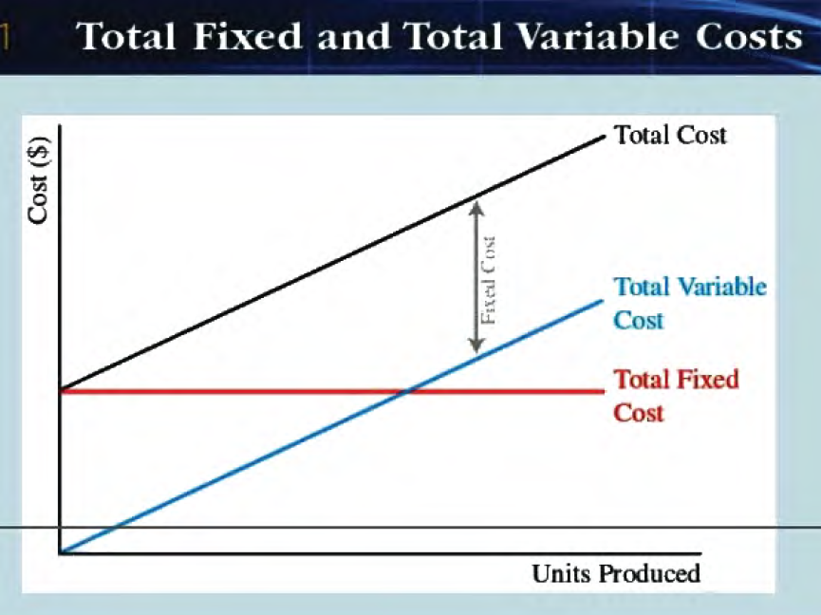
Fixed vs Variable Costs
Short term distinction
Linear or non-linear

Slide 7
Types of Break-Even Points
Operating Break-Even Point
Sales (units/dollars) at which EBIT = 0
Total Break-Even Point
Sales (units/dollars) at which EPS = 0
Accounting Break-Even Point
Sales (units/dollars) at which NI = 0
Financial Break-Even Point
Sales (units/dollars) at which NPV = 0
Target EBIT Break-Even
Sales (units/dollars) at which EBIT = target EBIT
Cash Break-Even Point
Sales (units/dollars) at which EBIT = 0 (excluding depreciation)
Break-Even Price
Price at which a profit measure = zero

Slide 8
Operating Break-Even Point
Operating break-even point: unit sales for EBIT to equal zero
Where:
Q* =operating break-even point in units
F = total fixed costs
P = price per unit
V = variable cost per unit
P − V is the contribution margin per unit
Operating break-even point in dollars:

Slide 9
Break-Even Graph
Total Revenues
Profits/
EBIT
250
Total Costs
175
REVENUES AND COSTS
($ thousands)
100
Fixed Costs
Losses
Variable Costs
50
0 1,000 2,000 3,000 4,000 5,000 6,000 7,000
QUANTITY PRODUCED AND SOLD

Slide 10
Other Break-Even Points
Break-even points in terms of other profit measures:
Target EBIT BE: Unit sales to generate a certain EBIT
Cash BE: Unit sales that that generate zero EPS (excluding depreciation)
Total BE: Unit sales that generate zero EPS
Also, break-even price: At what price would a profit measure = 0

Slide 11
Break-Even Point Pattern
Pattern:
Find the unit sales where
Sales = adjusted fixed cost + variable costs

Slide 12
Relationships Among Break-Evens
Because accounting break-even (ABE) uses non-discounted dollars, ABE will likely be lower than financial break-even (FBE).
Because cash break-even (CBE) treats depreciation as an “add back”, it will be lower than ABE.
CBE < ABE < FBE

Slide 13
Goal Seek for Break-Even Points
Goal Seek can calculate break-even points
Goal Seek is light version of Solver
Doesn’t allow for constraints
Steps:
“Set cell” to cell for value you want
“To value” to value you need
“By changing cell” to the cell to change
For example, find EPS break-even point:
“Set cell” EPS ($B$17) “To value” 0, “By changing cell” unit sales ($B$17), then click OK.

Slide 14
2. Leverage Analysis

Slide 15
Leverage
Use of “fixed cost” items resulting in greater earnings volatility/risk.
Effects fixed costs have on the returns that shareholders earn
Higher leverage generally results in higher, but more volatile returns
Capital structure is the mix of long-term debt and equity maintained by the firm.

Slide 16
Leverage Analysis
Firms face three types of risk:
Business Risk – Risk from your type of business
Operational Risk – Risk from production decisions
Financial Risk – Risk from using financial leverage
Combining these:
Firm Risk = Business + Operational Risk
Equity Risk = Business + Operational + Financial Risk
NOTE: Other categorizations are also used.

Slide 17
Business Risk
Business risk results from the environment in which the firm operates.
Competitive position of the firm in its industry,
State of its labor relations, and
State of the economy
NOTE: Business risk is largely beyond the control of managers

Slide 18
Operating Risk
Operating risk results from the production methods used by the firm:
Production technology
Fixed (as opposed to variable) costs
General Tradeoff:
Higher fixed costs, Lower variable costs.
Example: automation
Not influenced by financial leverage

Slide 19
Financial Risk
Probability that the firm will be unable to meet its fixed financing obligations
Interest payments
Preferred dividends
Interest and preferred dividends are fixed cost

Slide 20
Leverage Calculations
The Degree of Operating Leverage (DOL)
%Sales → %EBIT
The Degree of Financial Leverage (DFN)
% EBIT→ %EPS
The Degree of Combined Leverage (DCL)
%Sales → % EPS
Why no Degree of Business (Risk) Leverage?

Slide 21
DOL, DFL, DCL
Income Statement
Sales
.
.
.
EBIT
.
.
.
EPS
DOL
Sensitivity of EBIT to Sales
DCL
Sensitivity of
EPS to Sales
DFL
Sensitivity of
EPS to EBIT

Slide 22
Degree of Operating Leverage (DOL)
Risk from specific production decisions
More fixed operating costs, E B I T will vary more with sales
DOL is a function of the mix of variable and fixed operating costs
DOL measures how much (proportionately) EBIT changes for a percentage change in Sales.
DOL is how sensitive EBIT is to a change in Sales
Higher operating leverage generally causes greater firm risk

Slide 23
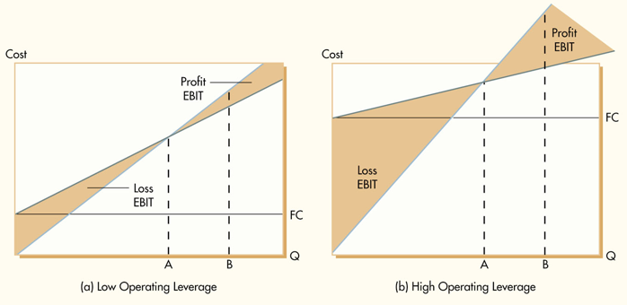
DOL and Break-Even

Slide 24
Degree of Financial Leverage (DFL)
Risk from using financial leverage
More fixed financing costs, then EPS will vary more with EBIT
DFL is a function of the mix of variable and fixed (interest expense and preferred dividends) financing costs
DFL measures how much (proportionately) EPS changes for a percentage change in EBIT
DFL is how sensitive EPS is to a change in EBIT
or
Higher financial leverage generally causes greater equity risk

Slide 25
Comparing DOL and DFL
Both can enhance results while increasing variation
Financial leverage substitutes debt for equity in the capital structure
Operating leverage substitutes fixed for variable costs in cost structure
Both substitutes fixed cash outflows for variable cash outflows
Both respective risks larger as leverage increases
No financial risk if no debt is, but business risk even if no operating leverage
Financial leverage is more controllable than operating leverage

Slide 26
Compounding Effect of DOL and DFL
Both can enhance results while increasing variation
Financial leverage substitutes debt for equity in the capital structure
Operating leverage substitutes fixed for variable costs in cost structure
Both substitutes fixed cash outflows for variable cash outflows
Both respective risks larger as leverage increases
No financial risk if no debt is, but business risk even if no operating leverage
Financial leverage is more controllable than operating leverage
Financial and operating leverage compound one another

Slide 27
Degree of Combined Leverage (DCL)
DCL combines operating and financial leverage
DCL measures how much (proportionately) EPS changes for a percentage change in Sales
DCL is how sensitive EPS is to a change in Sales
Also called (Degree of) Total Leverage

