Slide 1
FIN 470: Financial Analysis in Excel
Topic 2.2: Financial Statements, Excel
Larry Schrenk, Instructor
The slides for this course are adapted from: Timothy R. Mayes, Financial Analysis with Microsoft Excel, 9th Edition. © 2021 Cengage. All Rights Reserved.

Slide 2
Overview
Financial Statements
Income Statement
Balance Sheet
Statement of Cash Flows
Common-Size Financial Statements

Slide 3
The Financial Statements
We cover three basic financial statements:
Income Statement – Operations over some time period
Balance Sheet – Assets, liabilities, and equity at a given point in time
Statement of Cash Flows – Cash inflows and outflows over some time period
Quarterly (10-Q) and annual (10-K)
Performance of the firm and value of the company
Excel: Each on its own worksheet or one worksheet per period

Slide 4
Assignment Details
Two financial statements:
Income Statement
Balance Sheet
CapIQ
Most Recent Quarterly Data
Two Decimal Points
No Supplemental Data
Two Decimal Number Format
Original Line Items

Slide 5
CapIQ Details I
Main Functions
Collects Data
Standardizes Data
Login (‘New User?’)
Left Navigation Bar
Company: Domino's Pizza, Inc. (NYSE:DPZ)
Quarterly (10-Q vs 10-K)
Latest on Left/Slider
More Options > Decimals 2 (Display Only)

Slide 6
CapIQ Details I
+/- (Download Only Visible)
Original (-) for Assignment
Number Details (E.g., Revenue, COGS)
Raw
Calculation
10-Q
Supplemental (Not for assignment
Download Financials Button (All Financials)

Slide 7
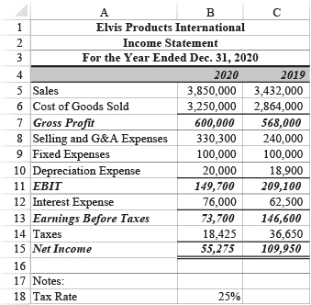
The Income Statement
EPI income statements 2019-2020
Sales = revenue over the period
Other lines
categories of expenses or
intermediate profit measures/earnings
Excel: Construct in Excel (A2)
Gross Profit = Sales − Cost of Goods
E B I T = Gross Profit − Operating Expenses
E B T = E B I T − Interest Expense
Net Income = E B T − Taxes

Slide 8
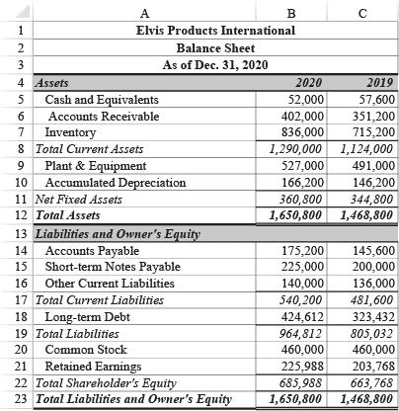
The Balance Sheet
E P I balance sheets 2019-2020
Assets = resources firm owns
Liabilities = debts firm owes
Equity = difference between total assets and total liabilities
Excel: Construct in Excel (A2)
Total Assets = Total Liabilities + Equity
Total Assets = Current Assets + LT Assets
Total Liabilities = Current Liabs + LT Liabs
Total Equity = Total Assets − Total Liabilities

Slide 9
Statement of Cash Flows I
E P I statement of cash flows 2020 (next slide)
Cash Flows from Operations
Cash Flows from Investing
Cash Flows from Financing
Each item is the change in a balance sheet item
EXCEPT: net income, depreciation expense, and dividends paid,
Positive = cash inflows; negative = cash outflows
Excel: Construct in Excel (Not in A2)

Slide 10
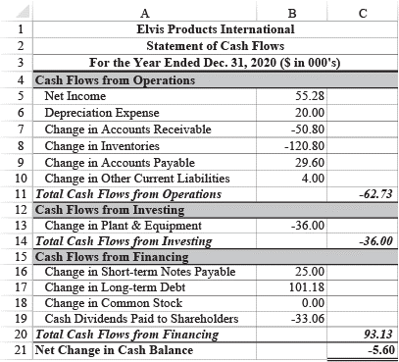
Statement of Cash Flows II
 | Direction of Change | Direction of Change | Order of Subtraction
Type of Item | Increase | Decrease
Asset | − | + | Older − Newer
Liability or Equity | + | − | Newer − Older

Slide 11
Common-Size Financial Statements
Item as percentage of a base value:
Income statement – Items are percentage of sales
Balance sheet – Items are percentage of total assets
Statement of cash flows – Items are percentage of either sales or beginning cash balance
Use Choose function in the denominator to toggle between different base values
Common-size statements
See trends over time
Compare financial statements across companies
Excel: Construct in Excel (Not in A2)

Slide 12
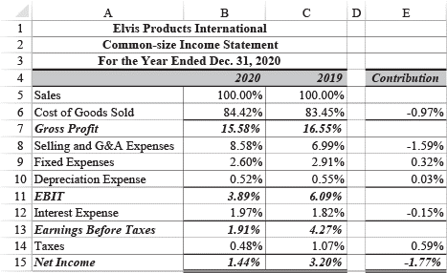
Common-Size Income Statement
E P I’s common-size income statements 2019-2020
Each item is percentage of that year’s sales
Contribution (to NI change) analysis (difference)
Some of the profitability ratios can be read directly from this statement

Slide 13
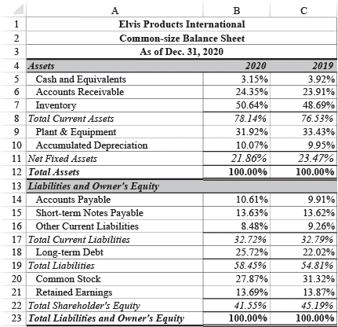
Common-Size Balance Sheet
E P I common-size balance sheet 2019-2020
Each item is percentage of the year’s total assets

Slide 14
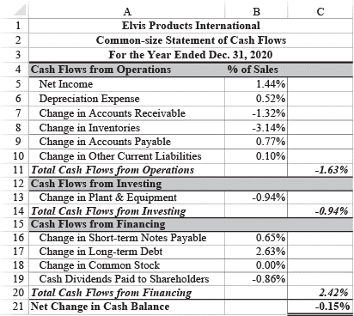
Common-Size Statement of Cash Flows
E P I common-size statement of cash flows 2020
Each item is percentage of the year’s total sales

Slide 15
Excel Tools Used
Excel tools used:
Outline Tool – Show or hide sections of a worksheet
Used to hide parts of the statement of cash flows
Could be used to hide excess detail on the other statements
Data Validation Tool – Makes sure that only acceptable values are entered into a cell
Both tools are useful in many situations; not just for financial statements

