Slide 1
FIN 470: Financial Analysis in Excel
Topic 12.2: Portfolio Statistics and Diversification, Excel
Larry Schrenk, Instructor
The slides for this course are adapted from: Timothy R. Mayes, Financial Analysis with Microsoft Excel, 9th Edition. © 2021 Cengage. All Rights Reserved.

Slide 2
Overview
Linear Algebra
Portfolio Calculations
Efficient Frontier
Capital Asset Pricing Model

Slide 3
1. Linear Algebra

Slide 4
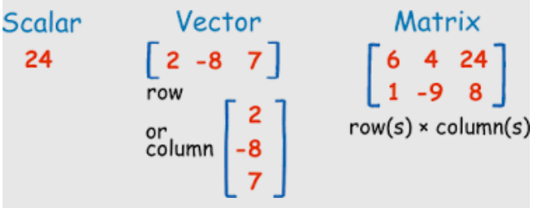
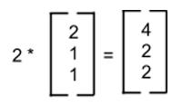
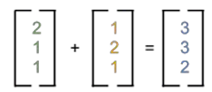
Linear Algebra/Matrix Math
Math of data, matrices and vectors
Applies +, -, x, / to columns (vectors) and arrays (matrices)

Slide 5
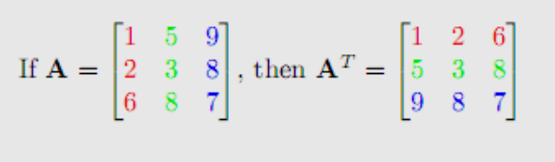
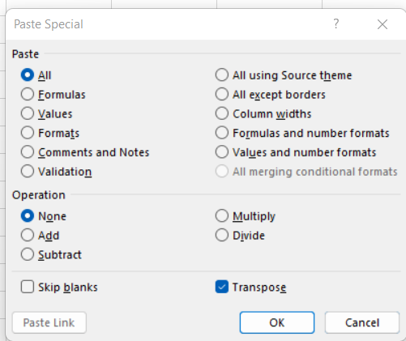
Transpose
“Flips on its side”; Exchanges row and column numbers
Changes row vector to column vector (and vice versa)
Symbols: X´ or X^{T}
Excel: =TRANSPOSE(array)
Paste Special: Option to paste transpose

Slide 6
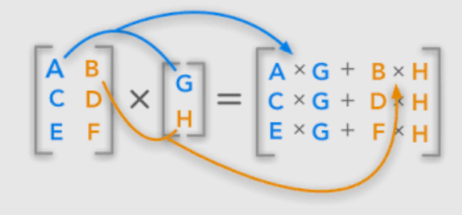
Matrix Multiplication
Special way to combine vectors and matrices
Don’t worry; Excel will do it for you
Excel: =MMULT(array1, array2)
NOTE: The order of multiplication matters
MMULT(array1, array2) ≠ MMULT(array2, array1)

Slide 7
2. Portfolio Calculations

Slide 8
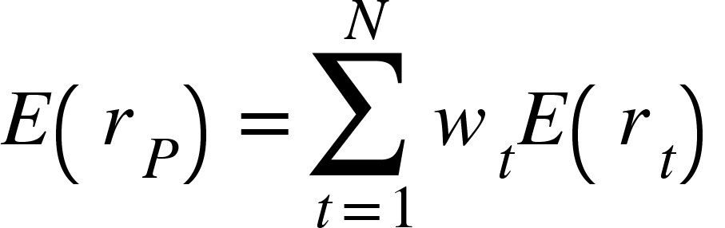

Expected Return/Standard Deviation
Expected return/Weighted Average (general formula):
Variance (general formula):

Slide 9


Standard Deviation Examples
2 Assets (2² = 4 Calculations):
3 Assets (3² = 9 Calculations):
5 Assets (5² = 25 Calculations)
S&P 500 (500² = 250,000 Calculations)
Russell 2000 (2000² = 4,000,000 Calculations)
Wilshire 5000 (5000² = 25,000,000 Calculations)

Slide 10
Excel: Expected Return
Expected return/Weighted Average (general formula):
=SUMPRODUCT(array1, array2)
=SUMPRODUCT(weight_array, return_array)
  Multiplies two columns (or rows) and sums the results
  Multiplies each return by its portfolio weight and sums
  Returns weighted average (expected return)

Slide 11
Weights Vector
Array of portfolio weights:
= W
Stocks
A | B | C
w_{A} | w_{B} | w_{C}

Slide 12
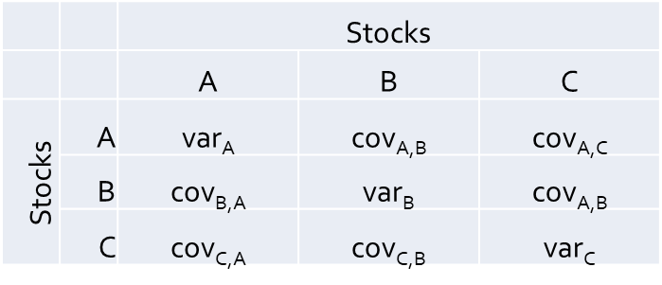
Variance/Covariance Matrix
Construct variance/covariance matrix
= V
Variances on diagonal
Covariances on upper and lower triangles
Triangles contain duplicate information
  cov_{A,C} = cov_{C,A}
Looks complicated, but easy in Excel

Slide 13
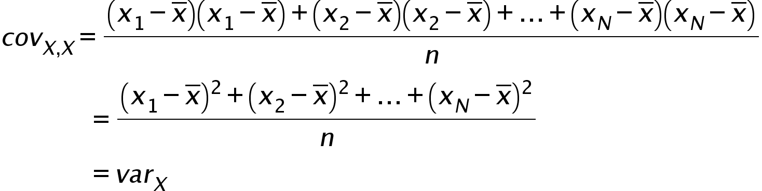
  cov_{X,X} = var_{X}

Slide 14
Variance/Covariance Matrix
Construct variance/covariance matrix
                =
=

Slide 15
Excel: Variance/Covariance Matrix
Variance/covariance matrix
= V
Like doing variance calculation
  Subtract averages from returns
  Matrix multiply
  Divide by n-1 (for sample variance /covariance)
Variance/Covariance formula:
=MMULT(TRANSPOSE(Returns - Avg), (Returns - Avg))/(n-1)

Slide 16
Standard Deviation
Matrix algebra formula for standard deviation:
    Where:
    W = Vector of weights
    W′ = Transpose of the weight vector
    V = Variance/covariance matrix
Matrix multiply and take the square root

Slide 17
Excel Linear Algebra
Matrix algebra formula for standard deviation:
Excel matrix functions:
  TRANSPOSE – Transposes a matrix or vector
  TRANSPOSE(Array)
  MMULT – Multiples two matrices
  MMULT(array1, array2)
Standard Deviation formula:
σ_{P} =SQRT(MMULT(MMULT (TRANSPOSE(W), V), W))
σ_{P} =SQRT(MMULT(MMULT (TRANSPOSE(W), V), W))

Slide 18
W′VW
W′VW =
x x

Slide 19
3. Efficient Frontier

Slide 20
Solver
Add-in for sophisticated what-if analysis
Constrained optimization problems
Change specified cells to find max or min given certain constraints
Like using first derivatives to find min or max
Steps
  Select cell to be maximized, minimized or set to a specific value
  Select objective: max, min, or set to value
  Select cells to change
  Set any constraints
  Click Solve

Slide 21
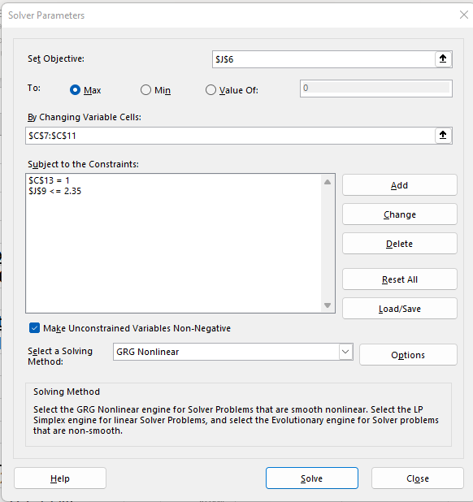
Solver Window
Objective Cell (max or min)
Objective (max, min, or set to value)
Cells to change
Constraints
Solve

Slide 22
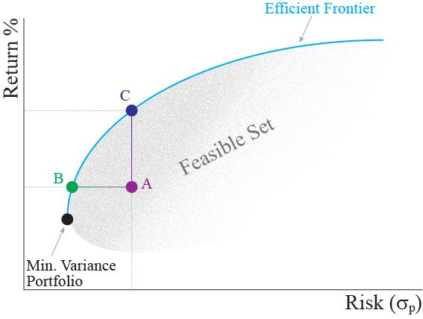
Efficient Frontier
Efficient Frontier
  Portfolios that have the highest return for a given standard deviation
  E.g., what is the highest return that can be achieved with a standard deviation <= 25%?
  (Alternative, which has the same result: Portfolios that have the lowest standard deviation for a given return)
25%

Slide 23
Find Efficient Frontier
Objective Cell: return or stdev
Objective: max return or min stdev
Minimum Variance Portfolio (MVP)
  Solve for minimum stdev (variance)
Portfolios on efficient frontier
  Select range of stdev’s
  For each, solve for the highest return possible for that (or less) stdev
  Add constraint sum(weights) = 1
  Click box to add shorts sales constraint
Connect portfolios with scatter plot

Slide 24
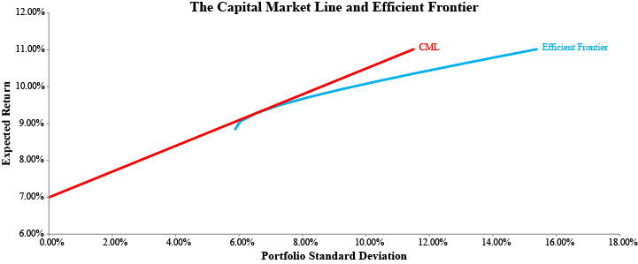
The Capital Market Line
Risk-free asset (r_{f}):
  Risk – Standard deviation of 0, and zero covariance with all other assets
  Return – Risk-free rate
  Treasury security as proxy
Risk-free asset + efficient frontier becomes Capital Market Line (CML)
Recalculate efficient frontier using Solver with the variance/covariance matrix so it will be linear

Slide 25
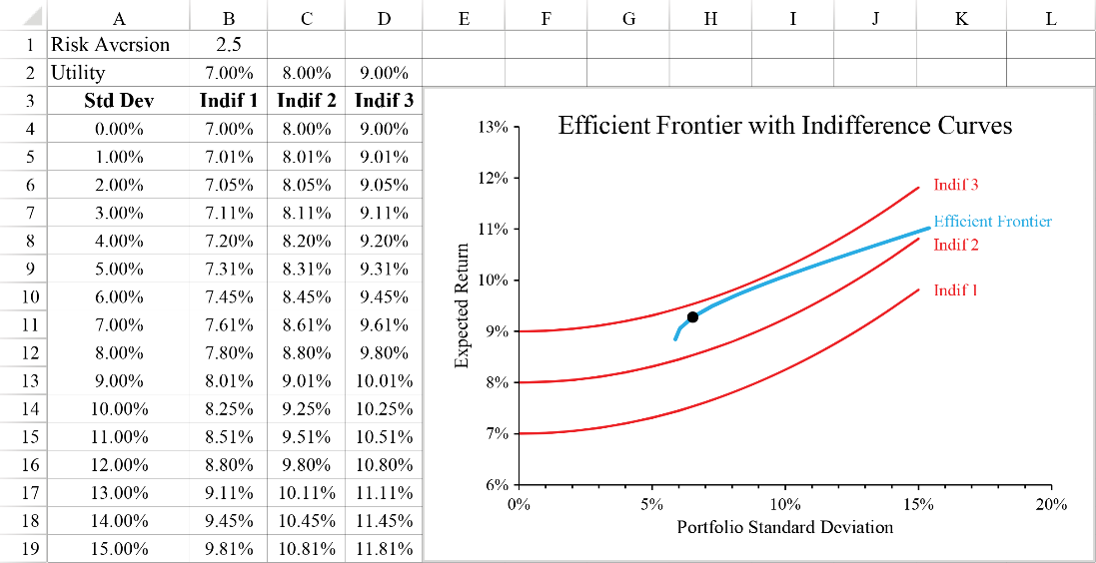
Utility Functions and the Optimal Portfolio
Utility function ranks portfolios according to individual satisfaction.
Example utility function:
Indifference curve shows all portfolios with same utility
Optimal portfolio lies at the tangency point of indifference curves and efficient frontier/CML

Slide 26
4. Capital Asset Pricing Model

Slide 27
The Capital Asset Pricing Model
Capital Asset Pricing Model (CAPM):
Inputs:
  R_{f} = Risk free rate – Use estimate (average) of US treasury security return with same time horizon as model
  E(R_{M} ) = Expected return on the markets – Use as estimate of market return the expected return (average) of a market proxy return, such as the S&P 500
  β = measure of market risk – Using linear regression, estimate the sensitivity of the return of your firm to the return of the market proxy

Slide 28
Excel: Linear Regression
Linear regression
  Best fit line
  beta (β) of a firm’s equity
Example
  Beta of MMM
  Independent variable (x-axis)
    S&P 500 as proxy for the market
  Dependent variable (y axis)
    Return on MMM

Slide 29
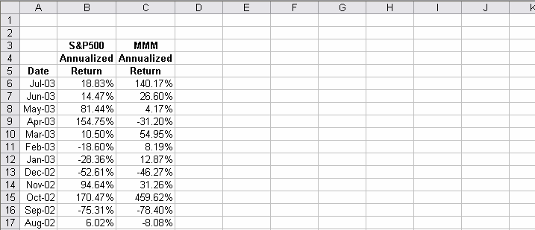
Excel: Linear Regression
1) Returns of the assets arranged in columns:

Slide 30
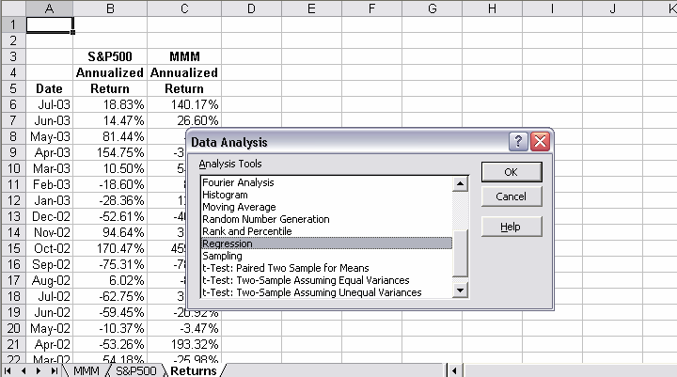
Excel: Linear Regression
2) Click on Data Analysis under the ‘Tools’ drop-down menu to open the Data Analysis window. Select ‘Regression’…

Slide 31
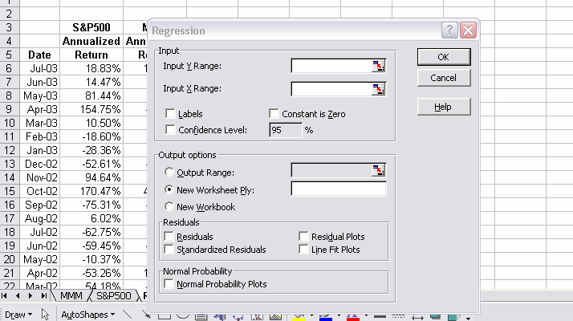
Excel: Linear Regression
3) Regression box opens

Slide 32
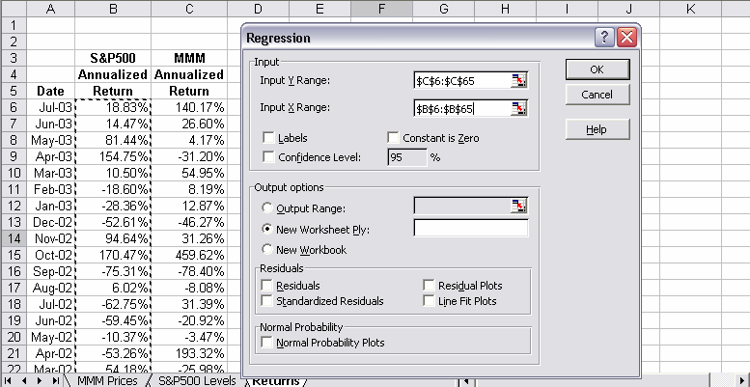
Excel: Linear Regression
4) Enter the cells for the y variable (MMM) and the x variable (S&P 500). Click on ‘Line Fit Plots’ box and ‘OK’.

Slide 33
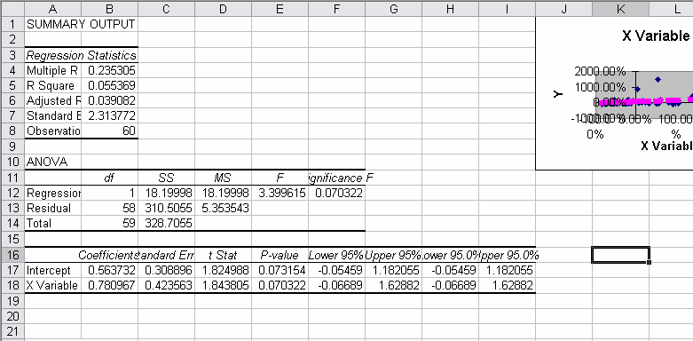
Excel: Linear Regression
5) A new worksheet will appear with the results and a graph.

Slide 34
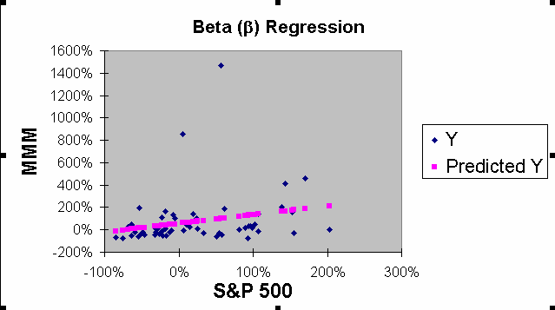
Excel: Linear Regression
6) Blue squares are data points and the pink the points on the best-fit line.

Slide 35
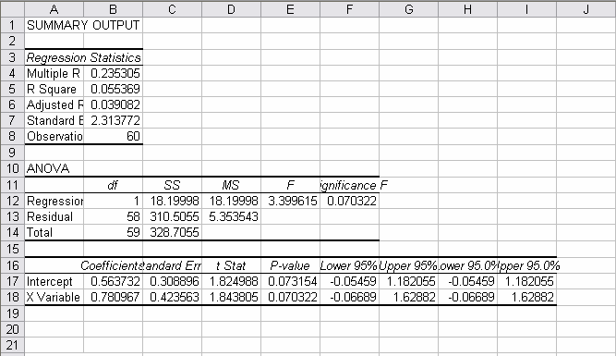
Excel Features: Linear Regression
8) Summary statistics: beta is the coefficient of the x variable.

