Slide 1
FIN 470: Financial Analysis in Excel
Topic 10.2: Capital Budgeting, Excel
Larry Schrenk, Instructor
The slides for this course are adapted from: Timothy R. Mayes, Financial Analysis with Microsoft Excel, 9th Edition. © 2021 Cengage. All Rights Reserved.

Slide 2
Overview
Decision Criteria

Slide 3
1. Decision Criteria

Slide 4
Sample Project
Evaluate the following project:

Slide 5
Payback Period
RULE: Accept if the payback is shorter than time horizon
Subtract annual cash flows from initial outlay until zero
Excel: Use IF statement

Slide 6
Discounted Payback Period
RULE: Accept if the payback is shorter than time horizon
Subtract PV(annual cash flows) from initial outlay until zero
Excel: Use IF statement

Slide 7
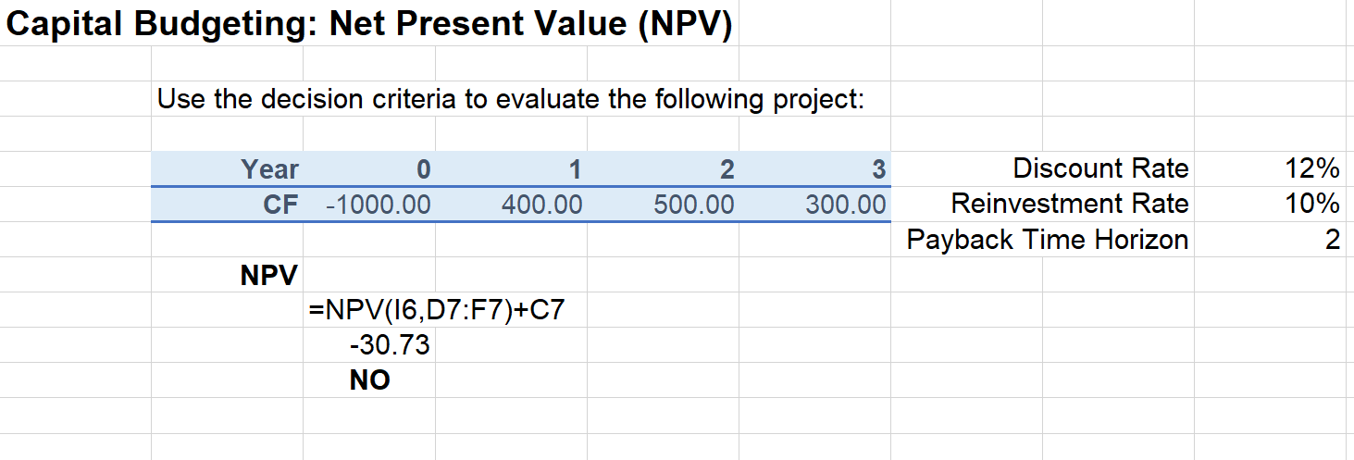
Net Present Value (NPV)
RULE: Accepted if NPV ≥ 0
Excel: Use NPV – IO
NPV(rate,value1,[value2],...) – IO

Slide 8
Profitability Index (PI)
RULE: Accepted if PI ≥ 1
Excel: Use NPV/IO
NPV(rate,value1,[value2],...)/IO

Slide 9
Internal Rate of Return (IRR)
RULE: Accepted if IRR ≥ WACC
Excel: IRR function
IRR(values, [guess])

Slide 10
Modified Internal Rate of Return (MIRR)
RULE: Accepted if If MIRR ≥ WACC
Excel MIRR function
MIRR(values, finance_rate, reinvest_rate)
Note: both rates should equal WACC

