Slide 1
FIN 470: Financial Analysis in Excel
Topic 1.3: Excel Details
Larry Schrenk, Instructor
The slides for this course are adapted from: Timothy R. Mayes, Financial Analysis with Microsoft Excel, 9th Edition. © 2021 Cengage. All Rights Reserved.

Slide 2
Overview
Excel Screen
Formulae
Naming
Graphics

Slide 3
Spreadsheet Uses
Not only for financial analysis, but also for any type of quantitative analysis:
Professional:
Economics
Statistics
Engineering
Marketing
Management
Personal
Monitor investment portfolio
Plan for retirement
Experiment with various mortgage options
Create and maintain a mailing list
Etc.

Slide 4
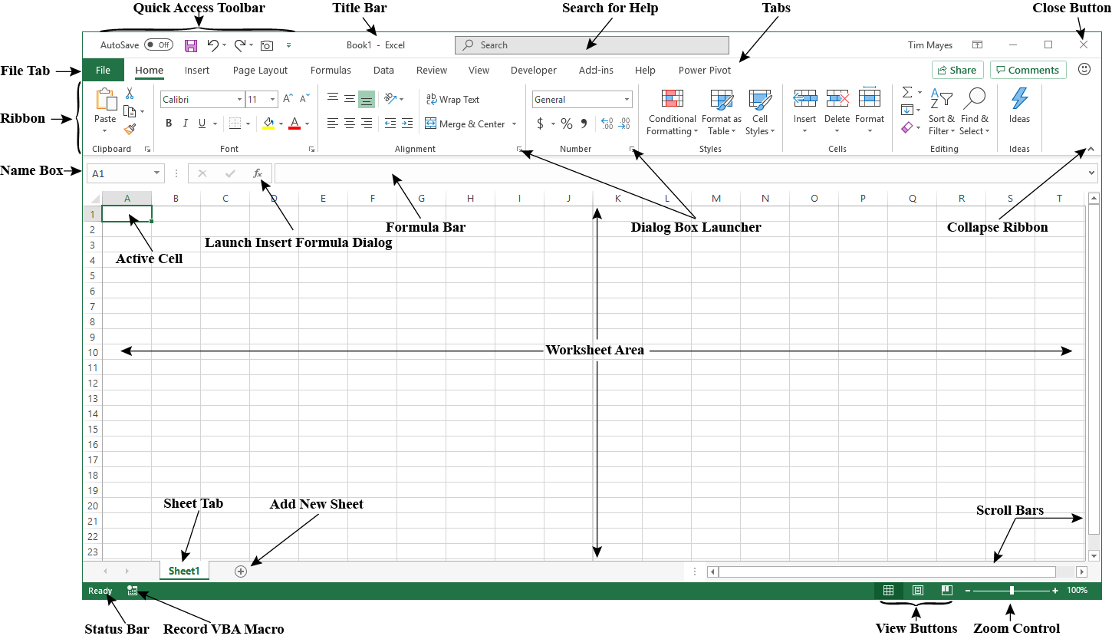
Parts of the Excel Screen I
Videos: Excel Tour, Quick Access Toolbar, Ribbon,

Slide 5
Parts of the Excel Screen
Videos: Ribbon, Status Bar
The File Tab – Open, close, save, and print files
Quick Access Toolbar – Undo, redo, and other shortcuts
The Home Tab – Cut, copy, paste, formatting options, find and replace
The Formula Bar – Used to enter and edit formulas
The Worksheet Area – This contains the spreadsheet cells
Sheet Tabs – Many worksheets can be contained in one workbook
Status Bar – Messages about the current status appear here

Slide 6
Using Defined Names
Videos: Naming
A name given to a cell or group of cells is called a defined name or a named range.
They are useful for quick navigation to a location
Also can be used in formulas in place of the cell reference
Defined names are formulas, so they may also be used to define a constant or a formula that can then be used in the worksheet
They can be created in two ways:
By selecting a range and then entering a name in the name box
Using the Define Name button on the Formulas tab

Slide 7
Formatting and Alignment Options
Videos: Font, Cell, Number Formats
Formatting is more than just making the worksheet look good
Use the buttons on the home tab to apply formatting
A well-formatted worksheet is much easier to use and understand:
Keep the number of fonts used to a minimum – Preferably no more than two
Formatting Numbers – Numbers should be formatted in a consistent manner throughout the workbook (e.g., with commas and the same number of decimal places)
Add Borders and Shading – These can help to set off the important areas of the worksheet and draw the reader’s attention

Slide 8
Entering Formulae I
Videos: Copying, Moving, Pasting, Formulae I, II
Formulas always begin with an equals sign and contain cell references and/or constants
Do not use numbers in formulas unless they will never change
Numbers that may change should be in a cell in the assumptions area
Copying and Moving Formulas
Copying and pasting formulas will change the cell references unless $-signs are used to freeze the reference
Moving formulas will keep existing references

Slide 9
Entering Formulas II
Videos: Copying, Moving, Pasting, Formulae I, II
Mathematical Operators – Similar to a calculator:
+, -, *, / – Basic arithmetic operators (add, subtract, multiply, divide)
Use a caret (^) to raise a number to a power
Parentheses and the Order of Operations
Excel follows the usual rules for the order of operations:
PEMDAS – Parentheses, Exponents, Multiplication, Division, Addition, Subtraction
Use parentheses to indicate which parts of a formula should be calculated first

Slide 10
Using Excel’s Built-In Functions
Videos: Function Videos
Excel has about 500 built-in functions
Use them instead of reinventing the wheel
Using the Insert Function Dialog Box
Press the f x button on the formula bar to launch Insert Function
“Dot Functions” in Excel
Many new functions introduced in Excel 2010 or later have a dot in the name
These may be brand new functions, or older functions that have been rewritten with a better (usually more accurate) algorithm
Be aware that new functions are not compatible with older versions of Excel
Using User-Defined Functions
U D Fs are functions that are written in the V B A programming language
See Chapter 15 to learn how to write your own

Slide 11
Creating Graphics
Videos: Charts, Intro
Excel can create three distinct kinds of charts:
Charts in a Chart Sheet – These are standalone charts on a special type of worksheet
Embedded Charts – Are stored within a regular worksheet along with data
Sparkline Charts – These are small charts held in a single cell
Formatting Charts
Each item in a chart is an object that can be selected and edited
Right click an item and select Format… to see what you can do to change its appearance
Changing the Chart Type
There are many different types of charts (line, scatter, pie, etc.)
You can change a chart to a different type after it is created by right clicking the chart and choosing Change Chart Type from the shortcut menu

Slide 12
Using Excel with Other Applications
Videos: Paste Special
Excel can be used to create content that will be used in other applications
It works particularly well with other Microsoft Office applications
Regardless of the application, there are generally two ways to use Excel data in it:
Copy and Paste
Copy and Paste Special
Paste Special, if available, will typically give you options regarding how the data is pasted (e.g., as an image, an editable “Microsoft Excel Worksheet Object,” or text)
You may also be able to create a link to your workbook so that the application updates the data if you change the Excel file

Slide 13
Quitting Excel
There is a difference between closing a workbook and quitting the Excel application:
Close a workbook by choosing File -> Close, or pressing the X in the upper right corner of the application
This will close the application if only one workbook is open
Otherwise, it will only close the workbook
Exit the Excel application by closing all workbooks and then clicking the X in the upper right corner of the application

