Slide 1
FIN 470: Financial Analysis in Excel
Topic 1.1: Course Introduction
Larry Schrenk, Instructor

Slide 2
Overview
General Approach
Schedule
About the Course

Slide 3
1. General Approach

Slide 4
Motivation
Excel Skills
Attempts
FIN 470/FIN 200

Slide 5
Tasks
Financial Analysis
Excel Mastery
Excel Application in Finance

Slide 6
1. Financial Analysis
Theory
Schedule (below)
Some Overlap with Other Courses

Slide 7
2. Excel Mastery
Different Backgrounds
Videos (Schedule Page, Complete List)
In Class
In Groups
Office Hours, E-Mail, etc.

Slide 8
Excel Mastery: Videos
Tasks
Schedule Page
Functions
By Chapter Schedule Page
Complete List

Slide 9
3. Weekly Schedule
Monday Financial Concepts
Wednesday Excel Functions
Friday Excel Application

Slide 10
2. Schedule

Slide 11
Schedule
Financial Statements (T 2-5)
TVM, Stocks and Bonds (T 6-8)
Corporate Finance (T 10-11)
No Topic 9
Portfolio Theory (T 12)
Advanced Excel (T 13-15)

Slide 12
Web Pages
Course Web Pages (http://larryschrenk.com/)
My Pages
Main Page
Schedule
Exams, Assignments, etc.
D2L Pages
Textbook
E-Mail
Grades
Exams

Slide 13
3. About the Course

Slide 14
About Me
?????
Home Page

Slide 15
About You
Introductions
Pair Introductions

Slide 16
Tools
S&P Capital IQ
Capital IQ Login
Capital IQ Intro Video (mp4, 27:36)
Capital IQ Resource Page
Financial Resources Page

Slide 17
Course Information
FIN 470: Financial Analysis in Excel
Larry Schrenk, Instructor
Course Page
http://larryschrenk.com/FIN470/FIN470.htm

Slide 18
Contact Information
Office: Somsen 319F
Telephone 507-457-2388
E-Mail
lschrenk@winona.edu
Webpage
http://larryschrenk.com/

Slide 19
Office Hours
Office Hours
9:00-9:50 AM MWF
12:00-1:00 PM MWF
Zoom Office Hours TR
By Appointment/Drop-In
Monday, Wednesday, Friday Campus or Zoom
Tuesday, Thursday (Zoom by appt)
On Campus Policy

Slide 20
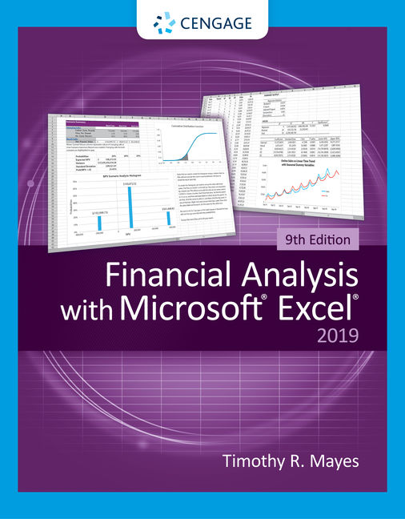
Textbook
Timothy R. Mayes, Financial Analysis with Microsoft Excel. 9th ed. Cengage, 2021.

Slide 21
Financial Calculator
Acceptable Calculators:
TI 83/84 Graphing
TI BA II Plus, HP 10BII, HP 10BII+
If you want to use a different calculator, see me
Three Methods:
Tables
Formulae
Calculator
On NOT becoming an expert with a financial calculator

Slide 22
Evaluation
Exams (2 @ 20% each) 40%
Group Assignments 40%
Individual Project 10%
Participation/Attendance Policy

Slide 23
Exams
Two Exams (20% each)
No Crib Sheets, Formulae Sheets, Etc.
Dates are on the Schedule Page

Slide 24
Exam Format
Format
100 Points
Short Answer: 10 Questions (50%)
Calculation: 5 Questions (50%)
Not Cumulative
But Later Material Builds on Earlier!

Slide 25
Exam Mechanics
Two D2L exams will be done in class
Lockdown Browser
Exam dates on Schedule Page

Slide 26
Tasks
Group Excel Assignments
Group membership under ‘Groups’ in D2L
Individual Project

Slide 27
Group Excel Assignments
Select Firm (See Below)
Weekly (per Topic)
Present/Analyze in Class
Topics and due dates on Schedule Page

Slide 28
Firm Selection
‘S&P 500’ (see Wikipedia for List)
Alternates Must be Approved
Firm Criteria:
Solvent and Simple
No Financial Firms
Issues Long-Term Bonds
Paid Dividends for the Last Five Years

Slide 29
Individual Project
Substantial Project
Excel Analysis of Significant Issue
Instructor Approval
Proposal and project due dates on Schedule Page

Slide 30
Attendance
Five permitted absences
Additional, unexcused absence = 1 point from course score
Daily Qualtrics Attendance Survey
Start Next Week

Slide 31
AI Policies
AI Policies
Course AI Chatbot
FIN470Chat
AI Uses
AI Day

Slide 32
Syllabus
Syllabus Questions???

