Slide 1
FIN 440: International Finance
Larry Schrenk, Instructor
Video 7.1 Arbitrage

Slide 2
7
International Arbitrage And Interest Rate Parity
Chapter Objectives
Explain the conditions that will result in locational arbitrage and the realignments that will follow.
Explain the conditions that will result in triangular arbitrage and the realignments that will follow.
Explain the conditions that will result in covered interest arbitrage and the realignments that will follow.
Explain the concept of interest rate parity.
Explain the variation in forward rate premiums across maturities and over time.
2

Slide 3
Arbitrage
Arbitrage
Guaranteed Profit
No Cost (self-financing trading strategy)
No Risk
Example:
IBM $100 in New York and $102 in Chicago.
How do you take advantage of the opportunity?
What is the arbitrage profit?
Law of One Price

Slide 4
‘Arbitrage’ Types
Pure Arbitrage: No risk nothing and earn more than the riskless rate
Near Arbitrage: Assets are identical or almost, but there is no guarantee of profit
Speculative Arbitrage:
Investors take advantage of what they see as mispriced and similar (though not identical) assets

Slide 5
No-Arbitrage Pricing
If markets are efficient and in equilibrium…
There is no arbitrage.
This can either
Set a limit on prices, or
Determine prices exactly.
Applications
Determining FX Rates
Pricing Derivative Securities

Slide 6
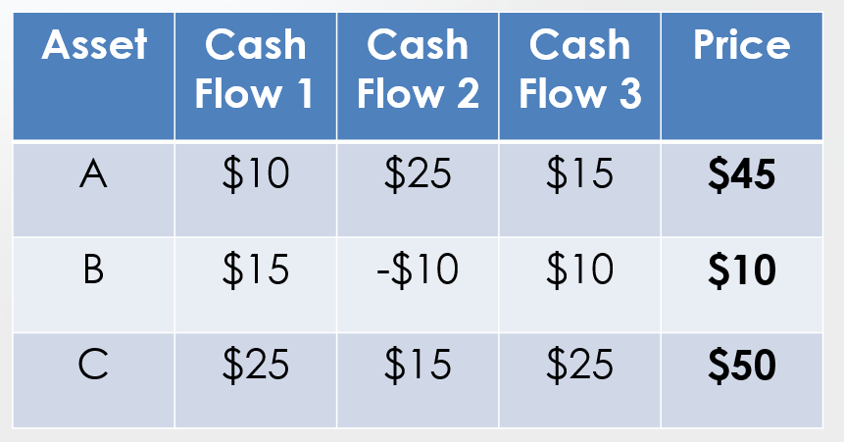
A Simple Example

