Slide 1
FIN 440: International Finance
Larry Schrenk, Instructor
Video 6.1 Exchange Rate Systems

Slide 2
6
Government Influence on Exchange Rates
Chapter Objectives
Describe the exchange rate system used by various governments.
Describe the development and implications of a single European currency.
Explain how governments can use direct intervention to influence exchange rates.
Explain how governments can use indirect intervention to influence exchange rates.
2

Slide 3
Exchange Rate Systems (1 of 9)
Exchange rate systems can be classified according to the degree of government control and fall into the following categories:
Fixed
Freely floating
Managed float
Pegged

Slide 4
Exchange Rate Systems (2 of 9)
Fixed Exchange Rate System
Exchange rates are either held constant or allowed to fluctuate only within very narrow boundaries.
Central bank can reset a fixed exchange rate by devaluing or reducing the value of the currency against other currencies.
Central bank can also revalue or increase the value of its currency against other currencies.

Slide 5
Exchange Rate Systems (3 of 9)
Fixed Exchange Rate System (cont.)
Bretton Woods Agreement 1944 – 1971 — Each currency was valued in terms of gold.
Smithsonian Agreement 1971 – 1973 — called for a devaluation of the U.S. dollar by about 8% against other currencies.
Advantages of fixed exchange rates
Insulate country from risk of currency appreciation.
Allow firms to engage in direct foreign investment without currency risk.
Disadvantages of fixed exchange rates
Risk that government will alter value of currency.
Country and MNC may be more vulnerable to economic conditions in other countries.

Slide 6
Exchange Rate Systems (4 of 9)
Freely Floating Exchange Rate System
Exchange rates are determined by market forces without government intervention.
Advantages of a freely floating system:
Country is more insulated from inflation of other countries.
Country is more insulated from unemployment of other countries.
Does not require central bank to maintain exchange rates within specified boundaries.
Disadvantages of a freely floating exchange rate system:
Can adversely affect a country that has high unemployment.
Can adversely affect a country with high inflation.

Slide 7
Exchange Rate Systems (5 of 9)
Managed Float Exchange Rate System
Governments sometimes intervene to prevent their currencies from moving too far in a certain direction.
Countries with floating exchange rates: Currencies of most large developed countries are allowed to float, although they may be periodically managed by their respective central banks. (Exhibit 6.1)
Criticisms of the managed float system: Critics suggest that managed float allows a government to manipulate exchange rates to benefit its own country at the expense of others.

Slide 8
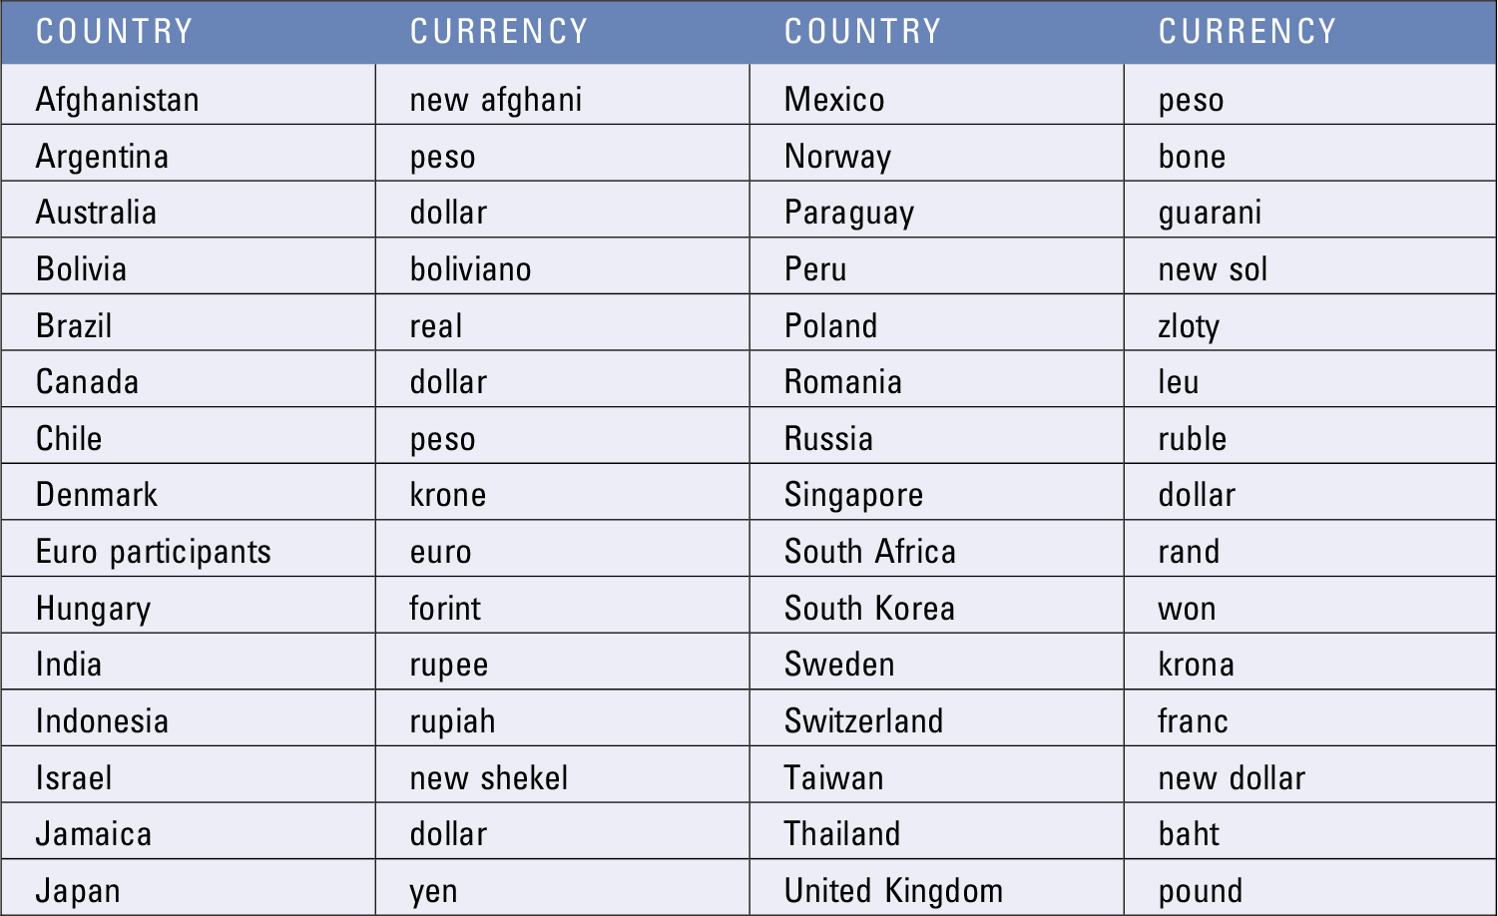
Exhibit 6.1 Countries with Floating Exchange Rates and Their Currencies

Slide 9
Exchange Rate Systems (6 of 9)
Pegged Exchange Rate System
Home currency value is pegged to one foreign currency or to an index of currencies.
Limitations of pegged exchange rate
May attract foreign investment because exchange rate is expected to remain stable.
Weak economic or political conditions can cause firms and investors to question whether the peg will be broken.

Slide 10
Exchange Rate Systems (7 of 9)
Pegged Exchange Rate System (cont.)
Examples:
Europe’s Snake Arrangement 1972 - 1979
European Monetary System (EMS) 1979 - 1992
Mexico’s Pegged System 1994
China’s Pegged Exchange Rate 1996 - 2005
Venezuela’s Pegged Exchange Rate 2010

Slide 11
Exchange Rate Systems (8 of 9)
Pegged Exchange Rate System (cont.)
Currency Boards Used to Peg Currency Values
A system for pegging the value of the local currency to some other specified currency. The board must maintain currency reserves for all the currency that it has printed.
Interest Rates of Pegged Currencies
Interest rate will move in tandem with the interest rate of the currency to which it is tied.
Exchange Rate Risk of a Pegged Currency
Provides examples of countries that have pegged the exchange rate of their currency to a specific currency. Currencies are commonly pegged to the U.S. dollar or to the euro.
Classification of Pegged Exchange Rates (Exhibit 6.2)

Slide 12
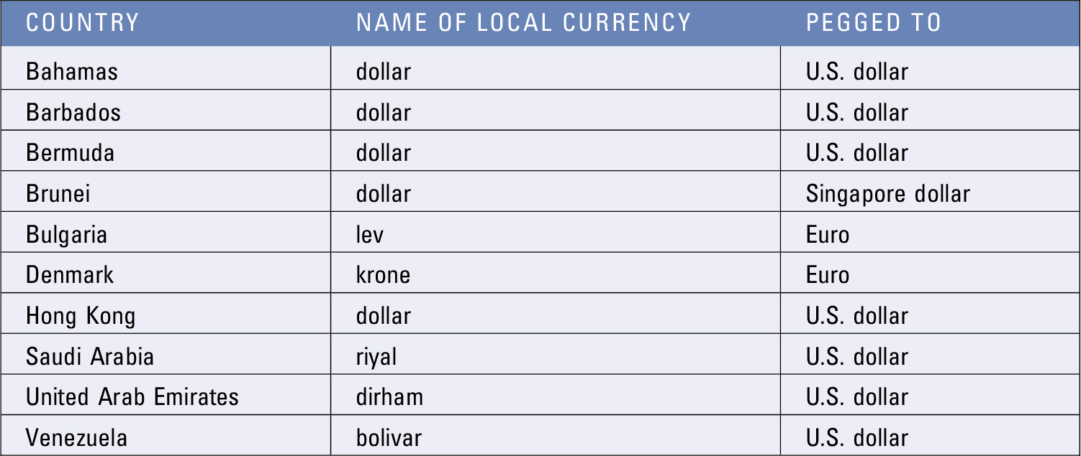
Exhibit 6.2 Countries with Pegged Exchange Rates and the Currencies to Which They Are Pegged

Slide 13
Exchange Rate Systems (9 of 9)
Dollarization
Replacement of a foreign currency with U.S. dollars.
This process is a step beyond a currency board because it forces the local currency to be replaced by the U.S. dollar. Although dollarization and a currency board both attempt to peg the local currency’s value, the currency board does not replace the local currency with dollars.

Slide 14
A Single European Currency (1 of 5)
Monetary Policy in the Eurozone
European Central Bank — Based in Frankfurt and is responsible for setting monetary policy for all participating European countries
Objective is to control inflation in the participating countries and to stabilize (within reasonable boundaries) the value of the euro with respect to other major currencies.
Impact on Firms in the Eurozone — Prices of products are now more comparable among European countries.
Impact on Financial Flows in the Eurozone — Bond investors who reside in the eurozone can now invest in bonds issued by governments and corporations in these countries without concern about exchange rate risk, as long as the bonds are denominated in euros.

Slide 15
A Single European Currency (2 of 5)
Exposure of Countries within the Eurozone
A single European monetary policy prevents any individual European country from solving local economic problems with its own unique monetary policy.
Any given monetary policy used in the eurozone during a particular period may enhance conditions in some countries and adversely affect others.
Impact of Crises within the Eurozone — may affect the economic conditions of the other participating countries because they all rely on the same currency and same monetary policy.

Slide 16
A Single European Currency (3 of 5)
Impact of Crises within the Eurozone (cont.)
Lessons from Eurozone crisis
Financial problems of one bank can easily spread to other banks.
Banks in Eurozone frequently engage in loan participations. If companies have trouble repaying, all banks may be affected.
News about concerns in one area of Eurozone can trigger actions in other areas.
Eurozone country governments must rely on fiscal policy when they experience serious financial problems.
Banks lend heavily to governments. Performance is related to whether that government can repay its debts.

Slide 17
A Single European Currency (4 of 5)
Impact of Crises within the Eurozone (cont.)
ECB Role in Resolving Economic Crises
In recent years the bank’s role has expanded to include providing credit for eurozone countries that are experiencing a financial crisis.
The ECB imposes restrictions intended to help resolve the country’s budget deficit problems over time.

Slide 18
A Single European Currency (5 of 5)
Impact on a Country that Abandons the Euro
Would allow a country to set its own exchange rate to encourage purchasers of exports.
Would possibly be expelled from the European Union, which would almost certainly reduce its trade with other European Union countries.
Impact of Abandoning the Euro on Eurozone Conditions
Investors may fear other countries abandoning the euro and reduce investments in the eurozone.
Critics agree that the threat of abandonment creates more problems than actual abandonment.

