Slide 1
FIN 440: International Finance
Larry Schrenk, Instructor
Video 5.3 Options Markets II

Slide 2
Currency Put Options (1 of 8)
Grants the right to sell a currency at a specified strike price or exercise price within a specified period of time.
If the spot rate falls below the strike price, the owner of a put can exercise the right to sell currency at the strike price.
The buyer of the options pays a premium.
If the spot exchange rate is lower than the strike price, the option is in the money. If the spot rate is equal to the strike price, the option is at the money. If the spot rate is greater than the strike price, the option is out of the money.

Slide 3
Currency Put Options (2 of 8)
Factors Affecting Put Option Premiums
Put option premiums are affected by three factors:
Spot rate relative to the strike price (S–X): The lower the spot rate relative to the strike price, the higher the probability that the option will be exercised.
Length of time until expiration (T): The longer the time to expiration, the greater the put option premium.
Variability of the currency (σ): The greater the variability, the greater the probability that the option may be exercised.

Slide 4
Currency Put Options (3 of 8)
Hedging with Currency Put Options
Corporations with open positions in foreign currencies can use currency put options in some cases to cover these positions.
Some put options are deep out of the money, meaning that the prevailing exchange rate is high above the exercise price. These options are cheaper (have a lower premium), as they are unlikely to be exercised because their exercise price is too low.
Other put options have an exercise price that is currently above the prevailing exchange rate and are therefore more likely to be exercised. Consequently, these options are more expensive.

Slide 5
Currency Put Options (4 of 8)
Speculating with Currency Put Options
Individuals may speculate with currency put options based on their expectations of the future movements in a particular currency.
Speculators can attempt to profit from selling currency put options. The seller of such options is obligated to purchase the specified currency at the strike price from the owner who exercises the put option.
The net profit to a speculator is based on the exercise price at which the currency can be sold versus the purchase price of the currency and the premium paid for the put option.

Slide 6
Currency Put Options (5 of 8)
Speculating with Currency Put Options (cont.)
Speculating with combined put and call options
Straddle — Uses both a put option and a call option at the same exercise price.
Good for when speculators expect strong movement in one direction or the other.
Efficiency of the currency options market
Research has found that, when transaction costs are controlled for, the currency options market is efficient.
It is difficult to predict which strategy will generate abnormal profits in future periods.

Slide 7
Currency Put Options (6 of 8)
Contingency graph for the caller of a call option
Compares price paid for the option to the payoffs received under various exchange rate scenarios. (Exhibit 5.6)
Contingency graph for the seller of a call option
Compares premium received from selling the option to the payoffs made to the options buyer under various exchange rate scenarios. (Exhibit 5.6)
Contingency graph for the buyer of a put option
Compares premium paid for put option to the payoffs received under various exchange rate scenarios. (Exhibit 5.7)
Contingency graph for the seller of a put option
Compares premium received for put option to the payoffs made under various exchange rate scenarios. (Exhibit 5.7)

Slide 8
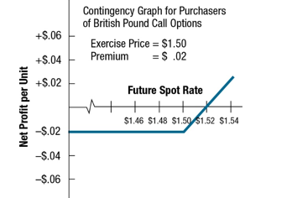
Exhibit 5.6 Contingency Graphs for Currency Call Options

Slide 9
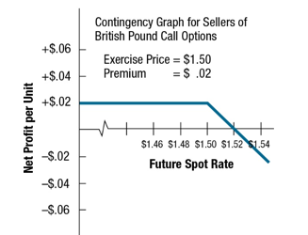
Exhibit 5.6 Contingency Graphs for Currency Call Options

Slide 10
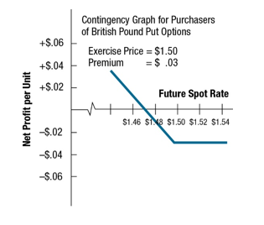
Exhibit 5.7 Contingency Graphs for Currency Put Options

Slide 11
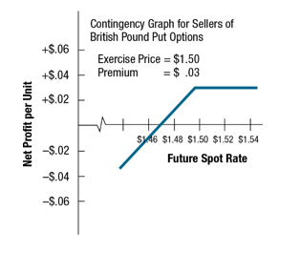
Exhibit 5.7 Contingency Graphs for Currency Put Options

Slide 12
Currency Put Options (7 of 8)
Conditional Currency Options (Exhibit 5.8)
A currency option can be structured with a conditional premium, meaning that the premium paid for the option is conditioned on the actual movement in the currency’s value over the period of concern.
Firms also use various combinations of currency options.

Slide 13
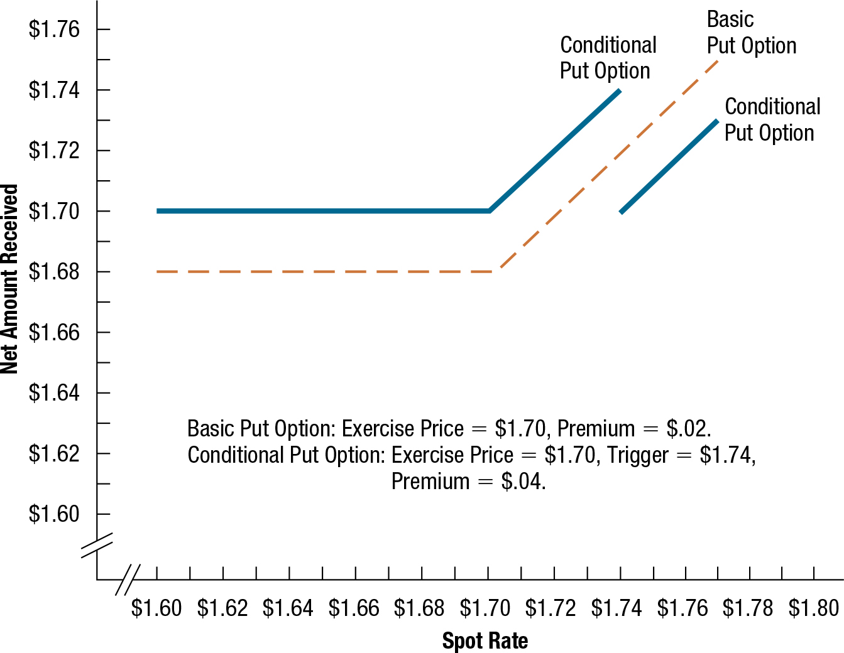
Exhibit 5.8 Comparison of Conditional and Basic Currency Options

Slide 14
Currency Put Options (8 of 8)
European Currency Options
European-style currency options must be exercised on the expiration date if they are to be exercised at all.
They do not offer as much flexibility; however, this is not relevant to some situations.
If European-style options are available for the same expiration date as American-style options and can be purchased for a slightly lower premium, some corporations may prefer them for hedging.

