Slide 1
FIN 440: International Finance
Larry Schrenk, Instructor
Video 4.1 Exchange Rate Equilibrium

Slide 2
4
Exchange Rate Determination
Chapter Objectives
Explain how exchange rate movements are measured.
Explain how the equilibrium exchange rate is determined.
Examine factors that determine the equilibrium exchange rate.
Explain the movement in cross exchange rates.
Explain how financial institutions attempt to capitalize on anticipated exchange rate movements.
2

Slide 3
Measuring Exchange Rate Movements
Depreciation: decline in a currency’s value
Appreciation: increase in a currency’s value
Comparing foreign currency spot rates over two points in time, S and S_{t-1}
A positive percent change indicates that the currency has appreciated. A negative percent change indicates that it has depreciated. (Exhibit 4.1)

Slide 4
Exhibit 4.1 How Exchange Rate Movements and Volatility Are Measured

Slide 5
Exchange Rate Equilibrium (1 of 2)
The exchange rate represents the price of a currency, or the rate at which one currency can be exchanged for another.
Demand for a currency increases when the value of the currency decreases, leading to a downward sloping demand schedule. (See Exhibit 4.2)
Supply of a currency for sale increases when the value of the currency increases, leading to an upward sloping supply schedule. (See Exhibit 4.3)
Equilibrium equates the quantity of pounds demanded with the supply of pounds for sale. (See Exhibit 4.4)

Slide 6
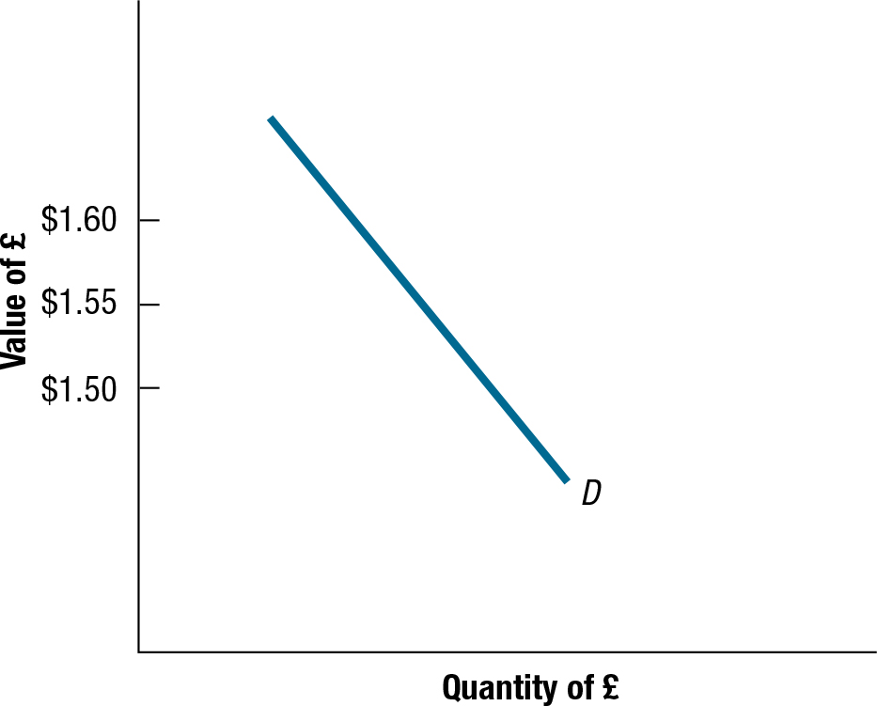
Exhibit 4.2 Demand Schedule for British Pounds
6

Slide 7
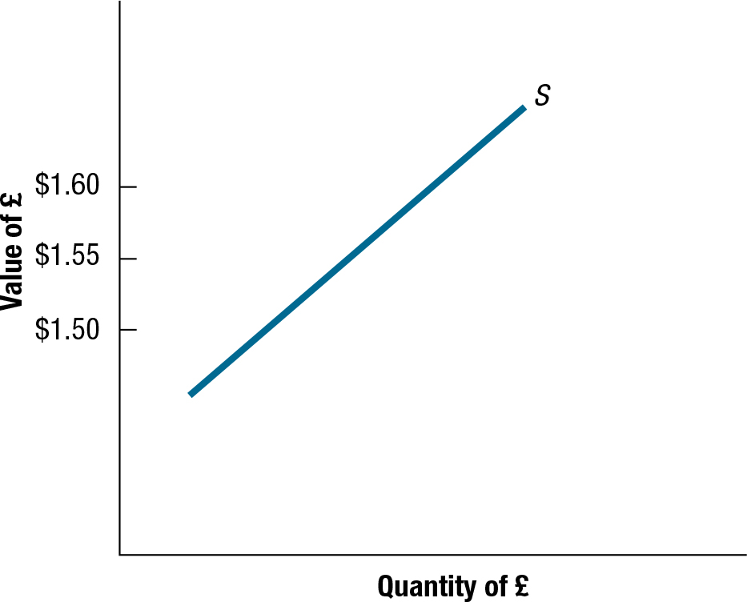
Exhibit 4.3 Supply Schedule of British Pounds for Sale
7

Slide 8
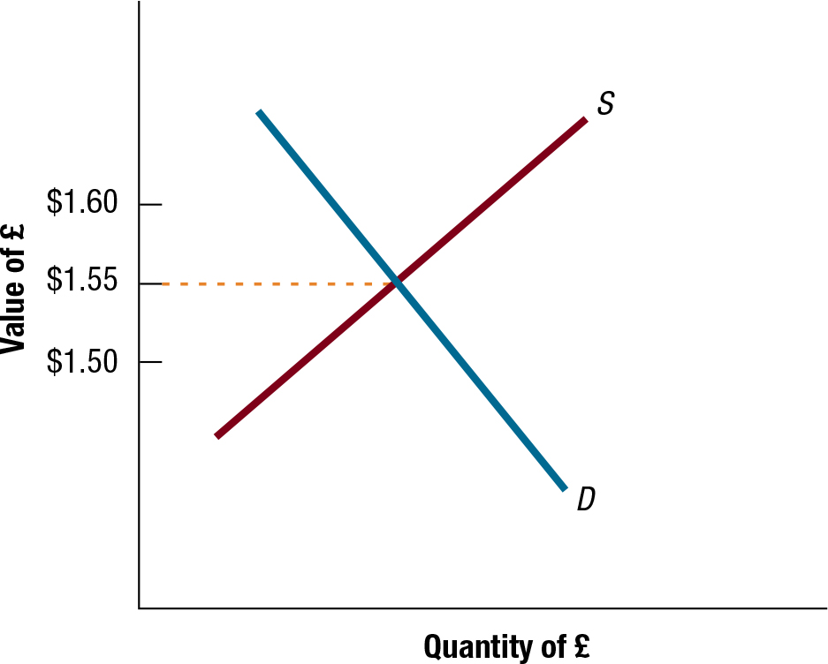
Exhibit 4.4 Equilibrium Exchange Rate Determination
8

Slide 9
Exchange Rate Equilibrium (2 of 2)
Change in the Equilibrium Exchange Rate
Increase in demand schedule: Banks will increase the exchange to the level at which the amount demanded is equal to the amount supplied in the foreign exchange market.
Decrease in demand schedule: Banks will reduce the exchange to the level at which the amount demanded is equal to the amount supplied in the foreign exchange market.
Increase in supply schedule: Banks will reduce the exchange to the level at which the amount demanded is equal to the amount supplied in the foreign exchange market.
Decrease in supply schedule: Banks will increase the exchange to the level at which the amount demanded is equal to the amount supplied in the foreign exchange market.

Slide 10
Factors That Influence Exchange Rates (1 of 5)
The equilibrium exchange rate will change over time as supply and demand schedules change.

Slide 11
Factors That Influence Exchange Rates (2 of 5)
Relative Inflation Rates: Increase in U.S. inflation leads to increase in U.S. demand for foreign goods, an increase in U.S. demand for foreign currency, and an increase in the exchange rate for the foreign currency. (See Exhibit 4.5)
Relative Interest Rates: Increase in U.S. rates leads to increase in demand for U.S. deposits and a decrease in demand for foreign deposits, leading to an increase in demand for dollars and an increased exchange rate for the dollar. (See Exhibit 4.6)
Real Interest Rates
Fisher Effect:

Slide 12
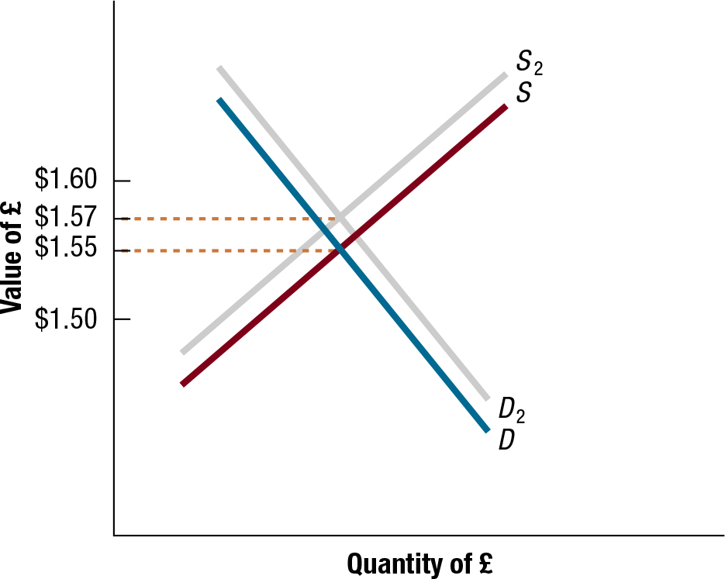
Exhibit 4.5 Impact of Rising U.S. Inflation on the Equilibrium Value of the British Pound
12

Slide 13
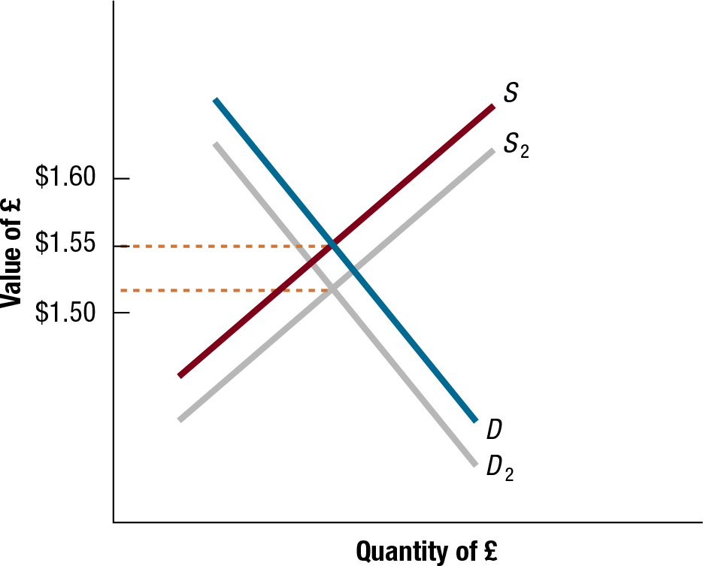
Exhibit 4.6 Impact of Rising U.S. Interest Rates on the Equilibrium Value of the British Pound
13

Slide 14
Factors That Influence Exchange Rates (3 of 5)
Relative Income Levels: Increase in U.S. income leads to an increase in U.S. demand for foreign goods, an increased demand for foreign currency relative to the dollar, and an increase in the exchange rate for the foreign currency. (See Exhibit 4.7)
Government Controls via:
Imposing foreign exchange barriers
Imposing foreign trade barriers
Intervening in foreign exchange markets
Affecting macro variables such as inflation, interest rates, and income levels

Slide 15
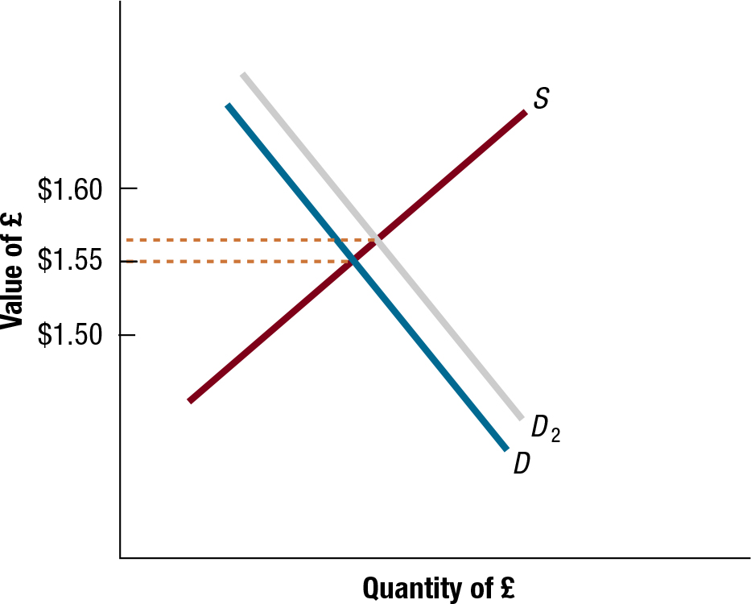
Exhibit 4.7 Impact of Rising U.S. Income Levels on Equilibrium Value of the British Pound
15

Slide 16
Factors That Influence Exchange Rates (4 of 5)
Expectations:
Impact of favorable expectations: If investors expect interest rates in one country to rise, they may invest in that country, leading to a rise in the demand for foreign currency and an increase in the exchange rate for foreign currency.
Impact of unfavorable expectations: Speculators can place downward pressure on a currency when they expect it to depreciate.
Impact of signals on currency speculation: Speculators may overreact to signals, causing currency to be temporarily overvalued or undervalued.

Slide 17
Factors that Influence Exchange Rates (5 of 5)
Interaction of Factors: Some factors place upward pressure while other factors place downward pressure. (See Exhibit 4.8)
Influence of Factors across Multiple Currency Markets: common for European currencies to move in the same direction against the dollar.
Influence of Liquidity on Exchange Rate adjustment: If a currency’s spot market is liquid then its exchange rate will not be highly sensitive to a single large purchase or sale.

Slide 18
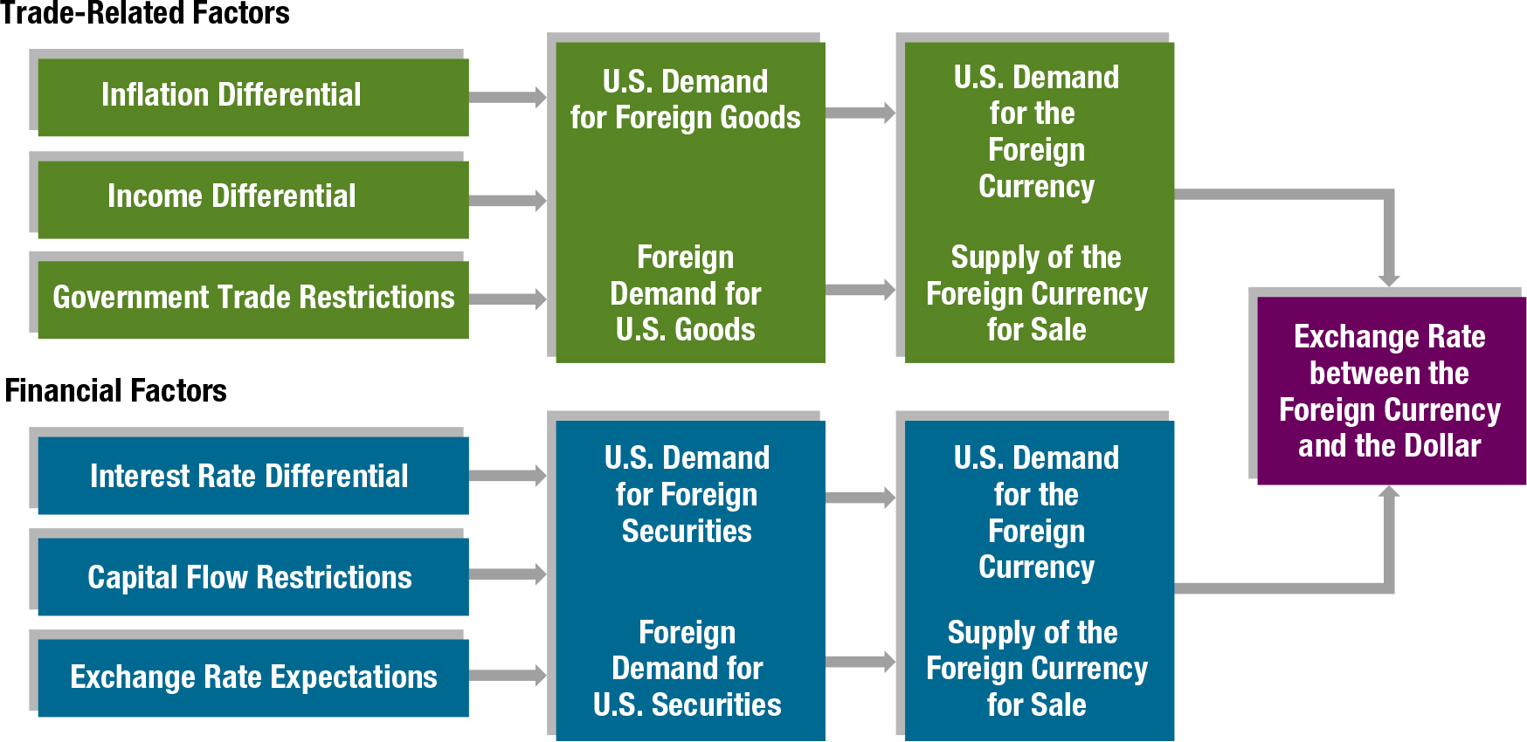
Exhibit 4.8 Summary of How Factors Affect Exchange Rates
18

