Slide 1
FIN 440: International Finance
Larry Schrenk, Instructor
Video 3.3 International Money and Credit Markets

Slide 2
International Money Market (1 of 4)
Corporations or governments need short-term funds denominated in a currency different from their home currency.
The international money market has grown because firms:
May need to borrow funds to pay for imports denominated in a foreign currency.
May choose to borrow in a currency in which the interest rate is lower.
May choose to borrow in a currency that is expected to depreciate against their home currency

Slide 3
International Money Market (2 of 4)
Origins and Development
European Money Market: Dollar deposits in banks in Europe and other continents are called Eurodollars or Eurocurrency. Origins of the European money market can be traced to the Eurocurrency market that developed during the 1960s and 1970s.
Asian Money Market: Centered in Hong Kong and Singapore. Originated as a market involving mostly dollar-denominated deposits, and was originally known as the Asian dollar market.

Slide 4
International Money Market (3 of 4)
Money Market Interest Rates Among Currencies
The money market interest rates in any particular country are dependent on the demand for short-term funds by borrowers, relative to the supply of available short-term funds that are provided by savers. (Exhibit 3.4)
Money market rates vary due to differences in the interaction of the total supply of short-term funds available (bank deposits) in a specific country versus the total demand for short-term funds by borrowers in that country.

Slide 5
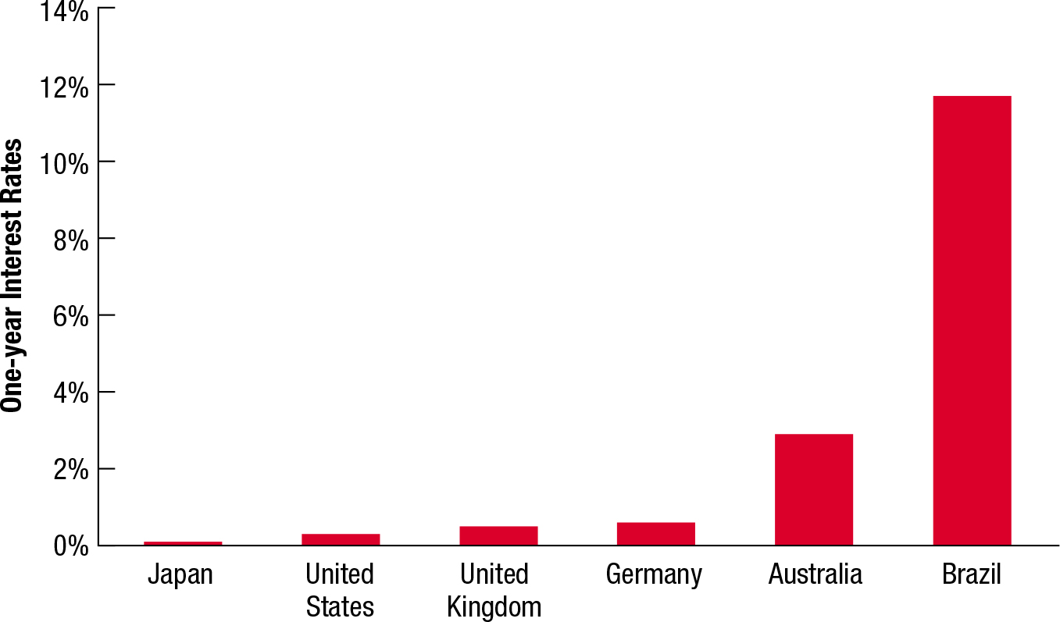
Exhibit 3.4 Comparison of 2015 International Money Market Interest Rates

Slide 6
International Money Market (4 of 4)
Money Market Interest Rates Among Currencies (cont.)
Global Integration of Money Market Interest Rates
Money market interest rates among countries tend to be highly correlated over time.
When economic conditions weaken, the corporate need for liquidity declines, and corporations reduce the amount of short-term funds they wish to borrow.
When economic conditions strengthen, there is an increase in corporate expansion, and corporations need additional liquidity to support their expansion.

Slide 7
Risk of International Money Market Securities
Money Market Interest Rates Among Currencies (cont.)
Risk of International Money Market Securities
International Money Market Securities are debt securities issued by MNCs and government agencies with a short-term maturity (1 year or less).
Normally, these securities are perceived to be very safe from the risk of default.
Even if the international money market securities are not exposed to credit risk, they are exposed to exchange rate risk when the currency denominating the securities differs from the home currency of the investors.

Slide 8
International Credit Market (1 of 5)
MNCs sometimes obtain medium-term funds through term loans from local financial institutions or through the issuance of notes (medium-term debt obligations) in their local markets.
Loans of 1 year or longer extended by banks to MNCs or government agencies in Europe are commonly called Eurocredits or Eurocredit loans.
To avoid interest rate risk, banks commonly use floating rate loans with rates tied to the London Interbank Offer Rate (LIBOR).

Slide 9
International Credit Market (2 of 5)
Syndicated Loans in the Credit Market
Sometimes a single bank is unwilling or unable to lend the amount needed by an MNC or government agency.
A syndicate of banks can be formed to underwrite the loans and the lead bank is responsible for negotiating the terms with the borrower.

Slide 10
International Credit Market (3 of 5)
Regulations in the Credit Market
Single European Act
Capital can flow freely throughout Europe.
Banks can offer a wide variety of lending, leasing, and securities activities in the EU.
Regulations regarding competition, mergers, and taxes are similar throughout the EU.
A bank established in any one of the EU countries has the right to expand into any or all of the other EU countries.
Basel Accord — Banks must maintain a high level of capital as a percent of their assets. For this purpose, banks’ assets are weighted by risk.

Slide 11
International Credit Market (4 of 5)
Regulations in the Credit Market (Cont.)
Basel II Accord — Attempts to account for differences in collateral among banks. In addition, this accord encourages banks to improve their techniques for controlling operational risk, which could reduce failures in the banking system. Also plans to require banks to provide more information to existing and prospective shareholders about their exposure to different types of risk.
Basel III Accord — Called for new methods of estimating risk-weighted assets that would increase the level of risk-weighted assets, and therefore require banks to maintain higher levels of capital.

Slide 12
International Credit Market (5 of 5)
Impact of the Credit Crisis on the Credit Market
The credit crisis of 2008 triggered by defaults in subprime loans led to a halt in housing development, which reduced income, spending, and jobs.
Financial institutions became cautious with their funds and were less willing to lend funds to MNCs.

