Slide 1
FIN 440: International Finance
Larry Schrenk, Instructor
Video 2.2 International Trade

Slide 2
Growth in International Trade (1 of 6)
Events That Increased Trade Volume
Removal of the Berlin Wall: Led to reductions in trade barriers in Eastern Europe.
Single European Act of 1987: Improved access to supplies from firms in other European countries.
North American Free Trade Agreement (NAFTA): Allowed U.S. firms to penetrate product and labor markets that previously had not been accessible.
General Agreement on Tariffs and Trade (GATT): Called for the reduction or elimination of trade restrictions on specified imported goods over a 10-year period across 117 countries.

Slide 3
Growth in International Trade (2 of 6)
Events That Increased Trade Volume (cont.)
The European Union: Free movement of products, services, and capital among member countries.
Inception of Euro: Avoid exposure to exchange rate risk.
Other Trade Agreements: The United States has established trade agreements with many other countries.

Slide 4
Growth in International Trade (3 of 6)
Impact of Outsourcing on Trade
Definition of Outsourcing: The process of subcontracting to a third party in another country to provide supplies or services that were previously produced internally.
Impact of outsourcing:
Increased international trade activity because MNCs now purchase products or services from another country.
Lower cost of operations and job creation in countries with low wages.
Criticism of outsourcing:
Outsourcing may reduce jobs in the United States.

Slide 5
Growth in International Trade (4 of 6)
Impact of Outsourcing on Trade (cont.)
Managerial decisions about outsourcing
Managers of a U.S.-based MNC may argue that they create jobs for U.S. workers.
Shareholders may suggest that the managers are not maximizing the MNC’s value as a result of their commitment to creating U.S. jobs.
Managers should consider the potential savings that could occur as a result of outsourcing.
Managers must also consider the possible bad publicity or bad morale that could occur among the U.S. workers.

Slide 6
Growth in International Trade (5 of 6)
Trade Volume Among Countries
The annual international trade volume of the United States is between 10 and 20% of its annual GDP.
Trade volume between the United States and Other Countries:
About 20% of all U.S. exports are to Canada, while 13% are to Mexico. (Exhibits 2.3 and 2.4)
Canada, China, Mexico, and Japan are the key exporters to the United States. Together, they are responsible for more than half of the value of all U.S. imports.

Slide 7
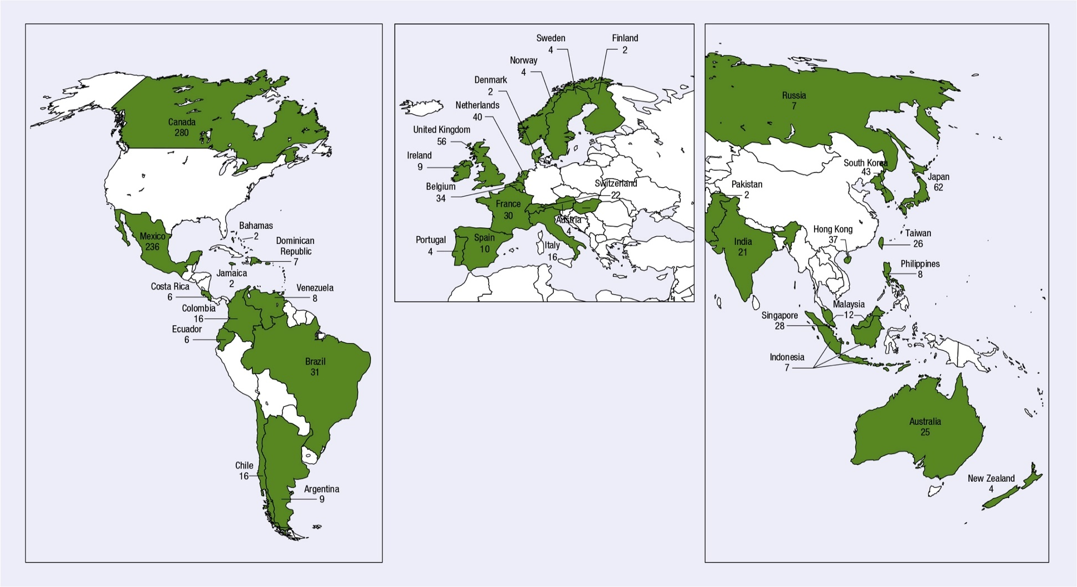
Exhibit 2.3 Distributions of U.S. Exports by Country (2015, billions of $)
Source: U.S. Census Bureau, 2016.

Slide 8
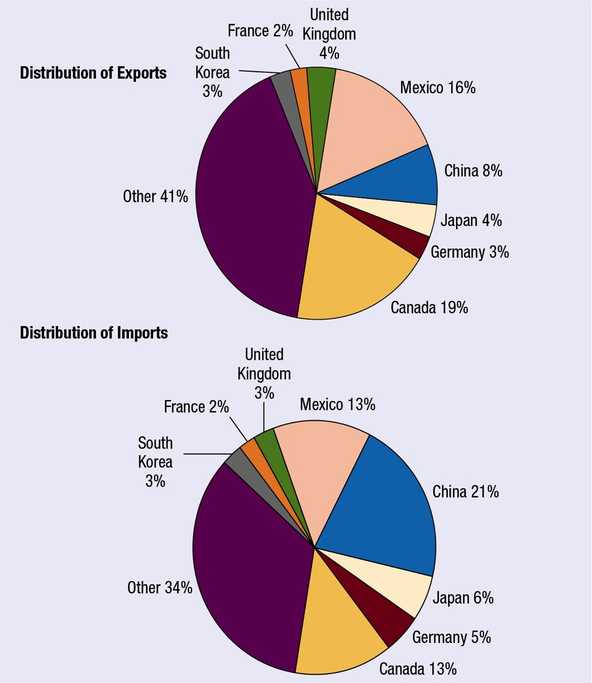
Exhibit 2.4 Distribution of U.S. Exports and Imports by Country (2015)
8

Slide 9
Growth in International Trade (6 of 6)
Trend in U.S. Balance of Trade (Exhibit 2.5)
The quarterly trend in the U.S. balance of trade is shown in Exhibit 2.5.
Much of the U.S. trade deficit is due to a trade imbalance with just two countries: China and Japan.
In recent years, the U.S. annual balance-of-trade deficit with China has exceeded $300 billion.

Slide 10
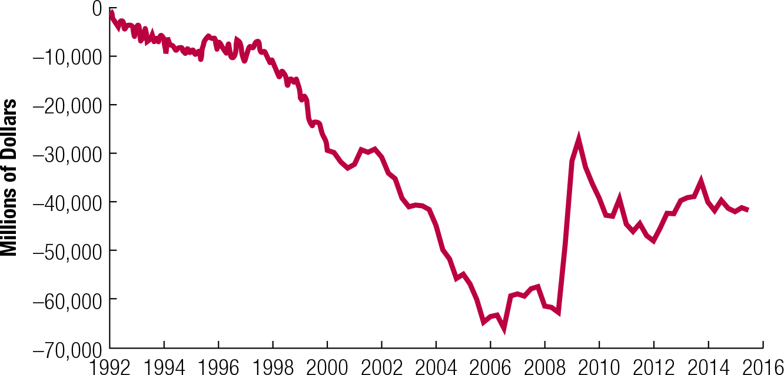
Exhibit 2.5 U.S. Balance of Trade Over Time (Quarterly)

Slide 11
Factors Affecting International Trade Flows (1 of 9)
Cost of Labor: Firms in countries where labor costs are low commonly have an advantage when competing globally, especially in labor intensive industries
Inflation: Current account decreases if inflation increases relative to trade partners.
National Income: Current account decreases if national income increases relative to other countries.
Credit Conditions: Tend to tighten when economic conditions weaken, causing banks to be less willing to extend financing to MNCs

Slide 12
Factors Affecting International Trade Flows (2 of 9)
Government Policies: can increase imports through:
Restrictions on imports
Subsidies for exporters
Restrictions on piracy
Environmental restrictions
Labor laws
Business laws
Tax breaks
Country trade requirements
Government ownership or subsidies
Country security laws
Policies to punish country governments

Slide 13
Factors Affecting International Trade Flows (3 of 9)
Impact of Government Policies (cont.)
Restrictions on Imports: Taxes (tariffs) on imported goods increase prices and limit consumption. Quotas limit the volume of imports.
Subsidies for Exporters: Government subsidies help firms produce at a lower cost than their global competitors.
Restrictions on Piracy: A government can affect international trade flows by its lack of restrictions on piracy.
Environmental Restrictions: Environmental restrictions impose higher costs on local firms, placing them at a global disadvantage compared to firms in other countries that are not subject to the same restrictions.

Slide 14
Factors Affecting International Trade Flows (4 of 9)
Impact of Government Policies (cont.)
Labor Laws: Countries with more restrictive laws will incur higher expenses for labor, other factors being equal.
Business Laws: Firms in countries with more restrictive bribery laws may not be able to compete globally in some situations.
Tax Breaks: Though not necessarily a subsidy, still a form of government financial support that might benefit many firms that export products.
Country Trade Requirements: Requiring various forms or obtaining licenses before countries can export to the country (Bureaucracy) is a strong trade barrier.

Slide 15
Factors Affecting International Trade Flows (5 of 9)
Impact of Government Policies (cont.)
Government Ownership or Subsidies: Some governments maintain ownership in firms that are major exporters.
Country Security Laws: Governments may impose certain restrictions when national security is a concern, which can affect on trade.
Policies to Punish Country Governments: Many expect countries to restrict imports from countries that:
Fail to enforce environmental laws and child labor laws.
Initiate war against another country.
Are unwilling to participate in a war.

Slide 16
Factors Affecting International Trade Flows (6 of 9)
Impact of Government Policies (cont.)
Summary of Government Policies:
Every government implements some policies.
No formula ensures a completely fair contest for market share.

Slide 17
Factors Affecting International Trade Flows (7 of 9)
Exchange Rates: Current account decreases if currency appreciates relative to other currencies.
How exchange rates may correct a balance of trade deficit:
When a home currency is exchanged for a foreign currency to buy foreign goods, then the home currency faces downward pressure, leading to increased foreign demand for the country’s products.
Why exchange rates may not correct a balance of trade deficit:
Exchange rates will not automatically correct any international trade balances when other forces are at work.

Slide 18
Factors Affecting International Trade Flows (8 of 9)
Exchange Rates (cont.)
Limitations of a Weak Home Currency Solution
Competition: Foreign companies may lower their prices to remain competitive.
Impact of other currencies: A country that has balance of trade deficit with many countries is not likely to solve all deficits simultaneously.
Prearranged international trade transactions: International transactions cannot be adjusted immediately. The lag is estimated to be 18 months or longer, leading to a J-curve effect. (Exhibit 2.6)
Intracompany trade: Many firms purchase products that are produced by their subsidiaries. These transactions are not necessarily affected by currency fluctuations.

Slide 19
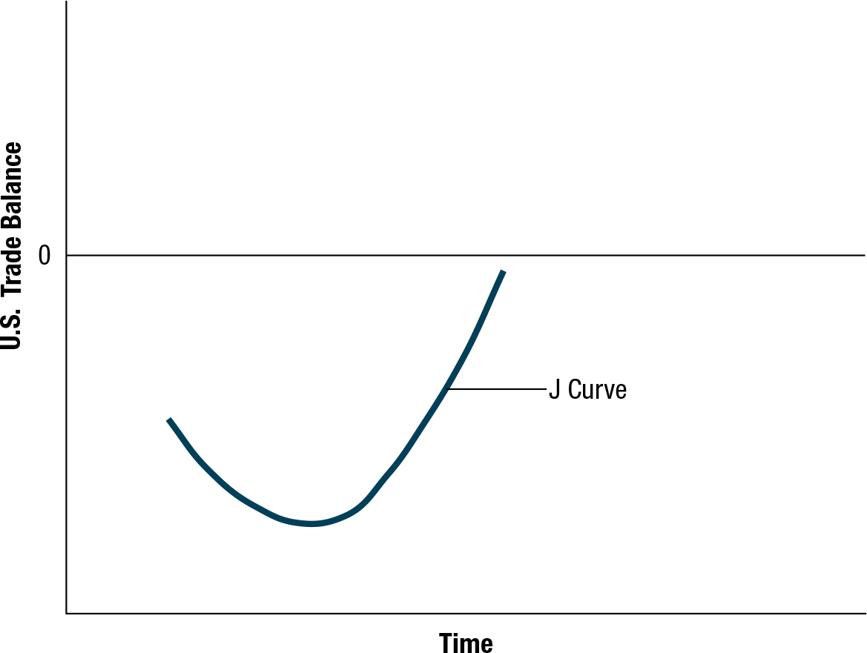
Exhibit 2.6 J-Curve Effect
19

Slide 20
Factors Affecting International Trade Flows (9 of 9)
Exchange Rates (cont.)
Exchange Rates and International Friction
All governments cannot weaken their home currencies simultaneously.
Actions by one government to weaken its currency causes another country’s currency to strengthen.
Government attempts to influence exchange rates can lead to international disputes.

