Slide 1
FIN 440: International Finance
Larry Schrenk, Instructor
Video 18.2 Long-Term Debt Financing II

Slide 2
Debt Maturity Decision
An MNC must decide on the maturity for its debt.
Assessment of Yield Curve
The shape of the yield curve can vary among countries. An upward sloping yield curve may indicate that investors require compensation for illiquidity associated with long-term debt.
Financing Costs of Loans with Different Maturities
Must decide whether to obtain a loan with a maturity that perfectly fits its needs or one with a shorter maturity if it has a more favorable interest rate and then additional financing when this loan matures. (Exhibit 18.6)
3

Slide 3
Exhibit 18.6 Loans of Different Maturities made to Foreign Subsidiary
3

Slide 4
Fixed versus Floating Rate Debt Decision (1 of 6)
MNCs that wish to use a long-term maturity but wish to avoid the prevailing fixed rate may consider floating rate bonds. (Exhibit 18.7)
Financing Costs of Fixed versus Floating Rate Loans
If an MNC considers financing with floating-rate loans it can first forecast the rate for each year, and that would determine the expected interest rate it would pay per year, allowing it to derive forecasted interest payments for all years of the loan.
Floating rates are often tied to the London Interbank Offer Rate (LIBOR).
3

Slide 5
Exhibit 18.7 Alternative Financing Arrangement with a Floating Rate Loan
3

Slide 6
Fixed versus Floating Rate Debt Decision (2 of 6)
Hedging Interest Payments with Interest Rate Swaps (Exhibits 18.8 and18.9)
If MNCs are concerned that interest rates will rise, they may complement their floating rate debt with interest rate swaps to hedge the risk of rising interest rates.
Financial institutions such as commercial and investment banks and insurance companies often act as dealers in interest rate swaps.
In a plain vanilla interest rate swap, one participating firm makes fixed rate payments periodically in exchange for floating rate payments.
The payments are based on a notional value.
3

Slide 7
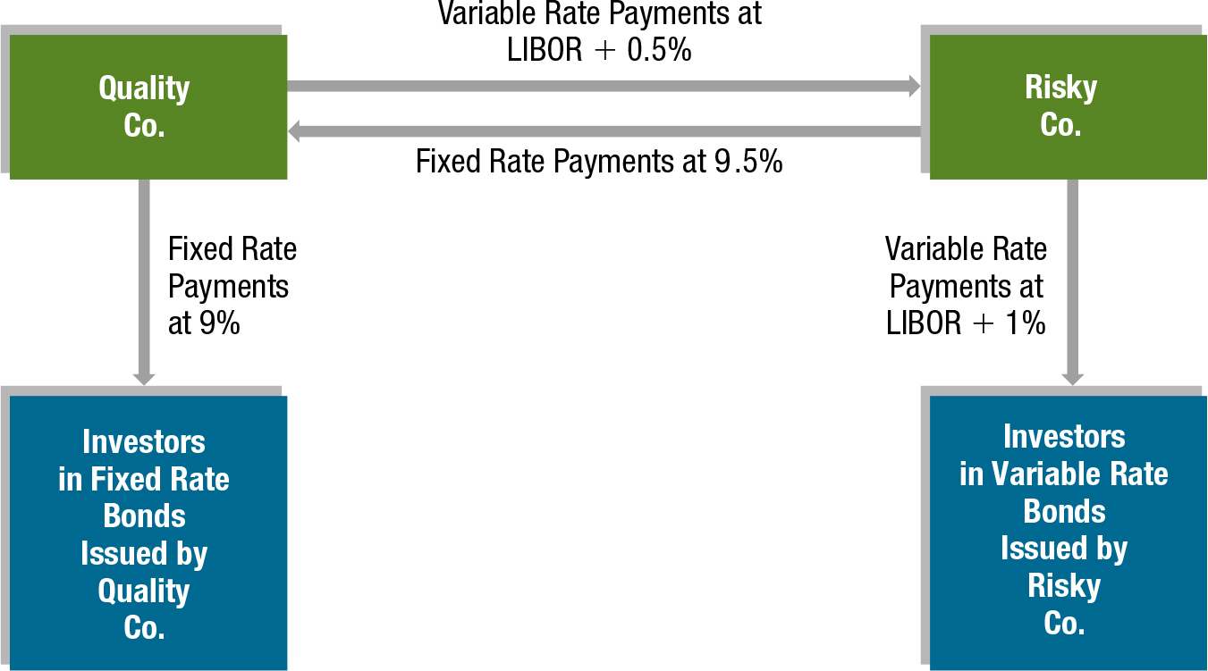
Exhibit 18.8 Illustration of an Interest Rate Swap
3

Slide 8
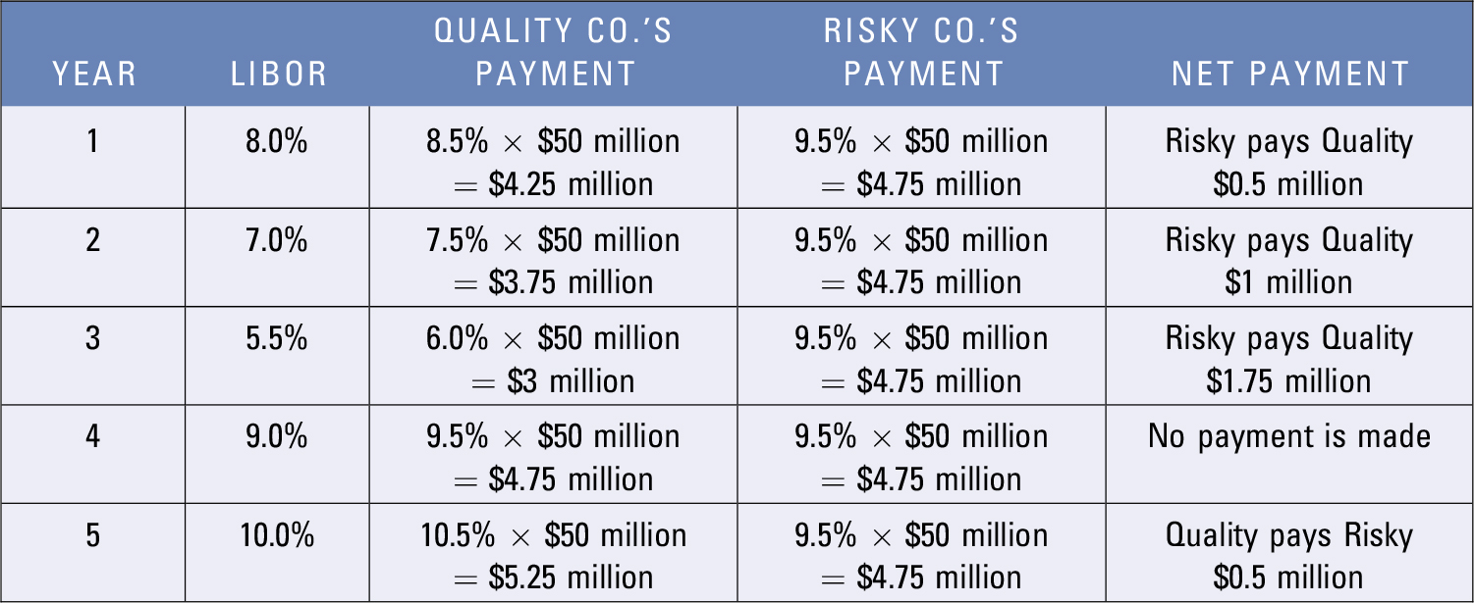
Exhibit 18.9 Expected Payments Resulting from Interest Rate Swap
3

Slide 9
Fixed versus Floating Rate Debt Decision (3 of 6)
Hedging Interest Payments with Interest Rate Swaps (cont.)
Limitations of Interest Rate Swaps
There is a cost of time and resources associated with searching for a suitable swap candidate and negotiating the swap terms.
Each swap participant faces the risk that the counter participant could default on payments.
3

Slide 10
Fixed versus Floating Rate Debt Decision (4 of 6)
Hedging Interest Payments with Interest Rate Swaps (cont.)
Other Types of Interest Rate Swaps
Accreting swap — A swap in which the notional value is increased over time.
Amortizing swap — A swap in which the notional value is reduced over time.
Basis (floating-for-floating) swap — Involves the exchange of two floating rate payments.
Callable swap — Gives the fixed rate payer the right to terminate the swap. The fixed rate payer would exercise this right if interest rates fall substantially.
3

Slide 11
Fixed versus Floating Rate Debt Decision (5 of 6)
Hedging Interest Payments with Interest Rate Swaps (cont.)
Other Types of Interest Rate Swaps (cont.)
Forward swap — An interest rate swap that is entered into today. However, the swap payments start at a specific future point in time.
Putable swap — Gives the floating rate payer the right to terminate the swap. The floating rate payer would exercise this right if interest rates rise substantially.
Zero-coupon swap — All fixed interest payments are postponed until maturity and are paid in one lump sum when the swap matures. However, the floating rate payments are due periodically.
Swaption — Gives its owner the right to enter into a swap.
3

Slide 12
Fixed versus Floating Rate Debt Decision (6 of 6)
Hedging Interest Payments with Interest Rate Swaps (cont.)
Standardization of the Swap Market
The International Swaps and Derivatives Association (ISDA) is a global trade association representing leading participants in the privately negotiated derivatives industry.
Two primary objectives are:
the development and maintenance of derivatives documentation to promote efficient business conduct practices and
the promotion of the development of sound risk-management practices.
3

Slide 13
SUMMARY (1 of 4)
An MNC’s subsidiary may prefer to use debt financing in a currency that matches the currency it receives from cash inflows. The cash inflows can be used to cover its interest payments on its existing loans. When a subsidiary issues debt in a currency that differs from the local currency it receives from sales, it is exposed to the risk that the local currency may depreciate over time.
3

Slide 14
SUMMARY (2 of 4)
An MNC’s subsidiary may consider long-term financing in a foreign currency different from its local (host country) currency in order to reduce financing costs. It can forecast the exchange rates for the periods in which it will make loan payments and then can estimate the annualized cost of financing in that currency. However, the actual cost of debt financing is uncertain because the subsidiary’s forecasts of future exchange rate movements may not be accurate.
MNCs can use currency swaps or parallel loans to hedge the exchange rate risk resulting from long term debt financing.
3

Slide 15
SUMMARY (3 of 4)
An MNC’s subsidiary can select among various available debt maturities when financing its operations. It can estimate the annualized cost of financing for alternative maturities and then determine which maturity will result in the lowest expected annualized cost of financing.
3

Slide 16
SUMMARY (4 of 4)
For debt that has floating interest rates, the interest (or coupon) payment to be paid to investors is dependent on the future LIBOR and is therefore uncertain. An MNC can forecast LIBOR so it can derive expected interest rates it would be charged on the loan in future periods. It can apply these expected interest rates to estimate expected loan payments and can then derive the expected annualized cost of financing of the floating rate loan. Finally, it can compare the expected cost of financing on a floating rate loan to the known cost of financing on a fixed rate loan. In some cases, an MNC may engage in a floating rate loan, and use interest rate swaps to hedge the interest rate risk.
3

