Slide 1
FIN 440: International Finance
Larry Schrenk, Instructor
Video 14.2 Other Factors in Multinational Capital Budgeting

Slide 2
Other Factors to Consider (1 of 10)
Exchange rate fluctuations
Inflation
Financing arrangement
Blocked funds
Uncertain salvage value
Impact of project on prevailing cash flows
Host government incentives
Real options

Slide 3
Other Factors to Consider (2 of 10)
Exchange Rate Fluctuations (Exhibits 14.3 and 14.4)
Though exchange rates are difficult to forecast, a multinational capital budgeting analysis could incorporate other scenarios for exchange rate movements, such as a pessimistic scenario and an optimistic scenario.
Exchange Rates Tied to Parent Currency — Some MNCs consider projects in countries where the local currency is tied to the dollar.
Hedged Exchange Rates — Some MNCs may hedge the expected cash flows of a new project, so they should evaluate the project based on hedged exchange rates. (Exhibit 14.5)

Slide 4
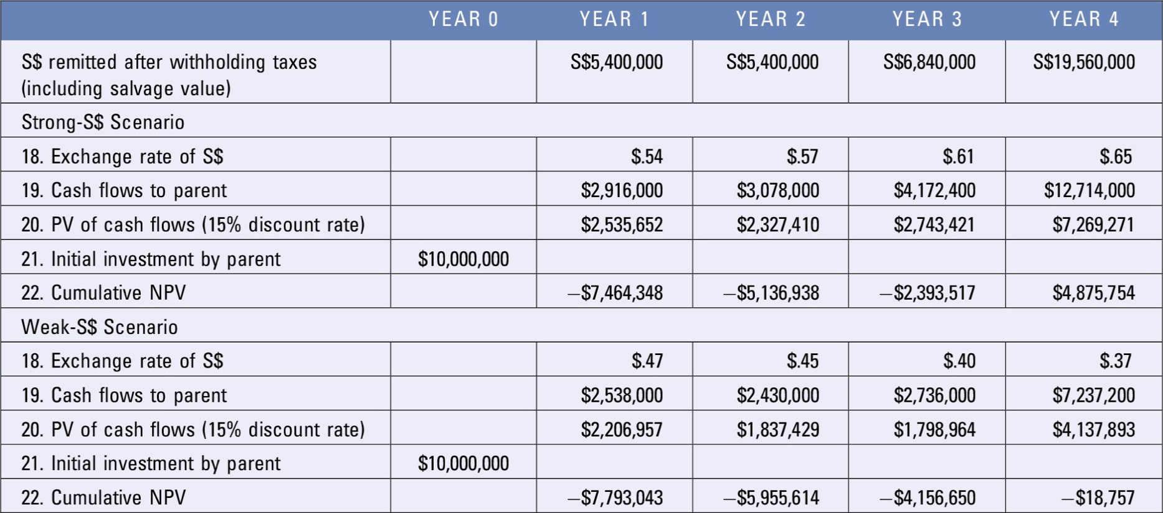
Exhibit 14.3 Analysis Using Different Exchange Rate Scenarios: Spartan, Inc.

Slide 5
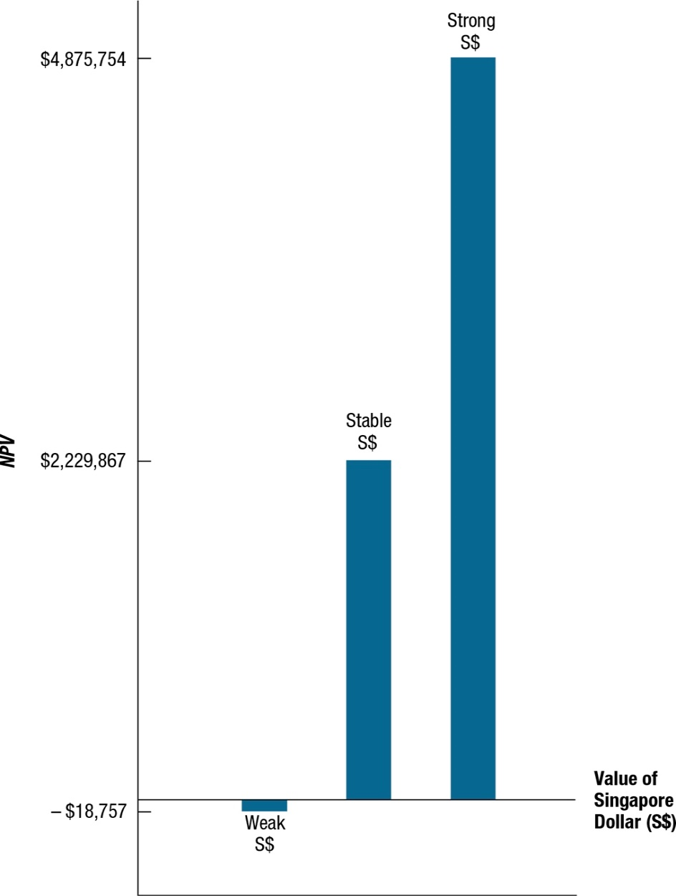
Exhibit 14.4 Sensitivity of the Project’s NPV to Different Exchange Rate Scenarios: Spartan, Inc.

Slide 6
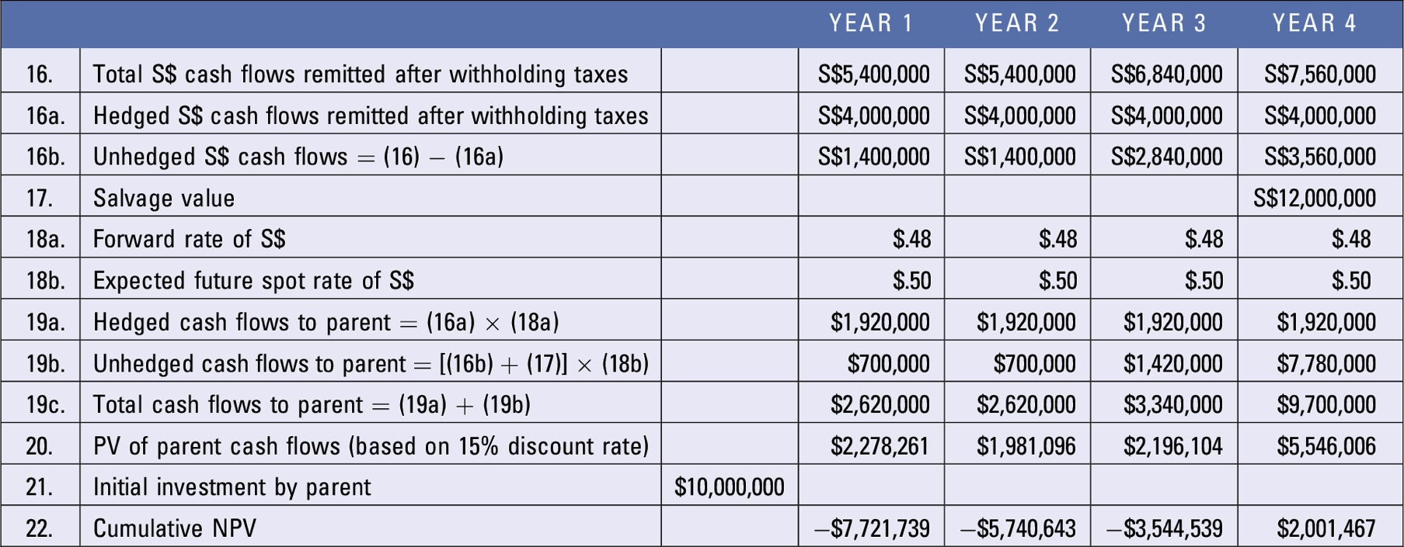
Exhibit 14.5 Analysis When a Portion of the Expected Cash Flows Are Hedged: Spartan Inc.

Slide 7
Other Factors to Consider (3 of 10)
Inflation
Should affect both costs and revenues.
Exchange rates of highly inflated countries tend to weaken over time.
The joint impact of inflation and exchange rate fluctuations may be partially offsetting effect from the viewpoint of the parent.

Slide 8
Other Factors to Consider (4 of 10)
Financing Arrangement
Subsidiary financing
Assume, subsidiary borrows S$10 million to purchase the previously leased offices. Subsidiary will make interest payments on this loan (of S$1 million) annually and will pay the principal (S$10 million) at the end of Year 4, at termination. Singapore government permits a maximum of S$2 million per year in depreciation for this project, the subsidiary’s depreciation rate will remain unchanged. Assume the offices are expected to be sold for S$10 million after taxes at the end of Year 4.
The annual cash outflows for the subsidiary are still the same.
The subsidiary must pay the S$10 million in loan principal at the end of 4 years. However, since it receives S$10 million from the sale of the offices, it can use the proceeds of the sale to pay the loan principal.

Slide 9
Other Factors to Consider (5 of 10)
Financing Arrangement
Parent financing
Instead of the subsidiary leasing or purchasing with borrowed funds, the parent uses its own funds to purchase the offices. Thus, its initial investment is $15 million, composed of the original $10 million investment, plus an additional $5 million to obtain an extra S$10 million to purchase the offices.
The subsidiary will not have any loan or lease payments.
The parent’s initial investment is $15 million instead of $10 million.
The salvage value to be received by the parent is S$22 million instead of S$12 million because the offices are assumed to be sold for S$10 million after taxes at the end of Year 4.

Slide 10
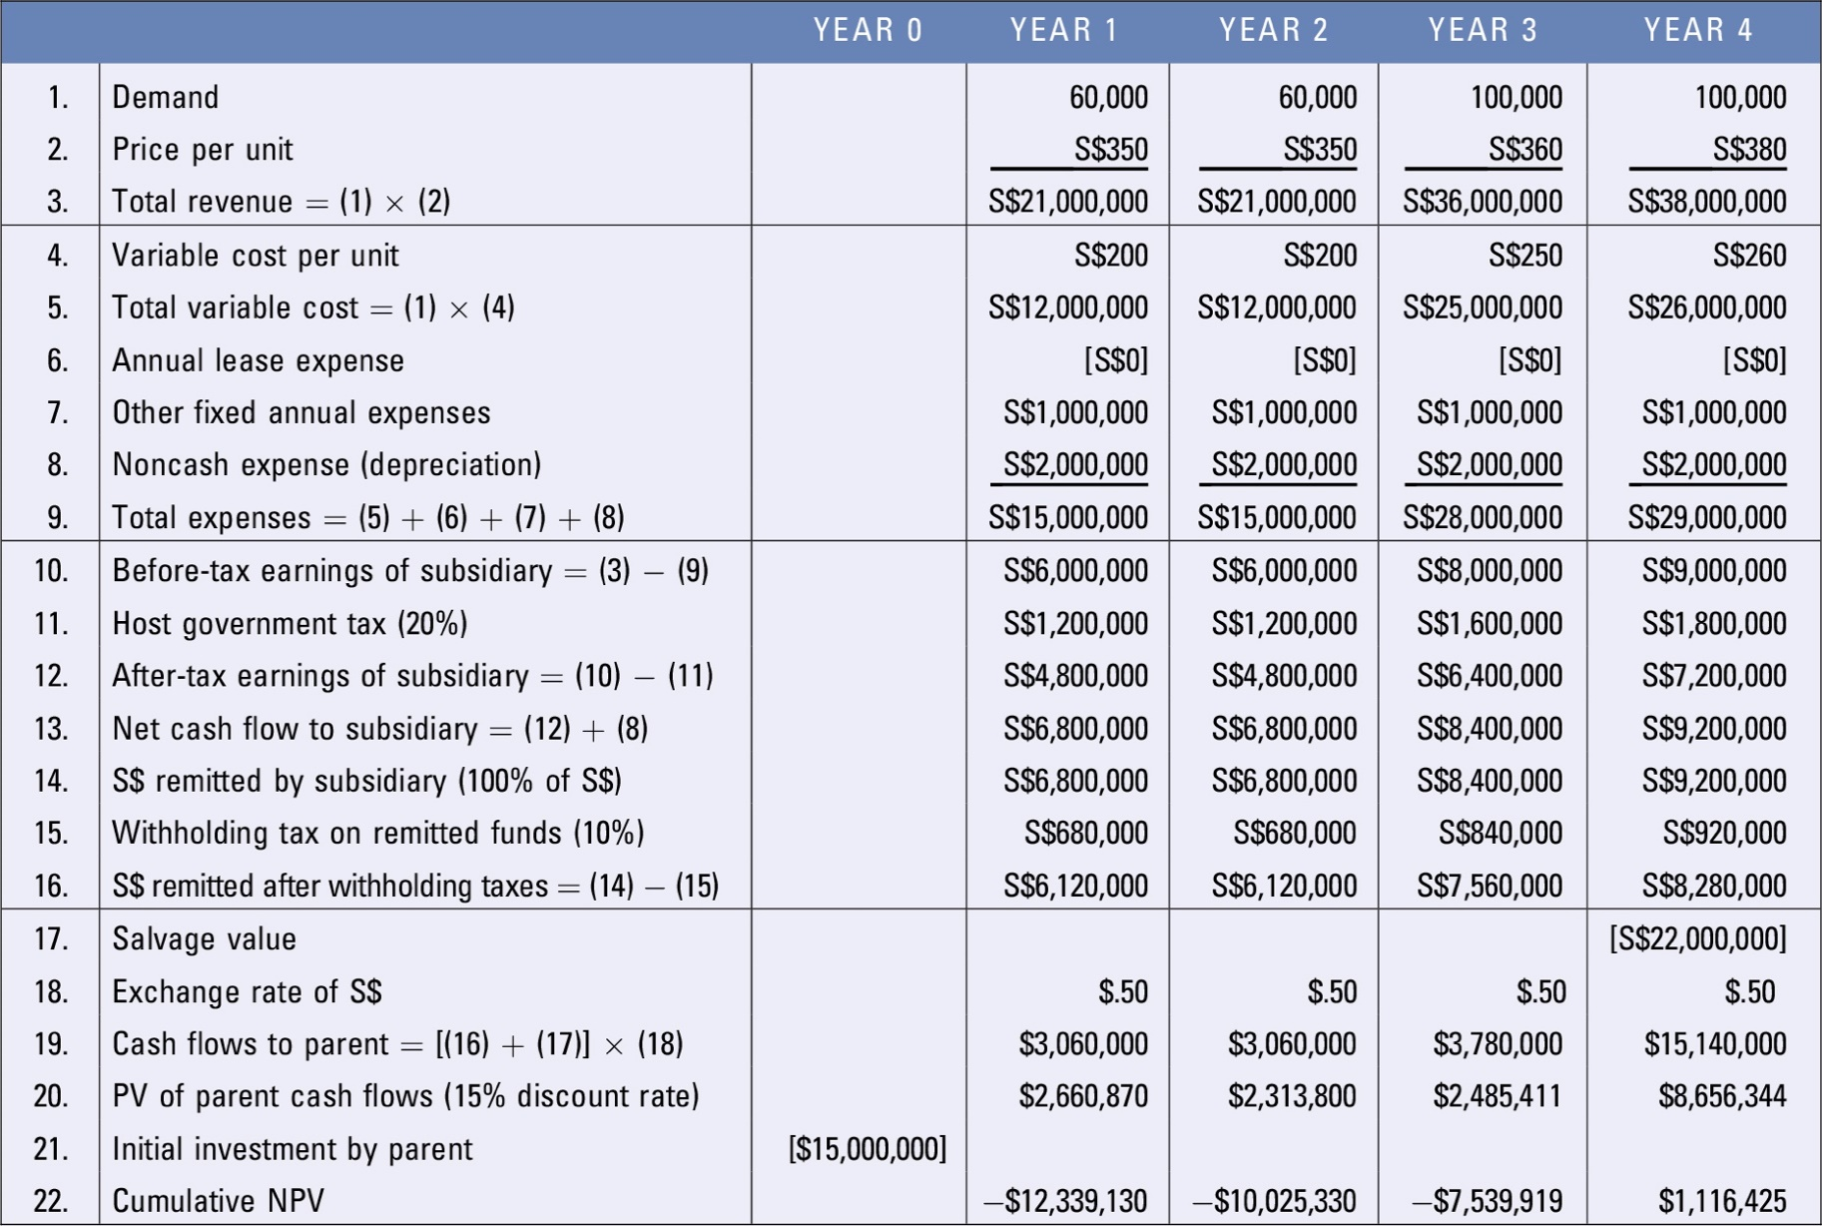
Exhibit 14.6 Analysis with an Alternative Financing Arrangement: Spartan, Inc.

Slide 11
Other Factors to Consider (6 of 10)
Financing Arrangement (cont.)
Comparison of parent and subsidiary financing
This revised example shows that the increased investment by the parent increases its exchange rate exposure for the following reasons.
First, since the parent provides the entire investment, no foreign financing is required. Consequently, the subsidiary makes no interest payments and therefore remits larger cash flows to the parent.
Second, the salvage value to be remitted to the parent is larger. Given the larger payments to the parent, the cash flows ultimately received by the parent are more susceptible

Slide 12
Other Factors to Consider (7 of 10)
Blocked Funds (Exhibit 14.7)
In some cases, the host country may block funds that the subsidiary attempts to send to the parent.
Some countries require that earnings generated by the subsidiary be reinvested locally for at least 3 years before they can be remitted.

Slide 13
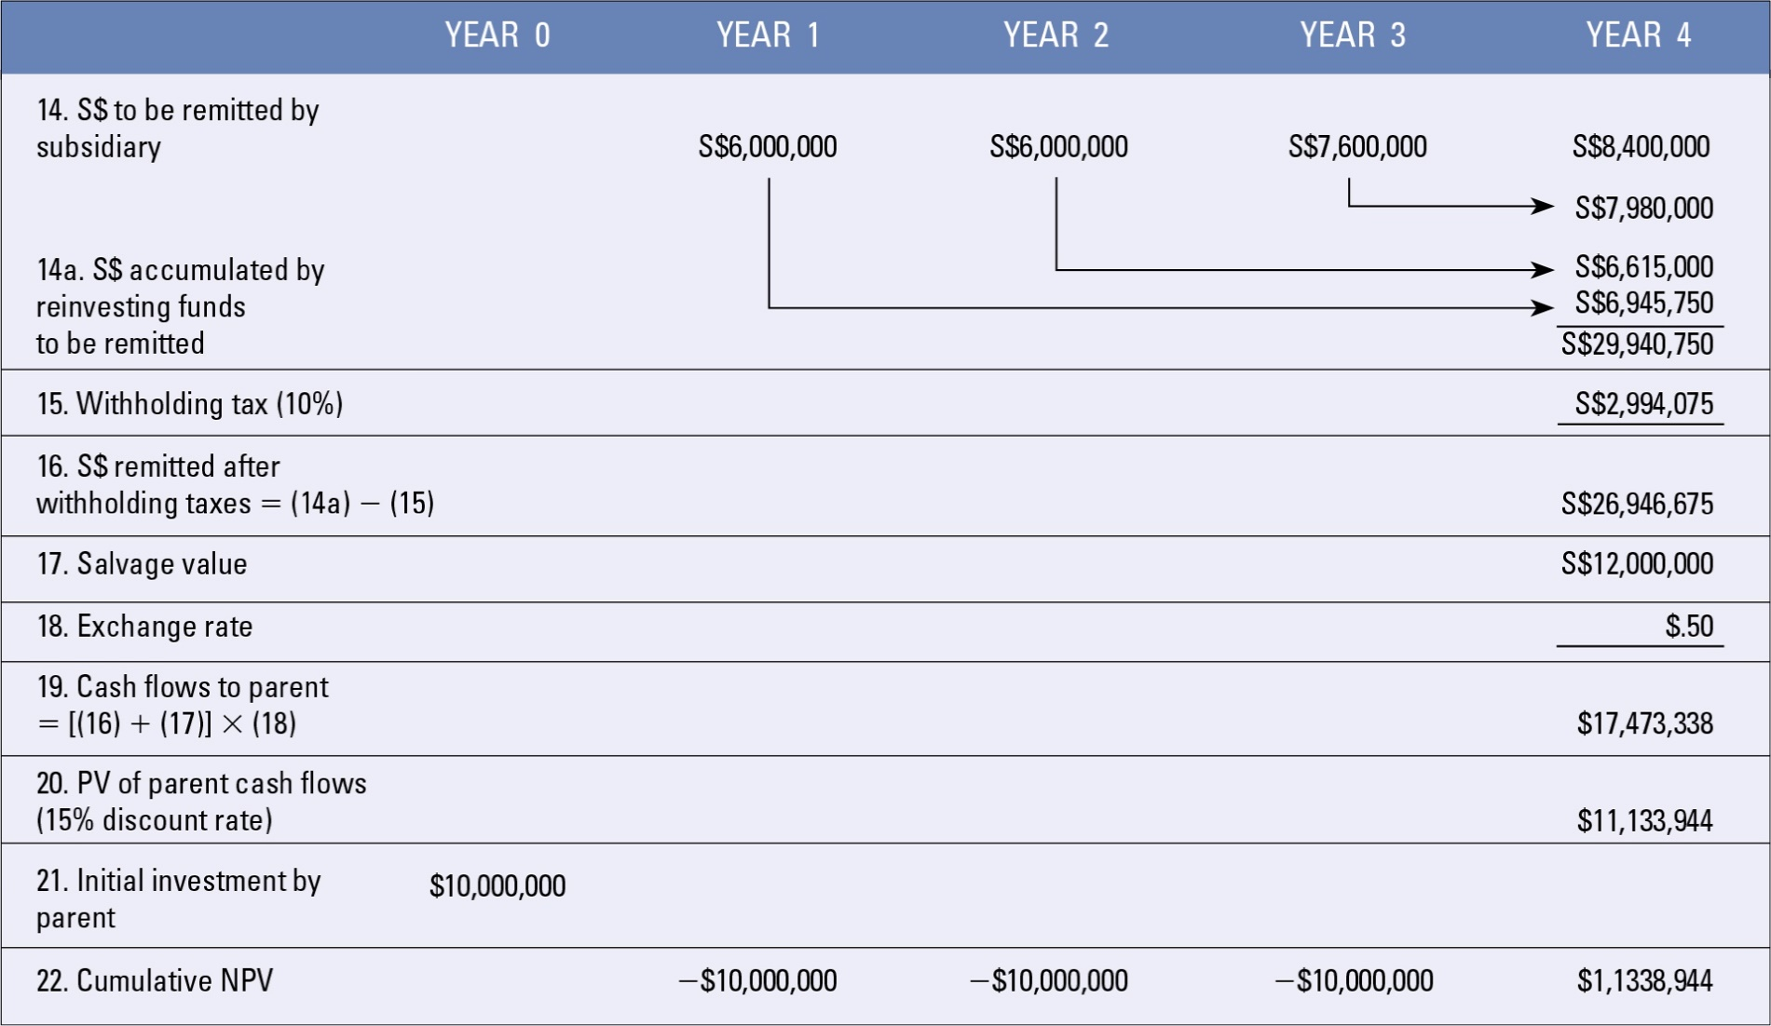
Exhibit 14.7 Capital Budgeting with Blocked Funds: Spartan, Inc.

Slide 14
Other Factors to Consider (8 of 10)
Uncertain Salvage Value
The salvage value of an MNC’s project typically has a significant impact on the project’s NPV.
Consider scenario analysis to estimate NPV at various salvage values.
Consider estimating break-even salvage value at zero NPV.
Breakeven Salvage Value:

Slide 15
Other Factors to Consider (9 of 10)
Impact of Project on Prevailing Cash Flows (Exhibit 14.8)
Impact can be favorable if sales volume of parent increases following establishment of project.
Impact can be unfavorable if existing cash flows decline following establishment of project.
Host Government Incentives may include:
Low-rate host government loans
Reduced tax rates for subsidiary
Government subsidies of initial investment

Slide 16
Exhibit 14.8 Capital Budgeting When Prevailing Cash Flows Are Affected: Spartan, Inc.

Slide 17
Other Factors to Consider (10 of 10)
Real Options
Opportunity to obtain or eliminate real assets
Value is influenced by:
Probability that real option will be exercised
NPV that will result from exercising the real option

Slide 18
Adjusting Project Assessment for Risk
Risk-adjusted discount rate — The greater the uncertainty about a project’s forecasted cash flows, the larger should be the discount rate applied to cash flows.
Sensitivity analysis — Can be more useful than simple point estimates because it reassesses the project based on various circumstances that may occur.
Simulation — Can be used for a variety of tasks, including the generation of a probability distribution for NPV based on a range of possible values for one or more input variables. Simulation is typically performed with the aid of a computer package. (Exhibit 14.9).

Slide 19
SUMMARY (1 of 3)
Capital budgeting may generate different results and a different conclusion depending on whether it is conducted from the perspective of an MNC’s subsidiary or from the perspective of the MNC’s parent. When a parent is deciding whether to implement an international project, it should determine whether the project is feasible from its own perspective.

Slide 20
SUMMARY (2 of 3)
Multinational capital budgeting requires any input that will help estimate the initial outlay, periodic cash flows, salvage value, and required rate of return on the project. Once these factors are estimated, the international project’s net present value can be estimated, just as if it were a domestic project.
It is normally more difficult to estimate cash flows for an international project. Exchange rates create an additional source of uncertainty because they affect the cash flows ultimately received by the parent as a result of the project. Other international conditions that can influence the cash flows ultimately received by the parent include the financing arrangement (parent versus subsidiary financing of the project), blocked funds by the host government, and host government incentives.

Slide 21
SUMMARY (3 of 3)
The risk of international projects can be accounted for by adjusting the discount rate used to estimate the project’s net present value. However, the adjustment to the discount rate is subjective. An alternative method is to estimate the net present value based on various possible scenarios for exchange rates or any other uncertain factors. This method is facilitated by the use of sensitivity analysis or simulation.

