Slide 1
FIN 440: International Finance
Larry Schrenk, Instructor
Video 10.2 Economic and
Translation Exposure

Slide 2
Economic Exposure (1 of 2)
Definition: The sensitivity of the firm’s cash flows to exchange rate movements, sometimes referred to as operating exposure. (Exhibit 10.5)
Exposure to local currency appreciation
Appreciation in the firm’s local currency causes a reduction in both cash inflows and outflows. The impact on a firm’s net cash flows will depend on whether the inflow transactions are affected more or less than the outflow transactions.
Exposure to local currency depreciation
Depreciation of the firm’s local currency causes an increase in both cash inflows and outflows.
Economic Exposure of Domestic Firms
Even purely domestic firms are affected by economic exposure.

Slide 3
Exhibit 10.5 Economic Exposure of a U.S. Firm to Exchange Rate Fluctuations

Slide 4
Economic Exposure (2 of 2)
Measuring Economic Exposure
Using sensitivity analysis (See Exhibits 10.6 & 10.7)
Consider how sales and expense categories are affected by various exchange rate scenarios.
Use of regression analysis

Slide 5
Exhibit 10.6 Estimated Sales and Expenses for Madison’s U.S. and Canadian Business Segments (millions of currency units)

Slide 6
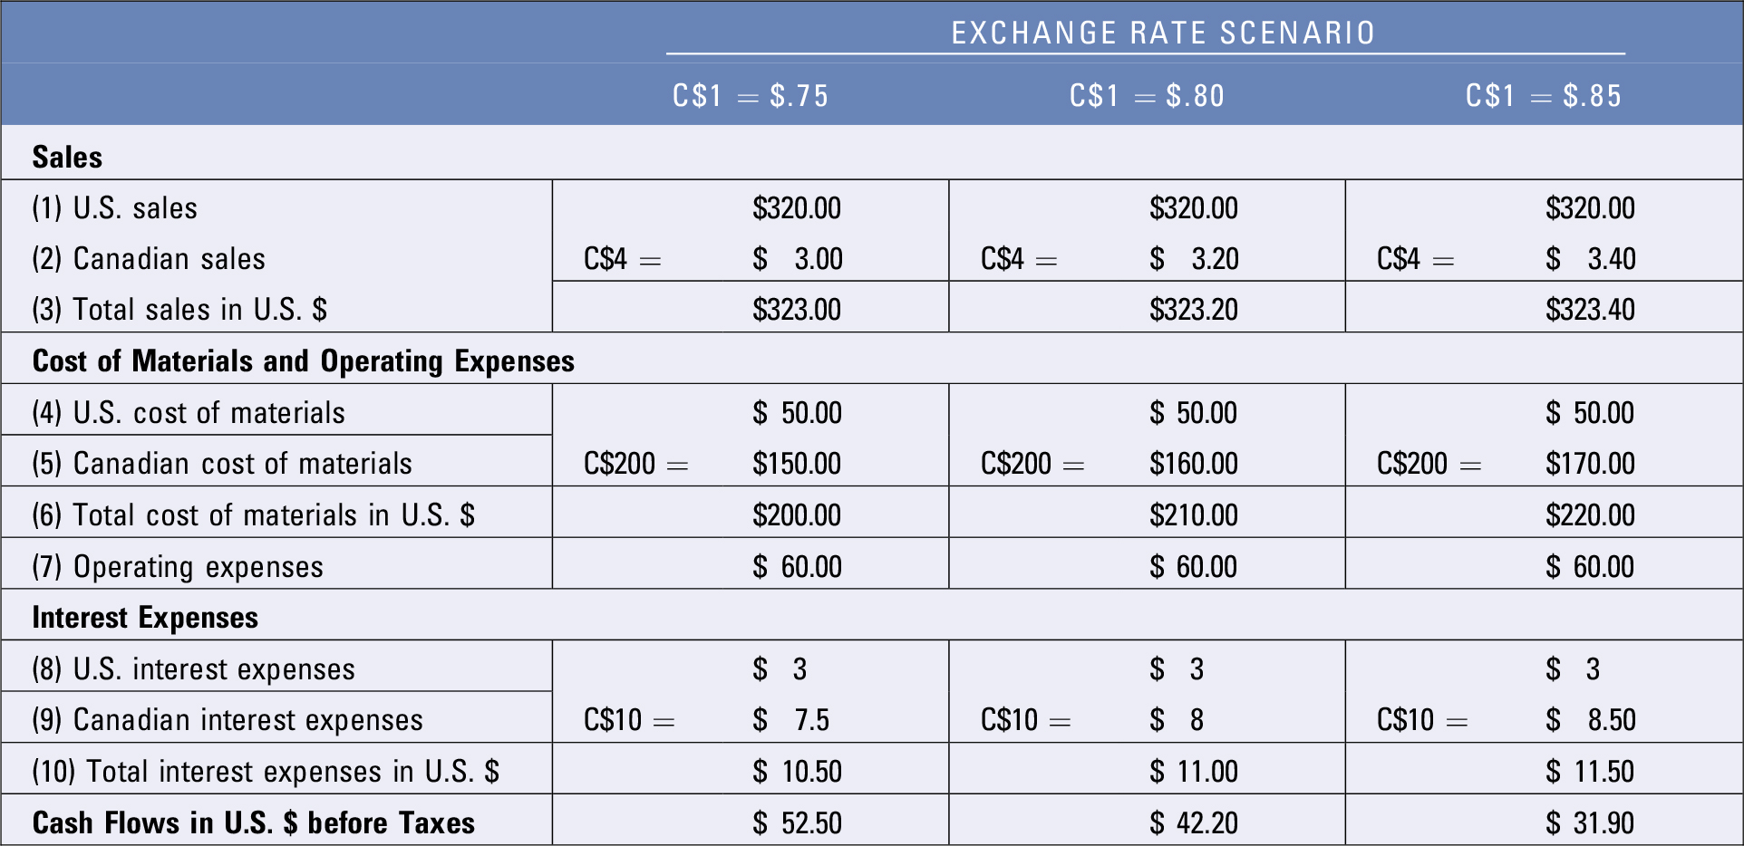
Exhibit 10.7 Impact of Possible Exchange Rates on Cash Flows of Madison Co. (millions of currency units)

Slide 7
Translation Exposure (1 of 4)
Definition: The exposure of the MNC’s consolidated financial statements to exchange rate fluctuations.
Determinants of translation exposure:
Proportion of business by foreign subsidiaries: The greater the percentage of an MNC’s business conducted by its foreign subsidiaries, the larger the percentage of a given financial statement item that is susceptible to translation exposure.
Locations of foreign subsidiaries: Location can also influence the degree of translation exposure because the financial statement items of each subsidiary are typically measured by the respective subsidiary’s home currency.

Slide 8
Translation Exposure (2 of 4)
Determinants of translation exposure (cont.)
Accounting Methods: MNC translation exposure is affected by accounting procedures, many of which are based on FASB 52
The functional currency of an entity is the currency of the economic environment in which the entity operates.
The current exchange rate of the reporting date is used to translate the assets and liabilities of a foreign entity from its functional currency into the reporting currency.

Slide 9
Translation Exposure (3 of 4)
Determinants of translation exposure (cont.)
Accounting Methods (cont.)
The weighted average exchange rate over the relevant period is used to translate revenue, expenses, and gains and losses of a foreign entity from its functional currency into the reporting currency.
Translated income gains or losses due to changes in foreign currency values are not recognized in current net income but are reported as a second component of stockholder’s equity; an exception to this rule is a foreign entity located in a country with high inflation.
Realized income gains or losses due to foreign currency transactions are recorded in current net income, although there are some exceptions.

Slide 10
Translation Exposure (4 of 4)
Exposure of an MNC’s Stock Price to Translation Effects
Because an MNC’s translation exposure affects its consolidated earnings, it can affect the MNC’s valuation. (Exhibit 10.8)
Signals that complement translation effects: Exchange rate conditions that cause a translation effect can also signal changes in expected cash flows in future years. Such changes could also influence the stock price.
Exposure of managerial compensation to translation effects: Since an MNC’s stock may be subject to translation effects and since managerial compensation is often tied to the MNC’s stock price, it follows that managerial compensation is affected by translation effects.

Slide 11
Exhibit 10.8 How Translation Exposure Can Affect the MNC’s Stock Price

Slide 12
SUMMARY (1 of 3)
Exchange rate movements can affect an MNC’s cash flows and therefore can affect its performance and value. MNCs with less risk can obtain funds at lower financing costs. Because they may experience more volatile cash flows due to exchange rate movements, exchange rate risk can also affect their financing costs. Thus MNCs frequently attempt to measure their exposure to exchange rate risk (as explained in this chapter), so that they can decide whether and how to hedge that risk (as explained in the next two chapters).

Slide 13
SUMMARY (2 of 3)
Transaction exposure is the exposure of an MNC’s contractual transactions to exchange rate movements. MNCs can measure their transaction exposure by determining their future payables and receivables positions in various currencies, along with the volatility levels and correlations of these currencies. From this information, they can assess how their revenue and costs may change in response to various exchange rate scenarios.

Slide 14
SUMMARY (3 of 3)
Economic exposure is any exposure of an MNC’s cash flows (direct or indirect) to exchange rate movements. MNCs can attempt to measure their economic exposure by determining the extent to which their cash flows will be affected by their exposure to each foreign currency.
Translation exposure is the exposure of an MNC’s consolidated financial statements to exchange rate movements. To measure translation exposure, MNCs can forecast their earnings in each foreign currency and then determine how their earnings could be affected by the potential exchange rate movements of each currency.

