Slide 1
FIN 440: International Finance
Larry Schrenk, Instructor
Video 1.2 The Why and How of International Business

Slide 2
Why MNCs Pursue International Business
Theory of Comparative Advantage: Specialization increases production efficiency.
Imperfect Markets Theory: Factors of production are somewhat immobile, providing incentive to seek out foreign opportunities.
Product Cycle Theory: As a firm matures, it recognizes opportunities outside its domestic market. (Exhibit 1.2)

Slide 3
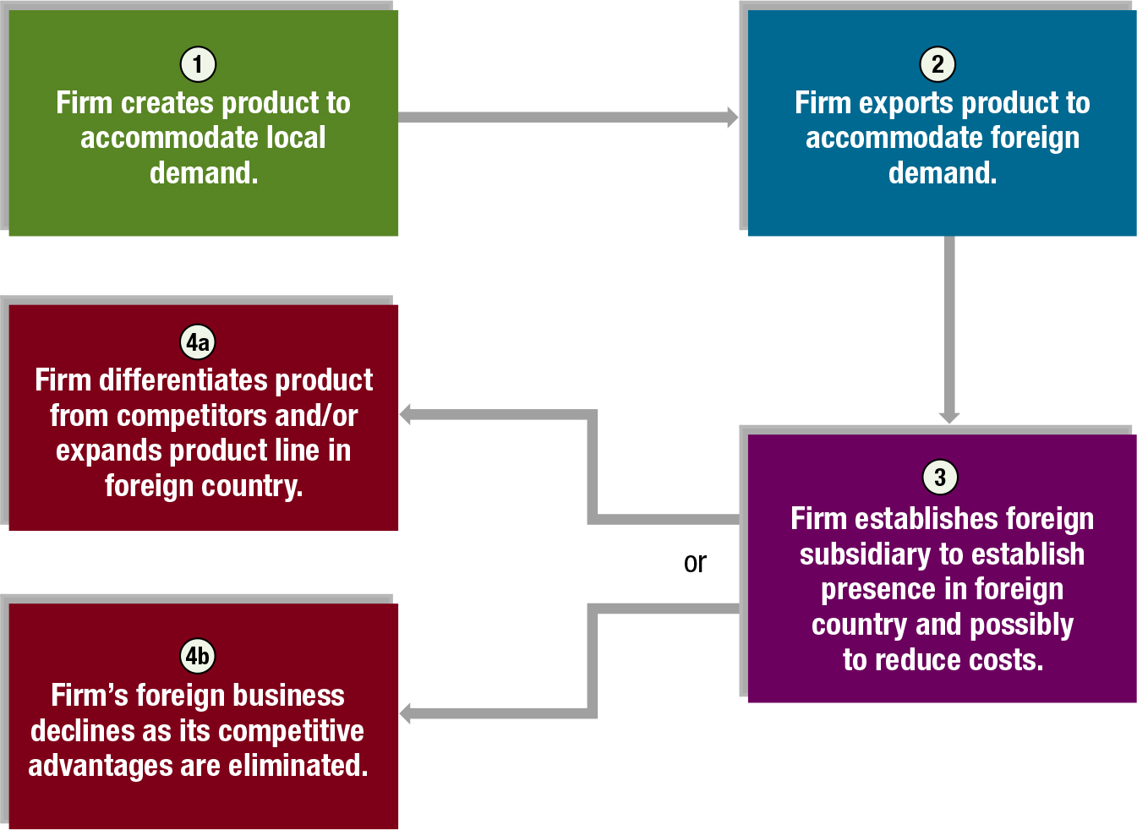
Exhibit 1.2 International Product Life Cycles
3

Slide 4
How Firms Engage in International Business (1 of 8)
International Trade
Licensing
Franchising
Joint Ventures
Acquisitions of Existing Operations
Establishment of New Foreign Subsidiaries

Slide 5
How Firms Engage in International Business (2 of 8)
International Trade
Relatively conservative approach that can be used by firms to:
penetrate markets (by exporting).
obtain supplies at a low cost (by importing).
Minimal risk — no capital at risk
How the Internet Facilitates International Trade
The internet facilitates international trade by allowing firms to advertise their products and accept orders on their websites.

Slide 6
How Firms Engage in International Business (3 of 8)
Licensing
Obligates a firm to provide its technology (copyrights, patents, trademarks, or trade names) in exchange for fees or some other specified benefits.
Allows firms to use their technology in foreign markets without a major investment and without transportation costs that result from exporting.
Major disadvantage: difficult to ensure quality control in foreign production process

Slide 7
How Firms Engage in International Business (4 of 8)
Franchising
Obligates firm to provide a specialized sales or service strategy, support assistance, and possibly an initial investment in the franchise in exchange for periodic fees.
Allows penetration into foreign markets without a major investment in foreign countries.
Joint Ventures
A venture that is jointly owned and operated by two or more firms. A firm may enter the foreign market by engaging in a joint venture with firms that reside in those markets.
Allows two firms to apply their respective cooperative advantages in a given project.

Slide 8
How Firms Engage in International Business (5 of 8)
Acquisitions of Existing Operations
Acquisitions of firms in foreign countries allows firms to have full control over their foreign businesses and to quickly obtain a large portion of foreign market share.
Subject to the risk of large losses because of larger investment.
Liquidation may be difficult if the foreign subsidiary performs poorly.

Slide 9
How Firms Engage in International Business (6 of 8)
Establishment of New Foreign Subsidiaries
Firms can penetrate markets by establishing new operations in foreign countries.
Requires a large investment.
Acquiring new as opposed to buying existing allows operations to be tailored exactly to the firms needs.
May require smaller investment than buying existing firm.

Slide 10
How Firms Engage in International Business (7 of 8)
Summary of Methods
Any method of increasing international business that requires a direct investment in foreign operations is referred to as direct foreign investment (DFI).
International trade and licensing usually not included.
Foreign acquisition and establishment of new foreign subsidiaries represent the largest portion of DFI.

Slide 11
How Firms Engage in International Business (8 of 8)
Summary of Methods (cont.)
Exhibit 1.3 Cash Flow Diagrams for MNCs
The first diagram reflects an MNC that engages in international trade. International cash flows result from paying for imports or receiving cash flow from exports.
The second diagram reflects an MNC that engages in some international arrangements. Outflows include expenses such as expenses incurred from transferring technology or funding partial investment in a franchise or joint venture. Inflows are receipts from fees.
The third diagram reflects an MNC that engages in direct foreign investment. Cash flows exist between the parent company and the foreign subsidiary.

Slide 12
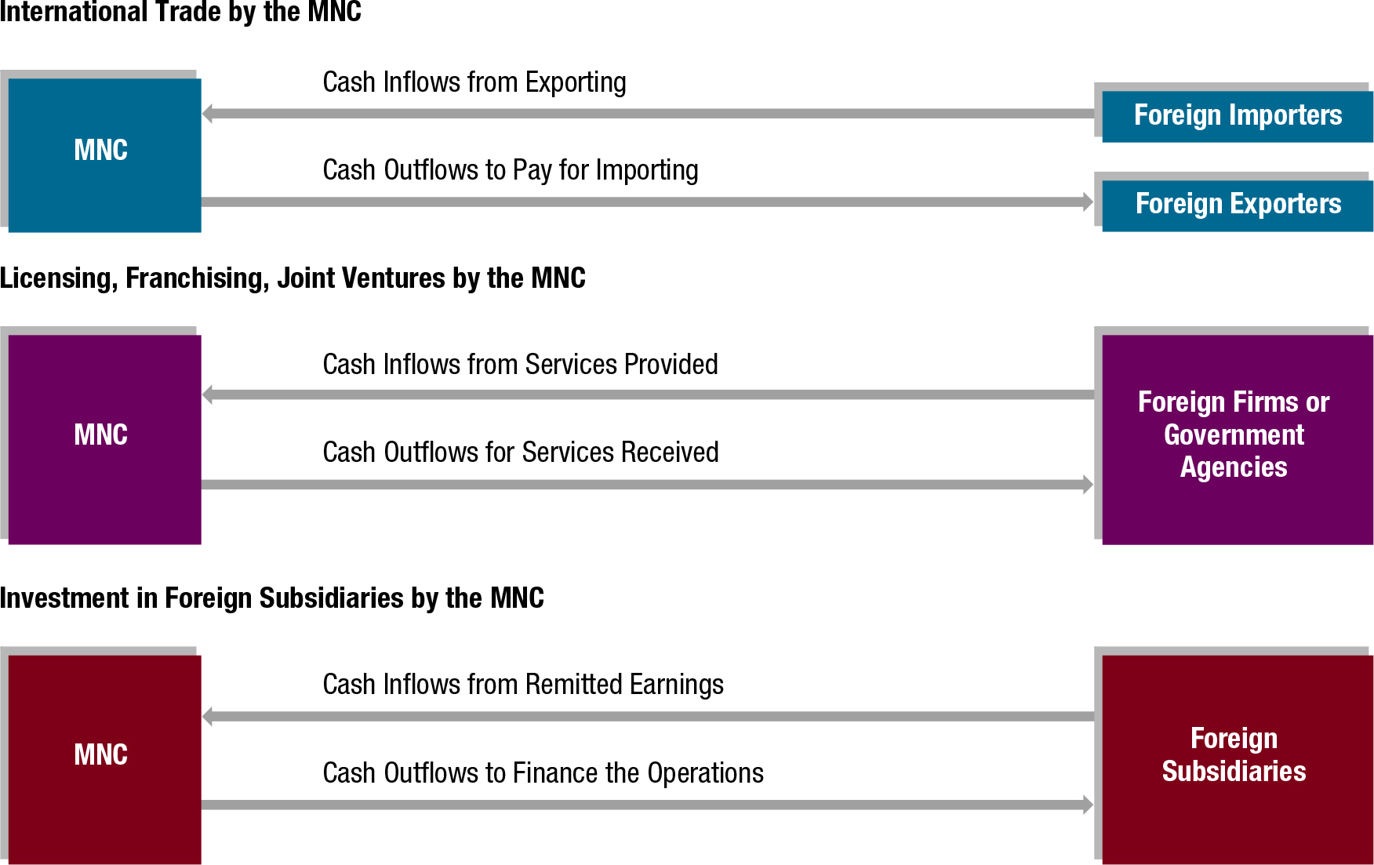
Exhibit 1.3 Cash Flow Diagrams for MNCs
12

