Slide 1
FIN 440: International Finance
Larry Schrenk, Instructor
Video 1.1 Managing the MNC

Slide 2
1
Multinational Financial Management: An Overview
Chapter Objectives
Identify the management goal and organizational structure of the Multinational Corporation (MNC).
Describe the key theories that justify international business.
Explain the common methods used to conduct international business.
Provide a model for valuing the MNC.
2

Slide 3
Managing the MNC (1 of 4)
Managers are expected to make decisions that will maximize the stock price.
Focus of this text: MNCs whose parents fully own foreign subsidiaries (U.S. parent is sole owner of subsidiary).

Slide 4
Managing the MNC (2 of 4)
How Business Disciplines Are Used to Manage the MNC
Common finance decisions include:
Whether to discontinue operations in a particular country
Whether to pursue new business in a particular country
Whether to expand business in a particular country
How to finance expansion in a particular country
Finance decisions are influenced by other business discipline functions:
Marketing
Management
Accounting and information systems

Slide 5
Managing the MNC (3 of 4)
Agency Problems
The conflict of goals between managers and shareholders
Agency Costs
Definition: Cost of ensuring that managers maximize shareholder wealth.
Costs are normally higher for MNCs than for purely domestic firms for several reasons:
Monitoring managers of distant subsidiaries in foreign countries is more difficult.
Foreign subsidiary managers raised in different cultures may not follow uniform goals.
Sheer size of larger MNCs can create large agency problems.
Some non-U.S. managers tend to downplay the short-term effects of decisions.

Slide 6
Managing the MNC (4 of 4)
Agency Problems (cont.)
Parent control of agency problems
Parent should clearly communicate the goals for each subsidiary to ensure managers focus on maximizing the value of the subsidiary.
Corporate control of agency problems
Entire management of the MNC must be focused on maximizing shareholder wealth.
Sarbanes-Oxley Act (SOX)
Ensures a more transparent process for managers to report on the productivity and financial condition of their firm.

Slide 7
SOX Methods to Improve Reporting
Agency Problems (cont.)
How SOX Improved Corporate Governance of MNCs
Establishing a centralized database of information
Ensuring that all data are reported consistently among subsidiaries
Implementing a system that automatically checks for unusual discrepancies relative to norms
Speeding the process by which all departments and subsidiaries have access to all the data they need
Making executives more accountable for financial statements

Slide 8
Management Structure of MNC
Management Structure of MNC
Centralized (See Exhibit 1.1a)
Allows managers of the parent to control foreign subsidiaries and therefore reduce the power of subsidiary managers.
Decentralized (See Exhibit 1.1b)
Gives more control to subsidiary managers who are closer to the subsidiary’s operation and environment.
How the Internet Facilitates Management Control
Makes it easier for parent to monitor the actions and performance of its foreign subsidiaries.

Slide 9
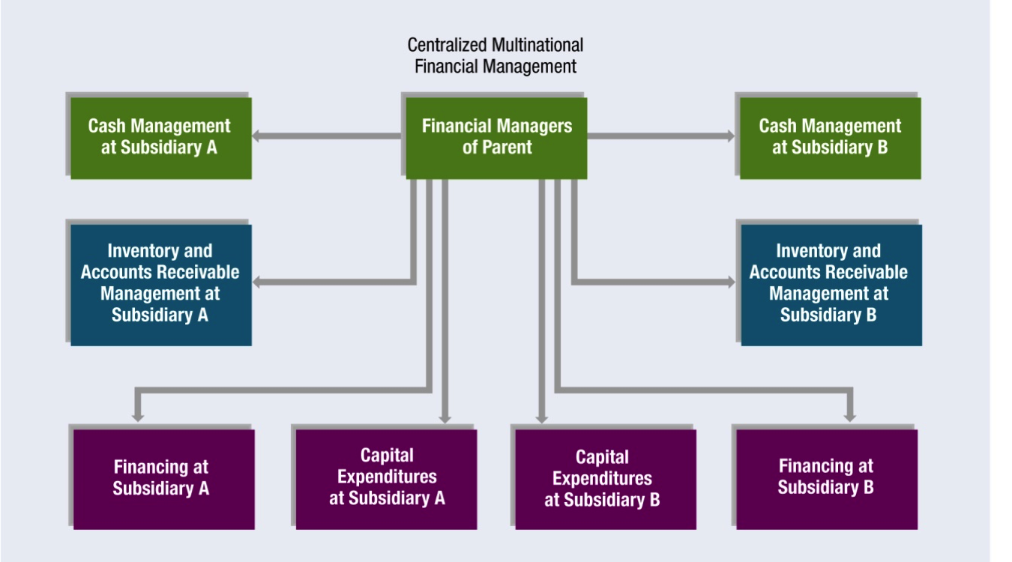
Exhibit 1.1a Management Styles of MNCs

Slide 10
Exhibit 1.1b Management Styles of MNCs

