Slide 1
FIN 440: International Finance
Topic 14-International Stock Markets
Larry Schrenk, Instructor

Slide 2
Learning Objectives
Describe the general features of international equity markets and international investing.
List and explain the main mechanisms for foreign equity investment.
Explain the characteristics and benefits/costs of emerging market investing.

Slide 3
Overview
International Investments
Mechanisms for International Equity Investment
Emerging Markets

Slide 4
1. International Investments

Slide 5
International Stock Market History
1980’s
  International equity investment was limited to trade among developed countries.
  Emerging equity markets illiquidity, uncertainty and poor reporting requirements.
  Companies in developing countries were not cross listed.
  Emerging market funds didn’t exist.
In the 1990’s investors began to take advantage of benefits for international diversification.
By 2000 there where 170 emerging market equity funds and 27 fixed income funds.

Slide 6
Size of Global Equity Markets
Market Capitalization, in $ Billions
Source: SIA 2001 Securities Industry Fact Book

Slide 7
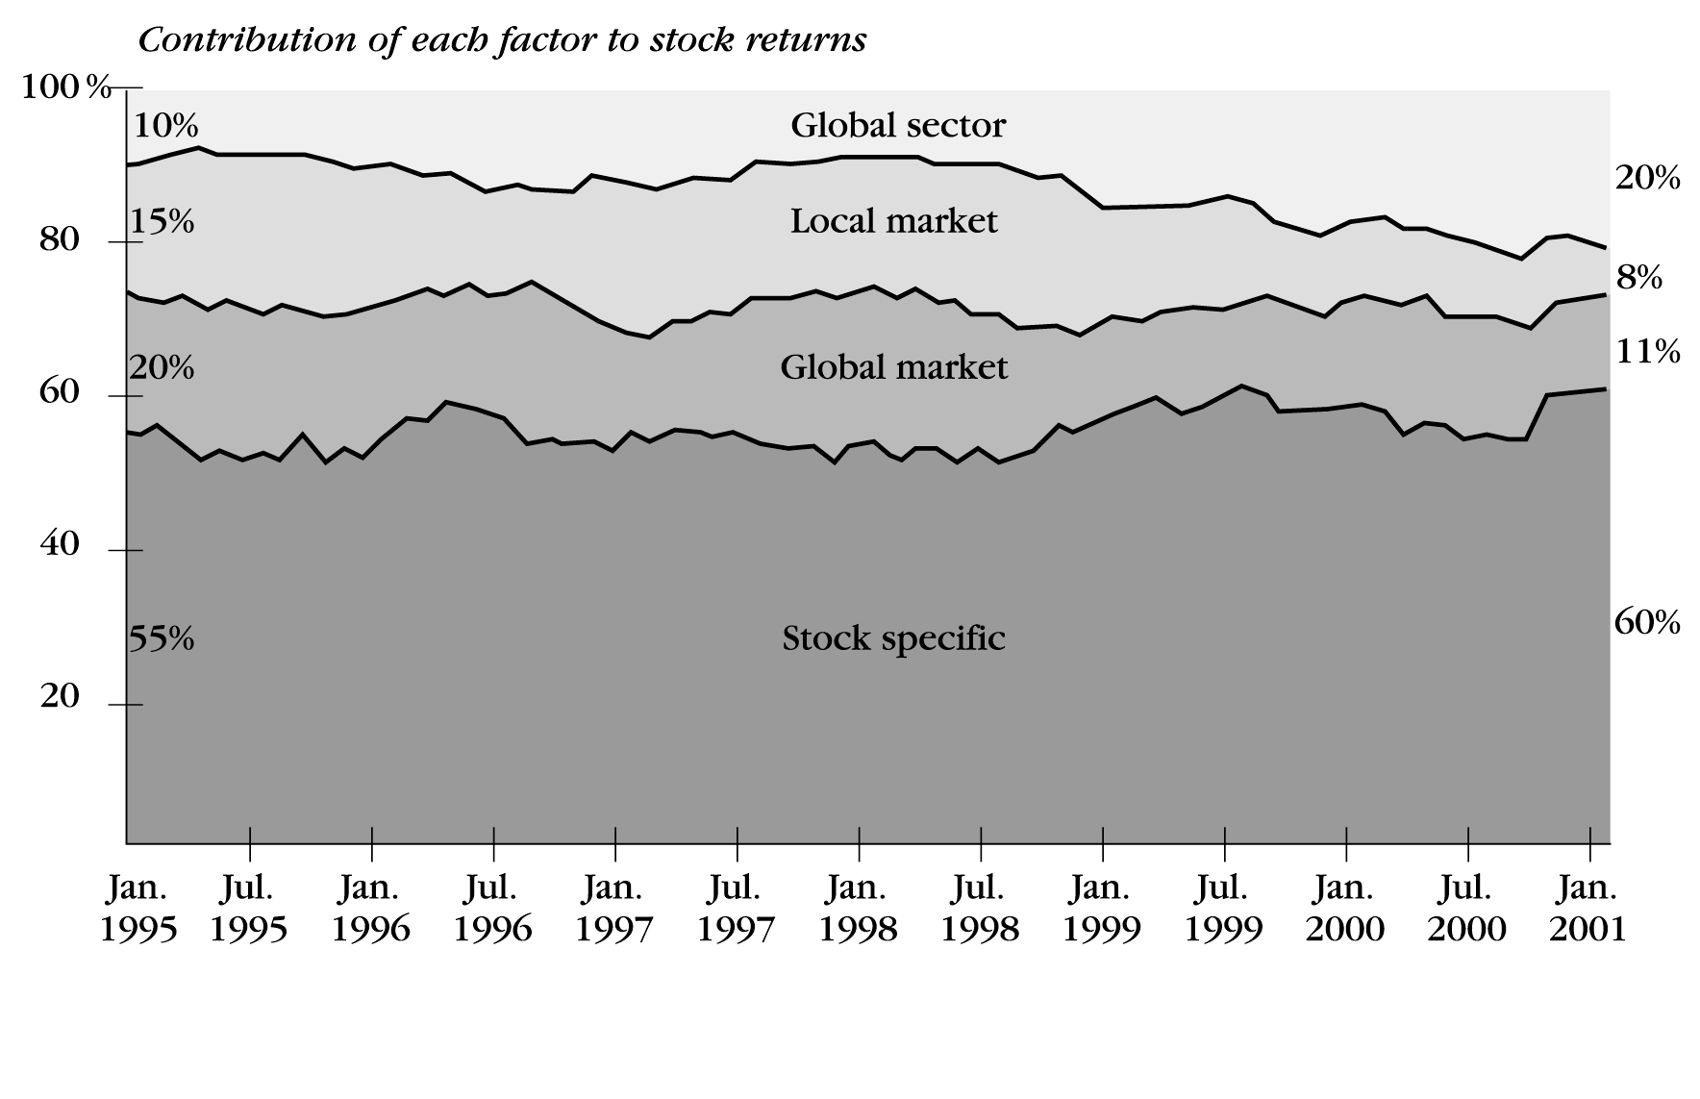
Increasing Importance of Global Sector versus Local Market
Note: Excludes emerging markets.

Slide 8
Motives
Ignoring foreign markets can substantially reduce the investment choices for U.S. investors.
The rates of return on non-U.S. securities often have substantially exceeded those for U.S. securities.
The low correlation between U.S. stock markets and many foreign markets can help to substantially reduce portfolio risk.

Slide 9
Challenges of Foreign Investing
Investment Issues
  Conducting research on foreign companies
  Restrictions on shareholders’ role in foreign companies
Trading Costs
  Illiquidity of foreign markets
  Difficulties in obtaining prices
Regulatory Issues
  May need government permission to buy securities
  May be caps on foreign ownership
Currency Risk
  Exchange rate fluctuations increase return volatility
Political Risk
  Government policies may change toward foreign investors
  Unexpected political problems may increase market risk
Operational Risk
  Some markets use physical stock certificates
  Some markets do not have centralized / efficient settlement

Slide 10
International Investment Performance

Slide 13
2. Mechanisms for International
Equity Investment

Slide 14
Cross-Listings
Cross-Listing refers to a firm having its equity shares listed on one or more foreign exchanges.
Mechanisms:
  ADRs
  Funds
  Direct Investment

Slide 15
American Depository
Receipts (ADRs)
Foreign shares are put in deposit with a bank. The bank issues ADRs.
ADRs are listed on U.S. exchanges.
ADR is priced in U.S. dollars and can be traded just like any other stock.
Dividends are paid in U.S. dollars.
Close to $900 Billion in ADRs are traded.

Slide 16
ADRs Types
Level I
  Traded over-the-counter
  Companies don't have to follow GAAP
Level II
  Follow SEC rules
  Traded on any U.S. stock exchange.
Level III
  Able to do public offerings in U.S. financial markets.

Slide 17
International Equity Funds
10% of all mutual fund assets.
Fund takes care of buying, selling, and foreign requirements.
Higher fees than other funds.
Types
  Developed versus Developing
  Regional
  Country

Slide 18
Country Specific Investing
Speculate in a single foreign market with minimum cost.
Construct their own personal international portfolios.
Diversify into emerging markets that are otherwise practically inaccessible.

Slide 19
Country Specific
Investing (cont’d)
World Equity Benchmark Shares (WEBS)
  Country-specific baskets of stocks designed to replicate the country indices of 14 countries (Morgan Stanley Capital International (MSCI) Indices).
  WEBS are subject to U.S. SEC and IRS diversification requirements.
  Low cost, convenient way for investors to hold diversified investments in several different countries.

Slide 20
Direct Investment
Direct investment in foreign equity markets is difficult and complicated
  Administrative,
  Information,
  Taxation,
  Market Efficiency Problems,
  Etc.

Slide 21
3. Emerging Markets

Slide 22
Emerging Markets
The term ‘emerging markets’ was coined by the World Bank's International Finance Corporation in the early 1980s.
Typically, emerging markets are in countries that:
  Are in the process of industrialization, and
  Have lower per capita gross national product (GNP) than the more developed countries.
  Higher growth rates and higher average returns in many countries
Of the 130 countries that the international financial community generally considers to be emerging or developing countries, approximately 40 currently have stock markets.

Slide 23
Emerging Markets Returns
From 1988 to 2006, emerging country stock markets have recorded an annualized return of 14.8% in US dollar terms.
For the four years ended December 31, 2006 emerging markets had an annualized return of 36.4% a year.
In 2006 alone, the MSCI Emerging Markets Index rose 30%, led by an extraordinary 77% average gain in its four biggest countries — Brazil, Russia, India and China!
In 2006, the Shanghai Composite Index posted a 128% gain, making it the “star performer” among equity markets.

Slide 24
Average Annual Returns for 1994-2006

Slide 25
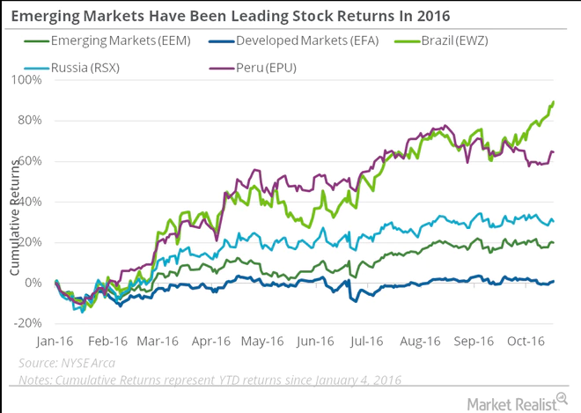
Returns for 2016

Slide 26
Emerging Markets Volatility
Emerging Markets | Last 3 years | Last 5 years
Annual Return | 24.45% | 21.46%
Standard Deviation | 17.71% | 18.11%
S&P 500
Annual Return | 10.06% | 6.95%
Standard Deviation | 6.27% | 12.29%

Slide 27
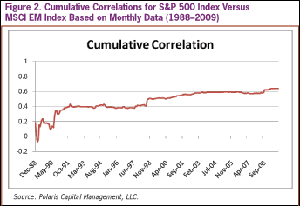
Emerging Markets Correlation

Slide 28
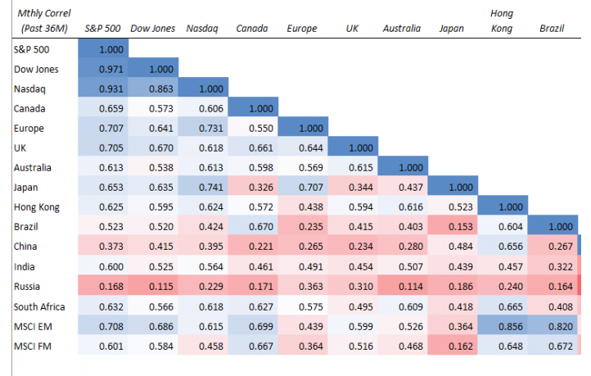
Developed Markets Correlation
https://www.investmentfrontier.com/2016/08/08/frontier-stock-market-correlations-2016/

Slide 29
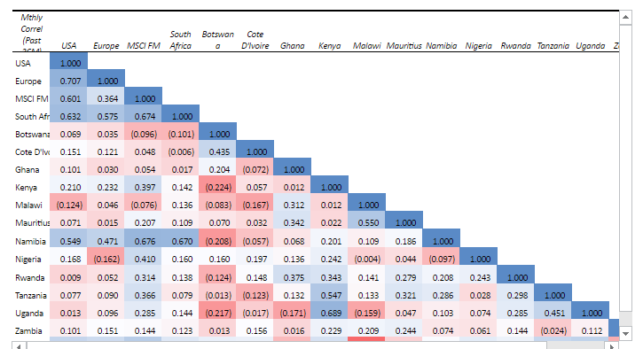
African Markets Correlation
https://www.investmentfrontier.com/2016/08/08/frontier-stock-market-correlations-2016/

Slide 30
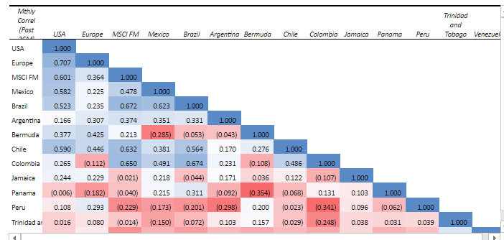
American Markets Correlation
https://www.investmentfrontier.com/2016/08/08/frontier-stock-market-correlations-2016/

Slide 31
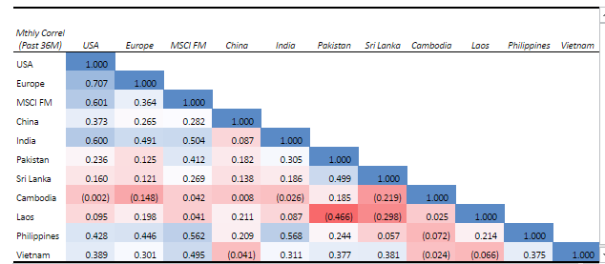
Asian Markets Correlation
https://www.investmentfrontier.com/2016/08/08/frontier-stock-market-correlations-2016/

Slide 32
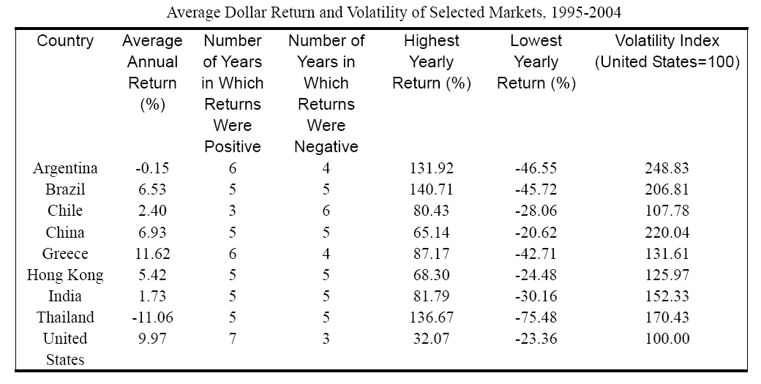

Slide 34
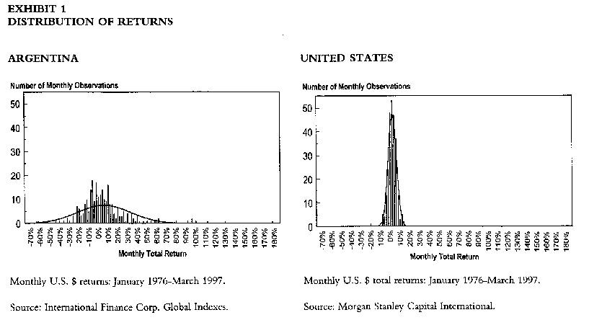

Slide 35
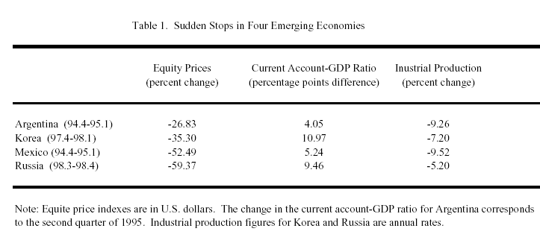
Emerging Markets Crises

Slide 36
Emerging Markets Concerns
Size and Scope of Markets
Correlation Variable and Increasing
Sophistication of The Local Professionals
Liquidity and Transaction Costs
Quality and Quantity of Financial Information
Financial Regulations, Business Laws, Ethics, Investor Protection

