Slide 1
FIN 422: Student Managed Investment Fund
Topic 1: Efficient Capital Markets, Behavioral Finance, and Technical Analysis
Larry Schrenk, Instructor

Slide 2
Overview
5.1 Efficient Capital Markets
5.2 Behavioral Finance
5.3 Implications of Efficient Capital Markets
5.4 Technical Analysis
5.5 Advantages of Technical Analysis
5.6 Challenges to Technical Analysis
5.7 Technical Trading Rules and Indicators

Slide 3
Learning Objectives I
After you read this chapter, you should be able to answer the following questions:
What does it mean to say that capital markets are efficient?
Why should capital markets be efficient?
What factors contribute to an efficient market?
Given the overall efficient market hypothesis (EMH), what are the three subhypotheses and what are the implications of each of them?
For each set of tests, which results support the EMH and which results indicate an anomaly related to the hypothesis?
What is behavioral finance and how does it relate to the EMH?
What are the major findings of behavioral finance and what are the implications of these findings for the EMH?
What are the implications of the efficient market hypothesis test results for the following?
Technical analysis
Fundamental analysis
Portfolio managers with superior analysts
Portfolio managers with inferior analysts

Slide 4
Learning Objectives II
What are the underlying assumptions of technical analysis?
What assumptions differ between technical analysis and the EMH?
What are the major advantages of technical analysis?
What are the major challenges to technical analysis?
What is the logic for the major contrary-opinion rules used by technicians?
What rules are used by technicians who want to “follow the smart money”? What are the three price movements postulated in the Dow Theory?
Why is trading volume important, and how do technicians use it?
How do technicians use moving-average lines to detect changes in trends?
What is the rationale behind a relative-strength line?

Slide 5
Readings
Reilley, et al., Investment Analysis and Portfolio Management, Chap. 5

Slide 6
5.1 Efficient Capital Markets

Slide 7
5.1 Efficient Capital Markets
An efficient capital market is one in which
security prices adjust rapidly to the arrival of new information,
which implies that the current prices of securities reflect all information about the security

Slide 8
5.1.1 Why Should Capital Markets Be Efficient?
An informationally efficient market:
A large number of participants analyze and value securities
New information comes in a random fashion
Prices adjust rapidly to new information

Slide 9
5.1.1 Why Should Capital Markets Be Efficient?
The combined effect of:
Random information, and
Many competing investors means that:
Price changes should be independent and random
Prices should be an unbiased reflection of all available information
The expected returns implicit of a stock should be consistent with its perceived risk

Slide 10
5.1.2 Alternative Efficient Market Hypotheses
Random Walk Hypothesis
– Changes in security prices occur randomly
Fair Game Model
Current market price reflects all available information about a security, and expected returns consistent with risk
Efficient Market Hypothesis (EMH)
Divided into three sub-hypotheses

Slide 11
5.1.2 Alternative Efficient Market Hypotheses
Weak-Form EMH
Prices reflect all market historical information, including prices, rates of return, trading volume data, and other market information.
Historical market information should not lead to above-average, risk-adjusted profits.
I.e., prices reflect all historical market information

Slide 12
5.1.2 Alternative Efficient Market Hypotheses
Semistrong-Form EMH
Prices reflect all public information, including market and non-market information
Known public information should not lead to above-average, risk-adjusted profits.
I.e., prices reflect all public information

Slide 13
5.1.2 Alternative Efficient Market Hypotheses
Strong-Form EMH
Prices fully reflect all public and private information.
No investors should be able to consistently derive above-average, risk-adjusted rates of return
This assumes perfect markets in which all information is cost-free and available to everyone at the same time
I.e., prices reflect all public and private information

Slide 14
5.1.3 Tests and Results of Efficient Market Hypotheses
The evidence on the EMH is mixed
Some studies supported market efficiency
Other studies reveal anomalies, results that do not support the hypotheses

Slide 15
5.1.3 Tests and Results of Efficient Market Hypotheses
Weak-Form Hypothesis:
Statistical tests of independence between rates of return
Risk–return results for trading rules using past market information
Compared to the results of a simple buy-and-hold policy

Slide 16
5.1.3 Tests and Results of Efficient Market Hypotheses
Statistical Tests of Independence
Autocorrelation tests
Runs tests
Tests of Trading Rules
Testing constraints
Use only publicly available data
Include all transactions costs
Adjust the results for risk
Only better-known technical trading rules have been examined
Too much subjective interpretation of data
Almost infinite number of trading rules

Slide 17
5.1.3 Tests and Results of Efficient Market Hypotheses
Results of Simulations of Specific Trading Rules
Trades a stock when the price change exceeds a filter value
Studies of this trading rule have used a range of filters from 0.5 percent to 50 percent
When the pre-2000 trading costs were considered, all the trading profits turned to losses. The recent lower trading costs could have a different result
Testing results generally support the weak-form EMH, but results are not unanimous

Slide 18
5.1.3 Tests and Results of Efficient Market Hypotheses
Semistrong-Form Hypothesis: Tests and Results
Two sets of studies:
Studies predicting future returns using public information beyond pure market information
Event studies of how fast stock prices adjust to significant economic events

Slide 19
5.1.3 Tests and Results of Efficient Market Hypotheses
Adjustment for Market Effects
Adjust security’s rate of return for the market return over the period
Abnormal rate of return (AR)
AR_{it} = R_{it} - R_{mt}
where:
AR_{it} = abnormal rate of return on security i during period t
R_{it} = rate of return on security i during period t
R_{mt} =rate of return on a market index during period t

Slide 20
5.1.3 Tests and Results of Efficient Market Hypotheses
Alternate Semistrong Tests
Return Prediction Studies
Predict returns for stocks or the market using public information
Predict Cross-Sectional Returns
Public information to predict the cross-sectional distribution of future risk-adjusted rates of return
Joint hypothesis of both market efficiency and the specific asset pricing model used

Slide 21
5.1.3 Tests and Results of Efficient Market Hypotheses
Results of Return Prediction Studies
Assumption: In an efficient market the best estimate of future returns will be the long-run historical returns
Question: Does public information provide superior estimates of returns for the short-run (1-6 months) or the long-run (1-5 years)
Risk Premium Proxies
Short-horizon returns limited results
Long-horizon returns successful based on:
Default spread
Term structure spread

Slide 22
5.1.3 Tests and Results of Efficient Market Hypotheses
Quarterly earnings reports may yield abnormal returns due to unanticipated earnings change
Earnings Surprise: Abnormal stock returns during 13 or 26 weeks following the announcement of a large unanticipated earnings change
Market does not adjust stock prices to reflect quarterly earnings surprises as fast as expected

Slide 23
5.1.3 Tests and Results of Efficient Market Hypotheses
The January Anomaly
Stocks with negative returns had higher returns next January
Tax selling???
Inconsistent with the EMH
Some results could not be explained by tax laws

Slide 24
5.1.3 Tests and Results of Efficient Market Hypotheses
Other Calendar Effects
Market’s cumulative advance occurs during the first half of year
Monday/weekend returns were significantly negative
Large firms had a weekend negative before the market opened;
Smaller firms had a Monday effect.

Slide 25
5.1.3 Tests and Results of Efficient Market Hypotheses
Predicting Cross-Sectional Returns
All securities should have equal risk-adjusted returns
Studies typically examine measures of size or quality
Joint hypothesis: efficiency of the market and asset pricing model
Therefore, failing a test could mean…
Market is not efficient, or
Measure of risk (asset pricing model) is faulty

Slide 26
5.1.3 Tests and Results of Efficient Market Hypotheses
Price-Earnings Ratios
Low P/E stocks yield superior risk-adjusted results; high P/E stocks inferior
Publicly available P/E ratios possess valuable information regarding future returns
Inconsistent with semistrong efficiency

Slide 27
5.1.3 Tests and Results of Efficient Market Hypotheses
Price-Earnings/Growth Rate (PEG) Ratios
Hypothesis: Inverse relationship between the PEG ratio and rates of return
Inconsistent with the EMH
Results mixed

Slide 28
5.1.3 Tests and Results of Efficient Market Hypotheses
The Size Effect
Studies have examined the impact of size on the risk-adjusted rates of return
For extended periods small firms experienced significantly larger risk-adjusted returns than large
Firm size is a major efficient market anomaly
Small-firm effect is not stable from year to year

Slide 29
5.1.3 Tests and Results of Efficient Market Hypotheses
Book Value–Market Value Ratio
Positive relationship between BV/MV ratio and future returns
Inconsistent with the EMH
Size and BV/MV dominate other ratios such as E/P ratio or leverage

Slide 30
5.1.3 Tests and Results of Efficient Market Hypotheses
Results of Event Studies
Stock split studies: Splits result in abnormal gains before, but not after announcement
Initial public offerings: Underpriced by almost 18 percent, but varies over time
Exchange listing: Listing on national exchange may offer some short-term profit

Slide 31
5.1.3 Tests and Results of Efficient Market Hypotheses
Stock prices adjust quickly to…
Unexpected world events and economic news
Announcements of accounting changes
Corporate events such as mergers and offerings

Slide 32
5.1.3 Tests and Results of Efficient Market Hypotheses
Summary on the Semistrong-Form EMH
Evidence mixed for semistrong EMH
Almost unanimous support from event
Mixed results from exchange listing studies
Studies predicting returns over time or for a cross section of stocks counter to semistrong efficiency
Cross-sectional predictors indicate anomalies

Slide 33
5.1.3 Tests and Results of Efficient Market Hypotheses
Strong-Form Hypothesis: Tests and Results
Will investors with private information consistently earn above-average profits?
Testing Groups of Investors
Corporate insiders
Security analysts
Professional money managers

Slide 34
5.1.3 Tests and Results of Efficient Market Hypotheses
Corporate Insider Trading
Corporate insiders: corporate officers, directors, and owners of 10%+ equity
Insiders must report to the SEC each month on their insider transactions
Insiders generally experience above-average profits, especially on purchase transactions
Implies many insiders use private information to gain above-average returns

Slide 35
5.1.3 Tests and Results of Efficient Market Hypotheses
Security Analysts
Can security analysts select undervalued stocks?
Is a significant abnormal return is available to those who follow their recommendations?

Slide 36
5.1.3 Tests and Results of Efficient Market Hypotheses
The Value Line Enigma
Value Line (VL) Report includes ranking from 1 to 5
Firms ranked 1 substantially outperform the market
Firms ranked 5 substantially underperform the market
Changes in rankings result in a fast price adjustment
Perhaps effect is merely the unexpected earnings anomaly due to changes in rankings from unexpected earnings

Slide 37
5.1.3 Tests and Results of Efficient Market Hypotheses
Analysts Recommendations
Evidence of superior analysts possessing private information
Market timing and stock-picking ability
Consensus recommendations do not contain incremental information, but changes in consensus recommendations are useful
Most useful information: Upward earning revision

Slide 38
5.1.3 Tests and Results of Efficient Market Hypotheses
Performance of Professional Money Managers
Trained professionals working in investment management
If any investor can achieve above-average returns, it should be this group
If any non-insider can obtain inside information, it would be this group due to the extensive management interviews that they conduct

Slide 39
5.1.3 Tests and Results of Efficient Market Hypotheses
Most tests examine mutual funds
Also trust departments, insurance companies, and investment advisors
Some weak support for the strong-form EMH

Slide 40
5.1.3 Tests and Results of Efficient Market Hypotheses
Conclusions Regarding the Strong-Form EMH
Mixed results
Corporate insiders not support
Value Line rankings changed over time and currently support
Individual analysts’ recommendations and changes in overall consensus estimates not support
Performance by professional money managers support
Money managers similar to most investors so more relevant to the hypothesis
Therefore, there is positive support for the strong-form EMH as applied to most investors

Slide 41
Implications for SMIF
Weak Form Efficiency
Semi-Strong Form Efficiency
Strong Form Efficiency

Slide 42
5.2 Behavioral Finance

Slide 43
5.2 Behavioral Finance
Acknowledges that investors are not perfectly rational
Allows for psychological factors of behavior
Applies results from experiments on risk taking
Laboratory experiments indicate that these can follow consistent patterns

Slide 44
5.2 Behavioral Finance
“Some of the cognitive biases…are that
people are overly optimistic and overconfident
are biased toward the status quo
are overly averse to losses over gains
are subject to framing
are often myopic and weak-willed
rely on the availability and representativeness of heuristics and anchoring
are notoriously bad at handling probabilities (particularly conditional probabilities), and
often make decisions depending on what others are doing rather than focusing on the merits of the options.”
Schmidt, “Getting Real on Rationality*

Slide 45
Top Behavioral Issues
Overconfidence
Loss aversion/house money
Anchoring/representativeness
Regret
Mental accounting
Probability mistakes
Ambiguity
Herd behavior

Slide 46
Bounded Rationality
Herbert Simon and “satisficing” versus “optimizing”
Theory of Bounded Rationality
Cognitive constraints
Information availability

Slide 47
Prospect Theory and Loss Aversion
Changes in wealth, rather than final position
Strong aversion to losses
Utility Function:
Convex for losses; concave for gains
Steeper for losses than for gains

Slide 48
Prospect Theory and Loss Aversion
Value
Losses
Gains

Slide 49
Framing
Choices are inconsistent across different presentations
Medical Example

Slide 50
Overconfidence
Overconfident about their skills, abilities, and knowledge
Important impact on financial decisions for both investors and managers

Slide 51
Overconfidence
Driving: 82% say above average
Intelligence: 90% say above average
New businesses
Most fail
Entrepreneurs believe 70% chance of success
Believe others have 30% chance of success
Investors believe they will earn above average returns

Slide 52
Overconfidence and Investor Behavior
Conjecture: Overconfident investors trade more (higher turnover)
Psychology: Men more overconfident than women
Data: Men trade more than women
Data: High turnover traders have lower returns (net transaction costs)

Slide 53
Anchoring/ Representativeness
Arbitrary value that impacts decision
Information shortcut
Quantitative anchor
Current stock price, or recent performance
Price of other stocks
Loss aversion
Representativeness/familiarity
Story telling
Qualities of good companies
Own company/local phone companies/home bias

Slide 54
Probability
Difficult for humans
Conditional probabilities harder
Information -> Decisions
Uncertainty/ambiguity

Slide 55
Probability
Linda is 31 years old, single, outspoken, and very bright. She majored in environmental studies. She is an avid hiker, and also participated in anti-nuclear rallies.
Which is more likely?
A.) Linda is a bank teller.
B.) Linda is a bank teller and a member of Green Peace.

Slide 56
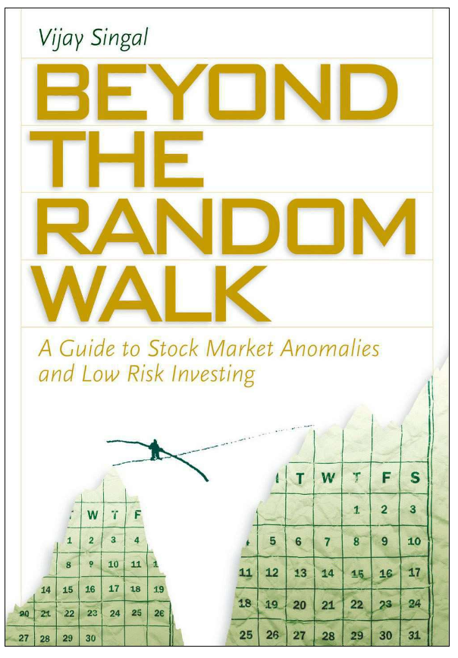
Book Recommendation
Vijay Singal. Beyond the Random Walk : A Guide to Stock Market Anomalies and Low-Risk Investing. Oxford University Press, 2004. HG4521 .S576 2004

Slide 57
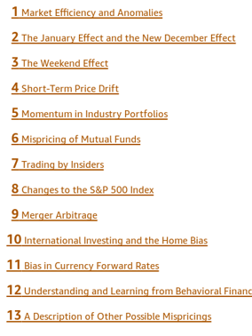
Singal. Beyond the Random Walk

Slide 58
5.3 Implications of Efficient Capital Markets

Slide 59
5.3 Implications of Efficient Capital Markets
Overall, the results of many studies indicate the capital markets are efficient as related to numerous sets of information
On the other hand, there are substantial instances in which the market fails to rapidly adjust to public information

Slide 60
5.3.1 Efficient Markets and Fundamental Analysis
Fundamental analysts believe that there is a basic intrinsic value for
Aggregate stock market,
Various industries, and
Individual securities,
and these values depend on underlying economic factors
Investors should determine the intrinsic value of an investment at a point in time and compare it to the market price

Slide 61
5.3.1 Efficient Markets and Fundamental Analysis
If you can do a superior job of estimating intrinsic value, you can
Make superior market timing decisions and
Generate above-average returns
Intrinsic value analysis involves:
Aggregate market analysis
Industry analysis and
Company analysis

Slide 62
5.3.1 Efficient Markets and Fundamental Analysis
Aggregate Market Analysis with Efficient Capital Markets
EMH implies that examining only past economic events is not likely to lead to outperforming a buy-and-hold policy because the market adjusts rapidly to known economic events
Merely using historical data to estimate future values is not sufficient
You must estimate the relevant variables that cause long-run movements

Slide 63
5.3.1 Efficient Markets and Fundamental Analysis
Industry and Company Analysis with Efficient Capital Markets
Wide distribution of returns from different industries and companies justifies industry and company analysis
Must understand the variables that effect rates of return and
Do a superior job of estimating future values of these relevant valuation variables, not just look at past data

Slide 64
5.3.1 Efficient Markets and Fundamental Analysis
Important relationship between expected earnings and actual earnings
Accurately predicting earnings surprises
Strong-form EMH indicates likely existence of superior analysts
Studies indicate that fundamental analysis based on E/P ratios, size, and the BV/MV ratios can lead to differentiating future return patterns

Slide 65
5.3.1 Efficient Markets and Fundamental Analysis
How to Evaluate Analysts or Investors
Examine performance of numerous securities analyst recommends (in comparison to randomly selected stocks of the same risk class)
Selections of superior analyst should consistently outperform randomly selected stocks
Consistency requirement is crucial; a random portfolio should outperform the market about half the time

Slide 66
5.3.1 Efficient Markets and Fundamental Analysis
Conclusions about Fundamental Analysis
Estimating the relevant variables is as much an art as a science
Must understand what variables are relevant and have the ability to do a superior job of estimating these valuation variables

Slide 67
5.3.2 Efficient Markets and Portfolio Management
Portfolio Managers with Superior Analysts
Concentrate efforts in mid-cap stocks that do not receive the attention given by institutional portfolio managers to the top-tier stocks
The market for these neglected stocks may be less efficient than the market for large well-known stocks

Slide 68
5.3.2 Efficient Markets and Portfolio Management
Portfolio Managers without Superior Analysts
Determine and quantify your client's risk preferences
Construct the appropriate portfolio
Diversify completely to eliminate unsystematic risk
Maintain th desired risk by rebalancing the portfolio
Minimize total transaction costs

Slide 69
5.3.2 Efficient Markets and Portfolio Management
The Rationale and Use of Index Funds and Exchange-Traded Funds
Efficiency and a lack of superior analysts imply many portfolios should be managed passively
Institutions created market (index) funds, which duplicate the composition and performance of a selected index series

Slide 70
5.3.2 Efficient Markets and Portfolio Management
Insights from Behavioral Finance
Opportunities for abnormal return from deeply ingrained biases
Analysts become overconfident in their ability to predict future growth rates and eventually derive valuations that either fully value or overvalue future growth
Contrary investing, confirming the notion of the herd mentality of analysts
Loss aversion
Market prices are a combination of fundamental value and investor sentiment

Slide 71
5.4-7 Technical Analysis

Slide 72
5.4 Technical Analysis
No need to study the multitude of economic, industry, and company variables
Past price and volume movements or some other market series will signal future price movements
Change in the price trend may predict a forthcoming change in some fundamental variables, such as earnings and risk, before the change is perceived by most fundamental analysts

Slide 73
5.4.1 Underlying Assumptions of Technical Analysis
Market value determined solely by supply and demand
Supply and demand governed by rational and irrational factors including economic variables as well as opinions, moods, and guesses.
Prices for individual securities and the market tend to move in trends, which persist for appreciable lengths of time
Prevailing trends change in reaction supply and demand relationships. These shifts can be detected in the action of the market itself

Slide 74
5.5 Advantages of Technical Analysis
Major problems with accounting statements:
Lack information needed by security analysts
GAAP allows firms to select reporting procedures; difficulty comparing statements from two firms
Psychological factors and other nonquantifiable variables do not show up in financial statements

Slide 75
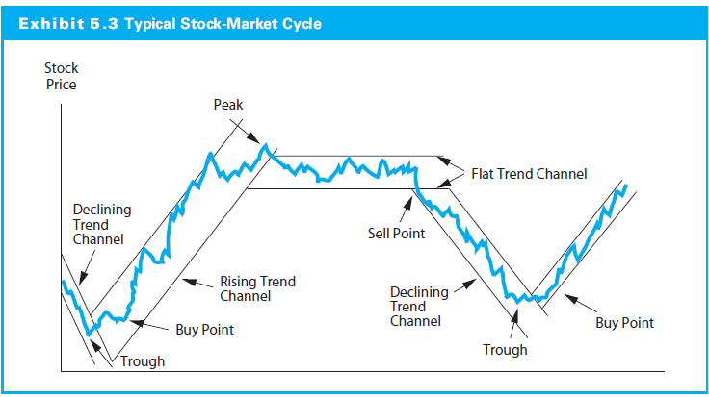
5.7 Technical Trading Rules and Indicators

Slide 76
5.7.1 Contrary-Opinion Rules
Mutual Fund Cash Positions
Buy when mutual fund cash position is high, sell when low
Credit Balances in Brokerage Accounts
Buy when credit balances increase, sell when fall
Investment Advisory Opinions
When a large proportion of investment advisory services are bearish, this signals a market trough and the onset of a bull market

Slide 77
5.7.2 Follow the Smart Money
Confidence Index
Yield spread between high-grade and intermediate grade bonds
Declining (increasing) yield spreads increase (decrease) this index and are a bullish (bearish) indicator
T-Bill/Eurodollar Yield Spread
Decreases indicates greater confidence and a bullish indicator
Debit Balances in Brokerage Accounts (Margin Debt)
Balances represent buying on margin, which is assumed to be done by largely sophisticated investors
Increases are a bullish signal

Slide 78
5.7.3 Momentum Indicators
Breadth of Market
Number of issues increasing/declining
Advance-decline index: Cumulative index of net advances or net declines
Stocks above their 200-Day Moving Average
Market overbought and negative correction when >80% of stocks trading above 200-day moving average

Slide 79
5.7.4 Stock Price and Volume Techniques
Dow Theory
The oldest technical trading rule
Stock prices as moving in trends like water
Three types of price movements over time
Major trends are like tides in the ocean
Intermediate trends resemble waves
Short-run movements are like ripples

Slide 80
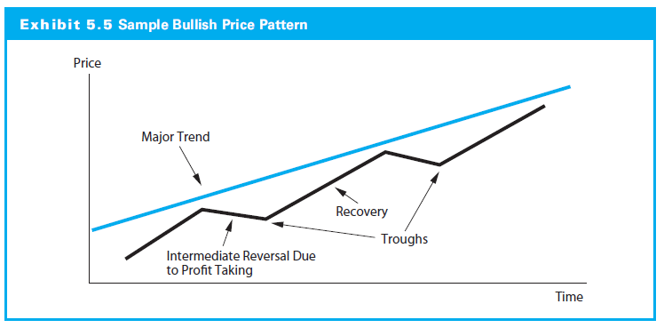
5.7.4 Stock Price and Volume Techniques

Slide 81
5.7.4 Stock Price and Volume Techniques
Importance of Volume
Volume changes as indicator of changes in supply and demand
Price increase on heavy volume relative to the normal trading volume indication of bullish activity
Price decline with heavy volume bearish
Ratio of upside-downside volume indicator of short-term momentum of aggregate stock market

Slide 82
5.7.4 Stock Price and Volume Techniques
Support and Resistance Levels
Support level: Price range to expect substantial increase in the demand for a stock and a price increase
Resistance level: Price range to expect increase in the supply of stock and a price reversal

Slide 83
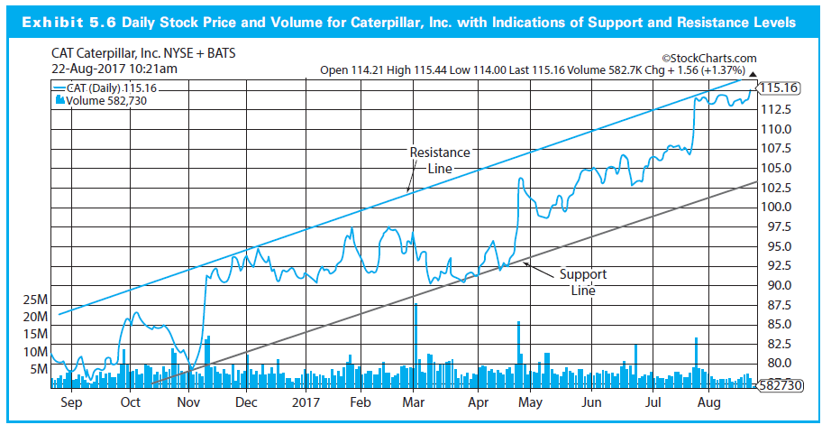
5.7.4 Stock Price and Volume Techniques

Slide 84
5.7.4 Stock Price and Volume Techniques
Moving Average Lines
MA lines reflect the overall trends
Shorter lines (50 versus 200-day), shorter trends
Prices reverse breaking through MA line from below with heavy trading volume is positive change, and vice versa
50-day line crossing 200-day line from below on good volume is bullish indicator

Slide 85
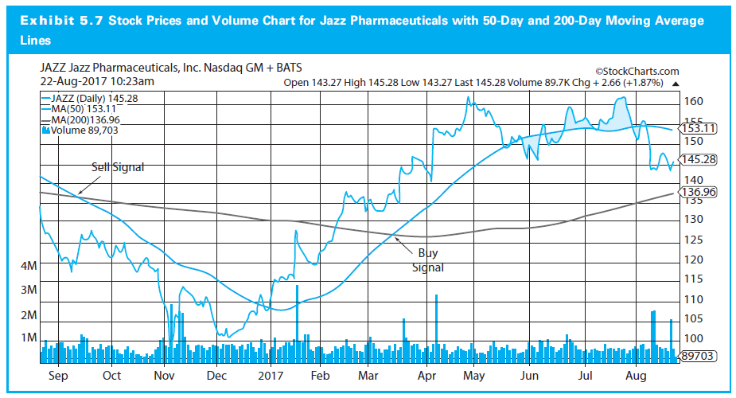
5.7.4 Stock Price and Volume Techniques

Slide 86
5.7.5 Efficient Markets and Technical Analysis
Assumptions of technical analysis oppose of efficient markets
The belief patterns of price adjustment contradicts EMH which says that security prices adjust to new information very rapidly
If weak-form efficiency, then prices fully reflect all relevant market information and technical trading cannot have any value

