Slide 1
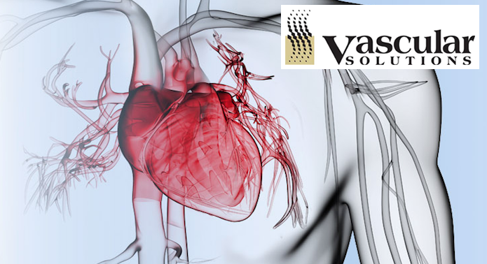
Brent Pfaff, Jack Bergloff, Mike Byrns

Slide 2
Recommendation
Vascular Solution is a conditional BUY
Current Price: $ 54.40
Entry price: $ 44.54
Currently Overvalued

Slide 3
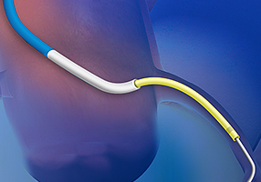
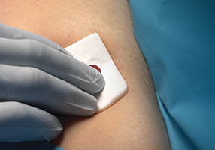
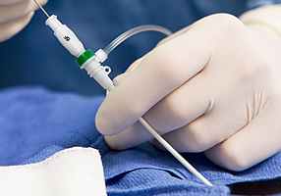
Company Overview
Vascular Solutions (NASDAQ: VASC)
Founded in 1996
Clinical solutions for treating coronary peripheral vascular disease.
Healthcare equipment & supplies industry
Headquartered in Minneapolis, Minnesota

Slide 4
Industry overview - Porter’s 5 Forces
Barrier to Entry: Large
Bargaining Power of Suppliers: Shrinking
Bargaining Power of Buyers: Increasing
Industry Rivalry: Strong, but weaker for VASC
Threat of Substitutes: Small (Patent Protection)

Slide 5
Industry Analysis - Industry Trends
Physicians and large hospitals
Tech innovation continues to drive the market
Industry Consolidation
Devices that help with our age-related problems
The population is becoming older
Hearing, Cardiovascular, Neurological and Endocrinology

Slide 6
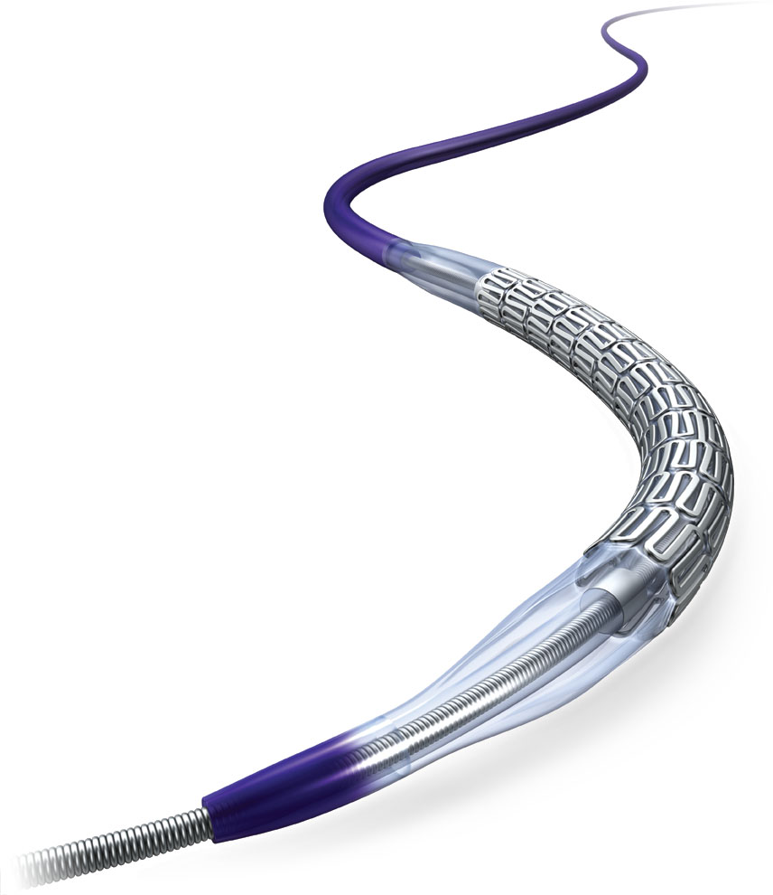
Industry Analysis - Vascular Solutions Placement
Growing but consolidated market
Small/Medium Size
Niche Company
“Stents & Catheters” segment

Slide 7
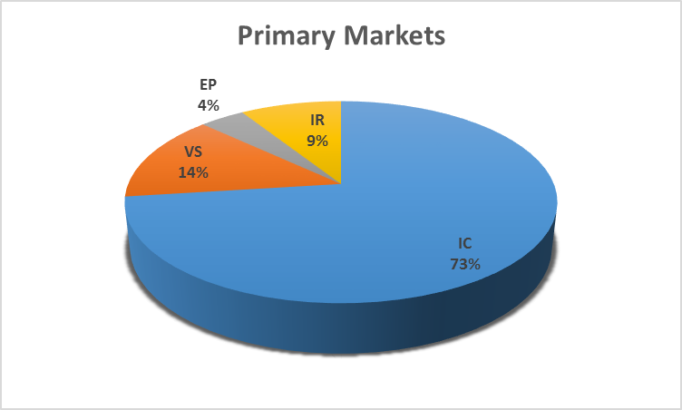
Vascular Solution’s Market Segment
Interventional Cardiologists (IC)
Interventional Radiologists (IR)
Vein Specialists (VS)
Electrophysiologists (EP)

Slide 8
Macroeconomic Trends
Pros: | Cons: | Uncertainty:
Interest rate changes Increase in life span | “Whistleblowers” Increasing scrutiny among regulations | Unexpected changes: regulatory requirements, trade barriers & tariffs

Slide 9
Top Products
Product | 2015 Revenue (in thousands) | Percent of Revenue
GuideLiner® Catheter | $45,409 | 31.18%
Pronto® catheter | $14,970 | 10.28%
Vein Catheter reprocessing | $12,602 | 8.66%
Micro-introducer kits | $12,337 | 8.47%
Hemostat Patches | $11,988 | 8.23%
Radial Access | $7,436 | 5.10%
Langston® catheter | $6,590 | 4.53%
D-Stat® hemostat | $5,322 | 3.70%
Other | $28,902 | 19.85%

Slide 10
Important Ratios (12 months Dec, 31 2015)
Vascular Solutions
P/E: 79.07 (as of Nov. 25, 2016)
Debt-to-Equity: 0
PEG: 1.99 (as of Nov. 25, 2016)
ROA: 7.1%
ROIC: 8.23%
Gross Margin: 66.3%
Healthcare Equipment
P/E: 26.5
Debt-to-Equity: 39.5%
N/A
ROA: 4.6%
N/A
Gross Margin: 46.3%

Slide 11
Market Performance
Trailing Twelve Months
Current share price: $54.50
52 week high: $54.58
52 week low: $24.82
Percent gained: 53.35%

Slide 12
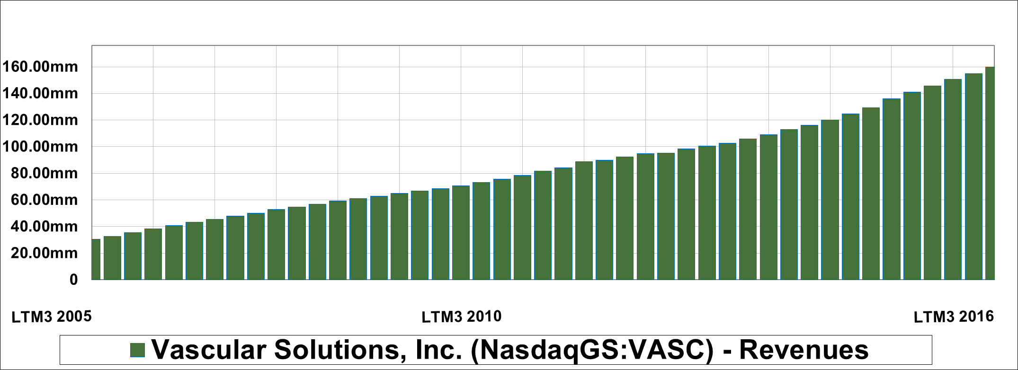
Market Performance (cont.)
Revenue growth

Slide 13
Market Performance (cont.)
Vascular Solutions
53.35%
Nasdaq
5.29%
Russell 2000
12.05%

Slide 14
Discounted Cash Flow Analysis
Key Driver: Revenue growth
Assumptions:
Capitalized Research & Development investment materializes
Capital expenditures will decrease
Continued above average growth
Valuation: $44.54
Current price: $54.35
Results: Overvalued

Slide 15
Summary
Out performs major indexes
Sale strength and Growth Potential
Currently over valued
Entry point: $44.54

