Slide 1
FIN 377: Investments
Week 5 (Topic 3): Asset Allocation and
Security Selection
Larry Schrenk, Instructor

Slide 2
Overview
Review and Questions
Group Project
Practice Problems
Excel Skills: TVM

Slide 3
1. Review and Questions

Slide 4
Key Ideas (Slides 3.1-50)
Investor Life-Cycle
Portfolio Management Process
Portfolio Policy Statement
Individual Investor Situations
Asset Allocation
Global/Alternative Investments

Slide 5
2.1 Individual Investor Life Cycle
Financial plans and investment needs differ for each individual and change over the life cycle
Financial plan should be related to age, financial status, future plans, risk aversion characteristics, and needs

Slide 6
2.1 Individual Investor Life Cycle
Financial plans and investment needs differ for each individual and change over the life cycle
Financial plan should be related to age, financial status, future plans, risk aversion characteristics, and needs

Slide 7
2.1.3 Life Cycle Investment Goals
Short-term, high-priority goals
Vacation or a car
Medium-term, high-priority goals
Down-payment for a house
Long-term, high-priority goals
Retirement

Slide 8
2.4.1 Investment Objectives
Capital preservation
Minimize their risk of loss, usually in real terms
Maintain purchasing power of investment
Return needs to be no less than the rate of inflation
Capital appreciation
Portfolio growth in real terms to meet some future need
Growth mainly occurs through capital gains
Current income
Income rather than capital gains
Retirees to generate spendable funds
Total return strategy
Portfolio growth in real terms to meet some future need
Capital gains and reinvesting current income

Slide 9
2.4.1 Investment Objectives
Investment Objective: 25-Year-Old
Typically, total return or capital appreciation
Investment Objective: 65-Year-Old
Typically, current income and capital preservation, or
Current income and total return (to outpace inflation)

Slide 10
2.6 The Importance of Asset Allocation
Capital Allocation
How much in risk-free vs. risky assets?
Asset Allocation
What asset classes should be included?
What weights for asset class?
Security Selection
What specific securities or funds should be in each asset class?
NOTE: Different than textbook

Slide 11
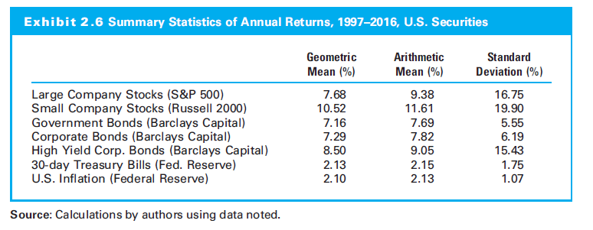
2.6.1 Investment Returns after Taxes and Inflation

Slide 12
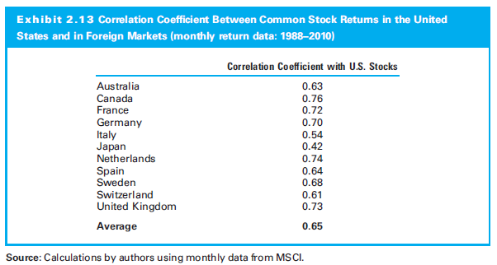
2.7.3 Risk of Diversified Country Investments

Slide 13
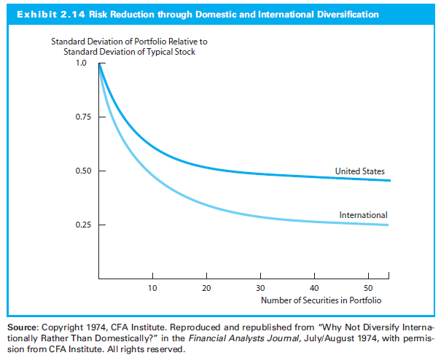
2.7.3 Risk of Diversified Country Investments

Slide 14
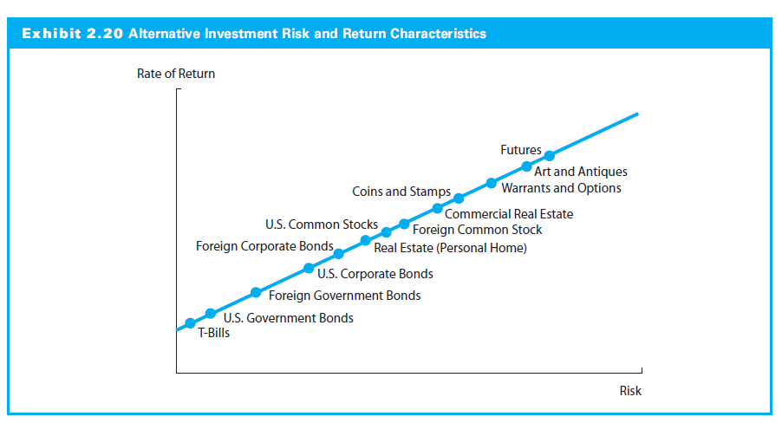
2.8 Historical Risk-Returns on Alternative Investments

Slide 15
2. Group Project

Slide 16
Course Project: Overview
Groups Randomly Assigned
Excel Spreadsheet
See Example Below
Follow the Excel Guidelines
Submit in D2L
No E-mail Attachments
Only One File per Group

Slide 17
Course Project: Firm
‘S&P 500’ (see Wikipedia for List)
Alternates Must be Approved
Firm Criteria:
Solvent and Simple
No Financial Firms
Issues Long-Term Bonds
Paid Dividends for the Last Five Years

Slide 18
Worksheet 1: Info
Firm Name
Ticker Symbol
Group Members
Please list in alphabetical order
Brief Explanation of Why You Chose this Firm

Slide 19
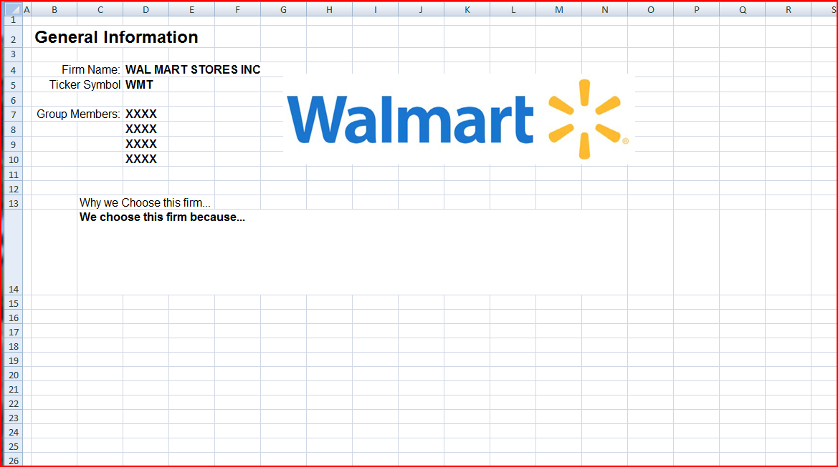
Worksheet 1: Example

Slide 20
Worksheet 2: FinStat
Financial Statements
Download your Firm's Most Recent 10Q from EDGAR
Extract/Copy
Current, Quarterly Income Statement and
Current Balance Sheet
Put these on Worksheet 2

Slide 21
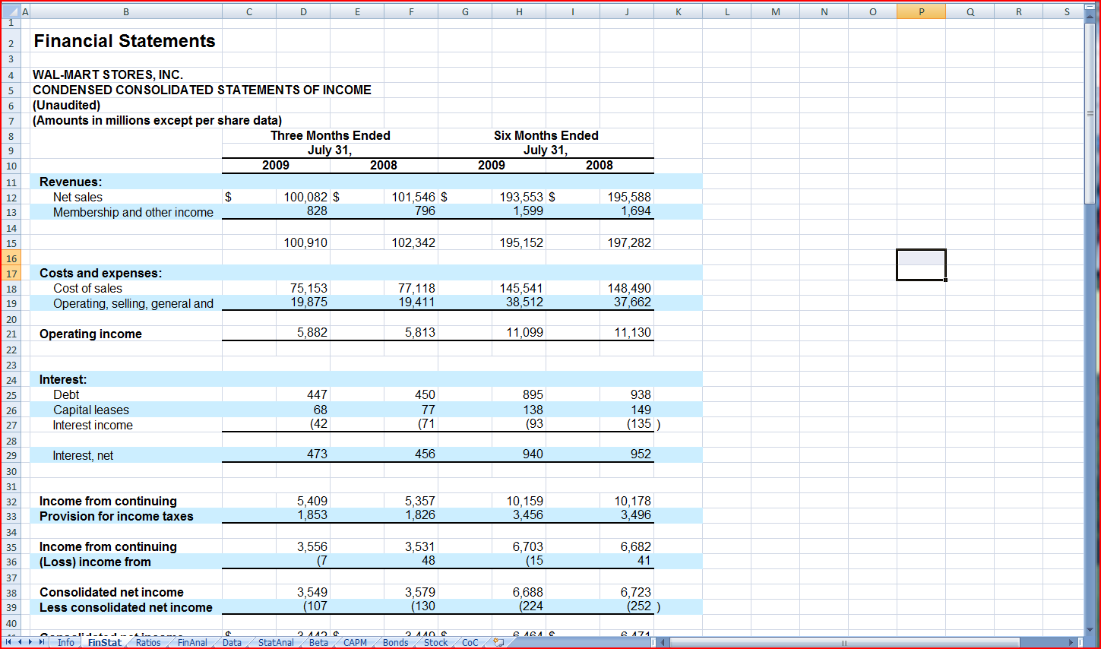
Worksheet 2: Example

Slide 22
Worksheet 3: Ratios
Calculate Ratios
Traditional Ratios
Use the example for the list
Remember to annualize
Custom Ratio
Calculate Ratios for Your Firm and Three Peer Firms
Use Capital IQ for Data
Capital IQ Intro

Slide 23
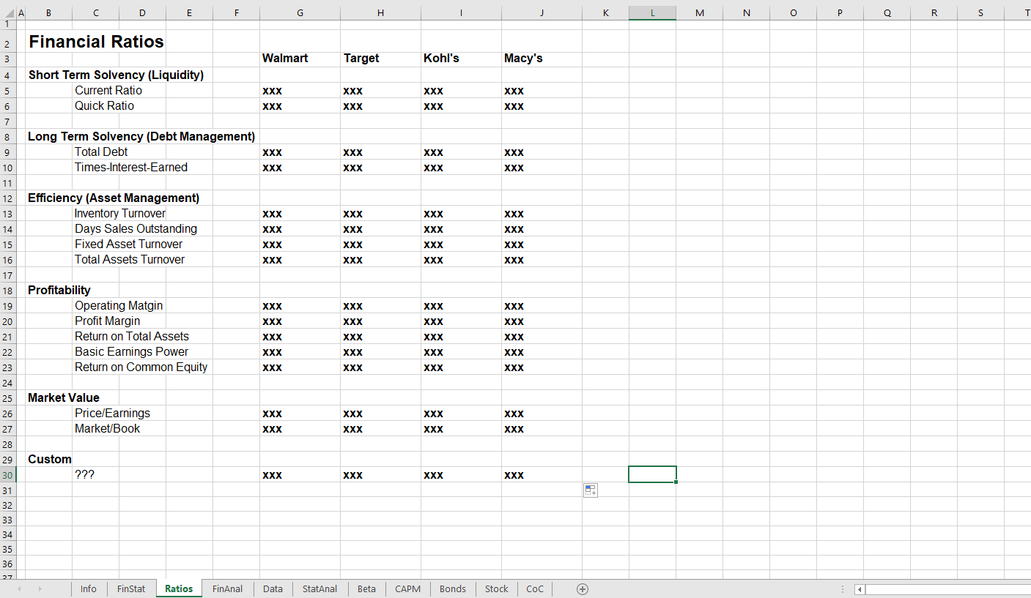
Worksheet 3: Example

Slide 24
Worksheet 4: FinAnal
Financial Analysis
Perspective: Equity Investor
Analysis
Financial Statements
Three Traditional Ratios (Only)
One Custom Ratio
Use CapIQ for Peer Comparisons
One Page
Recommendation: Do the report in Word and paste into Excel.

Slide 25
Worksheet 4: Example

Slide 26
Worksheet 5: Data
Market Data on Four Assets
Download from the FRED2 database (http://research.stlouisfed.org/fred2/):
Monthly data on the 1-Year Treasury Constant Maturity Rate (GS1) for the last five years.
Download from Yahoo Finance (http://finance.yahoo.com/):
Monthly levels of the S&P 500 Index for the last five years,
Monthly stock prices for your firm for the last five years, and
Monthly stock prices for IBM for the last five years.
Calculate the EAR.
NOTE: Use ‘Adj. Close’ Prices

Slide 27
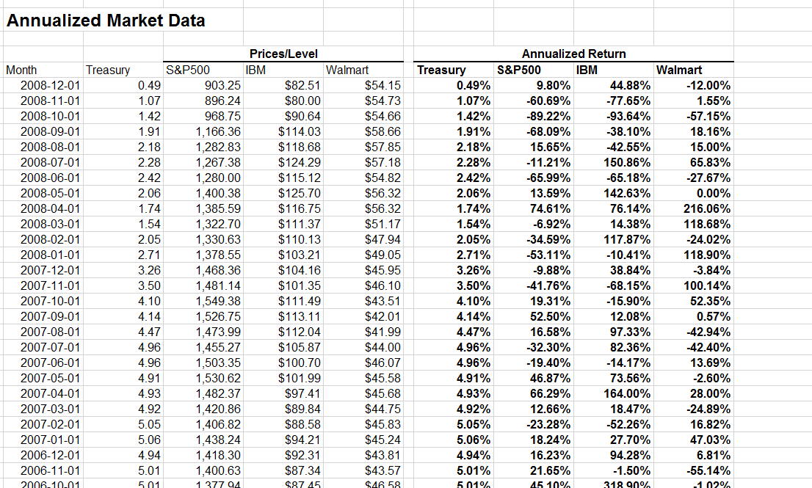
Worksheet 5: Data

Slide 28
Data Notes I
Put data in the columns on Worksheet 5.
Convert any non-return or non-annual data to the equivalent annual return (EAR).
Since you are downloading 60 months of data, you will have 59 returns.
Some data is listed from latest to earliest and other data in the reverse order. For each data set the most recent data should be at the top of each column.
Make sure that the dates match for data from different sources.

Slide 29
Data Notes II
Every downloaded data value should be in only one cell in the spreadsheet.
Do not copy the primary data to other worksheets.
To use data from one worksheet in a calculation another, make a reference to it using the ‘!’ operator.
For example, if I wanted to put the value in C4 on the Data worksheet in a cell on another worksheet, I would put ‘=Data!C4’ in that cell.
If I wanted to calculate the average value of the C4 to C10 cells from the Data worksheet on another worksheet, I would put ‘=AVERAGE(Data!C4:C10)’ in that cell.

Slide 30
Worksheet 6: StatAnal
Calculate for each asset:
Mean of Annualized Returns
Standard Deviation of Annualized Returns
Skewness of Annualized Returns
Kurtosis of Annualized Returns
Construct the covariance matrix
Construct the correlation matrix
Graph for each asset:
Histogram of returns
Use ‘Histogram’ in the Data Analysis Add-In

Slide 31
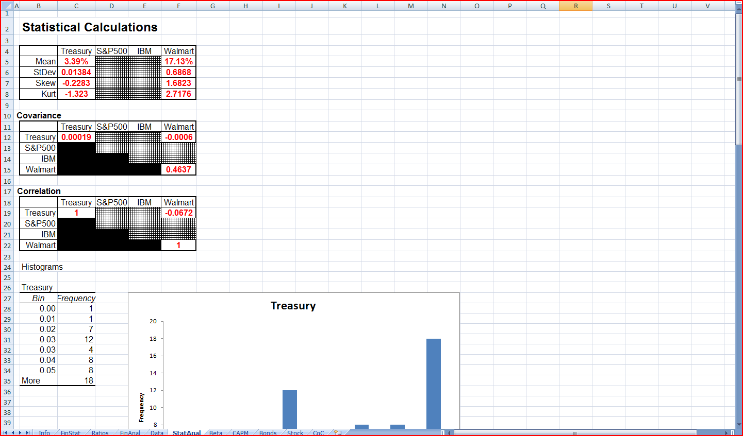
Worksheet 6: Example

Slide 32
Worksheet 7: Beta
Data already downloaded
Find the beta for the stock of your firm:
Linear regression:
Y (Dependent) Variable: Firm Equity Return
X (Independent) Variable: S&P 500 Return
NOTE: Slides for Topic 12 have Excel instructions for linear regression.

Slide 33
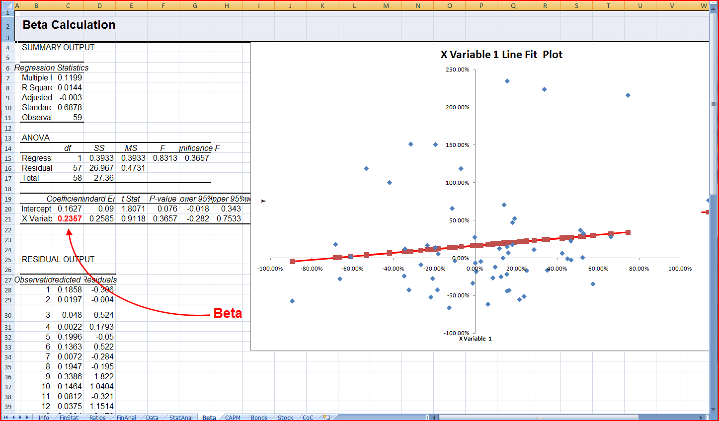
Worksheet 7: Example

Slide 34
Worksheet 8: CAPM
Use your data and beta to find the expected return

Slide 35
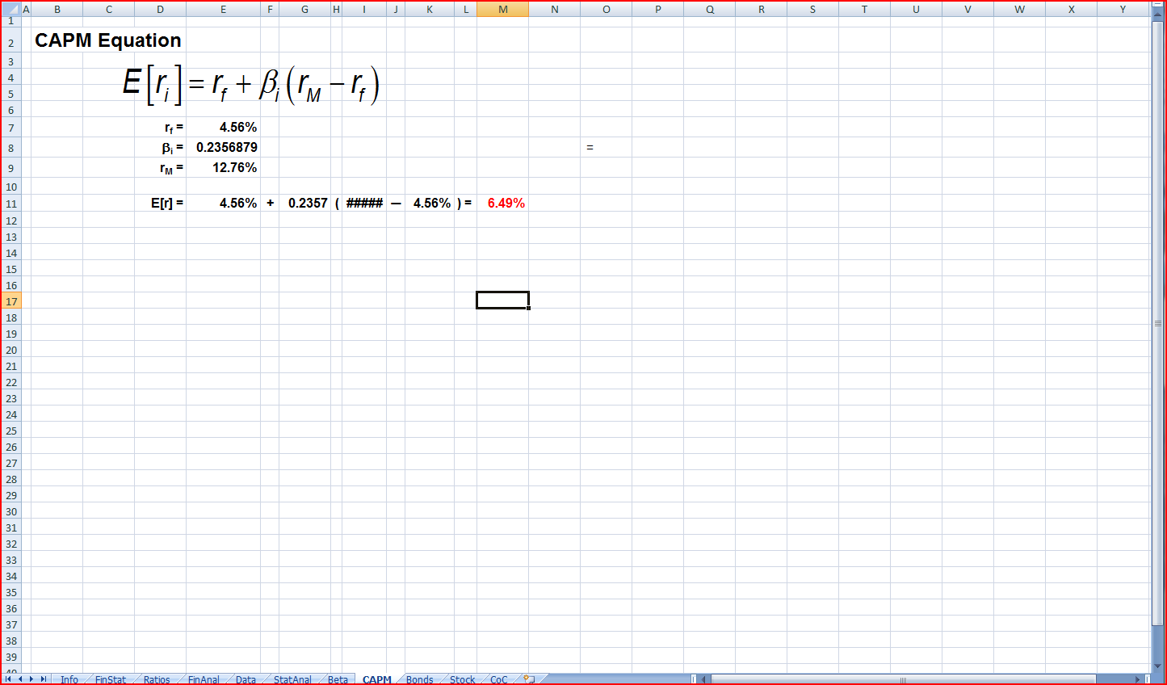
Worksheet 8: Example

Slide 36
Worksheet 9: Fama-French
TBA

Slide 37
Worksheet 10: Multifactor Model
TBA

Slide 38
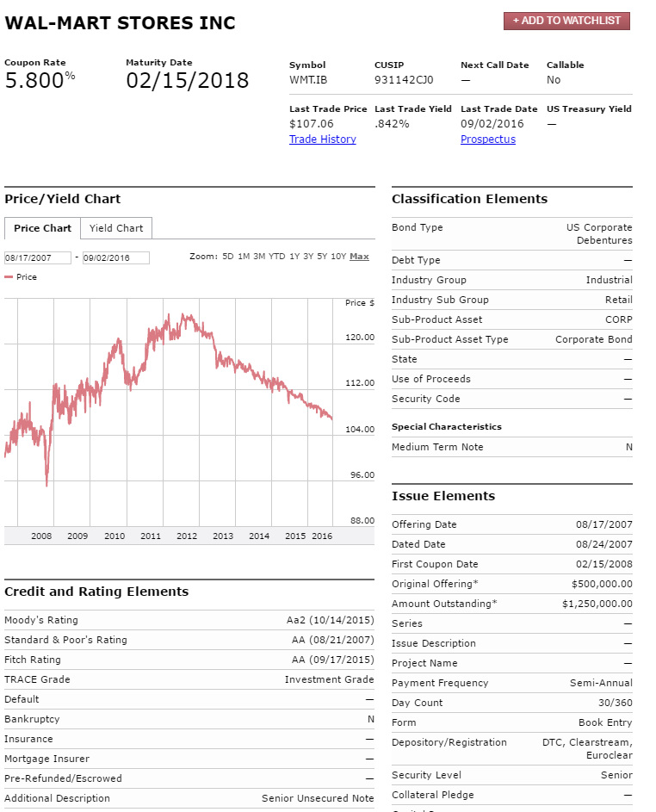
Worksheet 11: Bonds
Find a bond issued by your firm.
http://finra-markets.morningstar.com/BondCenter/Default.jsp
Search for a (preferably) non-callable bond
Click on the bond symbol
Use ‘Bond Profile’
Information.

Slide 39
Worksheet 11: Bonds
Calculate the yield to maturity and compare your calculation with FINRA’s.
How would the price of the bond change if the interest rate
Increased by 50 basis points?
Decreased by 50 basis points?

Slide 40
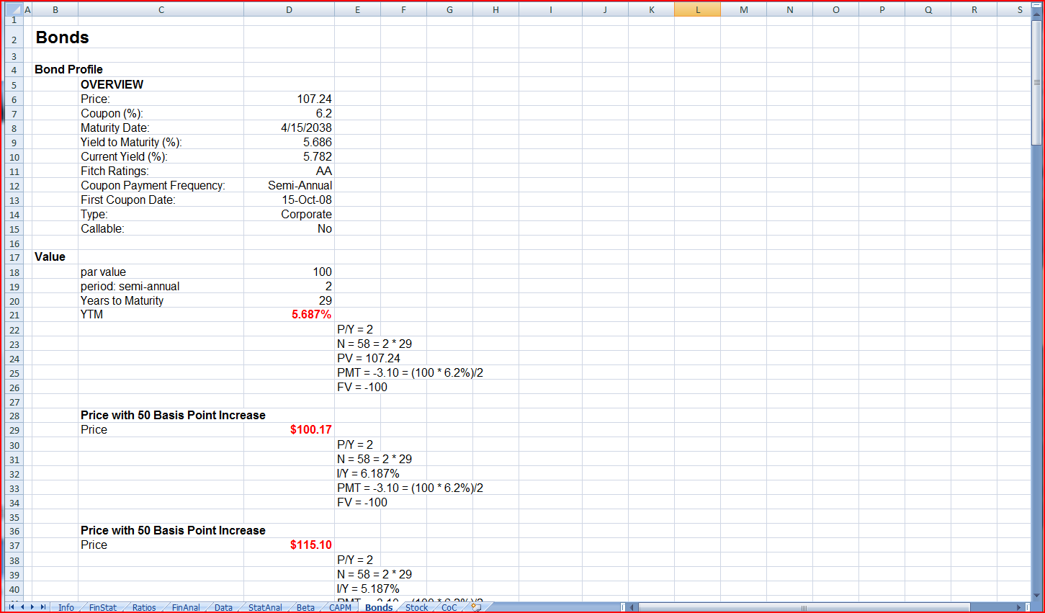
Worksheet 11: Example

Slide 41
Worksheet 12: Stock
Price the stock with DDM
Dividend History
http://finance.yahoo.com/
Enter Ticker Code in
Click on ‘Historical Prices’
Search selecting ‘Dividends Only’

Slide 42
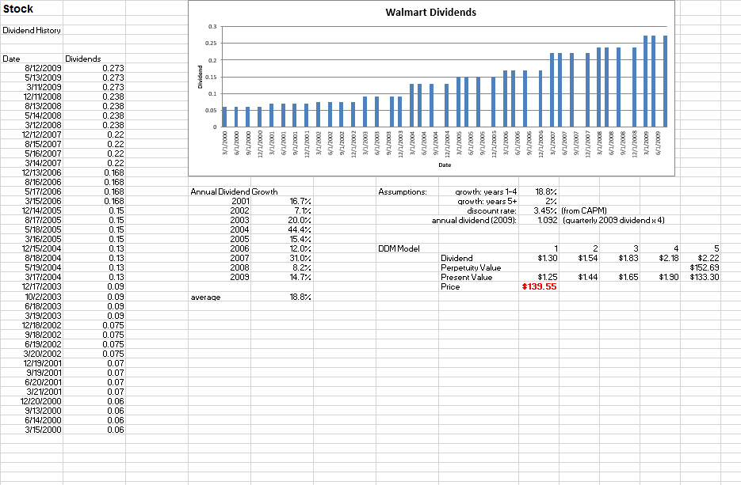
Worksheet 12: Example

Slide 43
Worksheet 13: Final Evaluation
About One Page
Evaluate the firm using the analysis from all the data and analysis you have done in the report.
This could take several forms, such as:
A recommendation of buy, hold, or sell with a justification
A report to the CEO of the firm and its financial stability

Slide 44
3. Practice Problems

Slide 45
Practice Problem 1
In 15 years, what will be the value of a one-time $20,000 investment an 8% tax-exempt IRA?

Slide 46
Practice Problem 2
In 15 years, what will be the value of a one-time $20,000 investment an 8% account with a tax rate of 30%?

Slide 47
Practice Problem 3
Find the arithmetic and geometric avergeas for an investment with the following returns.
8% 10% 3%

Slide 48
Practice Problem 4
If inflation is 3%, what is the real return of the following investments:
Investment | Nominal Return
T-Bills | 3.5%
Corporate Bonds | 5.1%
Corporate Stock | 8.7%

Slide 49
4. Excel Skills

Slide 50
TVM
FV
PV
NPER
RATE
PMT
(PPMT)
(IPMT)

