Slide 1
FIN 360: Corporate Finance
Topic 2: Financial Statements,
Cash Flow, and Taxes
Larry Schrenk, Instructor

Slide 2
Today’s Outline
Project
Financial Statements
Balance Sheet
Income Statement
Statement of Cash Flows
Free Cash Flow
Taxes
Website: EDGAR

Slide 3
1. Course Project
Financial Statements
Download your Firm's Most Recent 10Q from EDGAR
Extract
Quarterly Income Statement
Balance Sheet
Put these on one Excel Worksheet like…

Slide 4
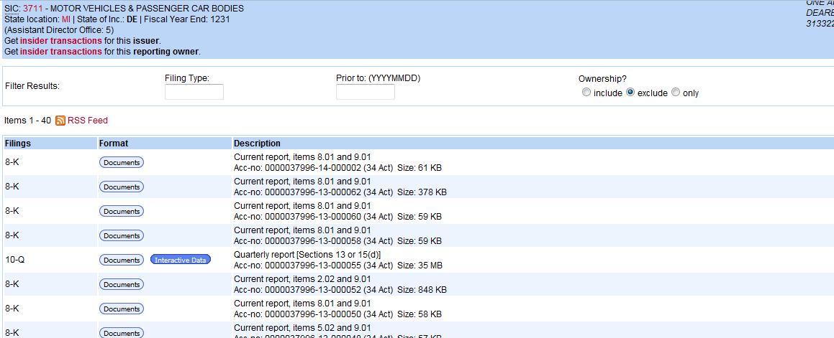
EDGAR 1
Click on ‘Interactive Data’

Slide 5
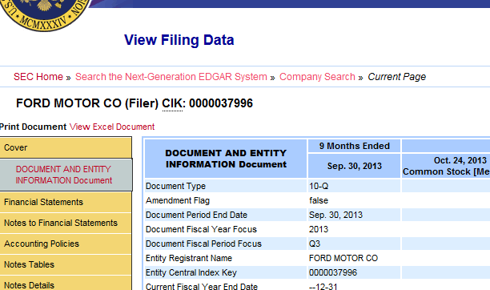
EDGAR 2
Click on ‘View Excel Document’

Slide 6
2. Financial Statements

Slide 7
Three Financial Statements
Income Statement Flow
Balance Sheet Stock
Statement of Cash Flows Flow

Slide 8
Stock versus Flow Statements
Stock Statements
Value at One Point in Time
‘Snapshot’
Time Unit: One Date
Example: Volume of Water in a Lake on a Specific Date
Flow Statements
Value over a Period of Time
Time Unit: Quarter, Year
Example: Flow/Increase of Water into a Lake over some Period of Time

Slide 9
Annualization
Data: ‘Annual’ Assumption
Annualizing
Annual Equivalent of Non-Annual
Quarterly x4, Semi-Annual x2
WARNING: Only Annualize Flow Statements!

Slide 10
Balance Sheet
Accounting Value at a Specific Point in Time.
Identity:
Assets = Liabilities + Equity
or better
Equity = Assets – Liabilities

Slide 11
Balance Sheet Analysis▪
Assets (LHS)
Firm Value
Allocation of Investments
Organized by ‘Receivable’ Liquidity
Assets Portfolio
Liabilities (RHS)
Claims on Firm Value
Allocation of Securities Issued
Organized by ‘Payable’ Liquidity
Claims Portfolio▪

Slide 12
Balance Sheet Issues
Accounting Liquidity
Debt versus Equity
Market Value versus Historical Cost

Slide 13
A. Accounting Liquidity
Liquidity
Time in which Assets can be Converted to Cash–without a Significant Loss in Value
Liquidity Risk-Return Trade-Off

Slide 14
Accounting Liquidity
Time Horizons
Cash and Equivalents???
Accounts Receivable???
Inventory???
Working Capital

Slide 15
B. Debt versus Equity
Equity ‘Residual Claimants’
Solvent Cash Flows
Bankruptcy (APR Rule)
Two Concerns
Total Amount of Debt
Ability to Service Debt

Slide 16
C. Value versus ‘Cost’
Market Value versus Historical Cost
Non-Real Cash Flows
Goodwill

Slide 17
T-P-S
What is the effect on the level of current assets of collecting more accounts receivable?
Increases
Decreases
Stays the Same
Cannot Determine

Slide 18
Income Statement
Measures financial performance over a specific period of time.
Accounting Definition of Income:
Income = Revenue – Cost
Organization: ‘Levels’ of Earnings

Slide 19
Income Statement Organization
Sales
– Variable Costs
Gross Costs
– Fixed Costs
EBIT
– Interest
EBT
– Taxes
Net Income
– Dividends
Additions to Retained Earnings
Earnings…▪
From Unit Production
From Total Production
After Financing Included
After Taxes Included
Retained by the Firm ▪

Slide 20
Income Statement Issues
Non-Cash Items
Annualization (above)

Slide 21
A. GAAP & B. Non-Cash Items
A. GAAP
Accrual Accounting Principle
Match Revenue with Expenses
Not Real Cash Flows
B. Non-Cash Items
Depreciation
Differed Taxes

Slide 22
T-P-S
How do changes in the balance sheet alter the income statement? Mainly through changes in…
Current Assets
Current Liabilities
Debt
Equity

Slide 23
3. Statement of Cash Flows
Measures Generation of Cash over a Specific Period of Time
Real Cash Flows (Almost)

Slide 24
Cash Flow Organization
Sources (+)/Uses (-) of Cash
LHS
Short Term Investments (Operations)
Long Term Investments
RHS
Financing

Slide 25
3. Free Cash Flow

Slide 26
Free Cash Flow (FCF)
Cash Flow Potentially Payable to Investors
Not Covered by GAAP
Contrast with Other Measures
Net Income
Dividends + Interest Payments

Slide 27
Free Cash Flow (FCF)
Pro: Best Measurement of Earnings
Con: Possibly Subjective
Contrast with Income Statement

Slide 28
Calculating Free Cash Flows
EBIT
– Taxes
+ Depreciation (not real cash flow)
– Δ Capital Expenditures
– Δ Working Capital
= Free Cash Flow (FCF)
NOTE: Δ, i.e., ‘delta’ means change in…

Slide 29
FCF Example
A firm records an EBIT of $1,000 and its corporate tax rate is 30%. Depreciation for this period is $400, the firm has increased capital appreciation by $200 and working capital by $50.
FCF Calculation
$1,000 EBIT
-300 Taxes
+400 Depreciation
-50 Δ Working Capital
-200 Δ Capital Appreciation
$850 FCF

Slide 30
4. Taxes

Slide 31
Tax Issues
Corporate versus Personal
Double Taxation
Debt-Equity Asymmetry
Tax Shields
Carry-Forward/Carry-Back
Expenses and Depreciation

Slide 32
Tax Rates
Corporate
Progressive
Uniform Rate (Generally)
Personal
Progressive
Multiple Rates Possible
Dividends
Interest Payments
Capital Gains

Slide 33
Marginal versus Average Tax
Average Tax: Tax Payment/EBT
Marginal Tax: Tax Paid on next $1 Earned.
Incremental
When to Use Each

Slide 34
Example
Current Tax Schedule
10% up to $100,000
20% over $100,000
Current Taxes on $500,000 income
10% of $100,000 = $10,000
20% of $400,000 = $80,000
Total $90,000
Average Tax Rate = $90,000/$500,000 = 18%
Marginal Tax Rate = 20%

